Slide 1
Digital Content for Frontline Health
Worker Training
Notes:
Welcome and introductions (Carolyn)

Slide 2
About mPowering
Who We Are
A partnership of private sector, government, donors, and program implementers
Our Mission
  Help end preventable maternal and child deaths by accelerating the use of mobile technology to improve the performance of frontline health workers
How we are doing this
  Increasing government led collaboration, and building capacity in-country to ensure high quality, sustainable, and scalable health education and training for Frontline Health Workers (FHWs)

Slide 3
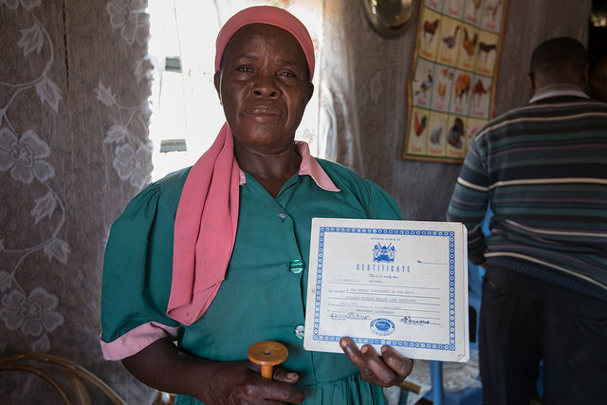

Role of Frontline Health Workers
Deliver advice and services to patients in their homes and in clinics.
Counselors, educators and treatment providers.
Understand the beliefs, practices and norms of their communities.
Photo: Allan Gichigi, MCSP
Notes:
Who better to address this source of poor health but FLHWs
They deliver advice and services to patients in their homes and in clinics, serving as counselors, educators and treatment providers. Because they often come from the communities they serve, they understand the beliefs, practices and norms of those communities, allowing them to provide more culturally appropriate health care.

Slide 4


Despite Their Importance support can be wanting…
How can mobile technology help?
Health workers overburdened with bulky textbooks, ill-suited job aids, etc.
Refresher trainings are inconvenient and inadequate when they actually take place
Few resources for on-demand training and information
Training materials costly to distribute and update
Multimedia content available in one place
Available for refresher trainings and constant reference
Access from many sources can be based on user’s workflow
Savings from reduction or elimination of print would pay for a digital content distribution program using smartphones
Notes:
For example in Ethiopia HEWs:
13 Health Training courses are contained in 21 books (each approx 150-200 pages), and all the content is in English (not the first language for any of the HEWs).

Slide 5
Why Distance Ed?
Multiple studies show, in aggregate, outcomes comparable between distance education and face-to-face but context is critical:
For example: online Computer Science course at Georgia Tech $510 while comparable course on campus at USC $5,535 yet quality of education comparable
Context in LMICs: refreshers not taking place, quality of face-to-face teaching methods vary greatly, and quite often basic training not always taking place

Slide 6

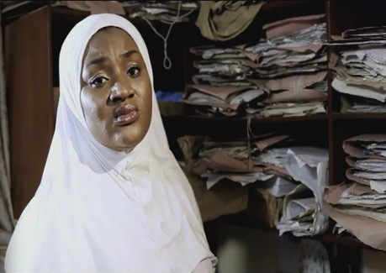
Why Video?
Can compensate where literacy is an issue
Video for understanding and retention
Not just about knowledge but behavior as well.
Notes:
mike

Slide 7
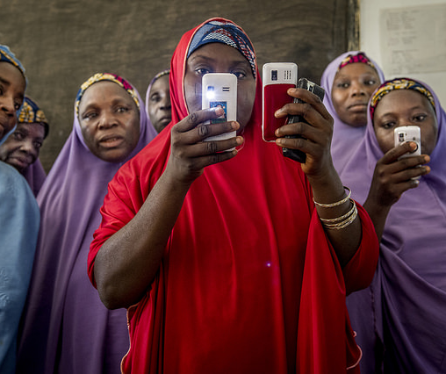
Why Government Ownership?
Ability to align with national curricula, context, and priorities
Consistency in training methodologies and durations
Prevent inequitable distribution of education and health services (SDG #3)
Photo: Karen Kasmauski/ MCSP
Uganda Case:
Ministry report cited: inequitable access, lack of coordination between partners, FHW allegiance to partners rather than government, with different formats, methods and reporting formats impossible to standardize.
Notes:
Mike
Although the Government of Uganda owns the VHT program, VHTs pay more allegiance to the IPs who provided them with more facilitation than government.
Poor IP coordination creates a problem for supervision of the program and eventually in sustainability when the partners’ projects end.
The report highlighted the inequity that arises from this fragmented approach, as it is often impossible to provide the same level of training for every worker in every district.
Implementing partners were not coordinated in offering their support to the VHTs. For example, they motivated VHTs differently, they had different reporting formats, and their program training followed different methodologies and durations.

Slide 8
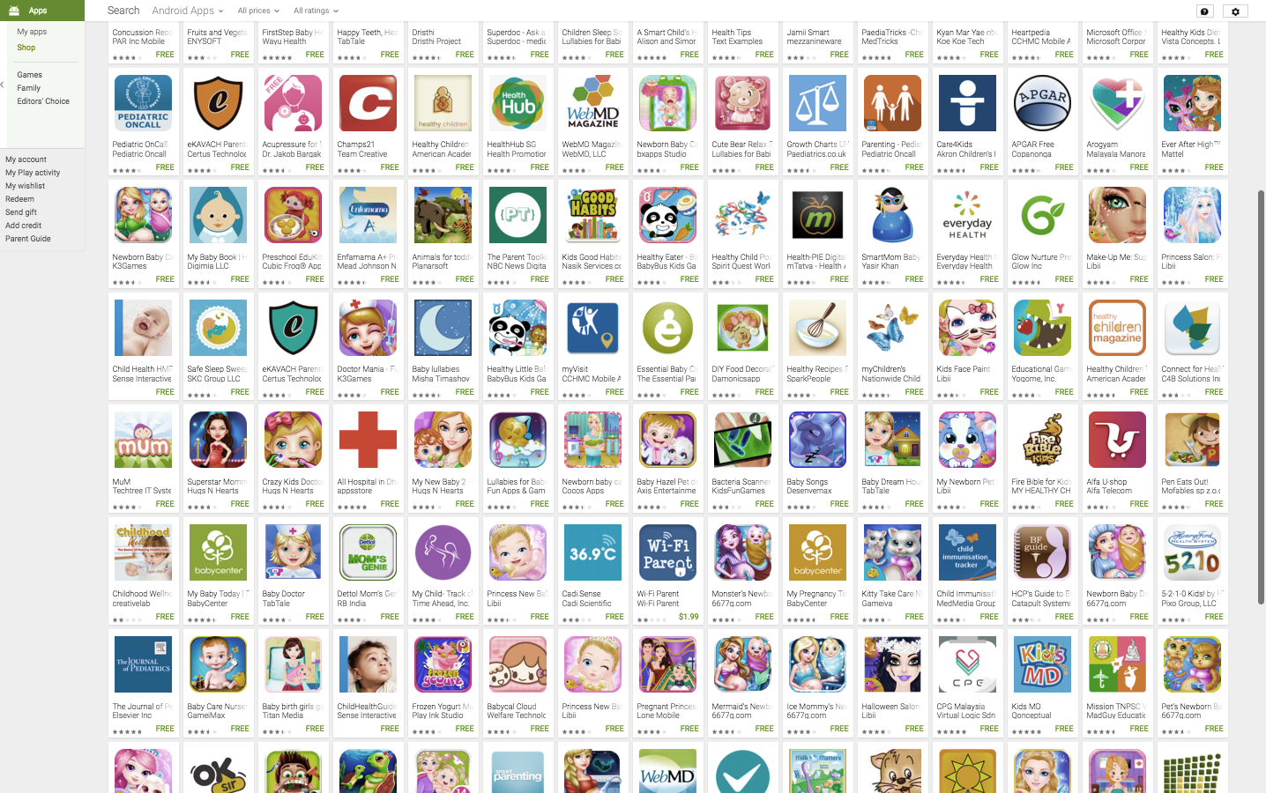
Why Government Ownership?
Sample search using
‘Child Health’ at Google App Store
Notes:
mike

Slide 9
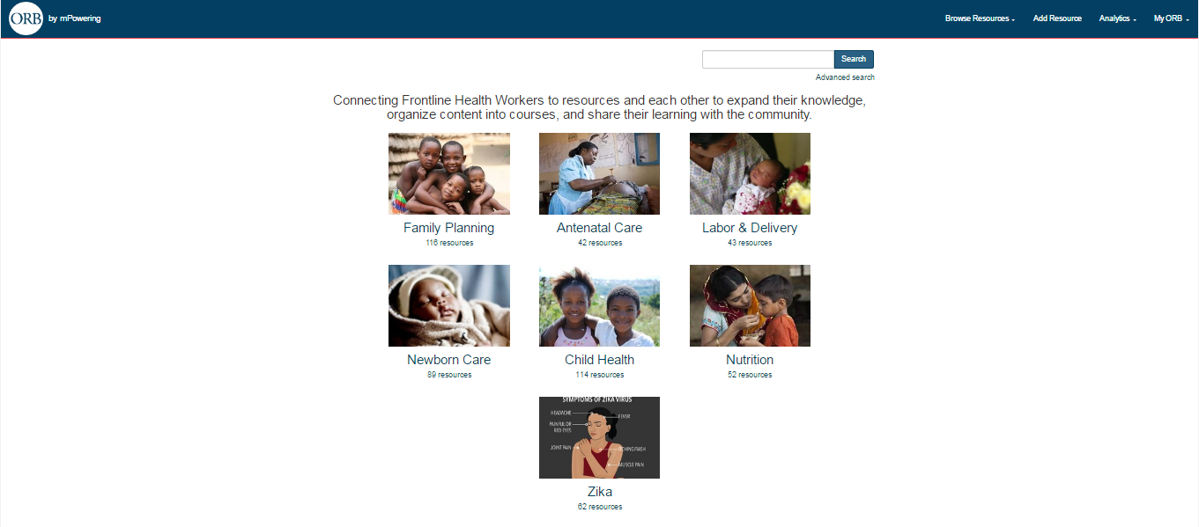
ORB Content Platform
Notes:
Carolyn, 15 min
Introduction to ORB
Brief rationale for why ORB was created - training need, mHealth fragmentation, etc
Short ORB demo and overview of content
Show example of a video that is available on ORB
Show how to share content and benefits of sharing content
Creative Commons video? [Show if time allows]

Slide 10
What is ORB?
ORB is an online platform located at www.health-orb.org that contains freely available and downloadable training materials for frontline health workers.
Connect frontline health workers and those that support them to resources to expand their knowledge and skills
Allows content providers to share their materials

Slide 11
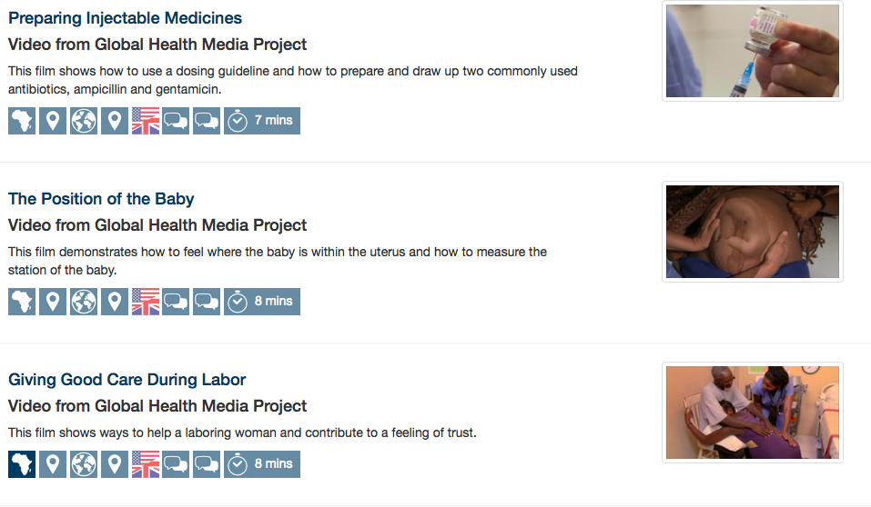
ORB Resources
Mobile-ready
Quality-assured
Openly licensed
Use in mobile and blended training

Slide 12
Open Deliver
A process-based solution designed for government
institutionalization, changing technology and shareable content
Monitor, Evaluate, Iterate
Address Demand
Identify & Adapt Content
Create Training
Program
Deploy Content
Deliver Training
Process
Content
Sharing
Library
Learning
Management
System
Client
Application
Technology
Notes:
Mike
Open Deliver means Open Source Delivery of Digital Content
The stages of this process involve:
Identify the training needs of the health workers; take into account workflows and what devices the HWs use
Create or adapt existing multimedia materials for use for education (and/or community engagement – e.g. family planning counselling)
Access existing resources on a content sharing platform to save cost and prevent duplication (at this stage, additional materials could be added, such as quizzes and linking narrative between videos)
Deploy content to Android based tablets or devices
Collect usage analytics that track usage of media to determine what materials work and what do not
Open Deliver streamlines digital content delivery through the reconfiguration of existing technologies into a single, integrated, platform. This allows governments to assure the quality of all content used in the system. The process can accept multiple streams of content from different providers, and all providers are able to access the content sharing platform to ensure new content development is not duplicative. This can then be published to any Android device. The process is designed to be technologically independent – thus if an alternative technology exists that is better it can be rotated in to replace the existing technology used for that stage of the process without disrupting the entire process.

Slide 13











Open Deliver
Address Demand
Identify & Adapt Content
Create Training
Program
Deploy Content
Deliver Training
Process
Monitor, Evaluate
Content
Sharing
Library
Learning
Management
System
Technology
Client
Application
Google Charts
Excel
Products
Tableau
ORB
OPEN edX
OppiaMobile
Drupal
Moodle
MoodleMobile
Joomla
OPEN edX- Client

Slide 14
User Centered Design Exercise
Notes:
mike

Slide 15
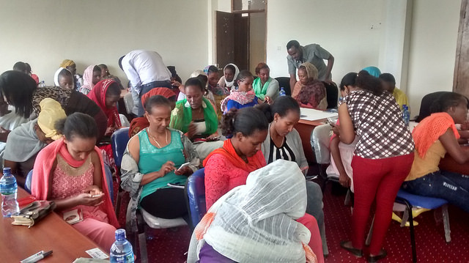
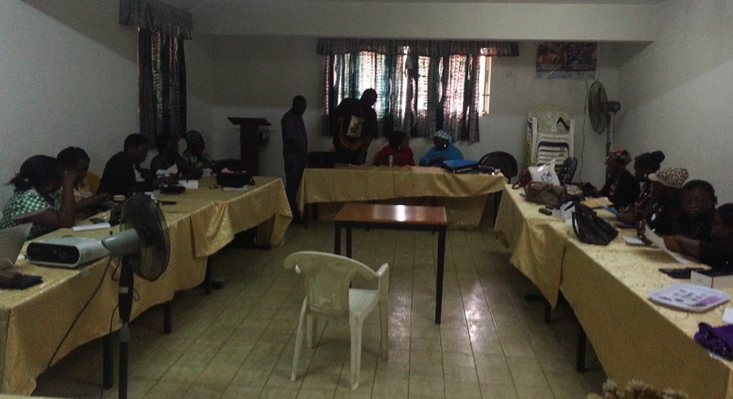
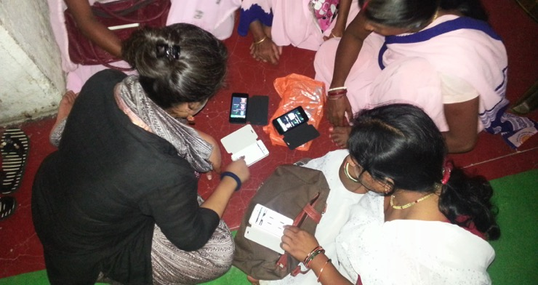
Stage 1: Address Demand
HEW Training in Ethiopia
Midwives in Nigeria
ASHAs in India
Notes:
Every country and context is different so the first stage involves a small representative sample of health workers you are targeting in a region.

Slide 16
Stage 2: Review/Create Content
Example: Scenario Based Video Training for Midwives
Notes:
Optional: Play Videos

Slide 17





Stage 3: Store, Curate and Share
Global ORB
National ORB
Access existing content at either the global level (ORB) or specific national level version
Share all created materials to prevent future duplication.
Business model based – in part – on reciprocity trading content for delivery
Validate and
Curate
Content Providers (e.g. NGOs)

Slide 18
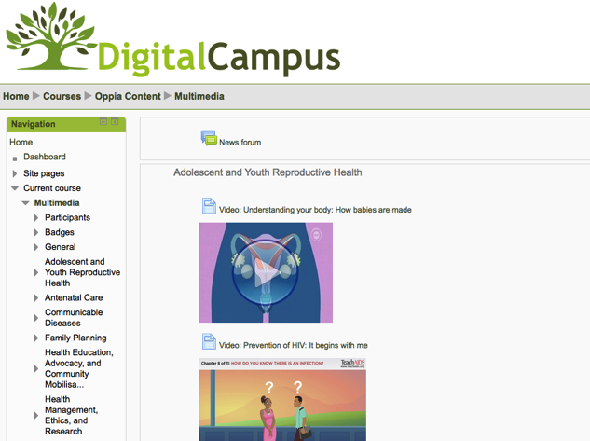

Stage 4: Deploy and Distribute
Notes:
From learning management system to video instruction on mobiles
Access to Outernet

Slide 19
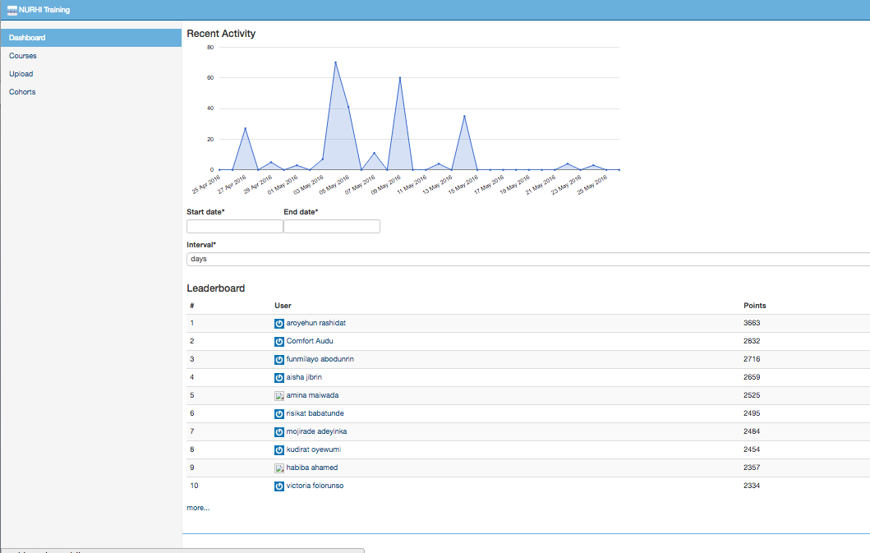
Stage 5: Evaluate and Iterate: mLearning
Notes:
How does this work in practice?
Creating a training course:
Identified what skills and knowledge the health workers need
Then the training institution/government etc simply selects the most relevant content from ORB
Then additional resources can be created to link the set of videos (or other content) into a course. This could include adding linking text (e.g. “you are now going to watch a video on how to check the position of the baby. As you watch, notice how the midwife does x. y. z …..”), and multiple choice questions or other types of quizzes, to make a complete course suitable for the particular HW cadre.
Then, if necessary, content can be translated into relevant language(s)
New content can be added when needed
OKEY to talk about the specific example in Ondo State

Slide 20
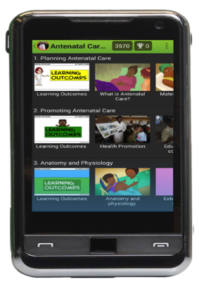
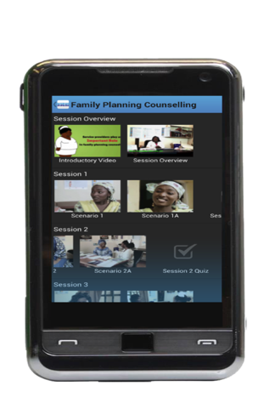
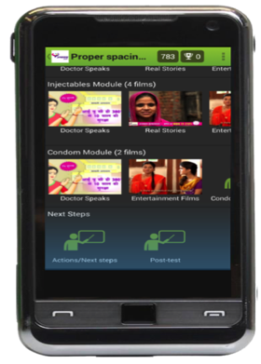
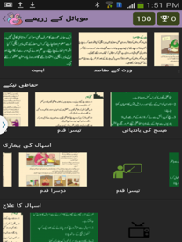
Open Deliver in the Field
Ethiopia: (Oppia Mobile)
Ministry of Health approved health program (up to 30,000+ HEWs).
Nigeria: (iDEA)
Gates funded 300 midwives in 4 cities using system to improve counseling techniques
India: (Gyan Jyoti)
FP decision support tool for client education & engagement creating effective mCounseling tool
Nigeria /Ondo State: (VTR)
Working with State Health Mgmt Board Content extended to 100 facilities in 6 states & roll out to 550 PHCs in Ondo
Pakistan: (Bright Future)
Undergoing pilot to adapt both mLearning and mCounseling functions for Lady Health Workers
to address entire RMNCH continuum
Notes:
This production system allows Governments working with individual programs to use the same platform to create and publish a wide range of content - whether for community engagement (mCounseling) or CHW training and education (mLearning). Each app can be customized in terms of appearance and language.
In Ondo state Nigerians are already running the platform
It took 14 days to produce a prototype in Urdu and English in the latest iteration of this process in Pakistan.

Slide 21
Demonstration
Alex Little
Notes:
mike

Slide 22
Achieving Government Ownership
Through (MSC) Multi-Stakeholder
Collaboration
Notes:
Huguette and Mike, 10 min

Slide 23
Multi-Stakeholder Collaborative Goal
Develop a strategy for adapting proven technologies into a single, sustainable digital content delivery system that accepts validated multimedia content from any source.
Which leads to cost and efficiency benefits from optimization of resources

Slide 24
MSC: Assumptions and Principles
Acknowledge and overcome fragmentation/pilotitus
View data collection and content distribution as interdependent
Start with solutions that meet criteria (e.g. PDD)
Recognize/work within market trends
Sync with overall transition from hard copy to digital
Open library (strive for Creative Commons licensing)
Incentivize private sector investment
Technological solutions can drive policy
Notes:
Acknowledge Fragmentation and move to consolidate fundamental functions under single Platform then allow new functions built on top
Treat Data Collection and Content Distribution as commodities which are “two sides of the same coin”
Work towards single platform that abides by Principles of Digital Development to ensure Sustainability(Open Source, Govt. Ownership, No licenses, subscriptions, interoperable, etc.)
Start with Solutions That Meet Criteria (don’t spend time cataloging existing programs set target instead)
Recognize Market Trends (smartphone cost going down)
Start Transition from hard copy to digital for everything
Enable library that anyone can contribute to or draw from (NGOs, iNGOs still retain mandate for training)
Provide private sector access in return for investment ( need to fund foundational layer in training and technology)
Technological Solutions can drive policy (make legislators aware of state of technology)

Slide 25
Open Deliver: Digital Content Delivery System
Incentivizes the contribution of validated content to content sharing platform (like ORB) by providing immediate means of distribution
Reduces duplication through Collaborative content production
Separates content from technology allowing technology to scale independent of evidence of content effectiveness
Reduces the time and cost to implement solutions for specific contexts and geographies by standardizing production process
Establishes an open collaborative model for the ongoing refinement of the process that can evolve independent of specific technologies
Contextualizes the evaluation of mHealth by providing a centralized resource of national content with a standard delivery system and large sample size
Notes:
We can also incentivize by (1) encouraging organizations who may still be reluctant to share their content to share selected content as a way of ‘showcasing’ the quality of their work. This opens the door to conversations for increased sharing of content; (2) using advocacy based on the Principles for Digital Development – reaching out to organizations which have endorsed these to invite them to share content

Slide 26


Thank you!
www.mpoweringhealth.org
www.health-orb.org

