Slide 1


OPENING HEALTH DATA
December 2016 // Melissa Sabatier, BlueSquare COO

Slide 2
DATA TYPES
At health facility/ hospital level:
Health service use/coverage
Quality of care/service availability and readiness
Patient feedback/patient exit interview
Where: Niger, Mali, DRC, Congo, Burkina Faso, Haiti, Kyrgyzstan, Benin, Nigeria, Zanzibar, Djibouti, Chad, Senegal, Ivory Coast, Cameroon, CAR, Kenya…

Slide 3
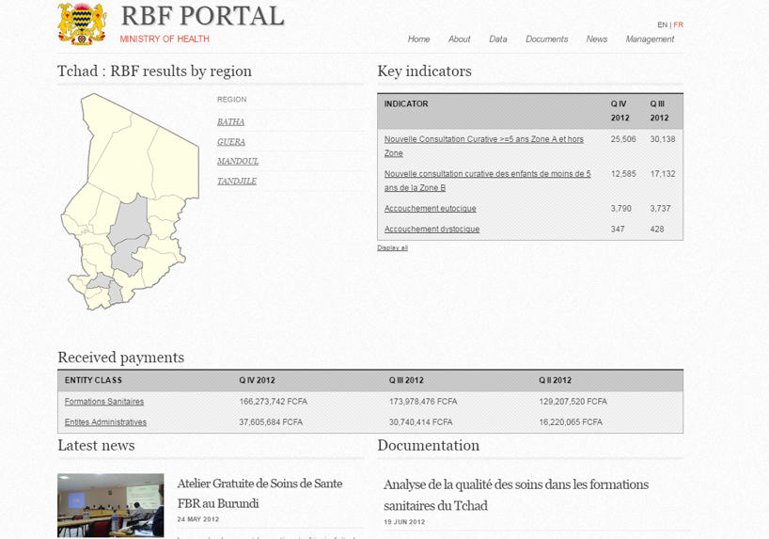
FIRST OPEN DASHBOARDS
Very little data.

Slide 4
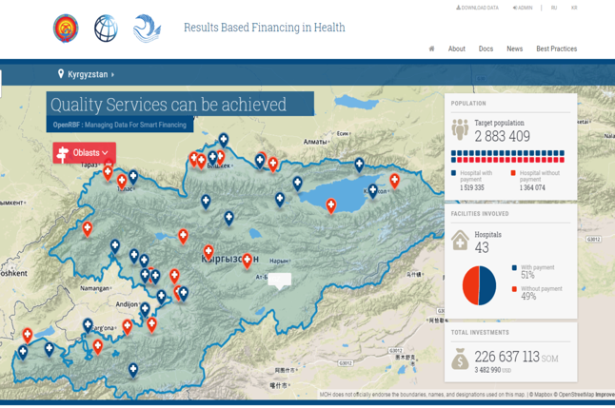
RESULTS, NOT JUST DATA

Slide 5
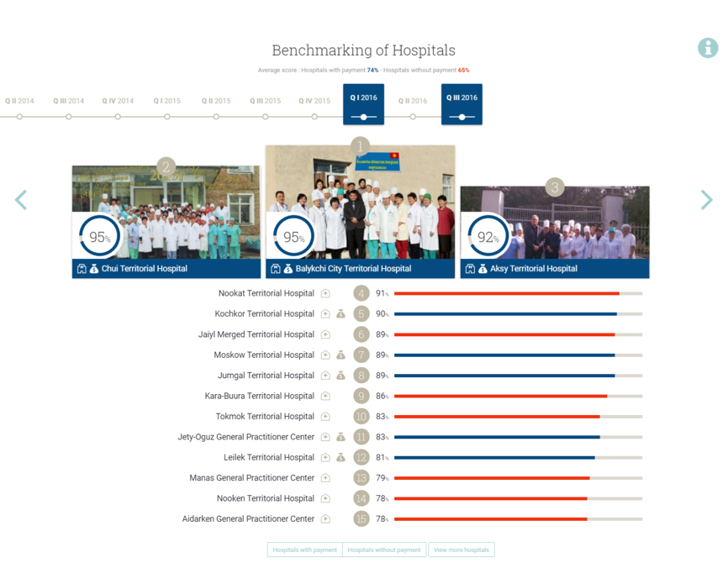
BENCHMARKING

Slide 6
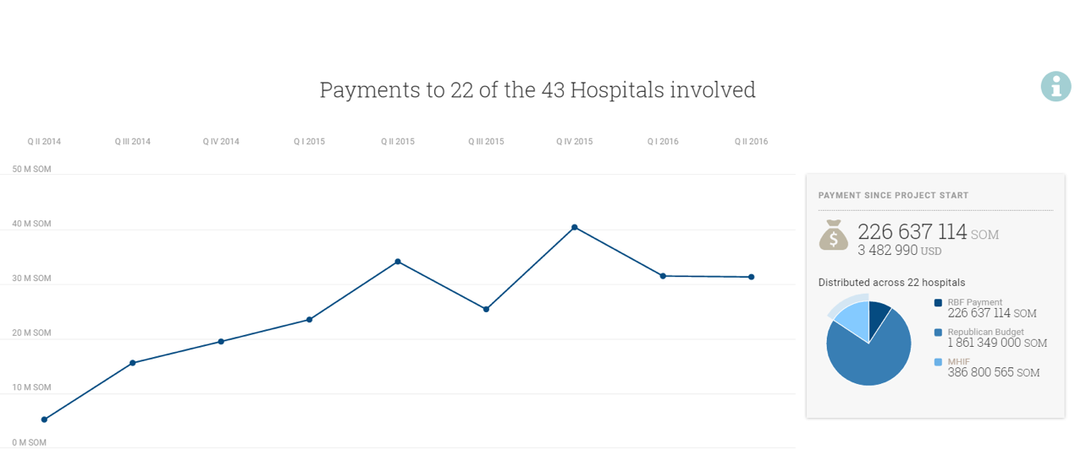
TRANSPARENT USE OF RESOURCES

Slide 7
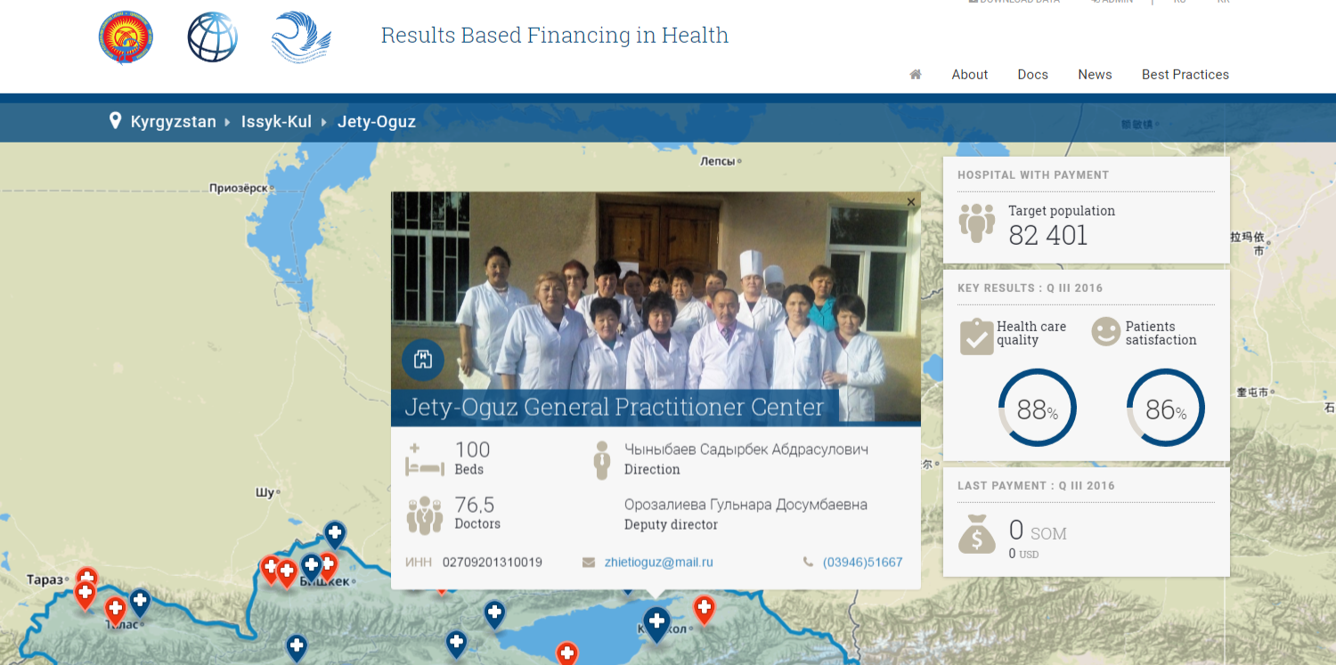
GEOLOCALIZED DATA

Slide 8
BENEFITS OF PROMOTING OPEN DATA POLICY
Transparency & accountability
Reputation and financial incentive
Peer effect
Entry point
Stronger decision-making and steering capacity
Helping governments opening more data

Slide 9
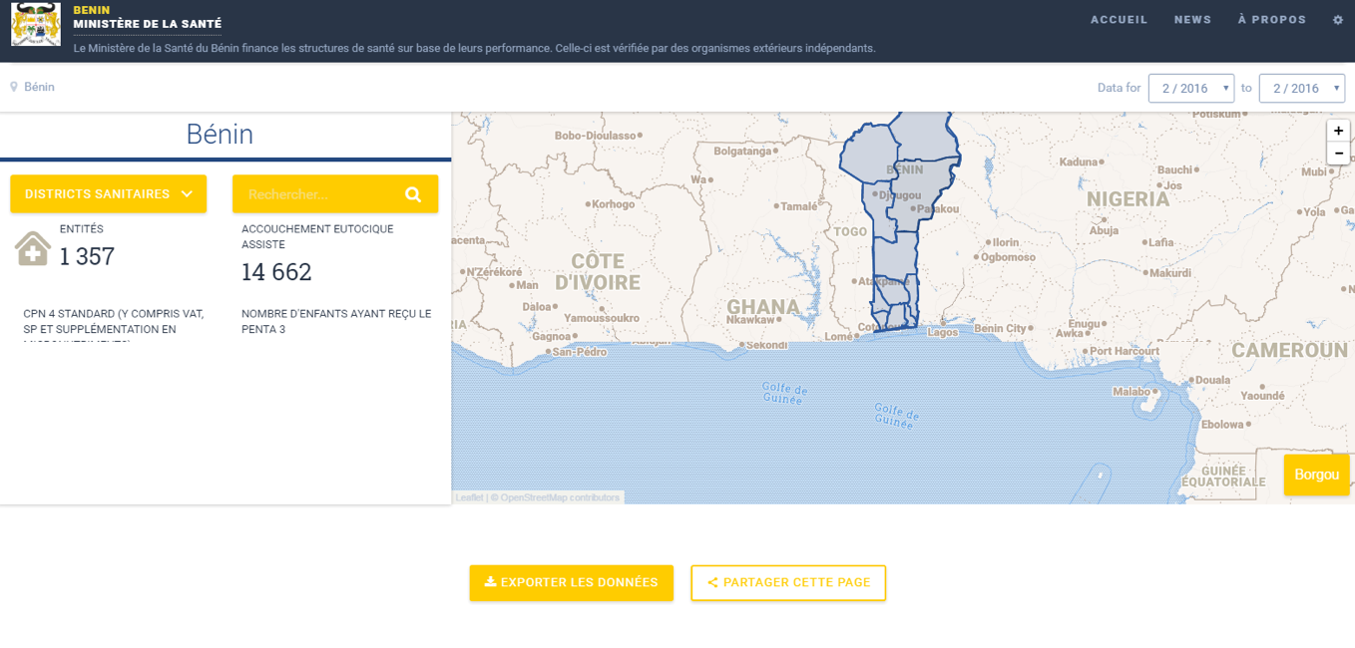
OPENING DHIS2 DATA

