Slide 1


Mobile Technology Helps Community Health Workers Increase Access to Skilled Delivery and
Provide Quality Counseling and Quick Referrals for Maternal and Newborn Health Care in Rural Afghanistan
Better Health for Afghan Mothers and Children Project
(BHAMC)
2008-2013
Dr. Dennis Cherian, BHMS, MS, MHA
Senior Director, Health, HIV, and AIDS
International Programs Group

Slide 2

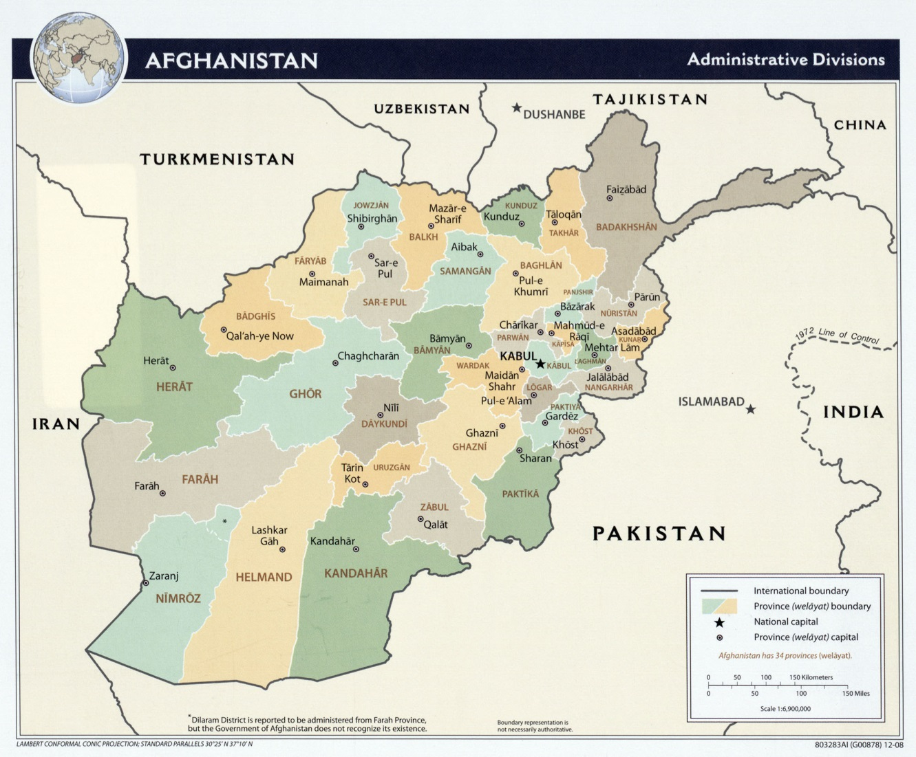
Background
Karukh District, Herat Province, Afghanistan
Maternal Mortality Rate
  460/100,000
Neonatal Mortality Rate
    25/1,000
Barriers:
  Access Geography
  Security Cultural
BHAMC (2008-2013) reached
  36,200 children <5
  45,250 WRA
  74 Villages, 4 Districts

Slide 3
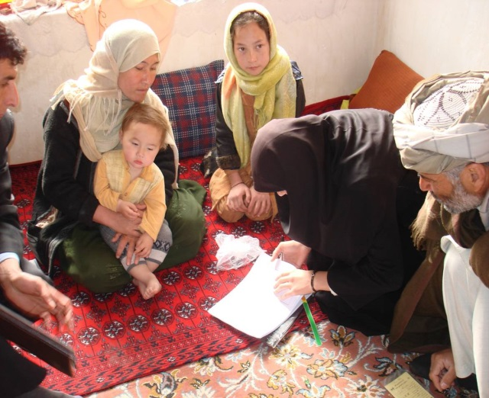
Project Overview
Goal: To achieve sustained improvements in the survival and health of mothers, newborns and children
Partners:
The Herat Department of Public Health (DOPH)
Afghanistan Ministry of Public Health (MOPH)
Bakhtar Development Network
USAID Mission, Kabul
Dimagi, Inc.

Slide 4
Operational Research Objective and Outcomes
To test if the use of mobile technology can:
Increase uptake of healthy actions by pregnant women
Increase knowledge of important information points
Improve communication and coordination of CHWs with higher-trained health workers
Improve pregnancy and newborn outcomes through improved routine care
Utilization
Knowledge
Access
Document socio-cultural, gender, and community factors influencing effective use of mobile phone applications

Slide 5
Key Steps in Project Development
2008-09 Adapt/ contextualize HBLSS* modules
Review/ refine existing CommCare tool
2009 IRB approval of study protocol
2009-10 Field assessment trip- Dimagi
2010 Module design and refinement
Baseline study
2011 CommCare module training
2012 Observation and field support
2013 Final evaluation
*Home Based Life Saving Skills, American College of Nurse-Midwives

Slide 6
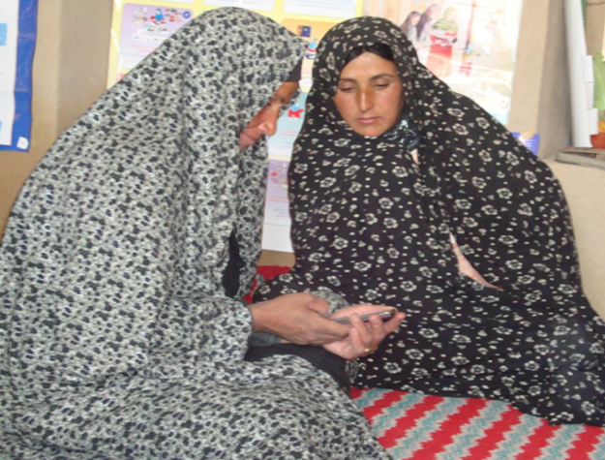
Inputs and Requirements
Technology support
Adequate budget
Supervisory support
Dedicated OR staff
Mobile provider partnership

Slide 7
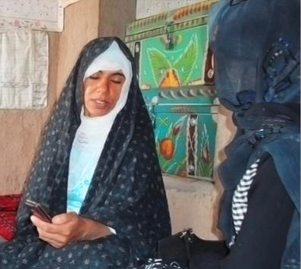

Research Design & Process
Study Design:
Case-Control
10 CHW pairs in Karukh District
Baseline & final evaluation
20 months of implementation
Study population:
CHWs
Mothers and children (0-23 months)
Health facility staff in both
intervention and control sites

Slide 8
Mobile Phones
Counseling
Two modules: ANC and PNC
Key Aspects:
Antenatal care and postnatal visits
Facility based delivery
Birth plan
Danger signs
Caring for a newborn
CHWs uploaded information on the mobile phones for record keeping, reporting and follow-up
Referrals
CHW
link a woman’s family
with a skilled provider
at delivery

Slide 9
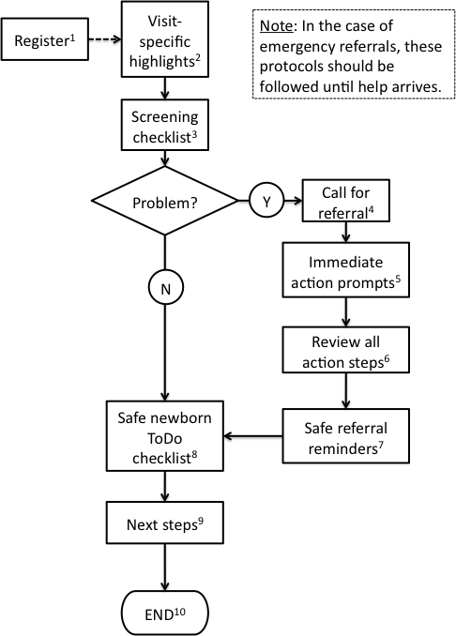
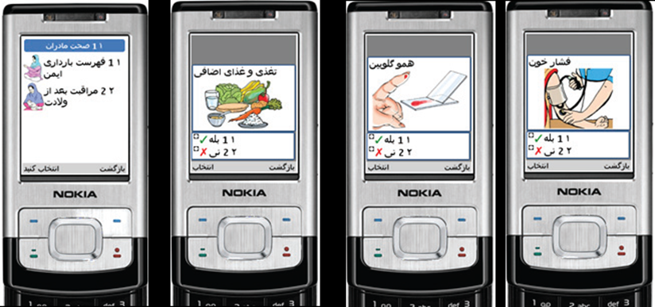
Decision Making Framework

Slide 10
Innovative Interventions Tested
Intervention Components |  | Intervention Group (5 Villages) | Comparison Group (5 Villages)
BHAMC Project | Strengthening of health system: Baby-friendly hospitals, continuum of care from home to health post to hospital, referral system, and facility-based maternal and newborn care | X | X
 | Capacity building for CHWs in delivery of interventions at household level, including HBLSS for life-threatening maternal and newborn problems | X | X
 | Child health community interventions: infant and young child feeding, treatment of diarrhea and pneumonia, immunization, and home water treatment | X | X
Operational Research, CommCare | Mobile phone counseling application for CHWs to counsel pregnant women on antenatal and postnatal care, birth preparedness, newborn care preparedness, and benefits of facility deliveries | X
 | Mobile phone referral application to help CHWs link women in labor to a skilled provider at the nearest facility | X

Slide 11
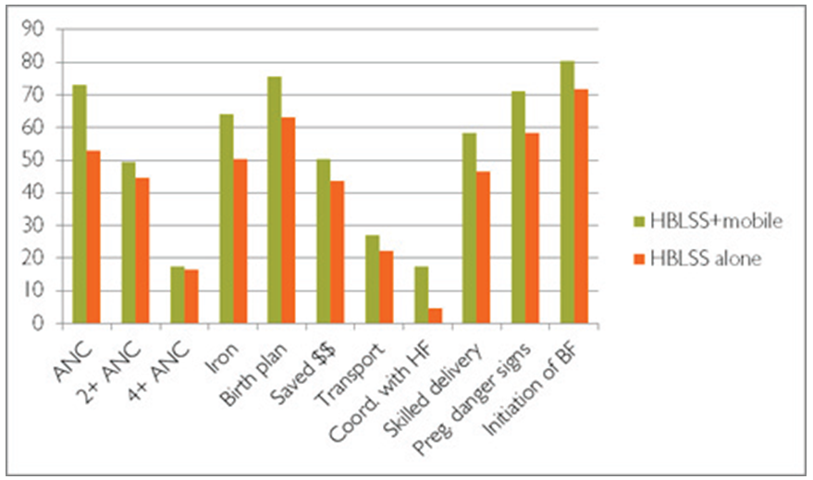
Results

Slide 12
Facility Delivery
Delivery in Facility by Doctor, Nurse or Midwife
Coordinated with Facility for Delivery
17.4
58.2
45
46.6
34
14.8
1
0
Intervention
Comparison
Intervention
Comparison
Baseline
Final
Baseline
Final

Slide 13
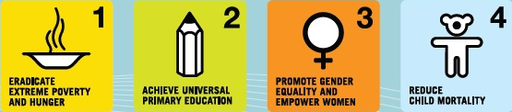

mHealth Theory of Change
mHealth Theory of Change
Millenium Development Goals
Natl & Intl Goals to
which project contributes
Lower maternal and child U5 mortality rates
Lowered child U5 morbidity
Improved maternal and child U5 nutritional status
Improved preventive health behavior among pregnant women and caregivers at the household level
More timely and effective use of health services on the part of pregnant women and caregivers
More sustainable and effective CHW/V workforce
Improved linkages between facility and community services for quality improvement
Outcomes to which project primarily contribute
CHW/V adherence to behavior change communications protocols
CHW/V adherence to case management protocols*
Referral closure rates between CHW/V and facilities
CHW/V motivation & retention
Appropriate and timely use of program monitoring information
Access to health information and complementary social services
immediate outcomes
Communicate project- roadmap, benefits, project management
Develop solution based on user needs
Undertake user acceptance testing
Train users on all aspects of solution
Build and sustain user capacity & ownership
Activity tracking, monitoring & evaluation
Deployment activities
Develop Operating Plan
Refine business needs & requirements
Establish programme management
Design budget & sustainable financial model
Training, curriculum and partner development
Consolidate sustainability plan and partner relationships
Finalise M&E plan and conduct baseline
Foundational activities
* i.e. ttC visit schedule or CCM clinical case management protocols
Notes:
KEY POINTS:
The goals are tied most closely to MDGs 4 and 5 but also contribute to some aspects of MDGs 1 (particularly nutritional status of pregnant women and children U5) and 6 (particularly HIV and malaria).
At the outcome level, we expect the “value add” of mHealth to be reflected in these 4 areas. These metrics would only be gathered periodically with the purpose of documenting quantifiable change at the population, CHW workforce or community level.
Immediate outcomes that would be tracked on an ongoing basis to both refine the application itself and document how the mHealth application has directly effected program beneficiaries. The information would either be sourced from standard M&E data tracked by the mobile application itself or by CHW supervisor records and the records kept by community-based structures that support the CHW program, for example, community health committees or advocacy groups. Strengthening community level structures is a central aspect of WV’s Maternal and Child Health and Nutrition strategy. NOTE that adherence to case management protocols can contribute to both the first and second outcome listed here – adherence to the ttC visit schedule for example, would also strongly affect the first outcome. Similarly, appropriate and timely use of program monitoring information can reinforce CHW supportive supervision systems and thus support both the 3rd and final outcome listed here.
We are in the process of developing an illustrative logical framework to propose appropriate indicators at both the output and outcome level.

Slide 14
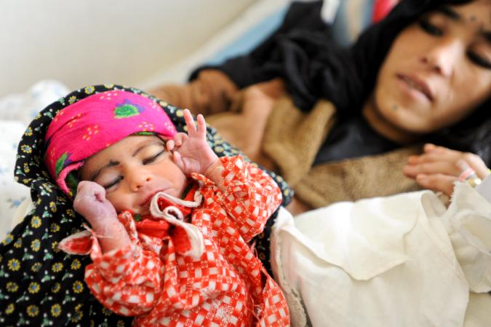
Program Areas for mHealth Solutions
Health System Strengthening
Country Ownership
Linkages to Health System & Services
Community
Community Mobilization & Sensitization
CHW Recruitment, Training, Supervision, Incentives & Performance Evaluation
CHW & Beneficiary Registration
Household/Individual
Home-Based Care
Referral System
Counseling & Behavior Change Communication
Response to Urgent Care Scenarios
Monitoring & Evaluation Data Collection
Provision of Health Commodities
Household based diagnostics/screening/case management tools
KEY SOLUTION FUNCTIONALITY
Registration
Referral Process
Alerts/Notifications
Reporting
Behavior Change Messages
Integration with HMIS
Testing/Rapid Diagnostics
Urgent Response
Supply Chain/Logistics
CHW training, supervision, performance evaluation

Slide 15
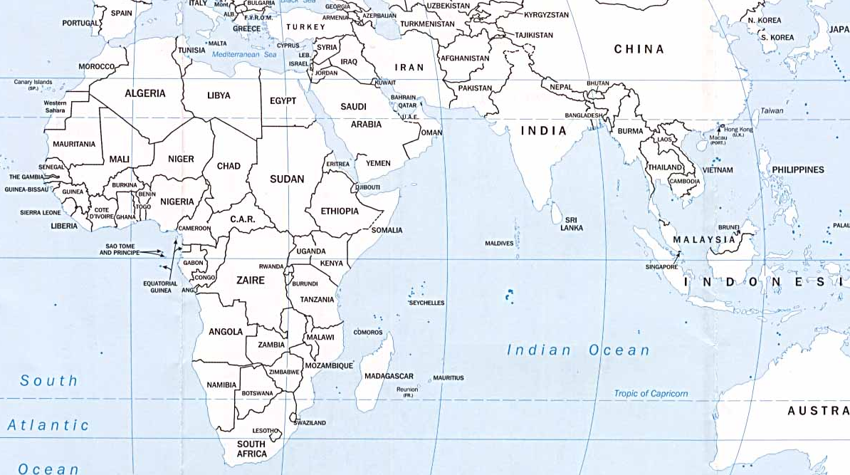
World Vision’s mHealth Portfolio
VISION STATEMENT: Empower the most vulnerable households and community health workers/volunteers through use of common, shared, multi-functional and collaboratively designed mobile health solutions to deliver community-based health interventions.
Timed & Targeted Counseling Community Case Management Positive Deviance / Hearth
Growth Monitoring & Promotion Community Management of
Acute Malnutrition

Slide 16
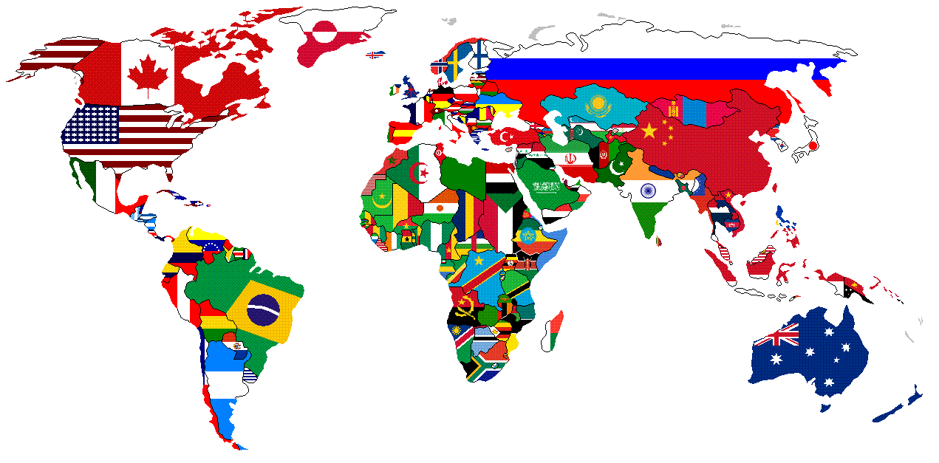
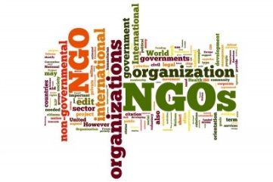
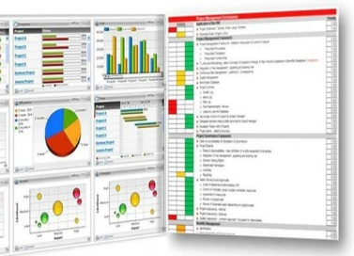



WV MOTECH Suite Solution:
Social Enterprise Open Source Model
Governments & Regulatory Bodies
Intl &
Local NGOs
Industry
Standards
Organizations
Private
& Public
Donors
Solution
Providers
Mobile
Operators
Notes:
KEY POINTS:
Model Summary:
Governments, Ministries, Regulatory Bodies provide national strategy, legal framework, policies, regulatory support
Donors and/or non-profit/low-profit solution developers provide seed funding for technology
NGOs provide their global requirements and specifications to solution developers, configures and contextualizes, with support from solution provider and deploys, rolls out and scales solution
Solution developers provide technology solution, code and configure global features and functionalities, training and tech/user support
Industry Standards Organizations provide guidelines, standards, metrics, indicators
Strengths:
Lowest overall costs (relative to other models)
Co-design of solution
Leveraging non-profit and/or low-profit technical expertise
Co-negotiation of product roadmap
Contribution to code base
Sharing open source solution and best practices with mhealth community
Solid alignment of vision and goals among collaborating NGOs, solution providers and donors
Trade-Offs:
Strong governance and collaboration structure needed to drive process
Maturation of product occurs in stages, rather than ‘out of the box’
Reduced professional support services
Increased dependency on external resources and funds
Reduced control of product evolution
KEY POINTS:
Model Summary:
Governments, Ministries, Regulatory Bodies provide national strategy, legal framework, policies, regulatory support
Donors and/or non-profit/low-profit solution developers provide seed funding for technology
NGOs provide their global requirements and specifications to solution developers, configures and contextualizes, with support from solution provider and deploys, rolls out and scales solution
Solution developers provide technology solution, code and configure global features and functionalities, training and tech/user support
Industry Standards Organizations provide guidelines, standards, metrics, indicators
Strengths:
Lowest overall costs (relative to other models)
Co-design of solution
Leveraging non-profit and/or low-profit technical expertise
Co-negotiation of product roadmap
Contribution to code base
Sharing open source solution and best practices with mhealth community
Solid alignment of vision and goals among collaborating NGOs, solution providers and donors
Trade-Offs:
Strong governance and collaboration structure needed to drive process
Maturation of product occurs in stages, rather than ‘out of the box’
Reduced professional support services
Increased dependency on external resources and funds
Reduced control of product evolution
KEY POINTS:
Model Summary:
Governments, Ministries, Regulatory Bodies provide national strategy, legal framework, policies, regulatory support
Donors and/or non-profit/low-profit solution developers provide seed funding for technology
NGOs provide their global requirements and specifications to solution developers, configures and contextualizes, with support from solution provider and deploys, rolls out and scales solution
Solution developers provide technology solution, code and configure global features and functionalities, training and tech/user support
Industry Standards Organizations provide guidelines, standards, metrics, indicators
Strengths:
Lowest overall costs (relative to other models)
Co-design of solution
Leveraging non-profit and/or low-profit technical expertise
Co-negotiation of product roadmap
Contribution to code base
Sharing open source solution and best practices with mhealth community
Solid alignment of vision and goals among collaborating NGOs, solution providers and donors
Trade-Offs:
Strong governance and collaboration structure needed to drive process
Maturation of product occurs in stages, rather than ‘out of the box’
Reduced professional support services
Increased dependency on external resources and funds
Reduced control of product evolution

Slide 17
Thank you!
The Better Health for Afghan Mothers and Children (BHAMC) project in Herat Province in western Afghanistan was supported by the American people through the United States Agency for International Development (USAID) through its Child Survival and Health Grants Program. BHAMC was managed by World Vision US and World Vision Afghanistan under Cooperative Agreement No. GHN-A-00-08-00008-00. The views expressed in this material do not necessarily reflect the views of USAID or the United States Government.

