Slide 1

UNICEF Uganda innovation strategic framework
Applying principles of digital Health to develop a sustainable innovations strategy - a case of mHealth initiatives in Uganda

Slide 2
The Session
Principles for Digital Development
UNICEF Uganda Innovations Strategic Framework
The Case – mTrac
How the principles were applied to Development of mTrac
Questions and Answers

Slide 3
PRINCIPLES FOR DIGITAL DEVELOPMENT
Design with the User
Understand the Existing Ecosystem
Design for Scale
Build for Sustainability
Be Data Driven
Use Open Standards, Open Data, Open Source, and Open Innovation
Reuse and Improve
Address Privacy & Security
Be Collaborative

Slide 4
Innovations strategic framework
Innovation focus areas
Real-time information
Outcome levels
Effectively contribute to programmatic results;
Strategic approaches
Regular review and assessment
Decentralized management capacity
Access to information
Civic engagement
New partnerships
Scaled or on their way to scale;
Nationally owned and sustained; and
Fully integrated into national systems.
Design for scale
Enabling environment established for national ownership
Inter-linking and consolidating initiatives

Slide 5

The Case - mtrac
Supported by UNICEF & WHO with funding from DFID – mTrac is a SMS tool used by the Government of Uganda:
  Track of Disease Surveillance and Stock data e.g. Malaria and Six Tracer drugs.
  Collect Health Service Delivery feedback
  Polling i.e. providing a platform to over 25,000 health workers to be part of decision making in the health sector in realtime.
  Provides a platform for information dissemination and exchange to over 25,000 health workers, 1300 District Health works and 800 community based health workers

Slide 6
Design with the user
mTrac is based on rapidSMS soon to be RapidPRO
MoH had challenges in collecting surveillance data
In 2011, idea was conceived and piloted in Kabale & Gulu
Decision made to only start with data collection
Based on the current Health Sector Hierachy
Strengthening accountability at the Health Facility level

Slide 7
Understand the existing ecosystem
Health facility based
mTrac strengthens the Health Management Information System: Manual vs Auto
Provides real-time Information to managers for evidenced decision making, planning and budgeting.

Slide 8
Design for scale
All Stakeholder involved Requirements Definition
Stakeholder review i.e. MoH, Health worker, DHT
MoH Planned a 4 phase scale up:
  Central 2011, Western 2013,
  Northern 2013, Eastern 2014
Demonstration for Imapct – Pilot in Gulu & Kabale

Slide 9
BUILD FOR SUSTAINABILITY
eHealth Policy
All 112 Districts Local Governments involved through the DHO
mTrac adopted by MoH as a data source & collection system in the HSSIp 2016-2021
MoH ToTs across the country and in-charge of Monitoring & Evaluation
mTrac managed by the Division of Health Information at MoH

Slide 10
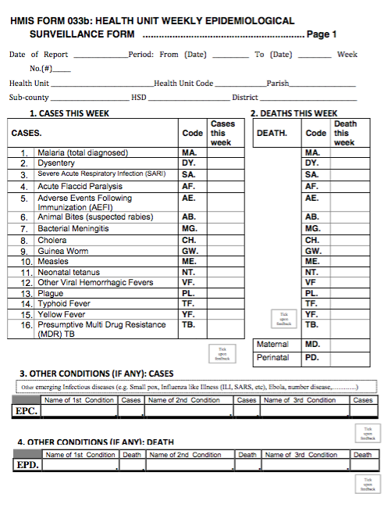
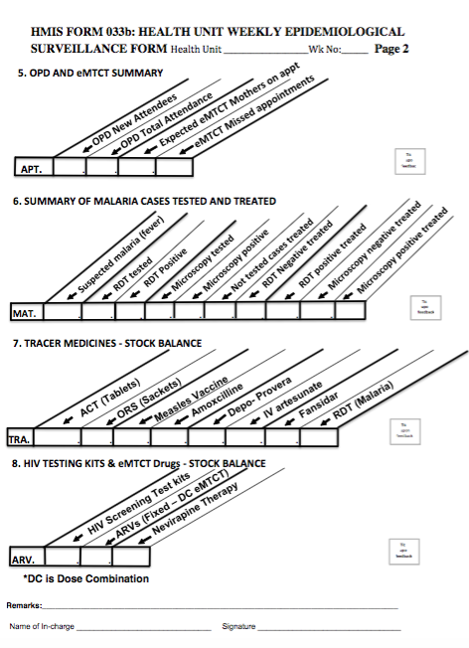
BE DATA DRIVEN
HMIS 033B Weekly Surveillance Form is sent via SMS through the mTrac system and immediately integrated into DHIS2

Slide 11
USE OPEN SOURCE, INNOVATIONS
mTrac based on RapidSMS / PRO
Open HIE Standard
All Code uploaded onto GitHub
Open helps leverage resources

Slide 12
Reuse
Survellaince and stock Management
Anonymous Health Service Delivery feedback
Polling
Communication

Slide 13
PRIVACY
MoH Access Control
Healthworkers

Slide 14
Be Collaborative
Funded by DFID, supported by UNICEF, WHO
Managed by MoH
Integrated into DHIS2

Slide 15
Questions

