Slide 1
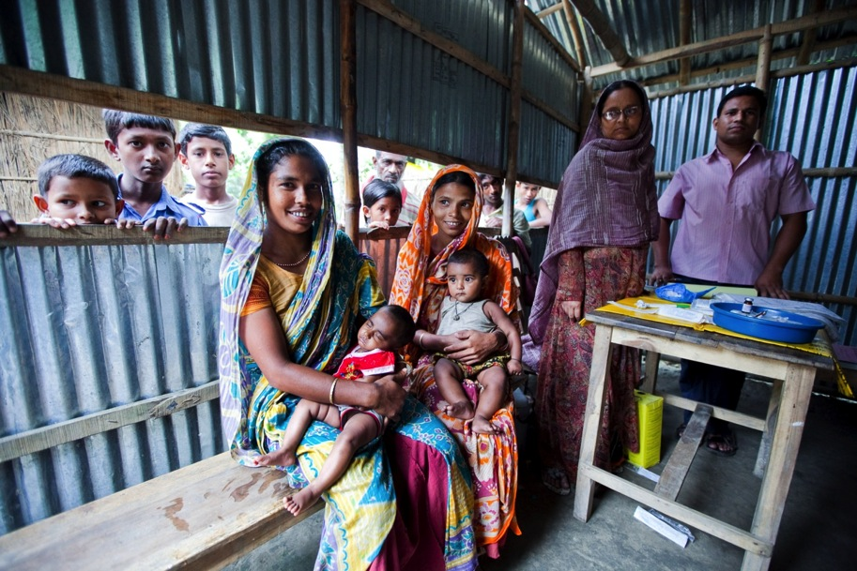





MTIKA: DESIGN, DEVELOPMENT & TESTING OF A DIGITAL VACCINE SUPPORT TOOL
KELSEY ZELLER, MSPH
RESEARCH ASSOCIATE
JOHNS HOPKINS SCHOOL OF PUBLIC HEALTH

Slide 2
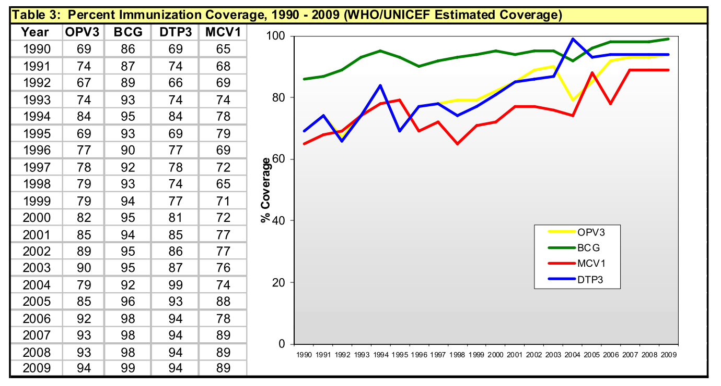
Expanded program on immunization (EPI)
Bangladesh EPI 2009 Fact Sheet
Bangladesh EPI 2009 Fact Sheet

Slide 3
COVERAGE IS HIGH, BUT…
Most children coming to the vaccination camps are not receiving vaccinations on time.
  Akmatov, M. K., & Mikolajczyk, R. T. (2011). Timeliness of childhood vaccinations in 31 low and middle-income countries. Journal of Epidemiology and Community Health, 5. doi:10.1136/jech.2010.124651
  Clark, A., & Sanderson, C. (2009). Timimg of children’s vaccinations in 45 low-income and middle-income countries: an analysis of survey data. The Lancet, 373, 1543 – 1549.

Slide 4
Formative research overview
Analysis of timely vaccination coverage in Gaibandha district, Bangladesh
Workflow mapping in 6 EPI clinics and interviews with HAs in Gaibandha and Sylhet
Collection of current recordkeeping mechanisms including scans of vaccination ledgers.

Slide 5
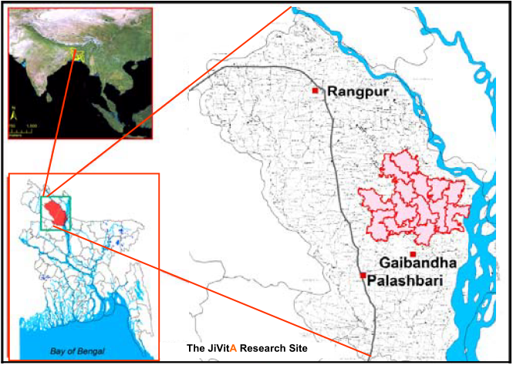
JiVitA study in Gaibandha, Bangladesh
Labrique, A. B., et al (2011). A cluster-randomized, placebo-controlled, maternal vitamin A or beta-carotene supplementation trial in Bangladesh: design and methods. Trials, 12, 102. doi:10.1186/1745-6215-12-102

Slide 6
Selection criteria for infants included in analysis
Live born infants in the JiVitA cohort between 2001-2007
Followed till the first postpartum interview at 3 months
Vaccination information available from first postpartum interview
Vasudevan et al. , manuscript in review

Slide 7
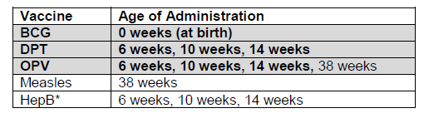
Only 19% of infants receive timely vaccination by 3 months of age
Out of 18,967 infants with vaccination cards at the first postpartum interview, only 3,959 infants (19%) had received all due vaccinations
Vasudevan et al. , Vaccine 2015

Slide 8
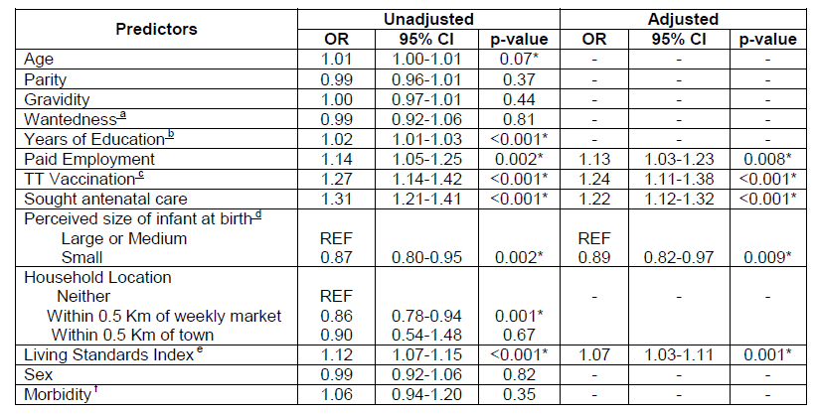
Maternal characteristics associated with timely vaccination of infant
L. Vasudevan et al. , manuscript in preparation
Vasudevan et al. , Vaccine 2015

Slide 9
Summary of results
80% of young infants remain susceptible to vaccine-preventable diseases during the early months of life
Benefits of antenatal care extend beyond pregnancy to impact infant health
Need to identify and counsel families where infants may be at risk for non-vaccination

Slide 10
Formative research overview
Analysis of timely vaccination coverage in Gaibandha district, Bangladesh
Workflow mapping in 6 EPI clinics and interviews with HAs in Gaibandha and Sylhet
Collection of current recordkeeping mechanisms including scans of vaccination ledgers.

Slide 11
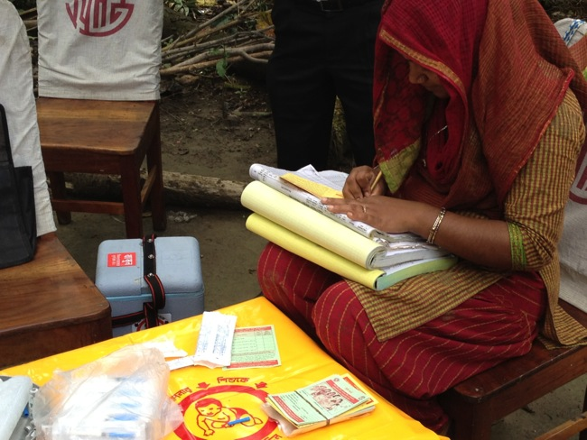
Formative research findings
2. Existing registration process is time consuming for HAs and involves filling 3 separate ledgers plus immunization cards.

Slide 12

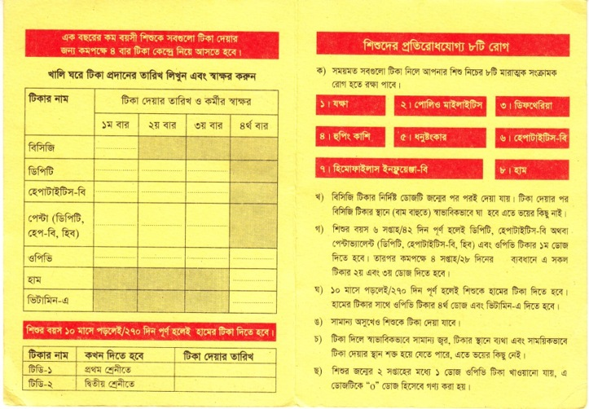
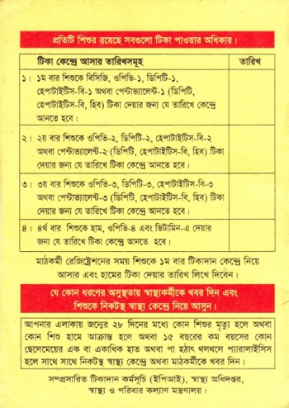
Formative research findings
3. There is a need for immunization records that are not the sole responsibility of mothers to keep.
On completion of 6 week/42 days after birth give your child DPT , Hepatitis – B, or pentavalent (DPT, Hep-B, HiB) and the first dose of OPV. Within an interval of 4 weeks or 28 days provide the second and third dose of all these vaccines.

Slide 13
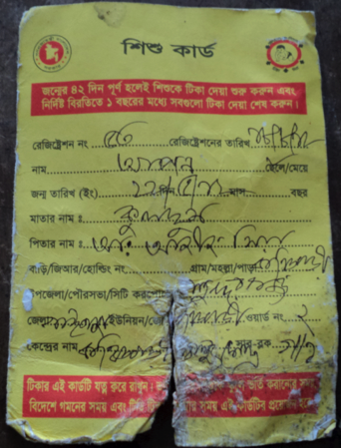

Slide 14
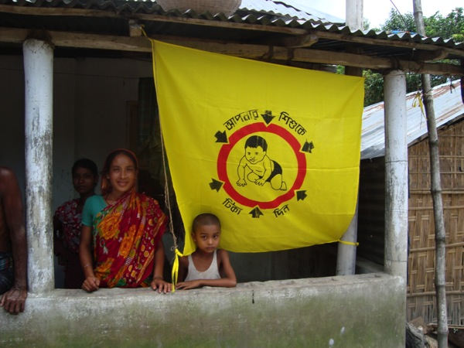
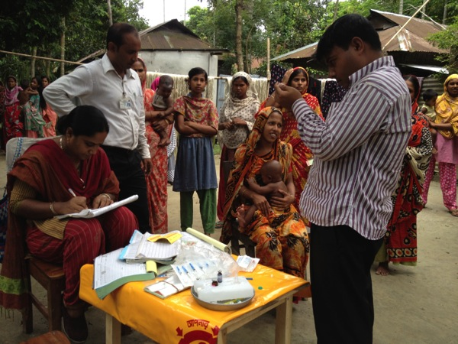
Formative research findings
4. HAs show a varying level of commitment to bringing children in for immunizations

Slide 15
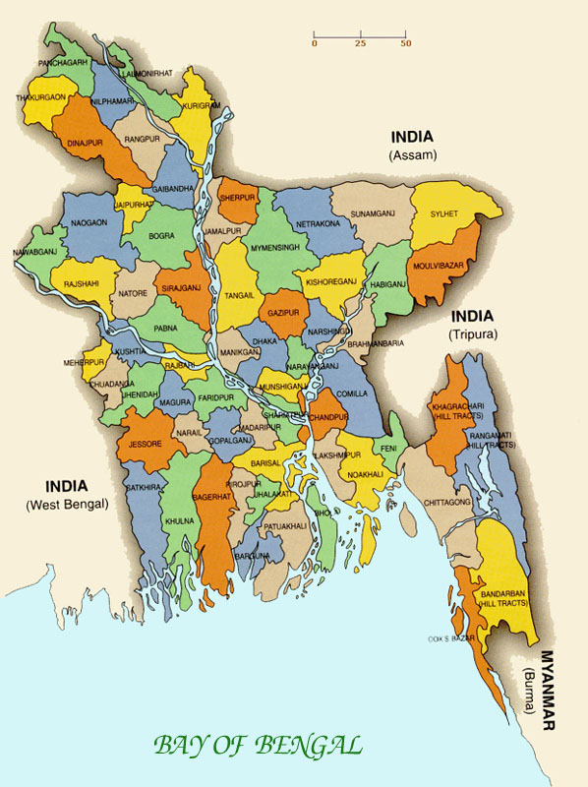
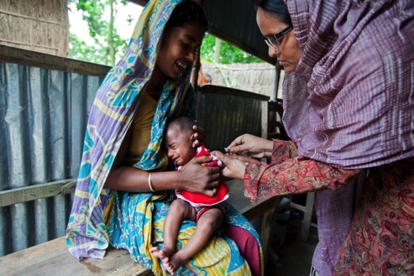
Formative research findings
5. Vaccination activities are similar across different districts of Bangladesh (Sylhet and Gaibandha).

Slide 16
Translating formative research into system design
Formative research findings | mTika system features
Timely vaccination rates are low | Reminder and scheduling
Burden of data collection and reporting | Electronic data collection and real-time reporting
Inefficient vaccination records | Electronic vaccine records that can be accessed from any phone
Camp notifications in person | Camp notifications through SMS
Passive counseling on importance of vaccination | Active vaccine knowledge assessment and counseling

Slide 17
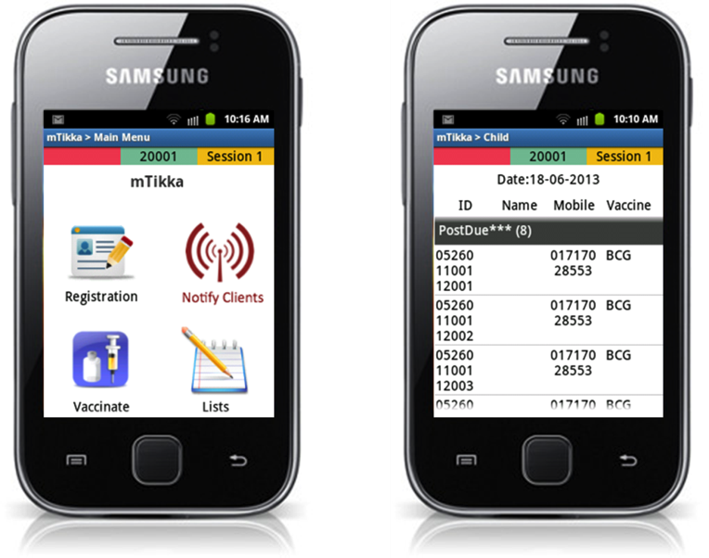
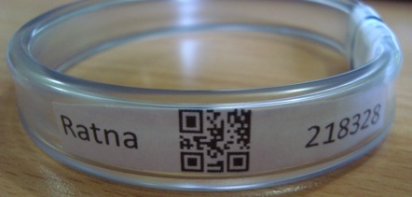
mTika – Mobile phone enabled virtual vaccination registry
http://tinyurl.com/mtikka-video

Slide 18
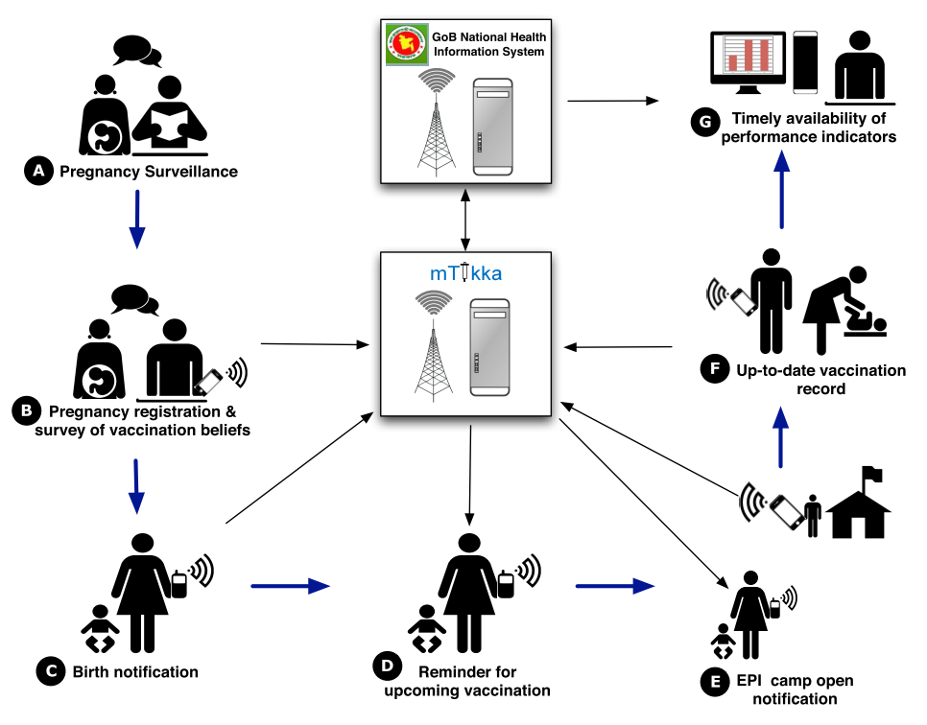
Overview of mTika
DEMAND
CREATE VALUE
ENGAGEMENT
IMPROVE
WORKFLOW
REMINDER

Slide 19

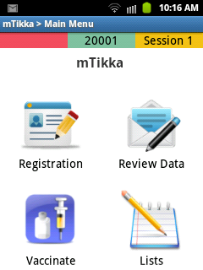
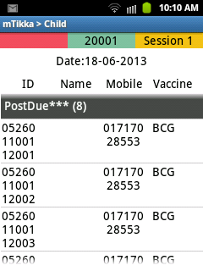


Slide 20


What does mTika do?
Registration
  Mother
  Child

Slide 21
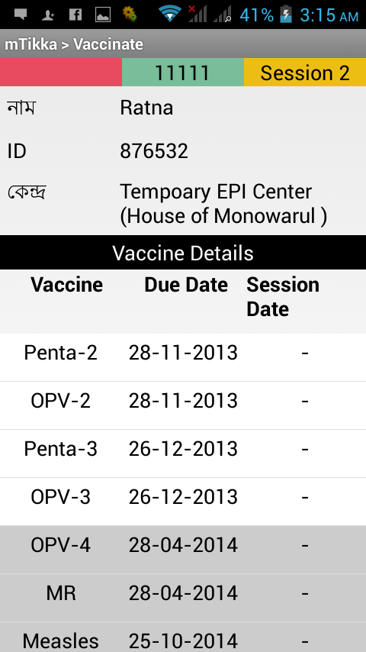
What does mTika do?
Vaccination Recordkeeping
  Automatic!

Slide 22
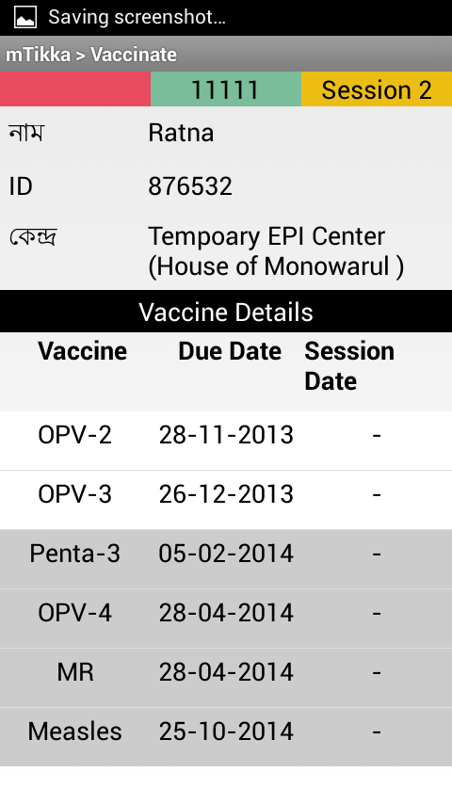
What does mTika do?
Vaccination Recordkeeping
  Automatic!

Slide 23
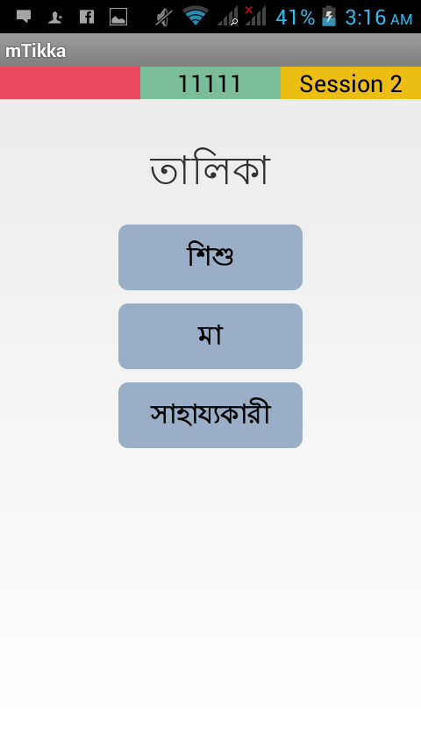
What does mTika do?
Session Management
  Who should come today?
  Quick record access

Slide 24
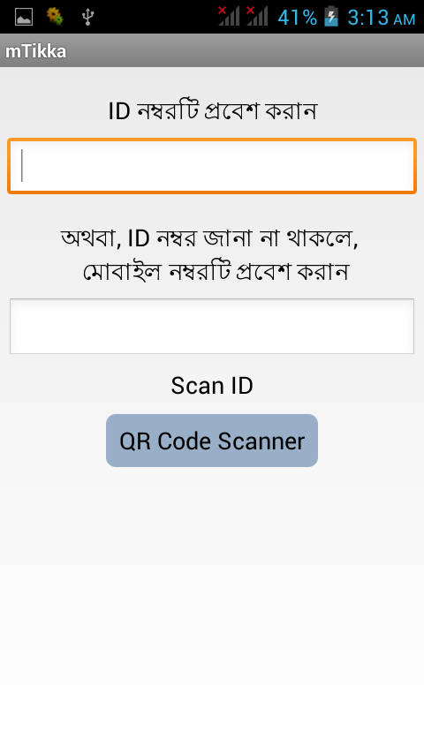
What does mTika do?
Session Management
  Who should come today?
  Quick record access…
  with OPTIONS!

Slide 25
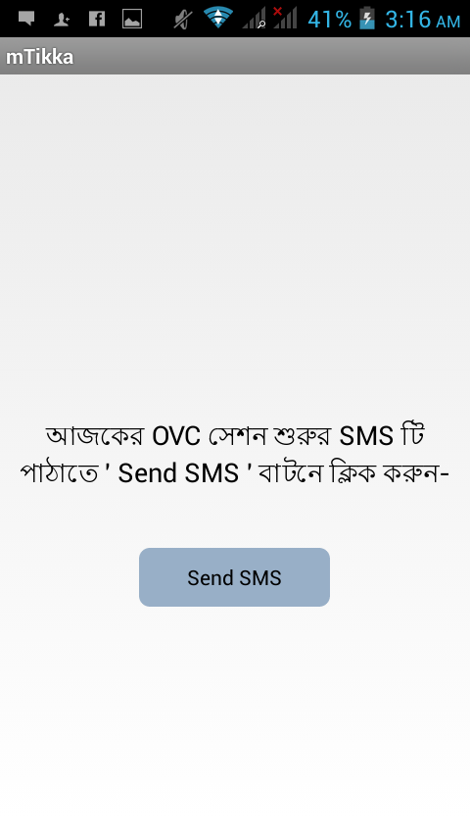
What does mTika do?
Announcements & Reminders
  Announce (by vaccinator)
  Remind (automatic!)

Slide 26
Pilot Study Design
Pre – mTika
200 Mother – Infant Pairs
Continued Use of Paper-Based System
Record baseline attendance rates at immunization sessions
6 week period
mTika
200 Mother – Infant Pairs
Introduction of Mobile-Based System
Measure effect of HA mTika use on attendance at immunization sessions
6 week period

Slide 27
mTika

Slide 28



Implemented with GoB Frontline Workers
1 AHI
4 HA
Kuptala
1 AHI
3 HA
Konchibari

Slide 29
mTika improves vaccination COVERAGE & TIMELINESS
Coverage (in %) among infants over 298 days in intervention and control areas with difference-in-difference (DID) and logistic model odds ratio
Vaccination status by type | Intervention: Rural |  |  | Control: Rural |  |  | DID and OR (with 95% CI) (n=393)
 | Baseline (n=131) | Endline (n=69) | Difference (95% CI) | Baseline (n=126) | Endline (n=67) | Difference (95% CI)
Fully vaccinated (BCG + Penta3 + MR) | 58.9 | 76.8 | 18.8* (5.7, 31.9) | 65.9 | 55.2 | -10.7* (-25.2, 3.9) | 29.5 3.8* (1.5, 9.2)
Vaccination status by type | Intervention: Urban |  |  | Control: Urban
 | (n=150) | (n=98) |  | (n=110) | (n=112) |  | (n=470)
Fully vaccinated (BCG + Penta3 + MR) | 40.7 | 57.1 | 16.5* (3.9, 29.0) | 44.5 | 33.9 | -10.6* (-23.4, 2.2) | 27.1 3.0*(1.4, 6.4)
Ref: Uddin et al. (2015) Vaccine
Vaccination status | Mother’s recall |  | Vaccination card
 | Control n = 59 | Intervention n = 59 | Control n = 59 | Intervention n = 59
Fully vaccinated by 3 months of age (BCG + Penta3 + OPV3) | 6.8% | 22% | 5.1% | 25.4%
Vaccination coverage (in %) among infants by 3 months of age in intervention and control areas, by mother’s recall or vaccination card data.
Ref: Vasudevan et al. (2016) under review

Slide 30
mTika improves vaccination COVERAGE
Vaccination status by type | Intervention: Rural |  |  | Control: Rural |  |  | DID and OR (with 95% CI) (n=393)
 | Baseline (n=131) | Endline (n=69) | Difference (95% CI) | Baseline (n=126) | Endline (n=67) | Difference (95% CI)
Fully vaccinated (BCG + Penta3 + MR) | 58.9 | 76.8 | 18.8* (5.7, 31.9) | 65.9 | 55.2 | -10.7* (-25.2, 3.9) | 29.5 3.8* (1.5, 9.2)
Vaccination status by type | Intervention: Urban |  |  | Control: Urban
 | (n=150) | (n=98) |  | (n=110) | (n=112) |  | (n=470)
Fully vaccinated (BCG + Penta3 + MR) | 40.7 | 57.1 | 16.5* (3.9, 29.0) | 44.5 | 33.9 | -10.6* (-23.4, 2.2) | 27.1 3.0*(1.4, 6.4)
Vaccination coverage (in %) among infants over 298 days in intervention and control areas with difference-in-difference (DID) and logistic model odds ratio (OR)
Ref: Uddin et al. (2015) Vaccine

Slide 31
mTikka improves TIMELY vaccination
Vaccination status | Mother’s recall |  | Vaccination card
 | Control n = 59 | Intervention n = 59 | Control n = 59 | Intervention n = 59
Fully vaccinated by 3 months of age (BCG + Penta3 + OPV3) | 6.8% | 22% | 5.1% | 25.4%
Vaccination coverage (in %) among infants by 3 months of age in intervention and control areas, by mother’s recall or vaccination card data.
Ref: Vasudevan et al. (2015) Manuscript in preparation

Slide 32


A paradigm shift is needed
Begin with “technologic agnosticism”
Identify constraints, then look for opportunities (include technology, where appropriate)
Focus on the “System” – that includes the provider, the client and the health ecosystem
Understand that (behavior) change is NOT EASY, requiring in depth formative research and careful evaluation
Notes:
Pilot strategies, or proofs of concept, being integrated and scaled at subnational and national levels. Today, we’ll hear from some of the most promising and stable projects.

Slide 33

Scale-up Strategy & Moving Forward
Local coding and ownership
Local technologies employed
Government as a formal partner
Engagement of frontline health workers in design & implementation
Transition to scalable technology base, compatible with National MIS
MoHFW adoption and national scale planned

Slide 34


Slide 35
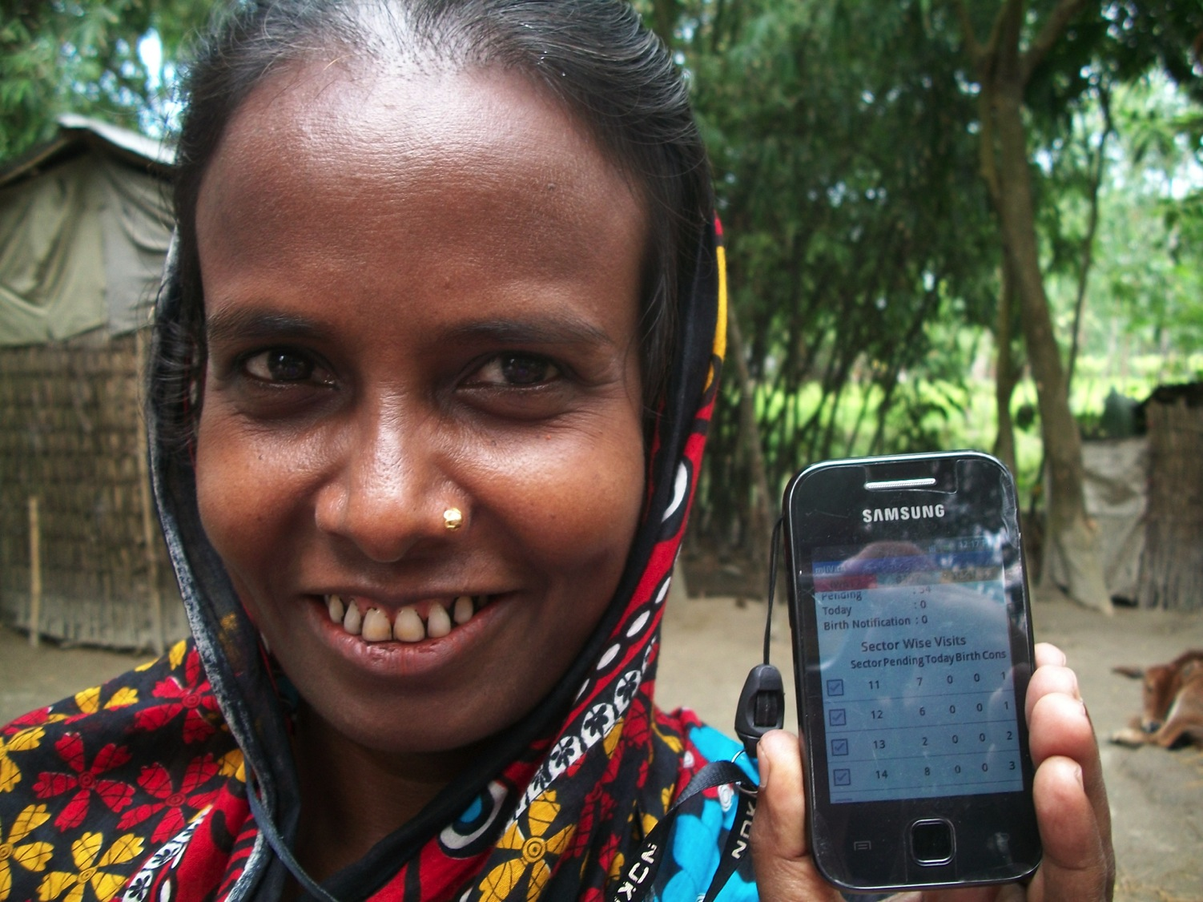
THANK YOU.

