Slide 1
Using the mERA Checklist to
Close Measurement Gaps:
Refining World Vision’s mHealth M&E Toolkit
Global Digital Health Forum
14 December 2016
Annette E. Ghee, World Vision International

Slide 2












Vision Statement
Empower the most vulnerable households and community health workers/volunteers through use of common, shared, multi-functional and collaboratively designed mobile health solutions to deliver community-based health interventions.
Principles for our Work:
Coherence and quality of approach and programe/project management
ALWAYS in partnership with others and building on global learning
Designed to meet the needs of community users but also provide the basis for maturing the evidence base
Initially affordable yet based on sustainable costing models and scalable technology
Considers data governance issues
Uses and strengthens government partners’ information systems
Favors open source solutions and emerging global standards
National Level
District Level
Community Level
Notes:
WV’s mHealth Vision Statement and related deployments focuses on the last mile – vulnerable communities and community health workers. The principles behind our work focus on collaborative, common solutions that are designed iteratively with end users.

Slide 3


mHealth Theory of Change
mHealth Theory of Change
Millenium Development Goals
Natl & Intl Goals to
which project contributes
Lower maternal and child U5 mortality rates
Lowered child U5 morbidity
Improved maternal and child U5 nutritional status
Improved preventive health behavior among pregnant women and caregivers at the household level
More timely and effective use of health services on the part of pregnant women and caregivers
More sustainable, effective and efficient CHW/V workforce
Improved linkages between facility and community services for quality improvement
Outcomes to which project primarily contribute
CHW/V adherence to behavior change communications protocols
CHW/V adherence to case management protocols*
Referral closure rates between CHW/V and facilities
CHW/V motivation & retention
ICT System performance & scalability
Appropriate and timely use of program monitoring information
Access to health information and complementary social services
Outputs & immediate outcomes
Communicate project- roadmap, benefits, project management
Develop solution based on user needs
Ensure client expectations were met
Undertake user acceptance testing
Train users on all aspects of solution
Build and sustain user capacity & ownership
Activity tracking, as part of M&E
Deployment activities
Develop Operating Plan
Refine business needs & requirements
Establish programme management
team
Design budget & sustainable financial model
Training, curriculum and partner development
Consolidate sustainability plan and relationships w partners
Develop M&E plan and conduct baseline
Foundational activities
* i.e. ttC visit schedule or CCM clinical case management protocols
Notes:
KEY POINTS:
The goals are tied most closely to MDGs 4 and 5 but also contribute to some aspects of MDGs 1 (particularly nutritional status of pregnant women and children U5) and 6 (particularly HIV and malaria).
At the outcome level, we expect the “value add” of mHealth to be reflected in these 4 areas. These metrics would only be gathered periodically with the purpose of documenting quantifiable change at the population, CHW workforce or community level.
Immediate outcomes that would be tracked on an ongoing basis to both refine the application itself and document how the mHealth application has directly effected program beneficiaries. The information would either be sourced from standard M&E data tracked by the mobile application itself or by CHW supervisor records and the records kept by community-based structures that support the CHW program, for example, community health committees or advocacy groups. Strengthening community level structures is a central aspect of WV’s Maternal and Child Health and Nutrition strategy.
NOTE that adherence to case management protocols can contribute to both the first and second outcome listed here – adherence to the ttC visit schedule for example, would also strongly affect the first outcome. Similarly, appropriate and timely use of program monitoring information can reinforce CHW supportive supervision systems and thus support both the 3rd and final outcome listed here.
ICT system performance characteristics are hypothesized to have a direct impact on the efficiency of front line health care workers but system performance and its potential scalability also have a reinforcing effect on several other pathways leading to positive health outcomes.
We are in the process of developing an illustrative logical framework to propose appropriate indicators at both the output and outcome level.

Slide 4
Improved Maternal and Child Health &
Nutritional Status
Optimum mHealth solution designed and deployed
Establish key elements of scale
High quality and coverage of programming
Evidence Need
Parent
program
Does ICT supported programming
enhance health and nutrition
outcomes?
What is the return on
investment in mHealth?
Continuous quality
improvement in
programming

Slide 5
Optimal mHealth Solution
User & beneficiary acceptability of ICT solution
ICT solution field adoption
Referral completion rate and elapsed time (1-way/2-way between CHW to health facility)
Beneficiary positive rating of factors influencing behavior change
Satisfactory user acceptance test results following each deployment/enhancement
Signal coverage at community level
Timeliness of access to standard reports
Data collection forms/processes are streamlined
Standardized training processes for primary users developed and integrated with
Primary users complete ICT solution training and acquire minimum competencies
Standardized training processes for level 1 IT support developed
Level 1 IT support complete training and acquire minimum competencies
“The plural for anecdote is not data”
-- Unknown

Slide 6
Key Elements of Scale
Solution coverage in target beneficiary population
Description of active collaborative partnerships in favor of scalability
Cost-benefit of ICT solution
Proportion of target user population equipped with ICT solution
Description of collaborative agreements with government partners
Description of new, established and dissolved partnerships
ICT solution costs (start up and running)
Estimated costs averted by replacing paper-based M&E systems

Slide 7
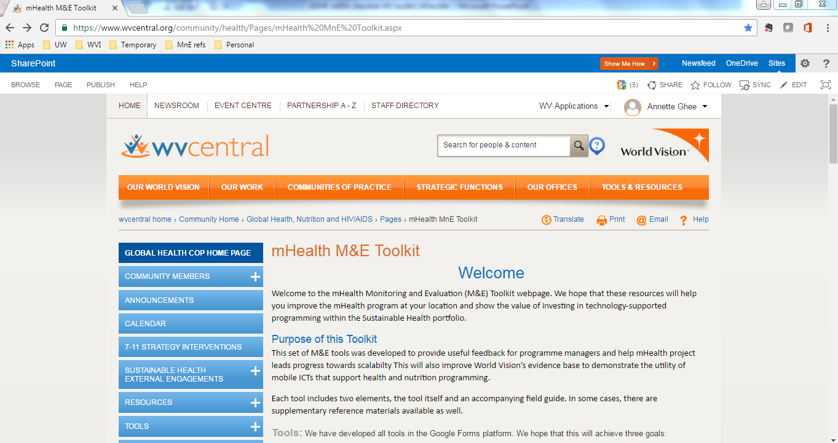
WV’s M&E Toolkit

Slide 8
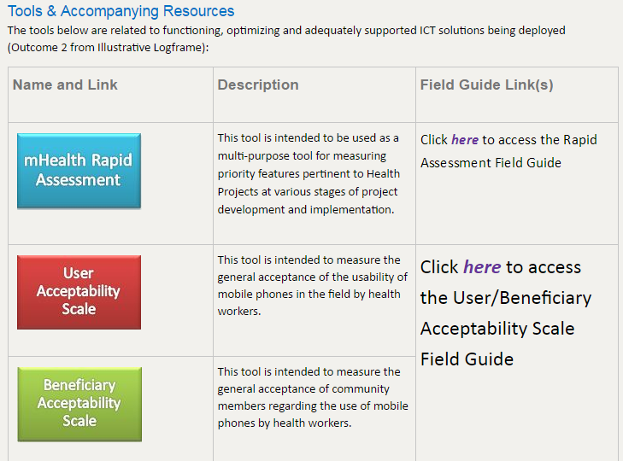
WV’s M&E Toolkit

Slide 9
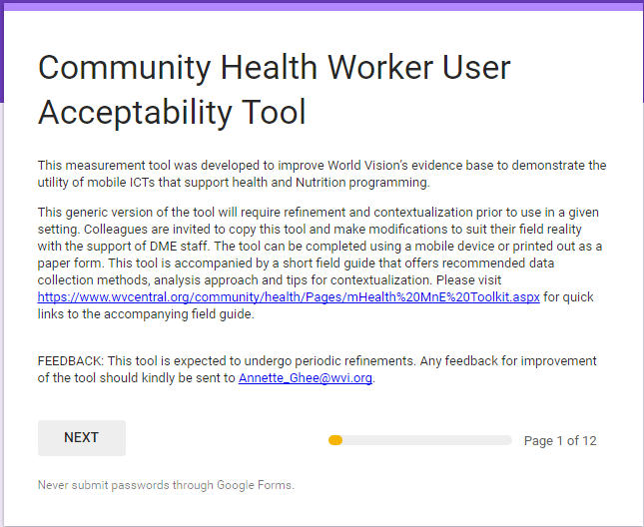
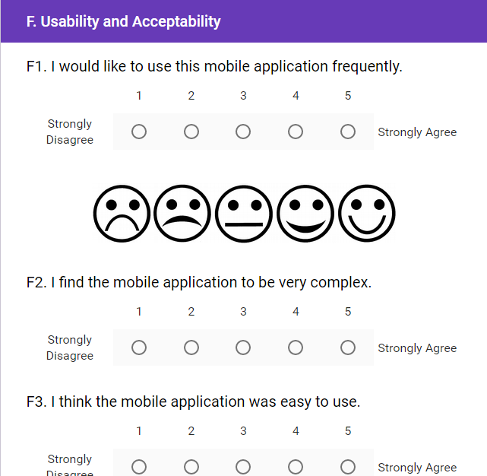

Slide 10
WV’s M&E Toolkit
Tool | Description
mHealth Rapid Assessment | Multi-purpose tool for measuring features pertinent at various stages of project development and implementation.​​
User & Beneficiary Acceptability Scale | Measures users’ acceptance and perceived usability of solution. Measures acceptance of the use of solution among those exposed to ICT-equipped CHW.
Post-training Competency Assessment | Measure effectiveness of the training for CHW users by assessing acquisition of skills
Standardized questions for baseline Evaluation | Assess exposure to mHealth at population level
Under development:
Data Quality Assessment
CHW Referrral Closure Assessment

Slide 11
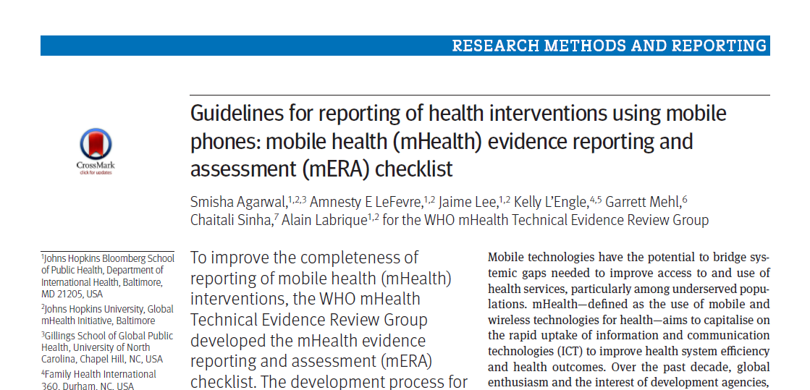
BMJ 2016;352:i1174 | doi: 10.1136/bmj.i1174

Slide 12
mERA
 | Criteria | Description | Source | Gaps
Item 1 | Infrastructure (population level) | Describe, in detail, the necessary ICT infrastructure which was required to enable the operation of the mHealth programmme | Rapid Assessment Tool | Literacy rate - is typically available in WV programming context through routine baselining for programming. Would not be available among mHealth users/beneficiaries specifically.
Item 2 | Technology platform | Describe, in sufficient detail to allow replication of the work, the software and hardware combinations used in the programme implementation | Factsheets; Project Reports | Factsheets would provide basic description of technology platform and infrastructure but not sufficient detail to replicate (i.e. system configuration specifications)
Item 3 | Interoperability/Health Information systems (HIS) context | Describe how, if at all, the mHealth strategy connects to and interacts with national or regional Health Information Systems (HIS)/programme context | Factsheets; Rapid Assessment Tool; Project Reports | Factsheets can assess interoperability on a very basic level. Project Reports would need to describe HMIS alignment efforts and negotiations towards achieving interoperability with MoH systems

Slide 13
mERA
 | Criteria | Description | Source | Gaps
Item 4 | Intervention delivery | Elaborate the mode, frequency, and intensity (dose) of the mHealth intervention | Factsheets; Referral Closure | Factsheets would provide basic description of frequency, intensity, mode of delivery but again not in sufficient detail to replicate (i.e. alerts/reminders received by users; structure of BCC messaging; duration of messaging exposure, etc.)
Item 5 | Intervention content | Describe how the content was developed/identified and customised | Factsheets; Project Reports | Again factsheets would give high level info but project documentation expected to give greater depth (e.g Source for BCC messaging, process to contextualize etc)
Item 6 | Usability/content testing | Describe how the end-users of the system engaged in the development of the intervention | Factsheets; Solution Provider Reports; User/Beneficiary Acceptability Tool | Again, high level description for factsheets would need to be augmented by project documentation info likely from solution provider. User acceptability can independently assess effectiveness of this component.

Slide 14
mERA
 | Criteria | Description | Source | Gaps
Item 7 | User feedback | Describe user feedback about the intervention or user satisfaction with the intervention | User/Beneficiary Acceptability Tool
Item 8 | Access of individual participants | Mention barriers or facilitators to the adoption of the intervention among study participants | Rapid Assessment Tool;Post Training Assessment and Competency Assessmen; Project Reports
Item 9 | Cost assessment | Present basic costs of the mHealth intervention | Rapid Assessment Tool; Data Quality Assessment Tool | Rigorous cost-efficiency or cost-benefit analysis
Item 10 | Adoption inputs/programme entry | Describe how people are informed about the programme or steps taken to support adoption | Post Training Assessment; Competency Assessment; Basic Training Event reports (facilitators, # participants, # classroom hrs, etc) | Quality and effectiveness of user support systems

Slide 15
mERA
 | Criteria | Description | Source | Gaps
Item 11 | Limitations for delievery at scale | Present expected challenges for scaling up the intervention | Rapid Assessment Tool; Project Reports | Dimagi document describes ideal modus operandi. We need rich description of how it really happened on the ground. Again factsheets would give superficial picture.
Item 12 | Contextual adaptability | Describe appropriateness of the intervention to the context, and any possible adaptions | Factsheets; Project Reports | Need a rich description of contextualization and language accommodations (comprehension field testing).
Item 13 | Replicability | Present adequate technical and content detail to support replicability | Full technical documentation available upon request. | Alignment to HMIS and metrics to assess mHealth system performance
Item 14 | Data security | Describe security and confidentiality protocols | Factsheets | Gather basic info via factsheet project. Probably sensible to identify projects that are furthest along and work together on a tool or checklist for documentation. This item is a required precursor for scalability (item 11).

Slide 16
mERA
 | Criteria | Description | Source | Gaps
Item 15 | Compliance with national guidelines or regulatory statutes | Assure that content or other guidance/information provided by the intervention is in alignment with existing national/regulatory guidelines and is described | Rapid Assessment Tool | Closely related to items 3, 11, 14. Need to develop a tool to assess progress towards compliance/alignment.
Item 16 | Fidelity of the intervention | Describe strategies employed to assess the fidelity of the intervention: assessment of participant engagement, use of backend data to track message delivery and other technological challenges in the delivery of the intervention | Post Training Assessment; system generated health/nutrition related output and intermediate outcomes; Project Reports

Slide 17
Conclusions
Many mERA Checklist criteria can be readily and rigorously captured by the existing range of field-ready tools
Addressing some criteria heavily dependent on project reports which do not have standardized structure/content
Measurement gap areas need to be prioritized and simple standardized tools developed
Guidance regarding levels of evidence and corresponding scope of measurement needed

Slide 18

Thank you
For more information:
http://www.wvi.org/mHealth
Annette_Ghee@wvi.org

