Slide 1

16 September 2016
From Paper to Digital
  Judith Nguimfack Tsague | Senegal eHealth Registry
  Evelyn Castle | eHealth Africa
  James Pringle | PMA2020
  Katherine Stanfill | Emory University Center for Global Safe WASH

Slide 2
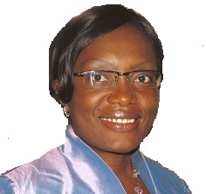
Judith Nguimfack
is a Public Health Informatician with 8 years of progressive experience in Information system development, eHealth, monitoring and evaluation,and project management in Africa. A national of Cameroon, Judith earned a Bachelordegree in Computer Sciences from the African Institute of Computer Sciences inYaoundé-Cameroon. She then completed a Master of Sciences in Public Health Informatics at Emory University, in Atlanta-USA in 2009.
Judith was involved in key public health informatics project in Rwanda, Zambia and Senegal. She provided technical expertise to the Ministry of Health in Rwanda through UNICEF for the development of an mHealth systems to reduce maternal Mortality. In Zambia, she contributed to the saving mothers giving lives (SMGL) initiative where she advised on the development of mHealth solutions to improve maternal health service delivery, working with the Zambia Center for Applied Health Research and Development (ZCAHRD). More recently in Senegal, she was one of the lead experts supporting the development of the national eHealth Strategic Plan for Senegal, and was the lead expert responsible for the development of the national eHealth Catalog for Senegal.
Judith is currently supporting the ministry of Health in Senegal in strengthening the epidemiologic surveillance system at community level.Judith is strongly committed to the promotion and development of public health informatics as one key pillar for strengthened and sustainable health systems, with a focus on Africa.

Slide 3

SENEGAL eHEALTH CATALOG
Monthly meeting: Global Digital Health Network
September 16th 2016
Presenter: Judith Nguimfack Tsague, MSPH
jnguimfack@gmail.com
Dakar – Senegal

Slide 4
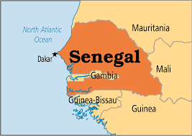
Context
A national eHealth survey run by MoH and supported by WHO in 2015 revealed a multiplicity of pilot eHealth initiatives and no coordination
Led to the development of a national eHealth Strategic plan
  To support universal Health coverage for better access of all people to quality health services in line with the National Health Development Plan
Capitalization of existing pilot eHealth initiatives
  including telemedicine, and applications of mobile technologies (SEDA, ODK, m-diabetes, etc.)
An eHealth Catalog would be developed and its output would guide the eHealth strategic plan

Slide 5

Purpose
To identify, document and assess key eHealth initiatives that had been recently or were currently being conducted in Senegal
Make available information on operational eHealth initiatives in Senegal
Serve as a decision making tool for MOH and partners

Slide 6
Methodology

Slide 7

eHealth Catalog content
Adapted from
https://www.mhealthevidence.org/
https://www.mindmeister.com/264463850/mhealth-evidence-taxonomy

Slide 8
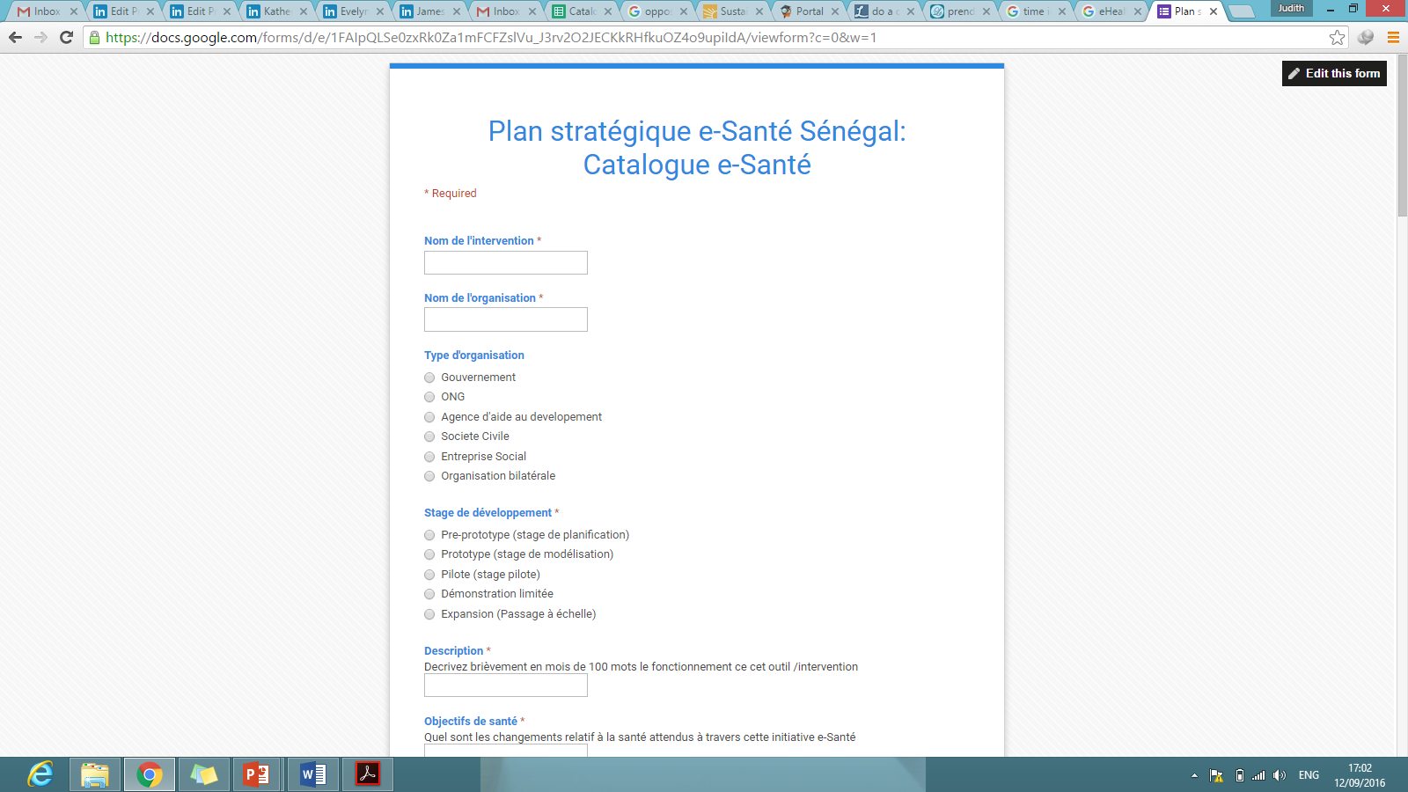
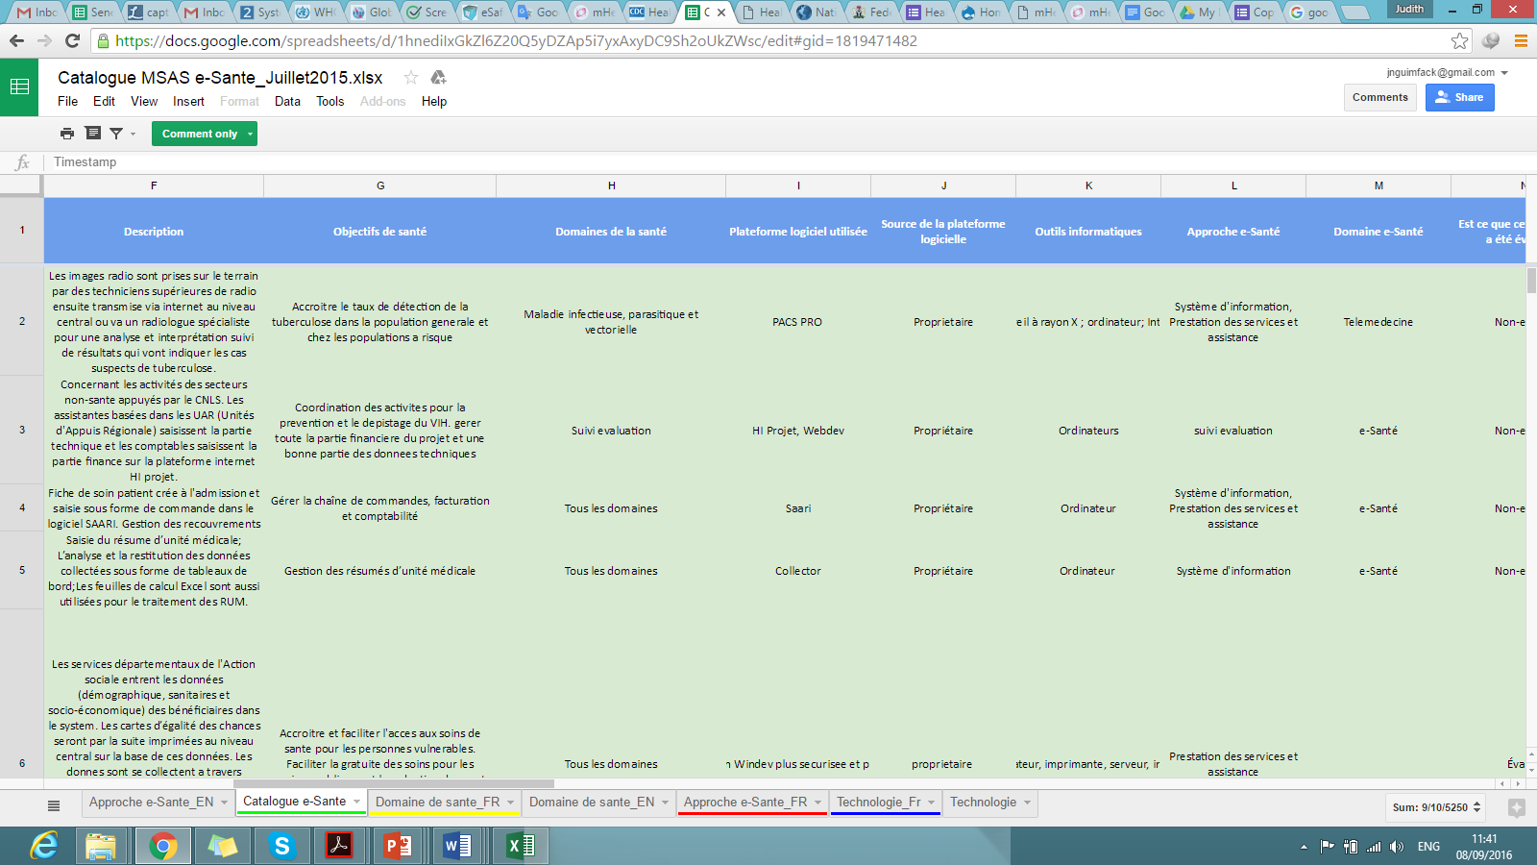
Google form
http://goo.gl/forms/PkVJeP68i9

Slide 9
How can stakeholders use the catalog?

Slide 10
Challenges and lessons learned (1)
Limited information and contact details on eHealth projects and partners
  Lesson: List of organizations; snowball approach.
Key informants’ unfamiliarity with eHealth (in some cases)
  Lesson: Request to have technical people contribute to the interview.
  If possible have a phone conversation with contact person to clarify expectations.

Slide 11
Challenges and lessons learned (2)
Delayed publication of the catalog online:
  Lesson: prompt sharing of the catalog could have maintained the momentum achieved and emphasized it’s dynamic nature. Stakeholders were eager to have an overview of the catalog
Discontinued utilization of the eHealth catalog following initial set up activity
  Lesson: Difficult to sustain without a functioning strategic framework and coordinating entity

Slide 12
Acknowledgements
Ministry of Health in Senegal
WHO
K4Health
Partners who contributed information in the catalog

Slide 13


Slide 14
Evelyn Castle
is the Executive Director and Co-founder of eHealth Africa. Her role is to provide high level leadership of eHA across Nigeria, Sierra Leone, Liberia, and Guinea. Evelyn has over five years experience living and working across West Africa. She has built and oversees multicultural, multinational teams of over 1,000 public health professionals. She has led eHA to triple staff capacity in 12 months and helped raised over $35m in eHA's first 4 years.
Evelyn leads senior-level partner relationships with major global foundations and NGOs including Gates Foundation, USAID, UN Foundation, WHO, and UNICEF, as well as high-net worth private donors, and manages stringent compliance with subsequent grants.

Slide 15
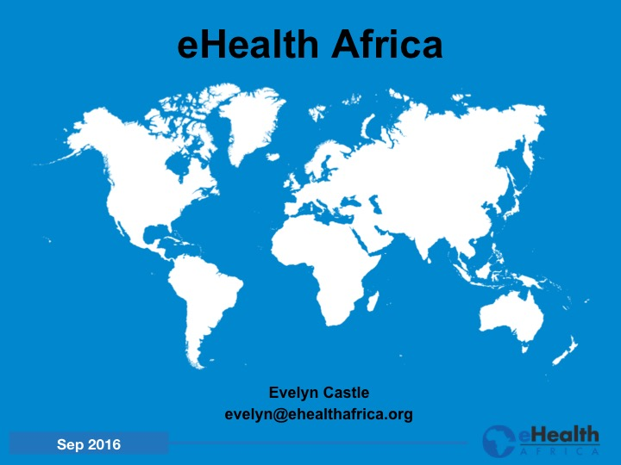

Slide 16
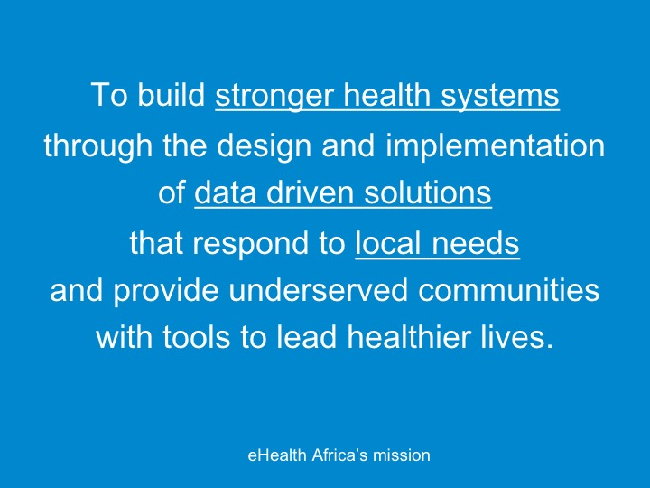

Slide 17
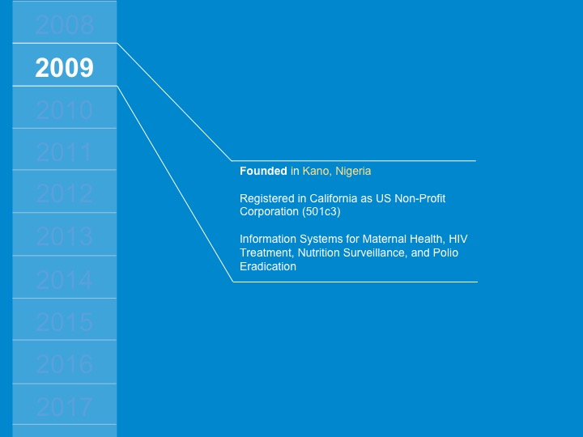

Slide 18
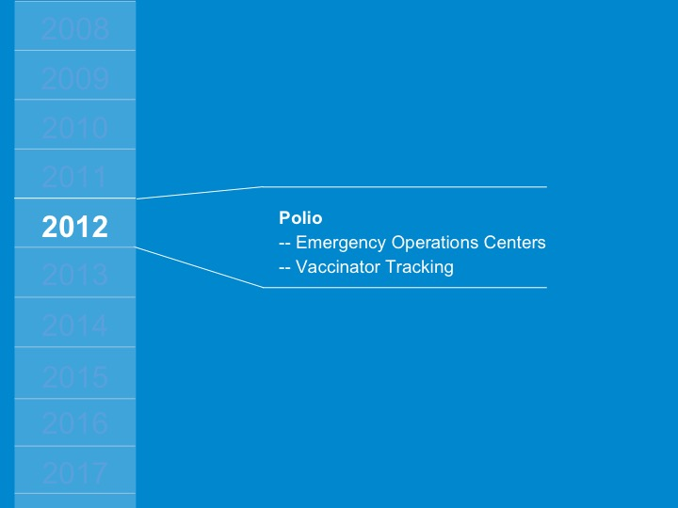

Slide 19
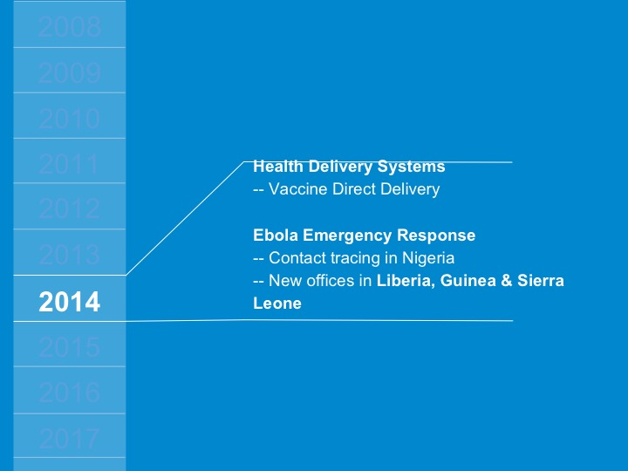

Slide 20
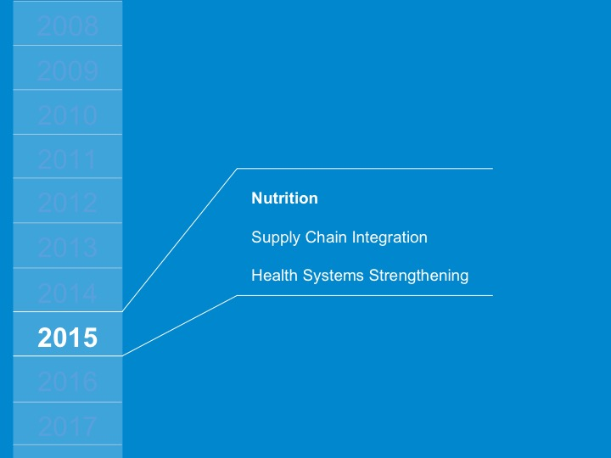

Slide 21
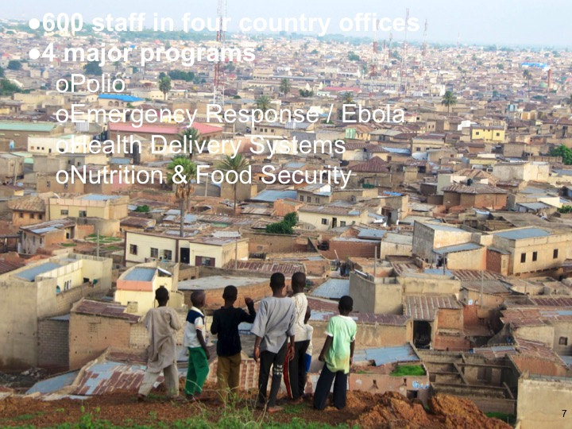

Slide 22
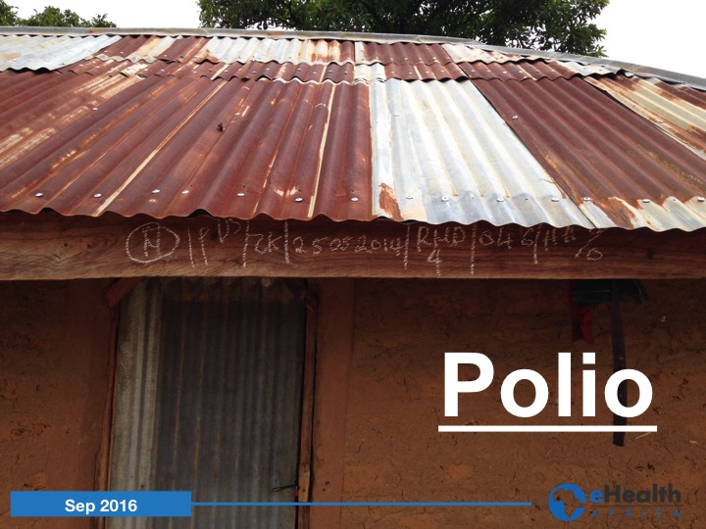

Slide 23
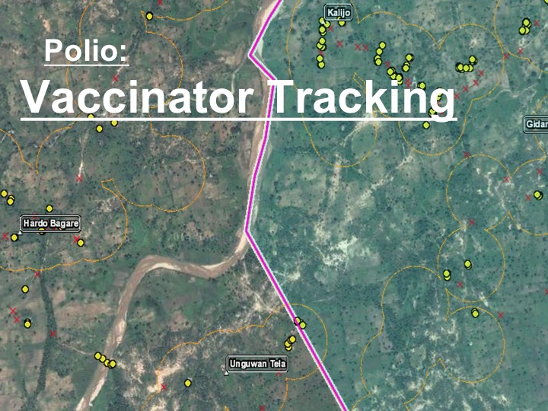

Slide 24
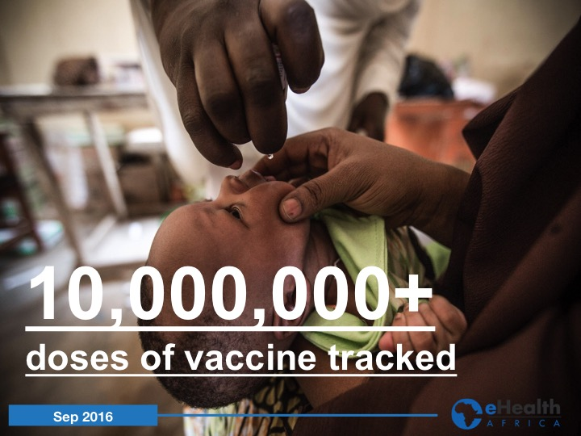

Slide 25
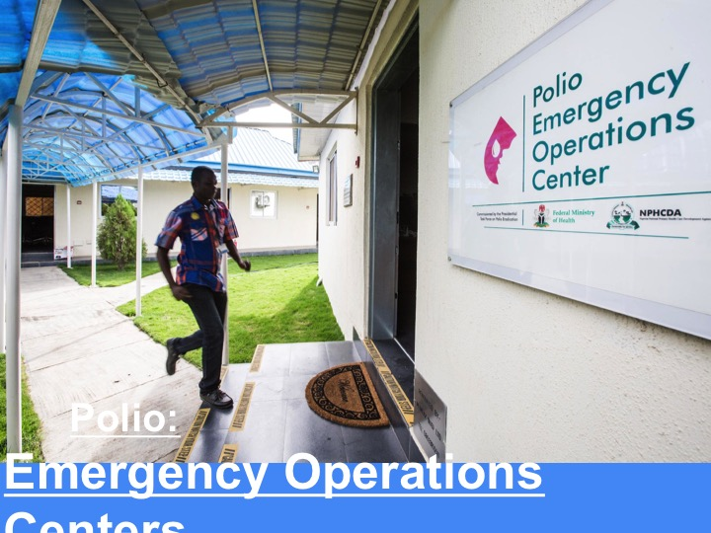

Slide 26
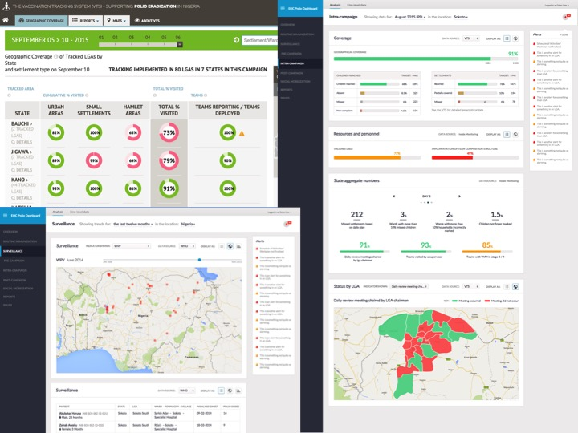

Slide 27
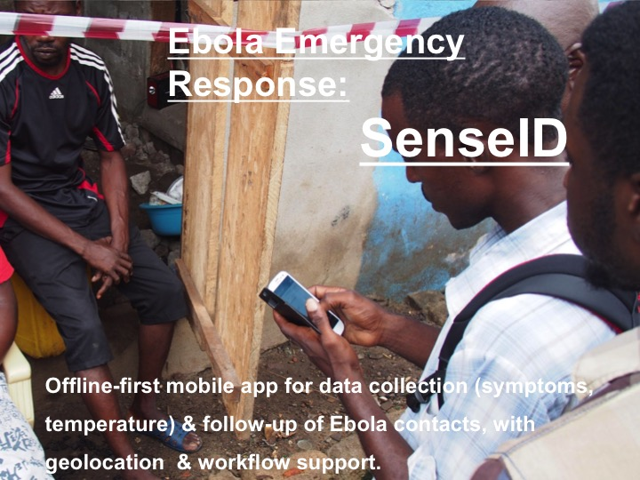

Slide 28
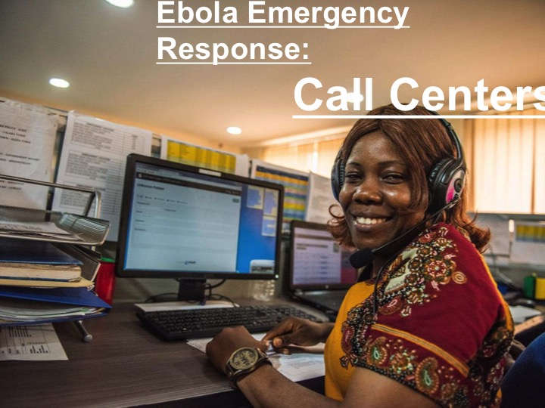

Slide 29
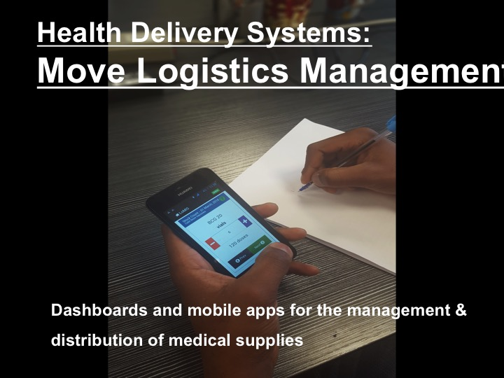

Slide 30
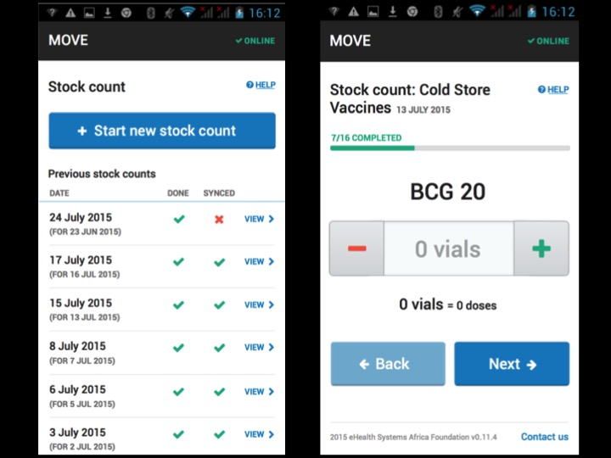

Slide 31
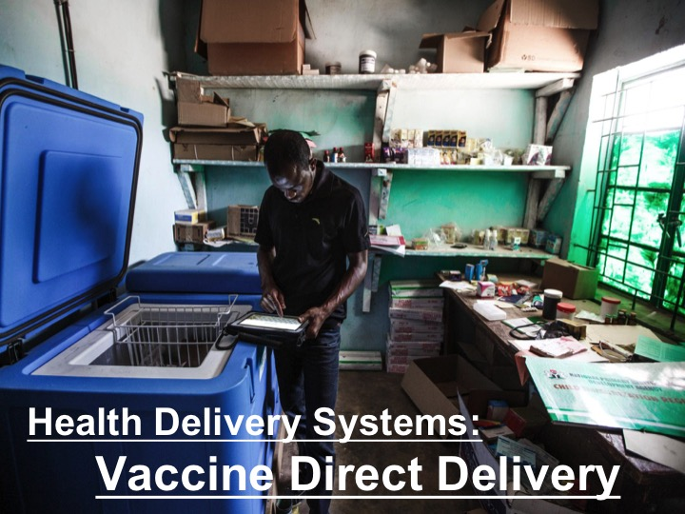

Slide 32
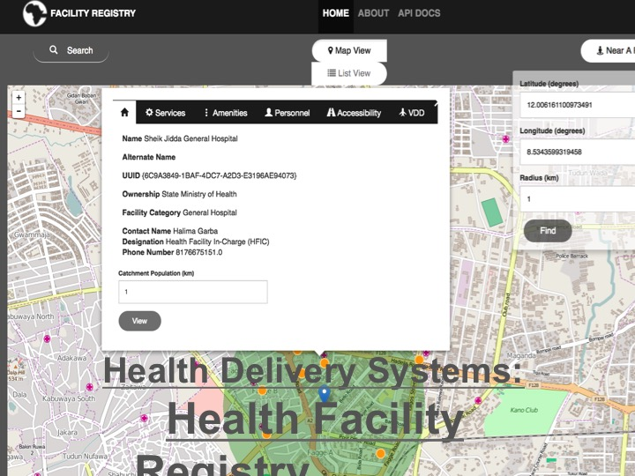

Slide 33
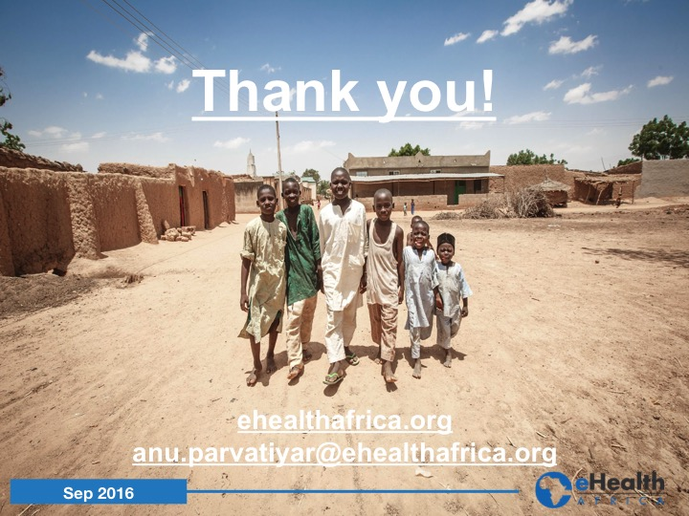

Slide 34
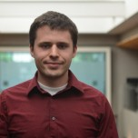
James Pringle
is the Programmer Analyst for PMA2020. He supports the mobile health data collection platform as an Android developer and an Open Data Kit specialist. He also builds up data housing and data visualization capacity for PMA2020. In particular, his GIS skills have created new vantage points for understanding PMA2020 data.
James has a Master of Science in Biostatistics from Johns Hopkins Bloomberg School of Public Health. He received his Bachelor's degree in Mathematics from Brigham Young University.

Slide 35
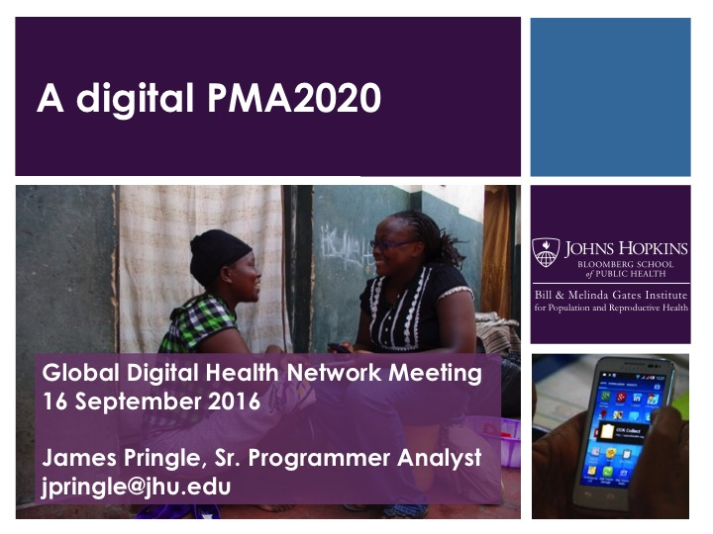

Slide 36


Slide 37
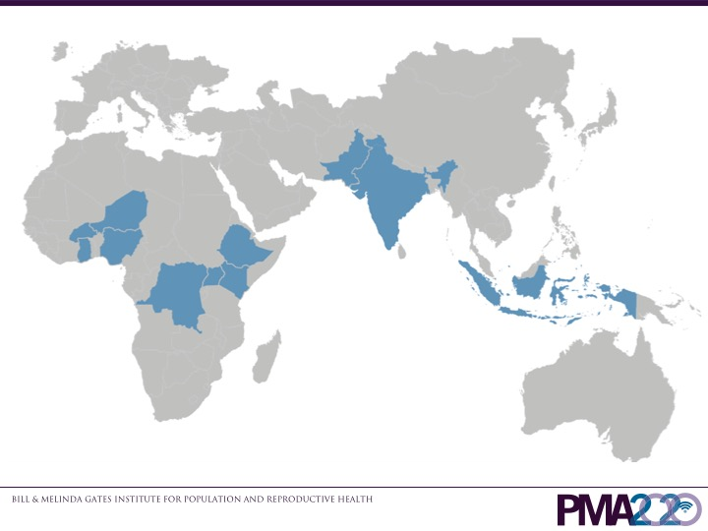

Slide 38
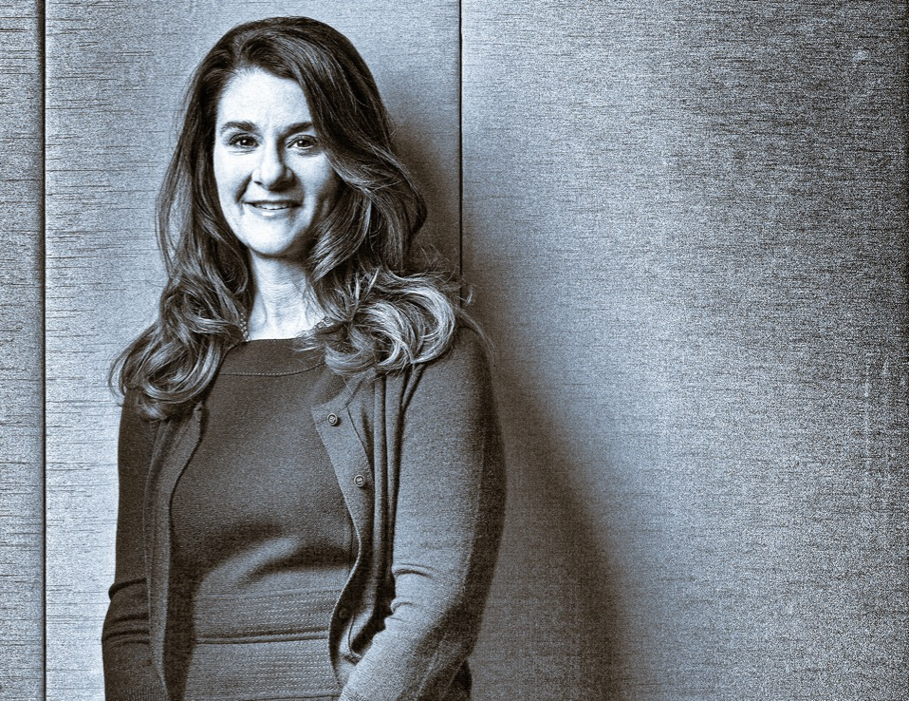
PMA2020 is leading the way to ensure that “governments are better informed than ever before and better able to respond more quickly to what women need and want.”
Melinda Gates
Notes:
Melinda Gates wrote in January of this year (2016) about five reasons to be optimistic about extending family planning access and use to women and girls all around the world. One reason is the data revolution that is helping to put focus where it is needed. PMA2020 is leading the way to ensure that “governments are better informed than ever before and better able to respond more quickly to what women need and want.”

Slide 39
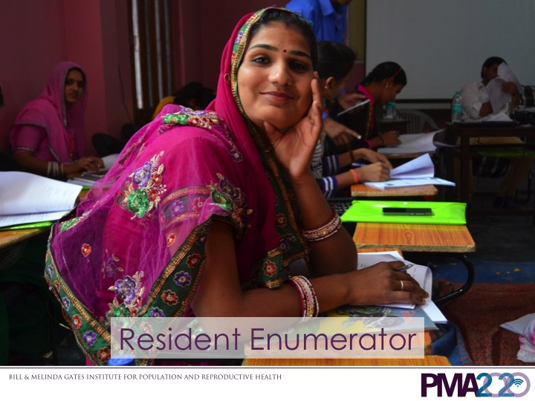
Notes:
In PMA2020, we hire and train women that are local to the randomly sampled villages and neighborhoods. We call them Resident Enumerators [picture with word RE]. The first training I attended was in India, so you will see many photos of India in this presentation.

Slide 40
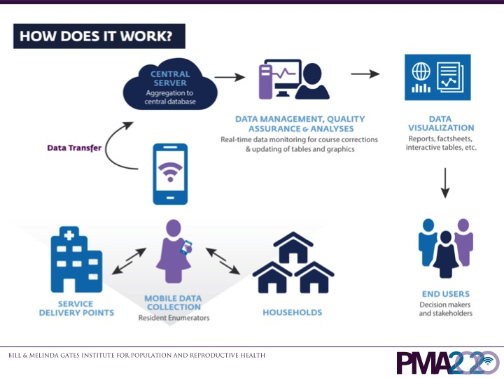
Notes:
These women conduct interviews at the household level and individual female level. They also conduct interviews at facilities that provide family planning products and services [graphic of RE work]. Most household and individual female questionnaires take 10 to 20 minutes to complete. Most facility questionnaires take 20 to 45 minutes. The women submit their data over the mobile network to our central servers, and our data managers diligently clean and analyze the results to produce statistics and graphics for dissemination. This data source allows the tracking of various programs and commitments, including Family Planning 2020 targets and UN Sustainable Development goals. Key metrics from the individual female surveys include contraceptive prevalence rates for modern and long-acting methods, total and adolescent birth rates, age at first contraceptive use, unmet need for family planning, reasons for use and non-use, and more.

Slide 41
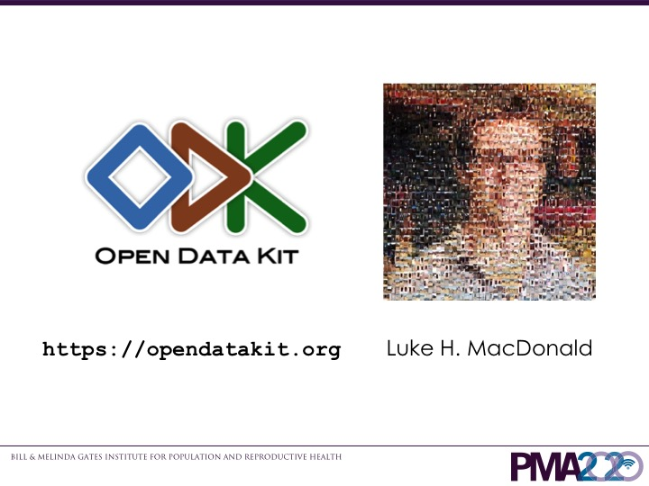
Notes:
All this work is done electronically on Android smartphones using the Open Data Kit platform, or ODK [ODK logo and website]. Why did we choose ODK? One of the original members of PMA2020, Luke MacDonald, had used ODK for a water survey in his previous work, so ODK was on his radar. Early on, Luke was able to meet ODK’s creators Yaw Anokwa and Carl Hartung, and they collaborated to get PMA2020 started.

Slide 42
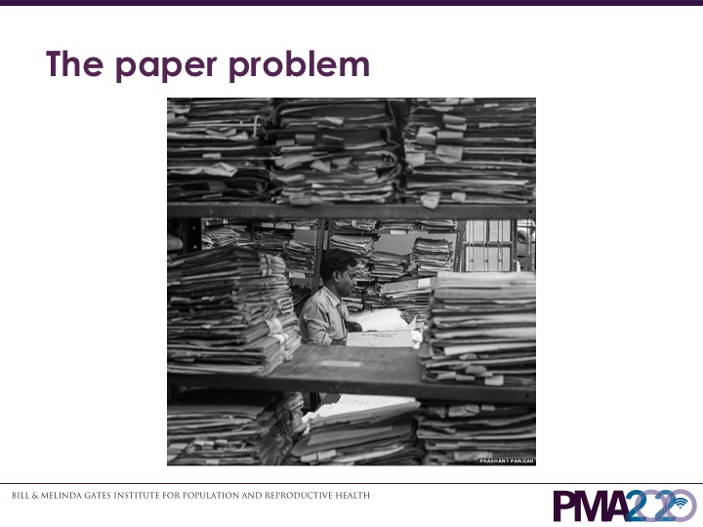
Notes:
ODK is a response to what Yaw Anokwa calls the paper problem. Throughout the world, people collect data on paper and store it in cabinets or on shelves. There are good reasons for that, but keeping data on paper is cumbersome, difficult to retrieve and review, and limited in availability. In a police department, how many case files involve a certain kind of crime? In a hospital, how many patients have a certain disease, and what treatments seem to be working for that disease? In a court’s case files, how many cases have been dismissed by which judges? These questions would take days to answer, and the more data on paper there is, the more impossible the task of finding answers becomes. This is why transitioning from paper to digital is crucial in today’s world. PMA2020 uses ODK to get high-quality, rapid-turnaround, and frequently captured data to get statistics at a national scale. PMA2020 would have none of those things that differentiate it if it were based on a set of traditional paper questionnaires.

Slide 43
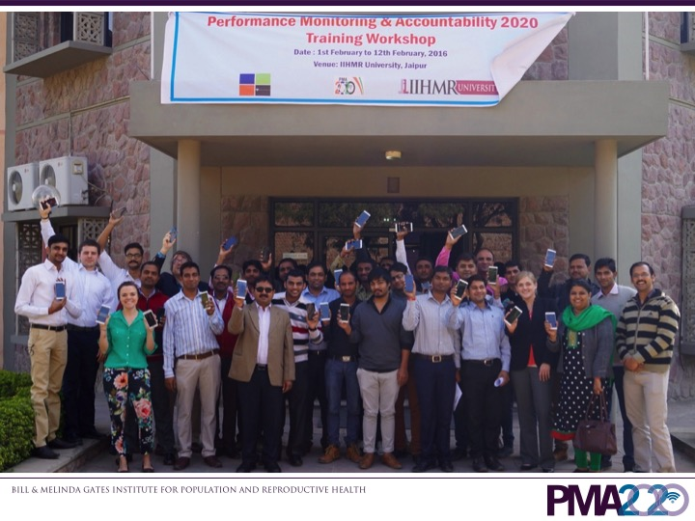
Notes:
We have a cascading training scheme for our project. Our central PMA2020 team in Baltimore chooses a partnering in-country research institution (for example, the Indian Institute of Health Management Research in India). We organize an initial training, sending several PMA2020 staff, to train their trainers and their supervisors. We train on our entire survey process, including how we utilize ODK. Our goal is that by the time we leave two weeks later, they can run the survey on their own. Once the villages and neighborhoods are sampled, the women are recruited and receive training from the supervisors at regional centers. Usually a single PMA2020 staff attends these regional trainings.

Slide 44
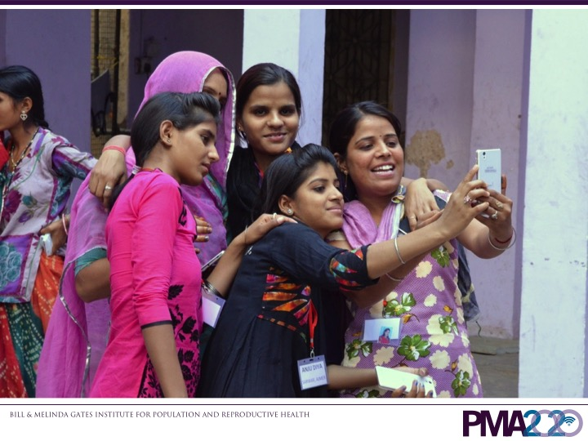
Notes:
At these trainings there is a fair number of people, supervisors and women, who have never used a smartphone before. Opening the new smartphones is always a joyous occasion, and shortly after, nearly everyone begins to take selfies.
This highlights one principle for going digital: Simplicity.
A lot of the women we hire come from cultures or backgrounds where education is not prioritized. For our trainings, we try to minimize the ways for errors to occur. In a group setting like our trainings, if one person’s phone is not working as expected, it slows everything down for everyone while we work on a fix.
Therefore, we handle the one-time setup processes. These are things like registering phones and collecting device information, installing apps, setting server URLs, typing in usernames and passwords. If it is something that needs to be done during fieldwork, we will train and practice as a group, otherwise, we trainers take care of it.
Surveys in ODK are also simple. The logic and calculations happen in the background so that the survey takers only have to read a question, enter in the respondent’s answer, advance to the next screen, and repeat. Contrast this with a paper questionnaire where there are directives to the interviewer to skip forward to certain questions based on certain answers.
Automated calculations, logic, and skip patterns combined with general on-the-spot data validation in ODK (for example, a positive number must be entered for age) provide immense cost savings. Getting the data correct the first time means that the need for cross-checking in the field, making small error corrections, or returning for complete redos is greatly reduced. The result is savings in time, money, and man-power.

Slide 45
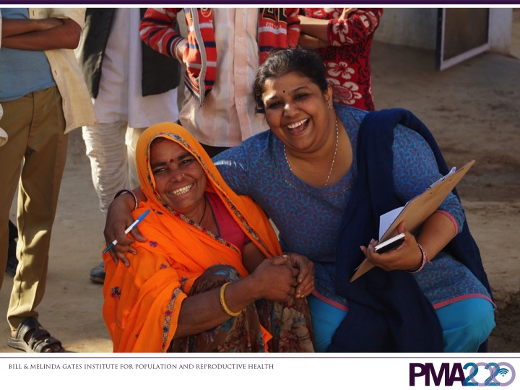
Notes:
Another one of our principles for going digital is joining a strong open-source community.
ODK is definitely a strong open-source community. From XLSForm for building questionnaires, to ODK Collect for administering questionnaires, to ODK Aggregate, the server for collecting filled-in questionnaires, to ODK Briefcase for retrieving resultant datasets from Aggregate, the software works harmoniously out of the box. Because of the ease of use, the community has grown explosively. It is easy to get help and solve problems with questions by using the mailing lists or reading the documentation
Let me highlight some of the efficiencies that come with the server, ODK Aggregate. The data are automatically joined together into a master dataset, completely bypassing the data-entry step in a traditional paper questionnaire workflow. Behind the scenes, ODK Aggregate builds the databases that store the information electronically. ODK Aggregate works easily with the Google Cloud, so database management is a non-issue. Anyone who has worked with his or her own database knows how many headaches come from a crash.
Because we use the ODK platform, we are able to train, collect data, and produce results in a matter of a couple of months.
Because ODK is open-source, we have been able to include extensions into the community version that allows for seamless date capture in the Ethiopian calendar system (as opposed to our Gregorian calendar system). We have other extensions such as automatic form linking and analytics. We are confident that as our needs evolve, we can adapt ODK to handle them. This way we do not need to retrain ourselves in a new platform midway through the project.

Slide 46
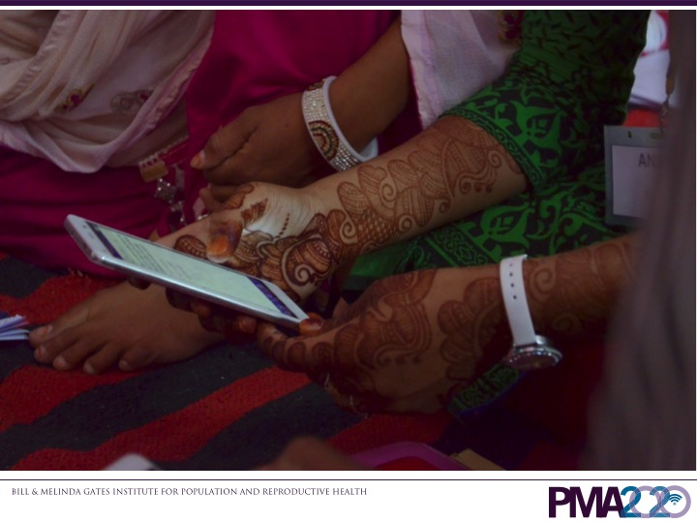
Notes:
A final principle is to think digitally
Originally in our budgets, we were planning for $200 per smartphone. Now, we can find high-quality smartphones in our partnering countries for $100 or less. Even in the poorest communities, there is usually cellular coverage. The upfront expense of purchasing a phone for each resident enumerator, and the ongoing expense of mobile data for form submissions will surely go down over time.
Because we use smartphones for our surveys, we can go beyond traditional paper-and-pencil survey taking. With each survey we collect a photo of the front of the structure. The photo is automatically attached to the questionnaire. We use the photo as an additional check that we are going back to the correct place between listing the structure as eligible and collecting household information in an interview. We also capture GPS coordinates at each structure. The GPS coordinates help us with quality assurance.
One of our next areas for development is to build a system to reduce duplication of efforts. We have program officers that maintain paper versions of questionnaires because it is easy to hold a questionnaire in hand and discuss it and train on it. The ODK questionnaires have to mirror what changes take place in those paper questionnaires, and a lot of effort is expired matching one to the other. Since we are thinking digitally, we plan to have one master source that can produce a paper version of a questionnaire and an ODK questionnaire simultaneously that match each other. Going digital means we can reduce duplicate effort and be more productive in other areas.

Slide 47
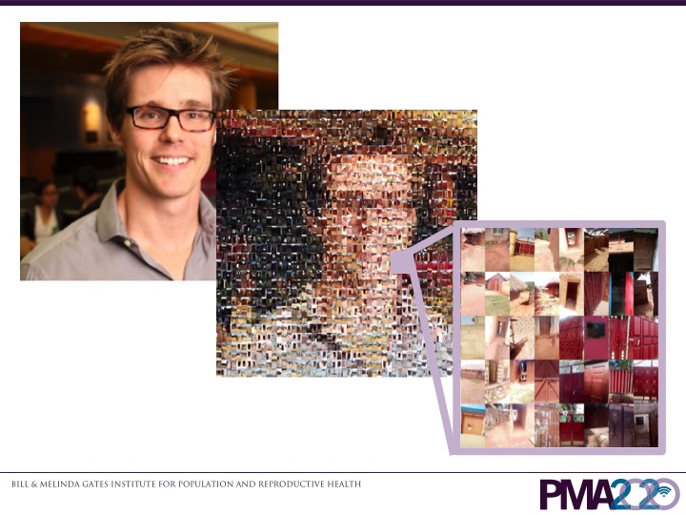
Notes:
I want to mention in more detail our door photos, and I am displaying a few here in the most interesting way I can think of, in a mosaic of Luke MacDonald. As the Android phones have gotten more sophisticated, so have their built-in cameras. With our first phones a few years ago, the photos were approximately 0.5 megabytes in size. Contrast that with a phone from this year that creates photos 2.5 megabytes in size. Before we made corrections, we were having our resident enumerators send a photo with each form in their often remote areas with spotty internet and mobile service coverage. This began to eat into our mobile data budgets, and the resident enumerators were often getting frustrated at not being able to send everything successfully. Since ODK is open-source, we were able to modify the source code so that the photos are guaranteed to be less than 100 kilobytes in size, a much lighter file to send over the network. This makes the work more efficient, happier, and cheaper.

Slide 48
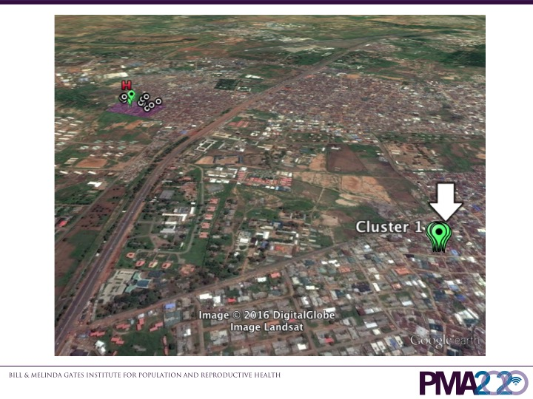
Notes:
Collecting GPS points with our questionnaires lets us perform some easy data quality checks. By far, the collected GPS points confirm that our resident enumerators are doing their jobs correctly. Every once in a while we see something that is not right. Here for example, the resident enumerator should have done her work and collected GPS points in the purple box in the upper left. Instead she collected her GPS points for most of her questionnaires in the bottom-right. Since the GPS points were there, it is likely that she filled in the entire questionnaire there as well. The supervisor was able to discuss the issue with her and get things straightened out.
With paper questionnaires, we have no way to do a check like this. Except for through diligent supervision, it is impossible to know what happens after we send them out and before we collect the results. Having gone digital, we can use ODK to give us a slightly better sense of what is happening.

Slide 49
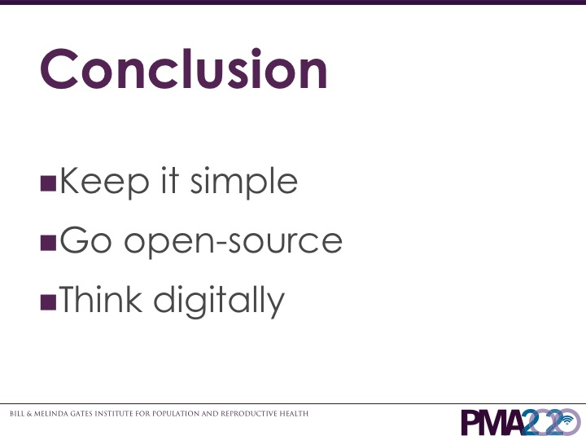
Notes:
Going from paper to digital provides many benefits. There are cost savings due to the simplicity of the platform. We require less effort because we use ODK to perform data quality checks and automatically manage skip patterns. This translates to less training needed and more focus on the content areas, like family planning. We have less maintenance work to do because ODK is a complete package. we don’t have to worry about managing databases, and the data are automatically joined together into a master dataset. We are not limited to the constraints of paper. We are able to collect multiple kinds of data easily such as photos and GPS coordinates along with the questionnaires. We live in the era of big data, and we at PMA2020 collect data on female health and family planning in 10 countries to make sure policy-makers and interested organizations know where to focus their efforts. Without going digital this would not have been possible on such a large scale.

Slide 50
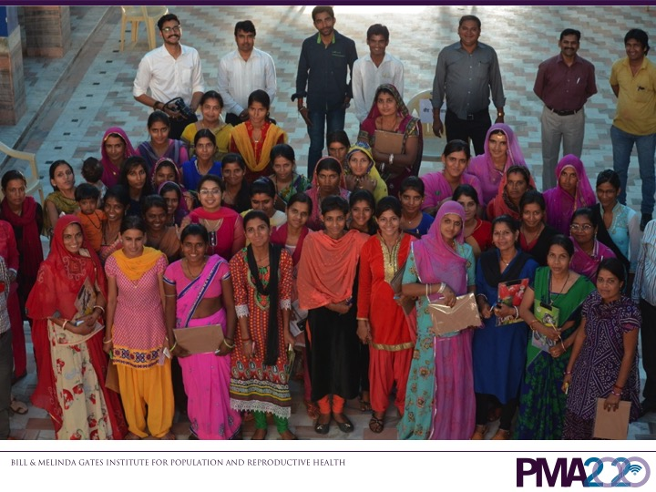
Notes:
Thanks!

Slide 51
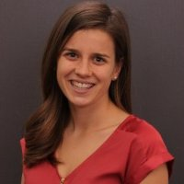
Katherine Stanfill
is a recent Master’s of Public Health graduate from Emory University, Rollins School of Public Health. She has a technical background from Ohio State University, with a degree in biomedical science focusing on medical research. Throughout her graduate studies, she worked in the field of mHealth at the Center for Global Safe WASH (Water, Sanitation, and Hygiene).
She worked to use mobile phone technologies to provide monitoring and evaluation of water systems in healthcare facilities in Cambodia and Uganda to improve performance, results, and impact. Katherine utilized a variety of technologies, most notably CommCare, to collect data, synthesize incoming information, maintain data management, conduct data analysis and produce reports for global stakeholders, including Cambodia’s Ministry of Health.
She focused her graduate coursework on the fields of WASH and Complex Humanitarian Emergencies. Katherine has a passion for implementing technology into the clinical sphere.

Slide 52
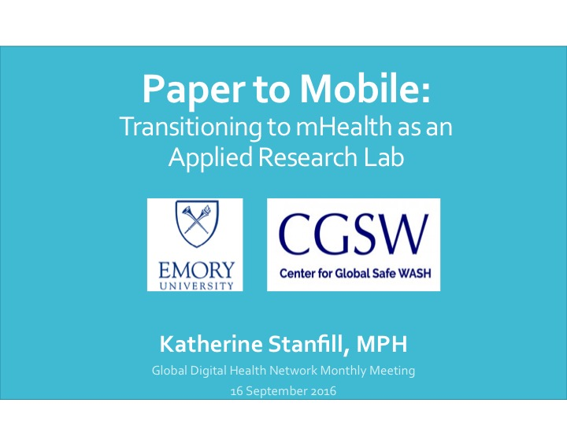

Slide 53


Slide 54
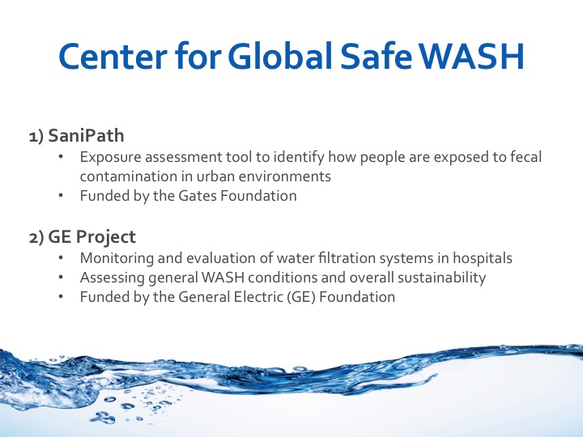

Slide 55
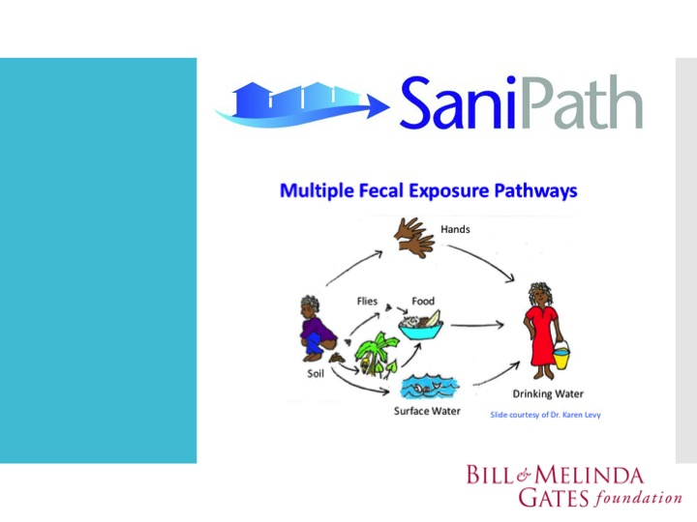

Slide 56
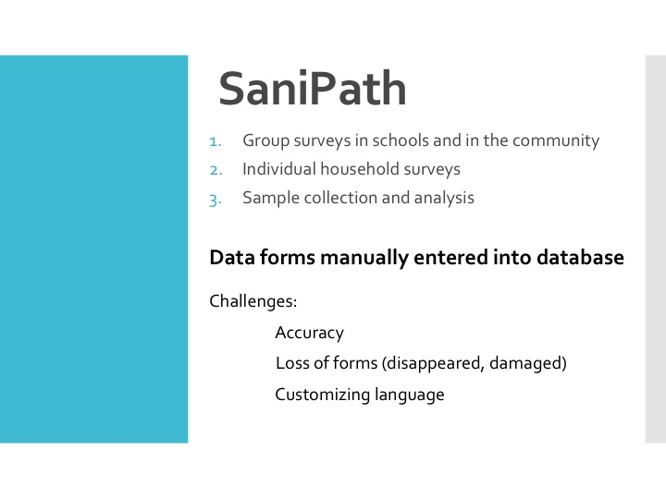

Slide 57
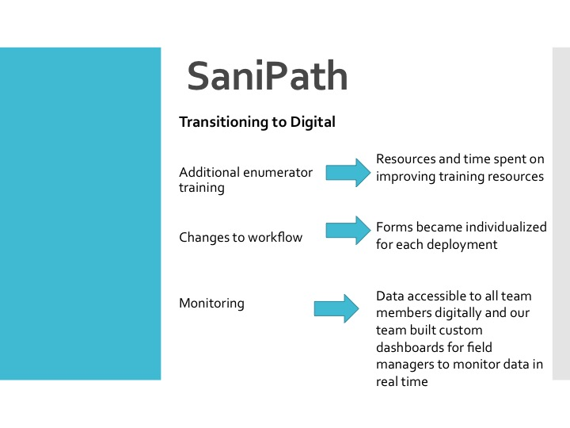

Slide 58
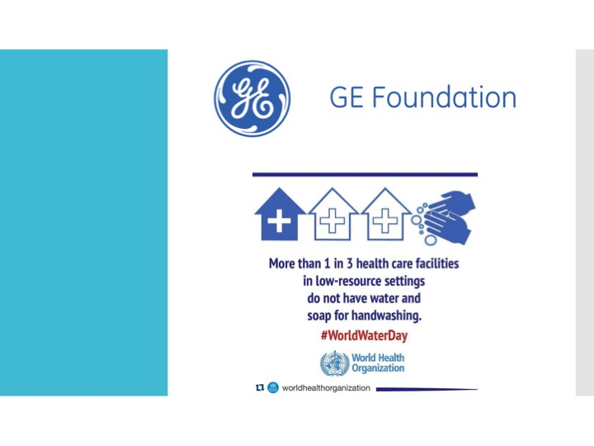

Slide 59
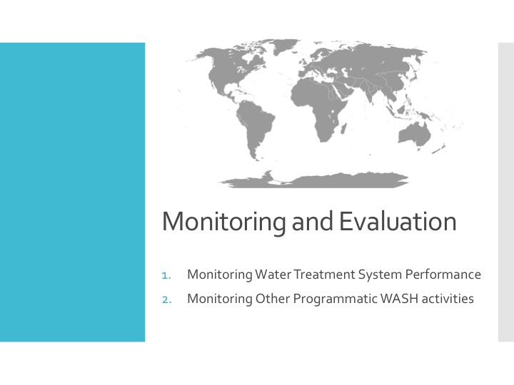

Slide 60
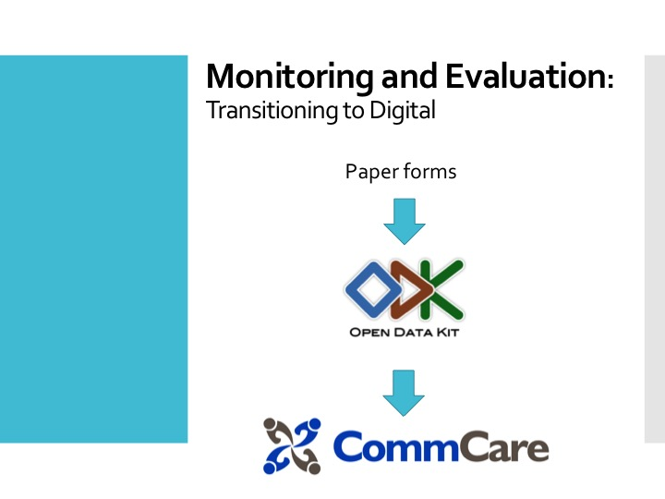

Slide 61
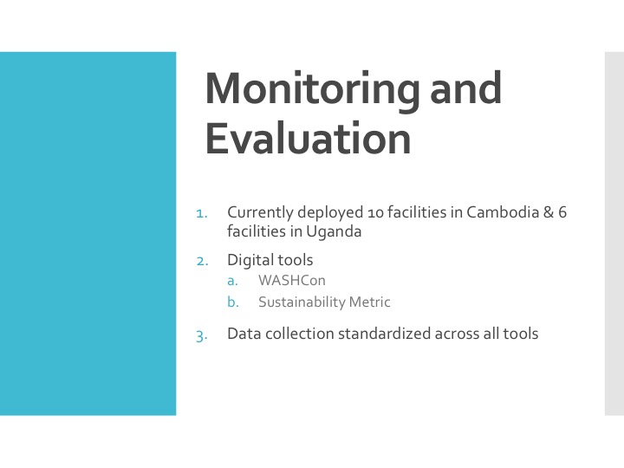

Slide 62
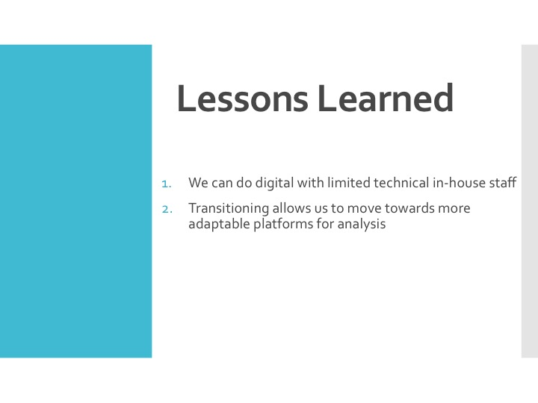

Slide 63


Slide 64


Slide 65


Slide 66
October 21st next meeting
Registration now open for the Global Digital
Health Forum December 13th & 14th

