Slide 1
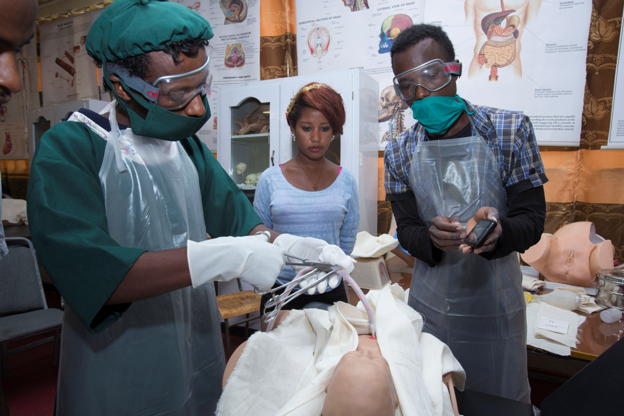



BEmONC learning:
So many tools! What to choose and how to use!
Notes:
Peggy: Thank you for joining us for the “BEmONC Learning: So many tools! What to choose and how to use!” session, presented by Jennifer Breads, Technical Advisor at Jhpiego; Tara Talvacchia, mHealth Manager and Anne Marie Frokjaer Barrie, Head of Development Programs at Maternity Foundation; and Carolyn Moore, Acting Director at mPowering Frontline Health Workers.

Slide 2
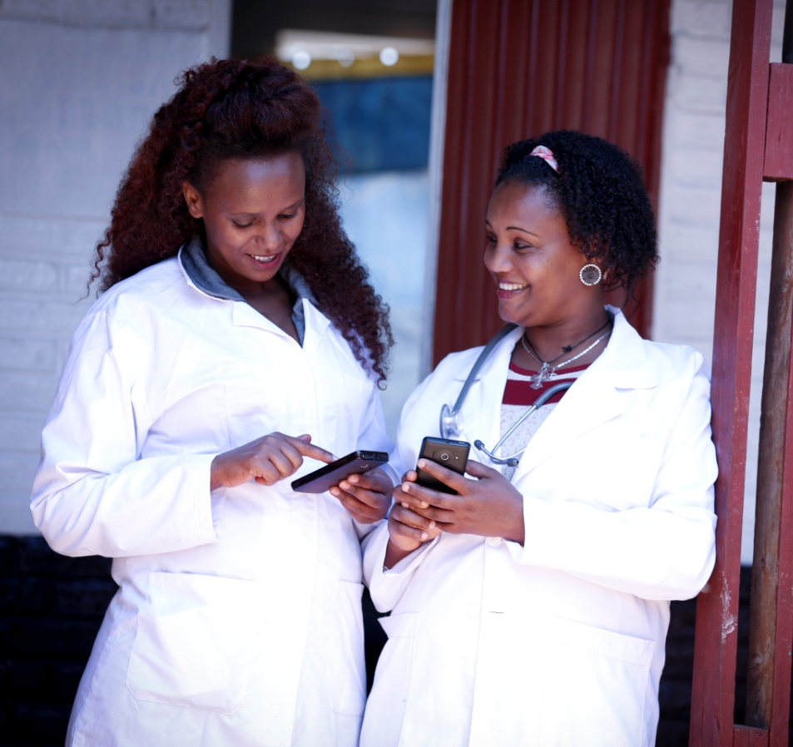
Session Objective
Demonstrate how to integrate digital and non-digital tools with proven best practices in BEmONC (basic emergency obstetric and neonatal care) capacity building approaches.
Notes:
Peggy: The purpose of this session is to demonstrate how to integrate digital and non-digital tools with proven best practices in BEmONC capacity building approaches. The presenters will be showing you models such as MamaNatalie - a birthing simulator that makes it easy to create simulations of complex or normal birthing scenarios, digital tools such as the Safe Delivery App by Maternity Foundation, Jhpiego's eLearning modules, mPowering’s ORB platform, and others. In addition, we will briefly describe other job aids and resources such as the Jhpiego-led Helping Mothers Survive Secretariat’s action plans and flipcharts and even a maternity clinic game that providers sit down to “play.” The format of this session is a brief introduction and overview of the organization and their tools, followed by a skit that takes place in a pretend facility BEmONC in-service training. Then the presenters will offer concluding remarks, and then we will turn it over to you for questions.

Slide 3
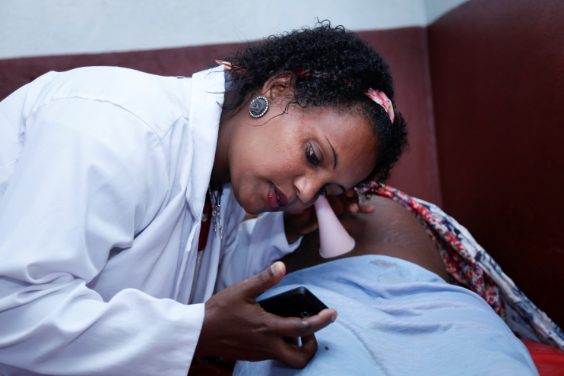
What do we mean by BEmONC?
Basic emergency obstetric and newborn care (BEmONC) is defined as 7 essential medical interventions, or ‘signal functions,’ that should be available to all women at the time of birth to address the common but unpredictable major causes of maternal and newborn morbidity and mortality.
Notes:
Carolyn: reads/ presents the above slide prior to sharing about mPowering.

Slide 4


mPowering Frontline Health Workers
Who We Are
A partnership of private sector, government, donors, and NGOs
Our Mission
  Help end preventable maternal and child deaths by accelerating the use of mobile technology to improve the performance of frontline health workers
How we are doing this
  Increasing government led collaboration, and building capacity in-country to ensure high quality, sustainable, and scalable health education and training for Frontline Health Workers (FHWs)
Notes:
Carolyn

Slide 5
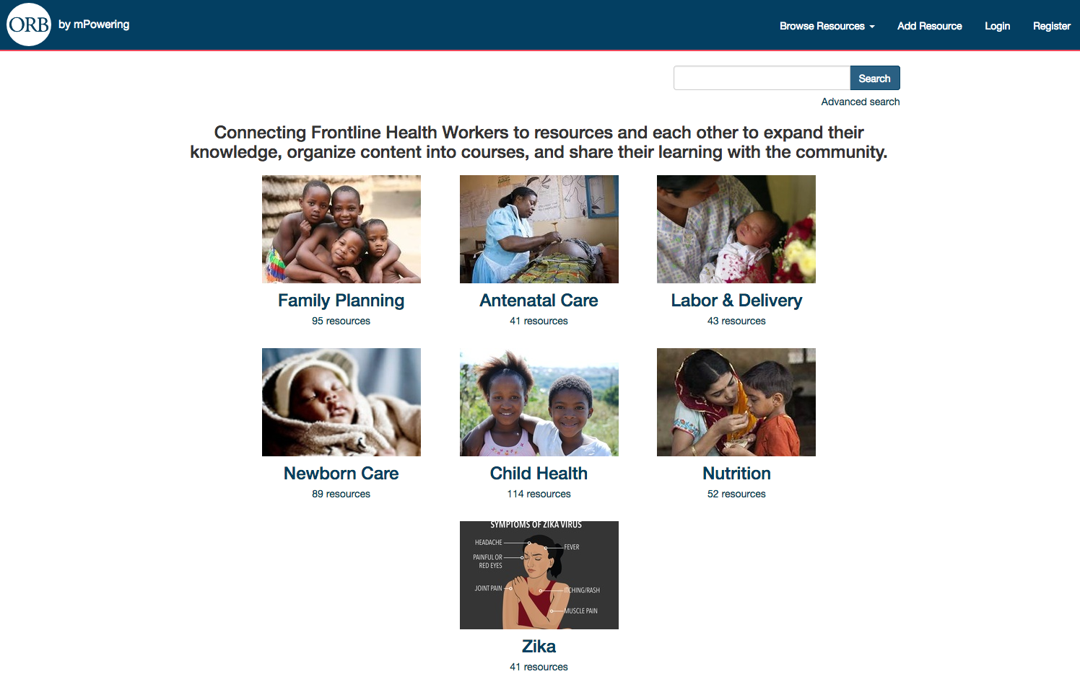
ORB
Notes:
Carolyn

Slide 6
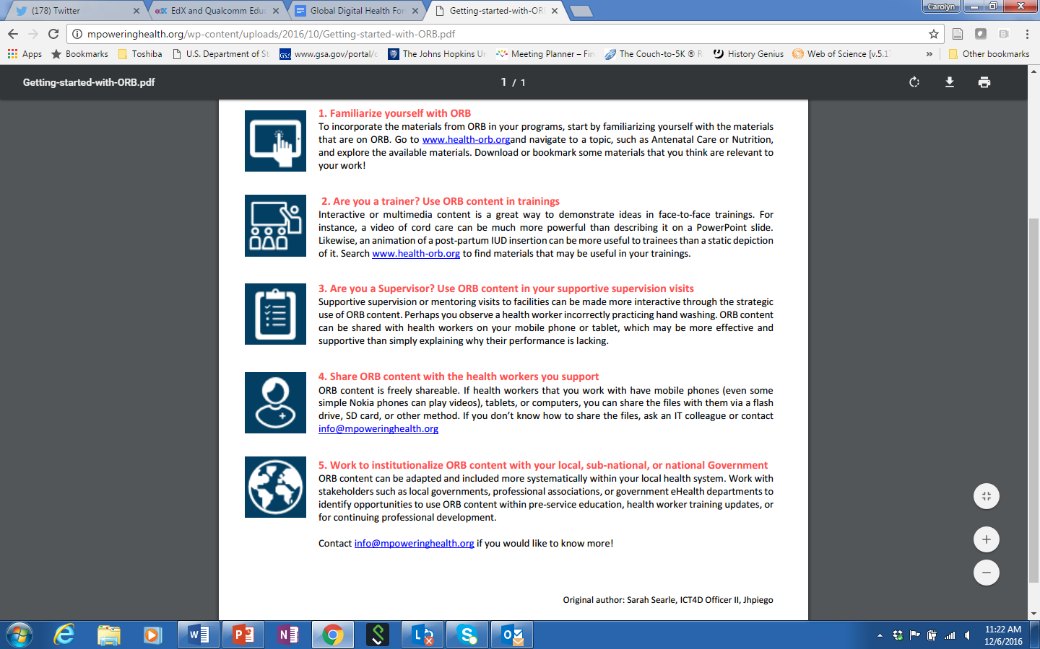
Using ORB Content
Notes:
Carolyn

Slide 7
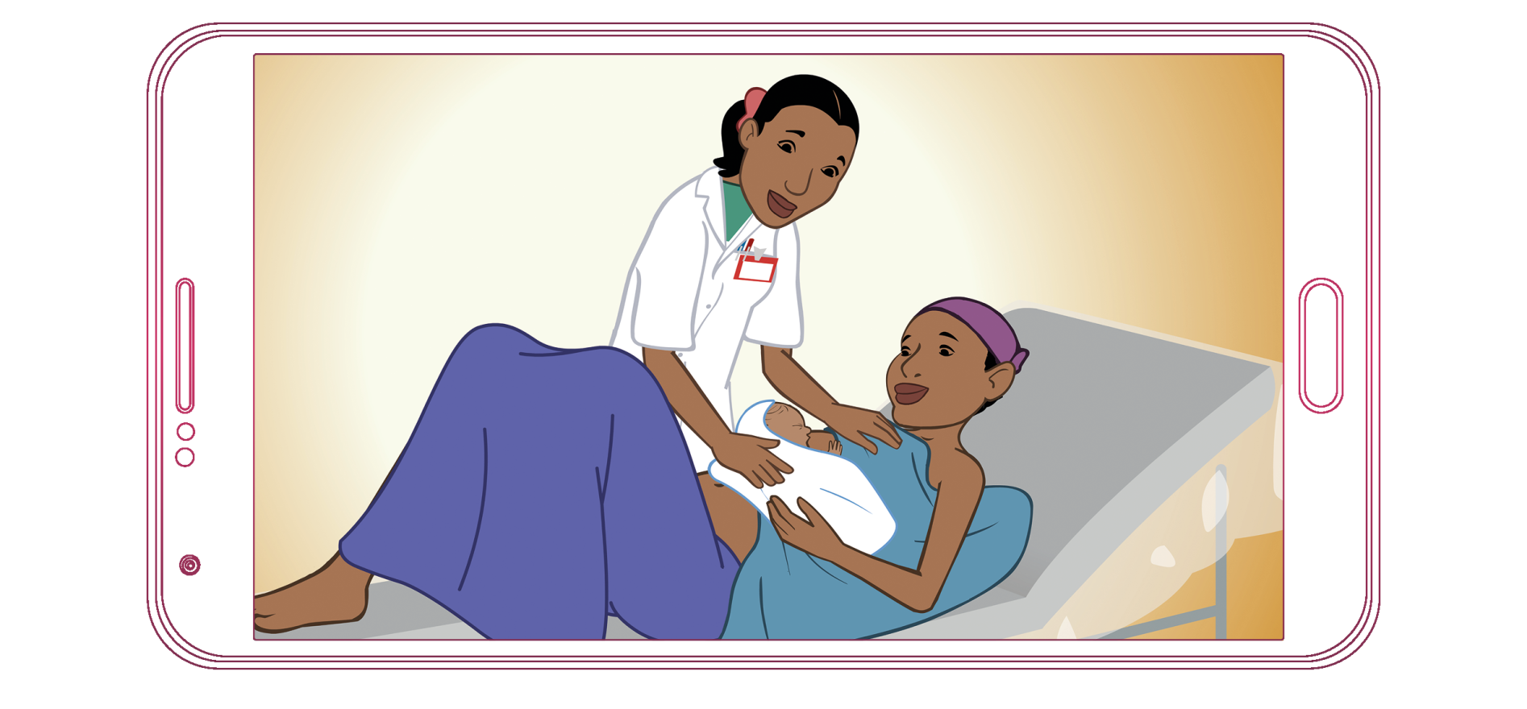



Maternity Foundation
The Safe Delivery App
Notes:
Anne Marie.
In 2012 Maternity Foundation and the Universities of Copenhagen and of Southern Denmark developed the Safe Delivery App.
The SDA is an application for smartphones or tablets, that provides frontline birth attendants in LMICs easy access to the clinical guidelines that they need in order to timely recognize and correctly manage life-threathening complications during labour.

Slide 8







The Safe Delivery App
Evidence - RCT published in JAMA Pediatrics demonstrates App is effective method to improve & sustain knowledge & skills.
Based on global clinical guidelines and validated with an international group of global health experts
All 7 Basic Emergency Obstetric and Neonatal Care Signal Functions distilled into the most essential information and protocols
Simple, animated, concise videos for low-literacy settings
No internet required for use & available for free
Easily translatable & adaptable to ensure guidelines are contextualized and up-to-date
Overcomes traditional barriers related to low literacy, distance, capacity & funding
Notes:
Anne Marie:
2013 – 2014 – impact of SDA on HWs skills and knowledge development was tested in RCT in Ethiopia. Strong evidence that the App can actually dramatically increase skills and knowledge in HWs. Tendential evidence, but not statistically significant, that it can reduce perinatal mortality too.
Based on Global clinical guidelines and content validated by Delphi group of international RH experts
The approach was to distill each of the procedures into the most essential key points, and build the clinical instructions around those- using a communication form that address barriers of low literary: this translated into simple, concise and animated instruction videos addressing all 7 signal functions – as well as 3 preventive protocols.
Other advantages of the SDA is that it is not dependent on internet or network – as long as the device is charged, you can use the app.
It is available for free, it can be context adapted to different country contexts.
As a training tool it overcomes many of the traditional barriers related to low literacy, the need for blended learning approaches and less classroom training and more.

Slide 9
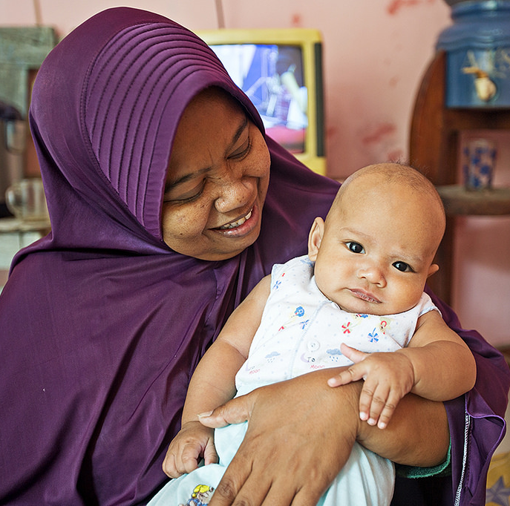
About Jhpiego
Non-profit global health affiliate of Johns Hopkins University
Over the past 43 years, Jhpiego has worked in over 150 developing countries
To prevent the needless deaths of women and their families
Notes:
Jen:
For those of you who don’t know Jhpiego, we are an international NGO affiliated with Johns Hopkins. Over the past 43 years, our over almost 4,000 employees, including countless physicians, nurses and nurse-midwives, have worked in 150 countries to carry out one simple mission…
To prevent the needless death of women and their families in the developing world.

Slide 10








Jhpiego’s Expertise
Maternal & Child Health
HIV/AIDS
Malaria Prevention & Treatment
Family Planning
Family
Planning
Innovations
& Treatment
Education &
Quality Improvement
Infection
Prevention
Innovations
Cervical Cancer Prevention & Treatment
Infection Prevention
Notes:
Jen
From our origins as technical experts in reproductive, maternal and child health, Jhpiego has grown to embrace new challenges, including HIV/AIDS, malaria and cervical cancer prevention—reflecting the increasing interconnectedness of women’s health. Because we recognize one health worker or a team of health workers are usually responsible for efforts across many of these areas at the same time, we place special focus on integration and strengthening health systems.

Slide 11
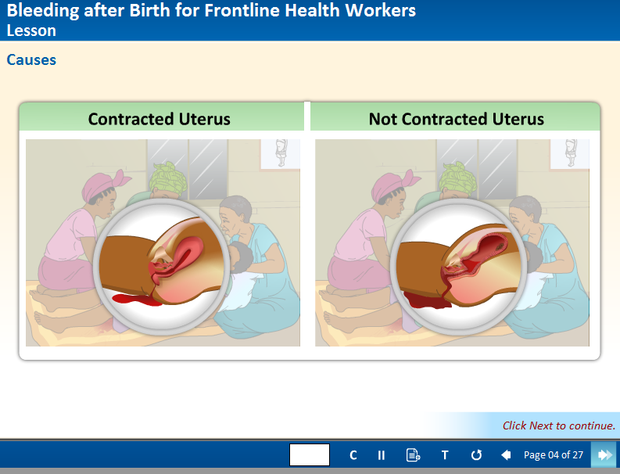
eLearning Modules
Module Name | Target audience
PE/E | MD, CNM, RN
PPH | MD, CNM, RN
Prolonged and Obstructed Labor | MD, CNM, RN
Essential Newborn Care | MD, CNM, RN
Puerperal Sepsis | MD, CNM, RN
Post Abortion Care | MD, CNM, RN
Bleeding After Birth | CHW
Danger Signs in Pregnancy | CHW
Family Planning | CHW
http://reprolineplus.org/learning-opportunities/course/managing-postpartum-hemorrhage
Notes:
Jen
The eLearning modules were developed in 2012 through a collaboration with Jhpiego/UNFPA/Intel/WHO. There are 9 modules that reflect WHO IMPAC materials and address top causes of maternal mortality worldwide. 6 of the modules target skilled birth attendants and 3 target CHWs. These modules are intended for use by Ministries, schools, facilities, and individuals. They offer a good way to provide practice prior to entering clinicals… or as a “booster” for experienced clinicians, and can be helpful for skills standardization or clinical updates. (Nursing and midwifery councils may consider having these be approved as CEU’s.)
Material is downloaded at no charge from Reproline Plus or distributed via USB’s, in which case you need Flashplayer (internet) to use them. OR, you need someone who can set up a local server, load the modules onto Moodle or a similar host platform, and have users create a personalized account to take the modules.
[In that case (like in Ghana), there is exciting potential to use back end data to track the pre/post assessments. A teacher can ping learners who have not yet completed the modules, or identify those who are struggling with the content. Lots of potential! But we haven’t worked out the kinks, and the lack of interoperability of online learning platforms makes it tricky for Ministries to pick these up and run with them.]
http://reprolineplus.org/learning-opportunities/course/bleeding-after-birth-frontline-health-workers

Slide 12
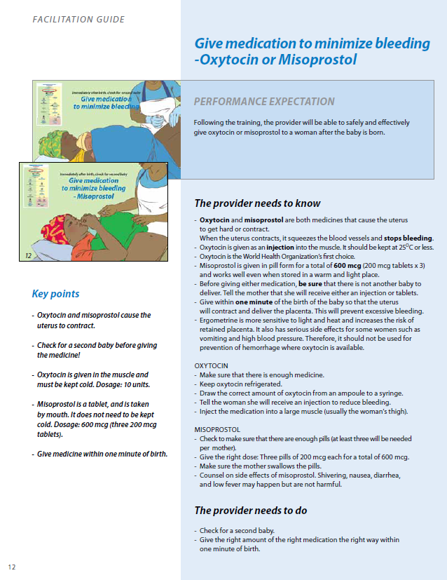
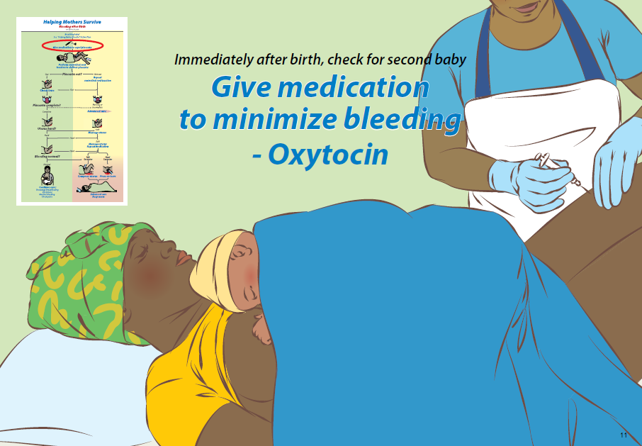

Low-dose, high-frequency learning: HMS example
Action Plan
Providers Guide
Flipbook
Notes:
Jen
Jhpiego is also the Secretariat of HMS, which is a global consortium that promotes a suite of hands on, simulation and team based modules, that utilize Jhpiego’s signature Low-dose, High-Frequency approach to capacity building, which involved short targeted sessions of learning during repeated frequency intervals at the worksite.
HMS materials are highly graphic and include:
the Action Plan which is a teaching tool and job aid (click)
Flipbook for training, and (click)
a Providers Guide for both facilitators and learners
Modules include: BAB, PE/E, Advanced Shock Mgmt, NLB & CLB
Material is available at no cost for download on the HMS website.

Slide 13

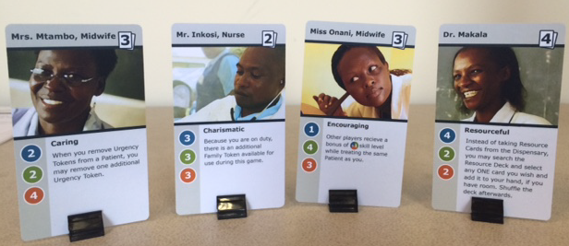
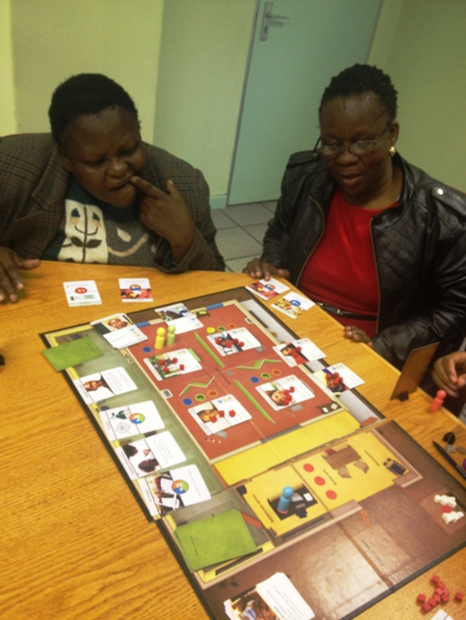
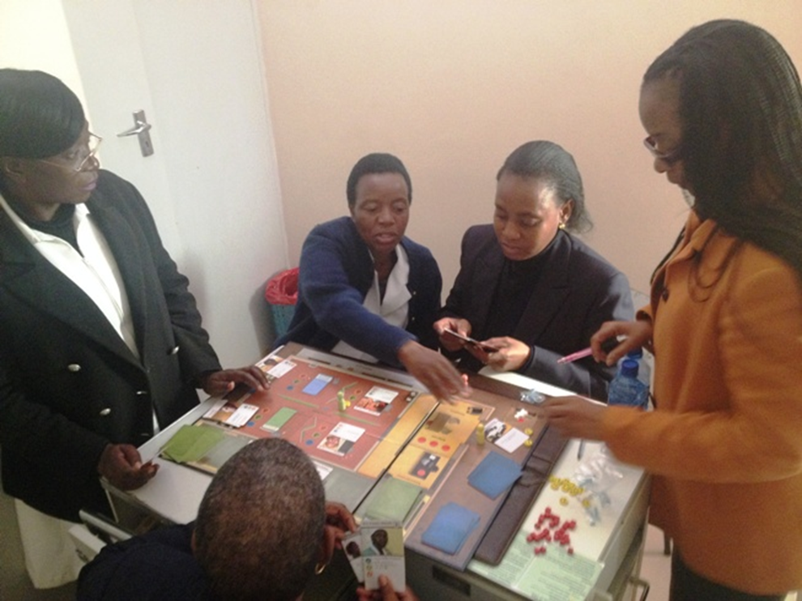

Serious Games: Maternity Clinic
Notes:
Jen
Jhpiego has also pioneered work in developing “serious games.” This game is intended not as a clinical learning tool (learning dosages of medications, for example) but rather as a way to improve and increase teamwork, collaboration and efficient use of clinic resources in a maternal health setting
30 minutes to play
Game goal = treat and discharge patients through teamwork and communication.
It was showcased at the Global Maternal Newborn Health Conference in Mexico City last year. Jhpiego technical experts especially in east and southern Africa provided inputs to the clinical aspects of the game, to help ensure that the game does not contain inaccuracies.
[One exciting potential that we have yet to explore in the field is also to use the game as an advocacy tool (play with Ministers and HR managers to demonstrate why having a full team of “players” at the clinic is so vital to patient outcomes).]

Slide 14
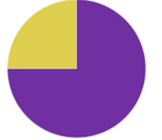



The need for improved skilled birth attendance & quality of care
Globally 3/4 of women now deliver with assistance from a skilled birth attendant.*
However, quality of care remains a pressing issue. Many facilities lack emergency obstetric care and fail to provide respectful, evidence-based routine care.
This is a direct result of the fact that many skilled birth attendants do not have the skills and knowledge needed to prevent the leading causes of maternal and neonatal death.
Millions of women receive services that are delayed, inadequate, unnecessary, or harmful, minimizing the opportunity for health gains for both mothers and babies.
*According to the September 2016 Lancet Maternal Health Series
Notes:
Jen: (Read the slide and then-) The tools that I have just shared, and those shared by Carolyn, Tara and Anne Marie help to address the need for improved skilled birth attendance and quality of care by enhancing BEmONC trainings to ensure that skilled birth attendants practice critical life-saving skills; and transfer their knowledge and skills to their clinical sites. The topic that we chose for this session is Postpartum hemorrhage (also called PPH) is when a woman has heavy bleeding after giving birth. We will now demo these tools using the example of PPH.

Slide 15
2. DEMONSTRATION
Notes:
Peggy: It’s now time for the demonstration portion of our session. The skit that takes place in a facility BEmONC in-service training. It is a simulated skills training in a facility with a midwife, assistant, instructor and patient wearing the MamaNatalie simulator. The goal of the skit is to demonstrate that there are a wide variety of strong tools and resources that can be used and integrated into BEmONC training in a variety of ways. In this case, the MamaNatalie simulator will be used to demonstrate skills on, and the following tools will be integrated into the skit- the Safe Delivery App, LDHF approaches/job aides, maternity clinic game, Jhpiego's eLearning modules, ORB platform, and potentially others.
[The assistant is seated in the front row of the audience at the beginning of the skit, while the midwife, instructor and patient are standing in the pretend skills lab on stage/ in the front of the room.]

Slide 16
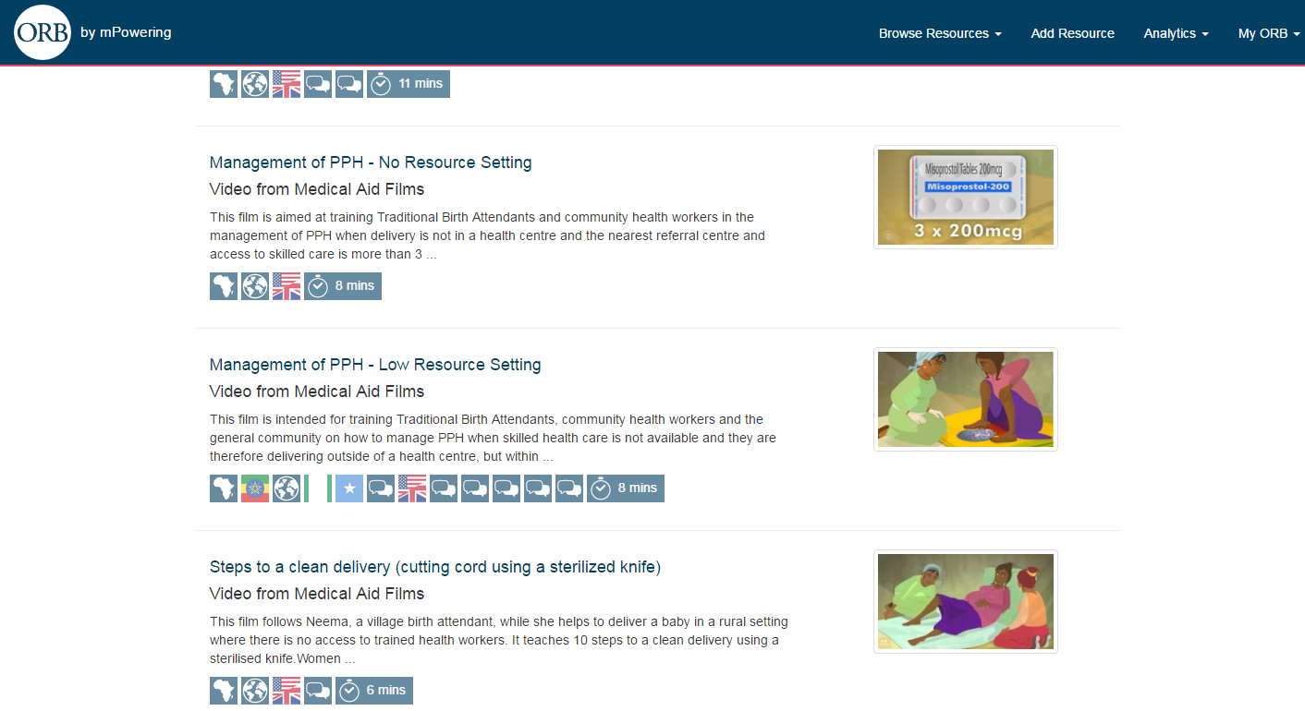
Overview of PPH
Notes:
Carolyn: First, let’s start with an overview of management of PPH. This film, from ORB, will show you how a skilled birth attendant manages PPH in a low-resource setting.

Slide 17
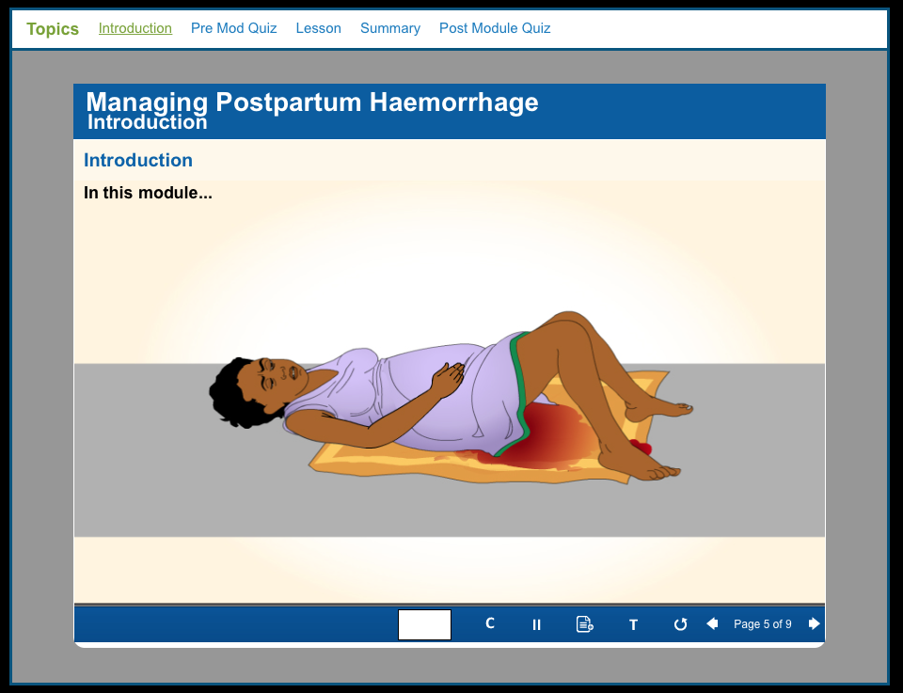
eLearning Module
Notes:
Carolyn: You’ll see that the attendant goes through a number of steps to learn how to prevent, recognize, and manage PPH. Now, Jen will show you how to perform the steps you saw in this film.
Jen: It is time to learn about PPH. We have different resources to introduce you to. We are going to start the lesson. Let’s first take a closer look at digital resources. This is an eLearning module. I am going to walk you through and explain what it is and how to use. You will be able to access it on the computer.

Slide 18
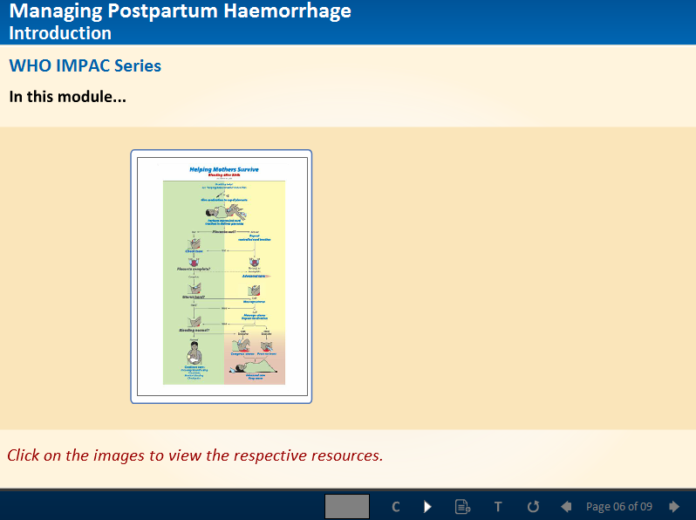
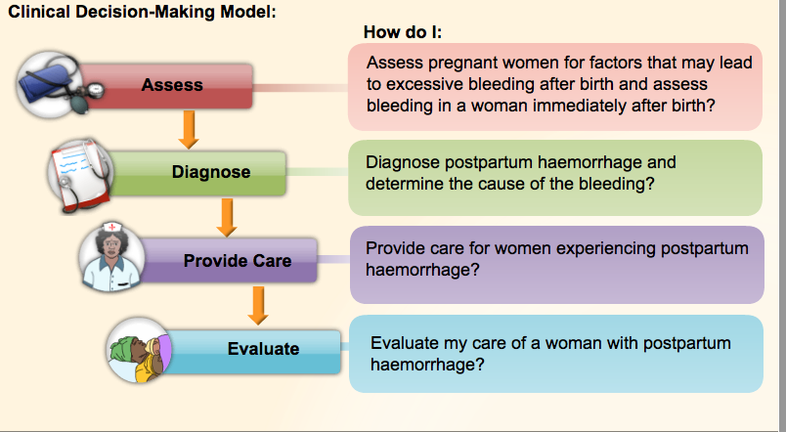
Notes:
Jen- You will go through the case studies presented to you using this Clinical Decision-Making Model. You will assess, diagnose, provide care and evaluate. These are the type of questions that you will ask as you go through each step.
This module links to the Action Plan from the HMS BAB module, which you can always refer to at our worksite here.

Slide 19
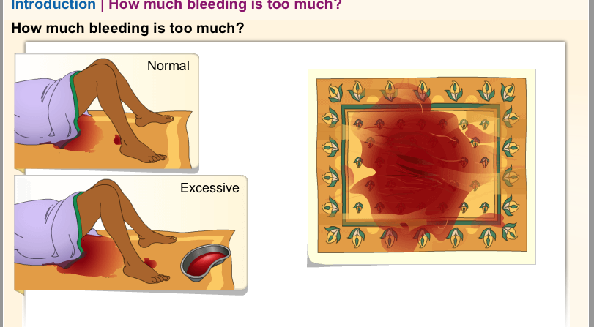
Notes:
Jen- You will go through a series of case studies to assess and determine how to manage PPH caused by retained placenta and uterine atony

Slide 20
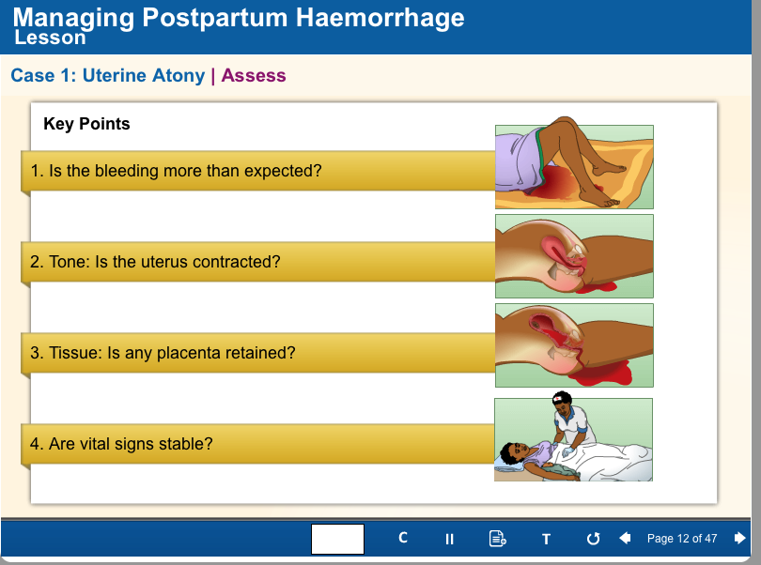
Assess
Notes:
Jen- There are several causes of excessive bleeding after birth and therefore, a thorough assessment is critical. You will learn that these are some of the key points to assess for uterine atony. We must check: is the bleeding more than expected? Is the uterus firm and contracted? Is the bladder full? Is the woman’s condition stable or are her vital signs trending toward shock (increase HR, decrease BP)? The eLearning module continues with information to help learn what to do.

Slide 21
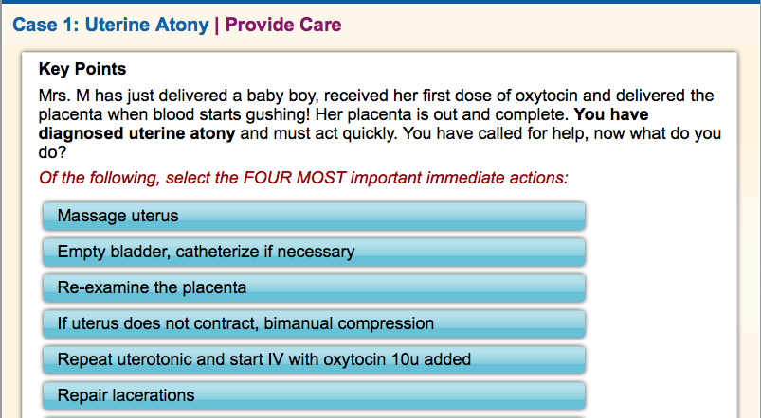
At the end of the lesson…you will be asked to choose FOUR. Pay attention.
Notes:
Jen- At different points in the module, there will be knowledge checks such as this. They check if you learned those key points that were introduced to you in the module. You will have to answer them before you go to the next part. The upcoming simulation that we are going to do will discuss some of these actions. Pay close attention to these points because at end of this session we may come back and quiz you on it!
[Answer: Massage uterus, empty bladder, bimanual compression, repeat uterotonic]

Slide 22
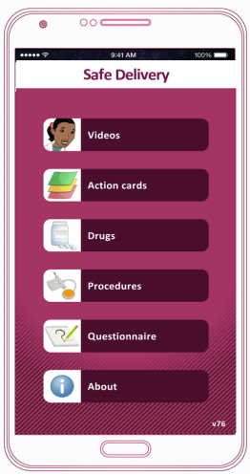
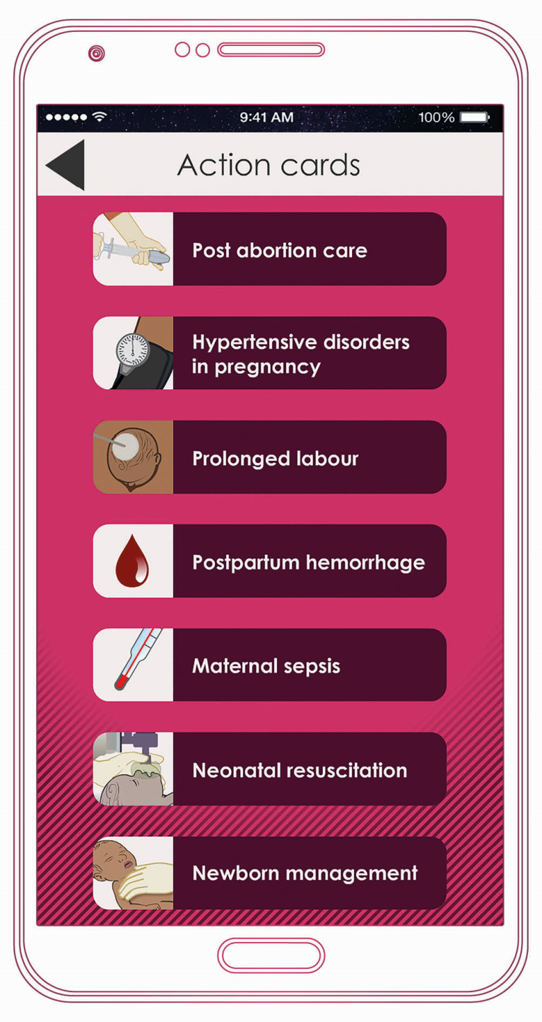
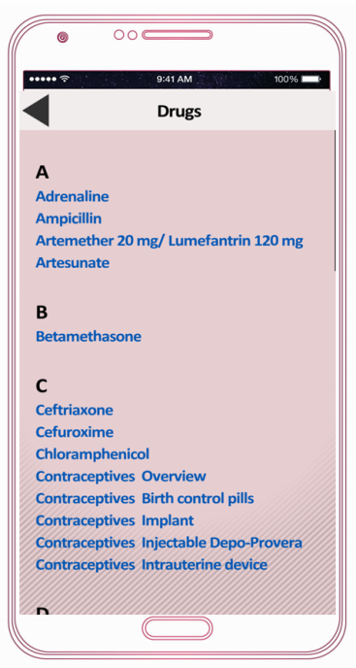
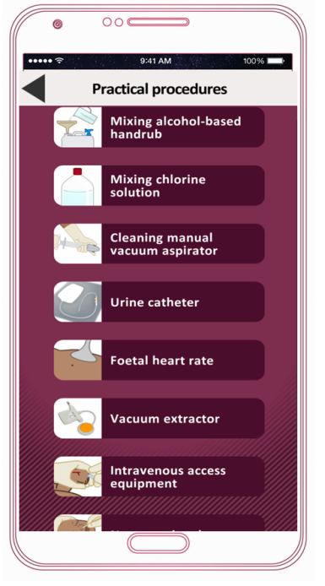
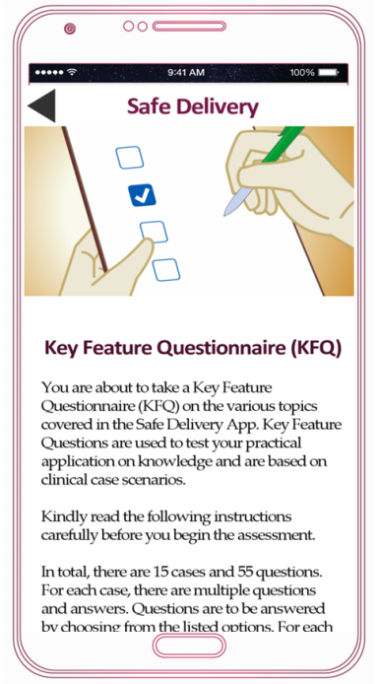
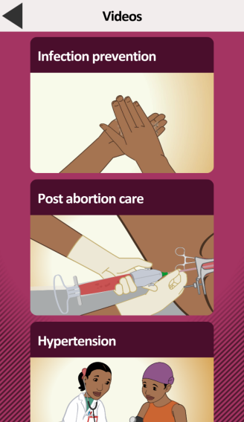
Which together form an integrated learning platform
The Safe Delivery App has 5 features
Videos
Action cards
Drug list
Practical procedures
Assessment
Notes:
Tara- Hello, let me introduce to you another tool you can use to manage PPH, the Safe Delivery App. The Safe Delivery App has five features- the videos, actions cards, drug list, practical procedures and a knowledge assessment.

Slide 23
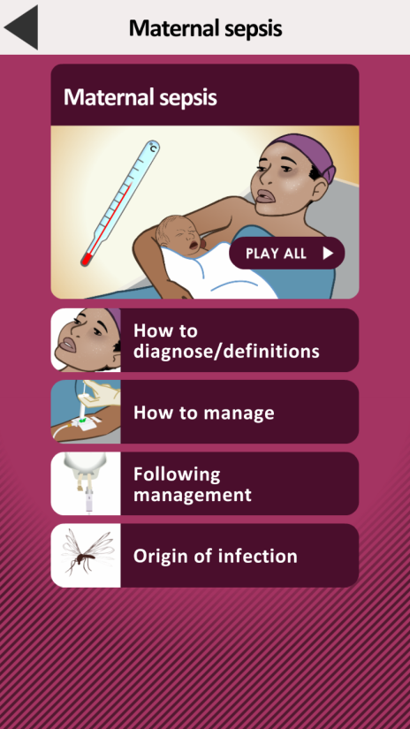
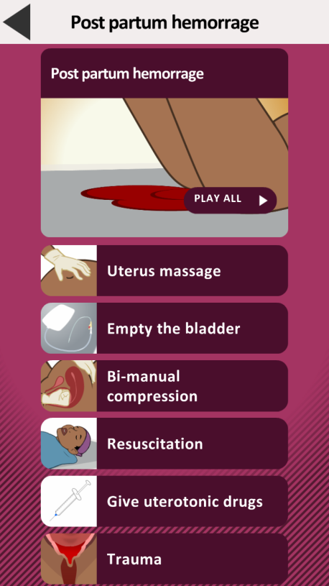
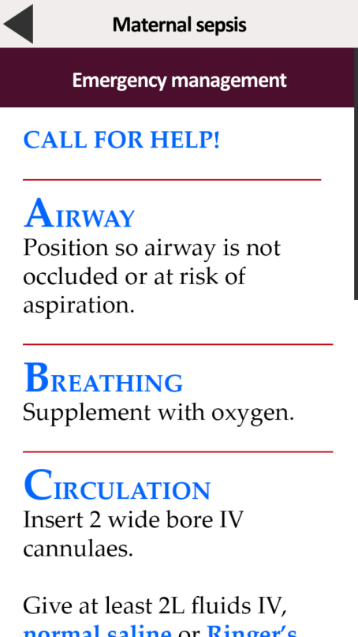
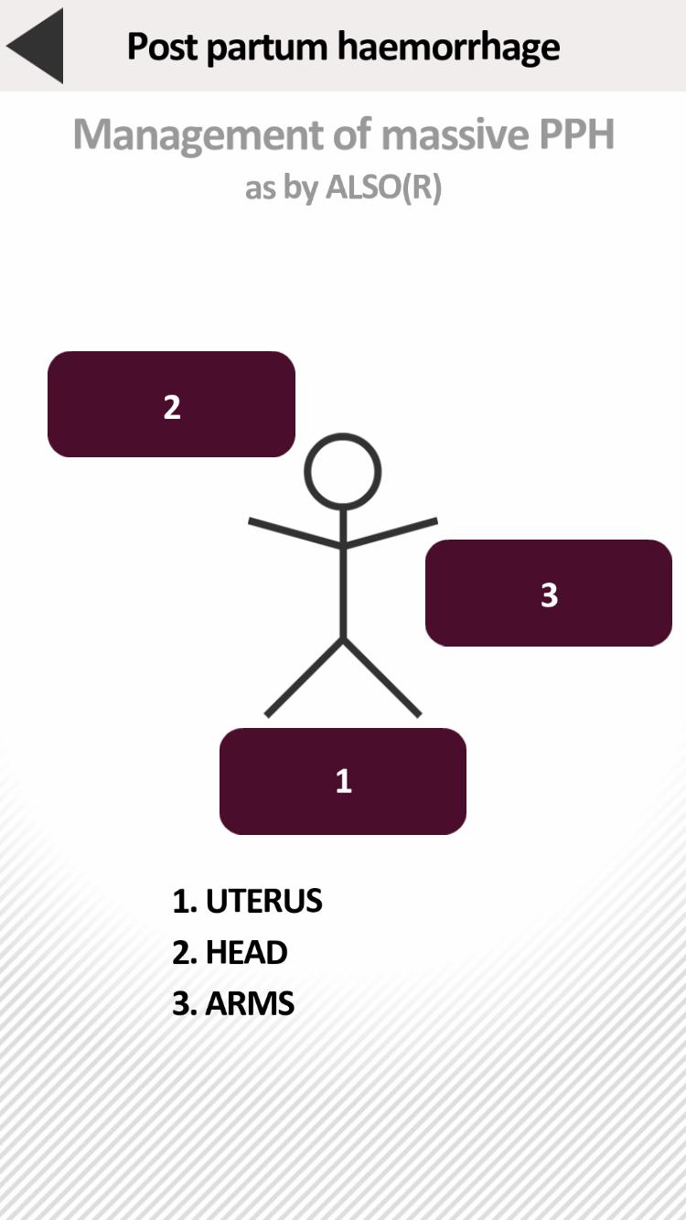
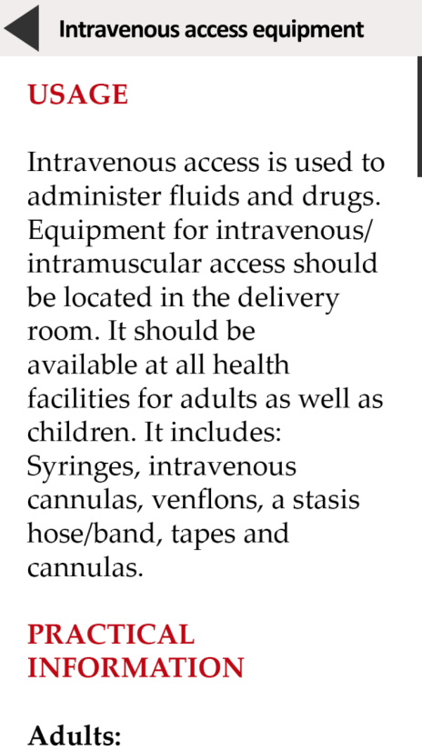
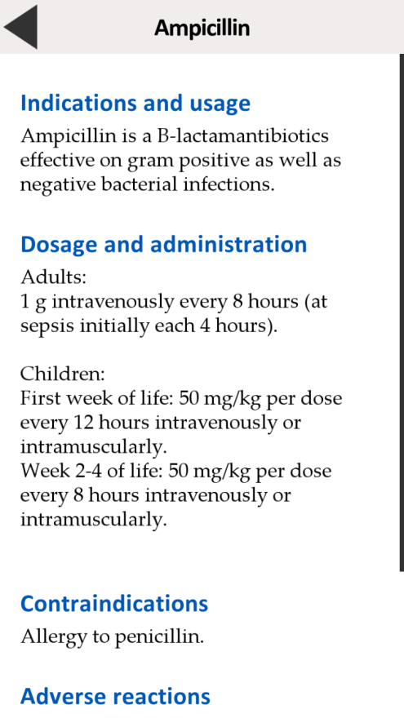
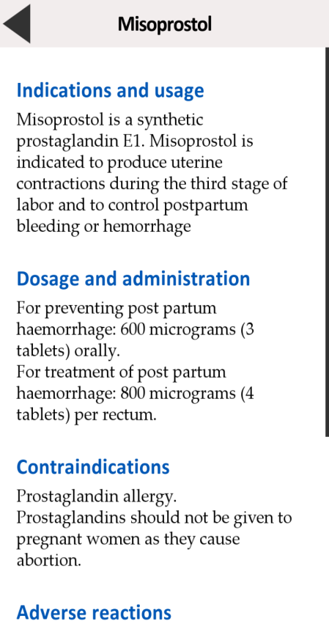
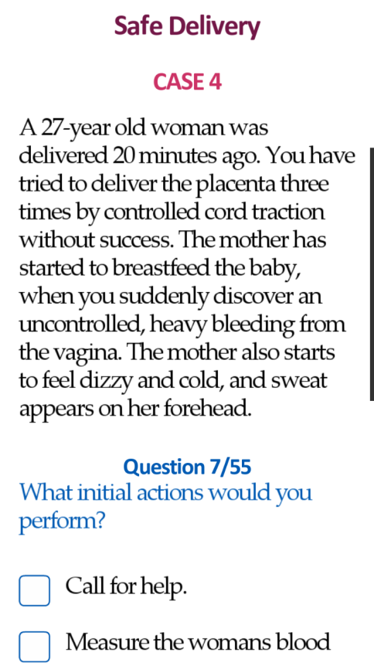
Integrated Learning Example: PPH
Watch videos
on diagnosis, management, monitoring; in sections or all at once.
Follow instructions
in action cards during
emergencies
Learn how to use intravenous access equipment in practical procedures
Read up referenced drugs
Test your knowledge in the Key Feature Questionnaire
Notes:
Tara- You can choose from videos which will help you correctly diagnose, manage and monitor PPH. You can these play all at once or if you need clinical instruction- for example bimanual compression- you can go and play that step directly. You can also select action cards which provide you with a brief and chronological overview of what to do. The practical procedures are there if you need to look up how to perform a specific procedure such as putting in a urine catheter or an IV access. If you need information on drugs- such as dosage, indications, contra-indiciations and adverse effects you have all of these here. Finally if you want to quiz yourself on what you know, you can use the key feature questionnaire.

Slide 24
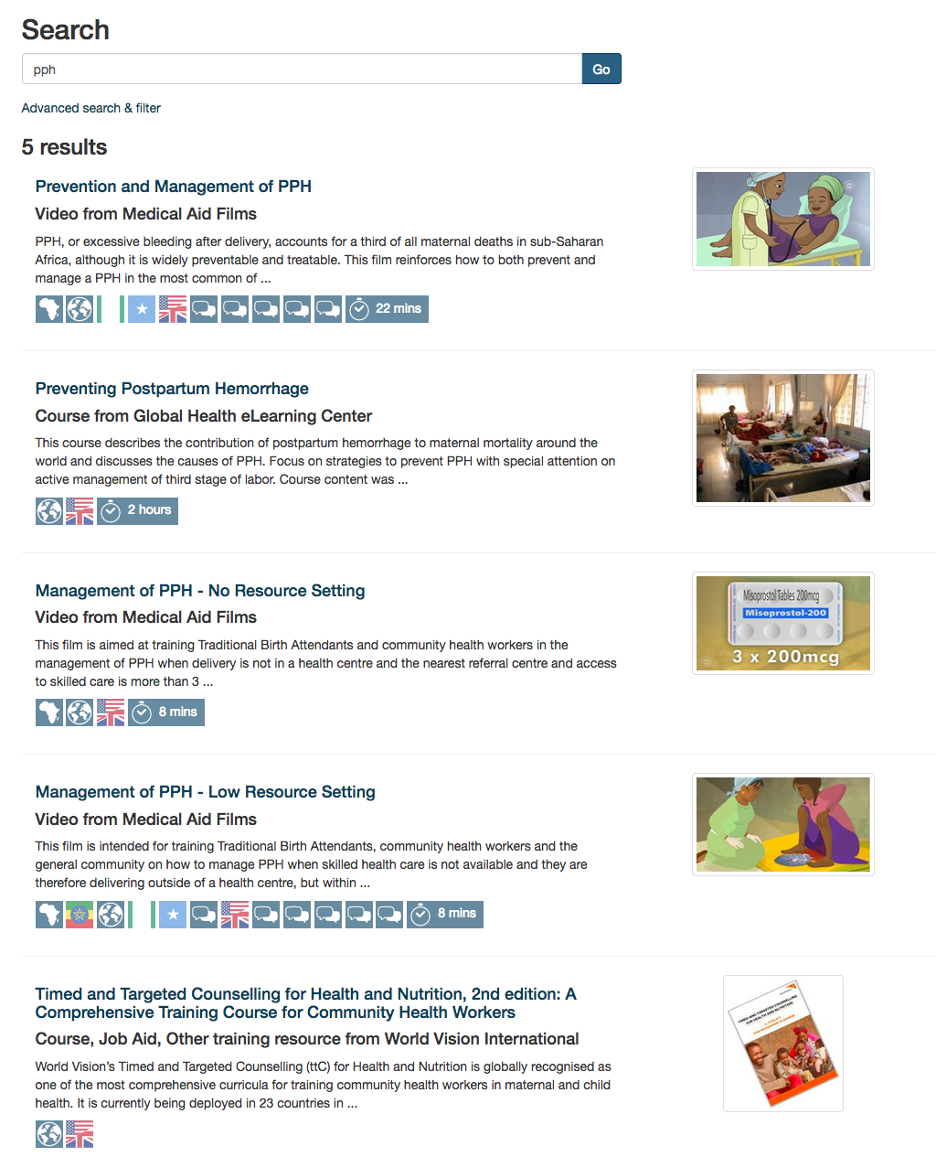
Notes:
Carolyn- You did very well on your eLearning course. Here are some additional resources from ORB. You can use these to refresh yourself on what you learned today; and you can also show them to your patients to help you explain how they can reduce their risk of PPH.
Let’s put these on your phone now, so that you can access them even when you don’t have a mobile connection.

Slide 25
Skills Lab Skit
Notes:
Peggy: (Please keep this up until Jen says, “Yes, I could look in the Safe Delivery App!” Then click to next slide.)

Slide 26
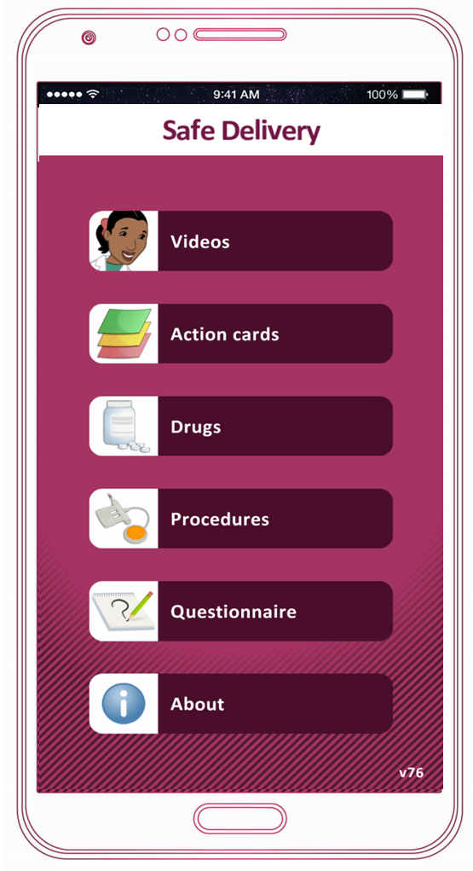

Notes:
Peggy: Please click to next slide after Jen says “Okay, let me see… I will try the action card on PPH as I need to act fast.”

Slide 27
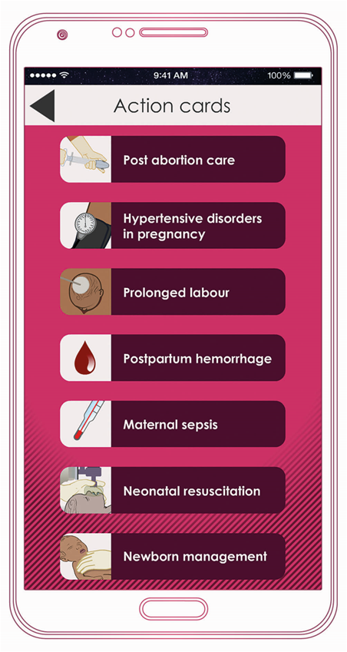

Notes:
Peggy to go to next slide after pause of 1 second.

Slide 28
Notes:
Peggy to go to next slide after pause of 1 second.

Slide 29
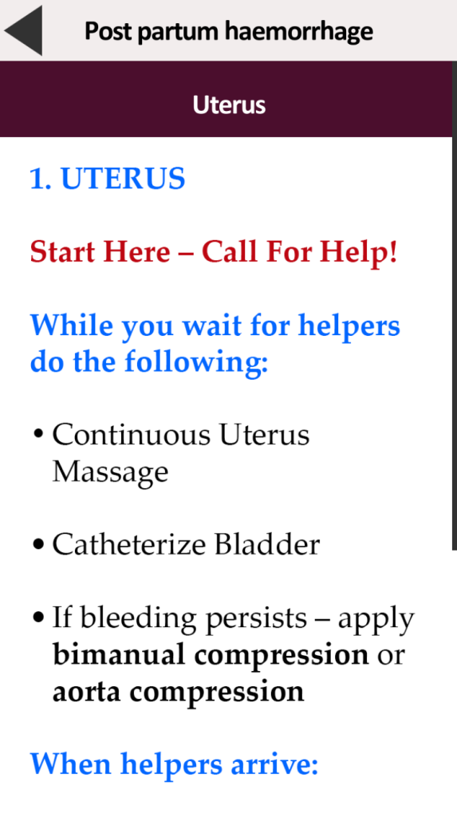
Notes:
Peggy to hold here until Anne Marie the Instructor: says “Your patient is still bleeding heavily. She is losing a lot of blood. What do you do?”

Slide 30
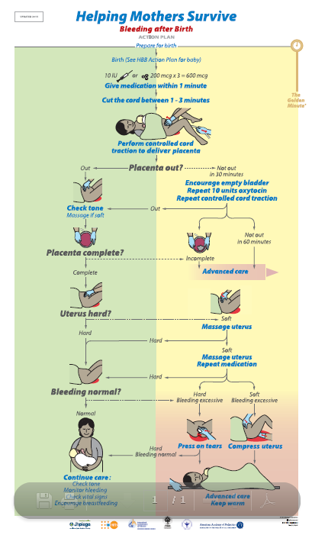

Helping Mothers Survive:
Bleeding after Birth
Action Plan
Notes:
Jen the Midwife: Let me take a look at the HMS Action Plan. [Point along the way on poster where we are] I’ve already given the first dose of oxytocin… the placenta is out and complete… the uterus is soft… I tried massage and emptying the bladder… I think I need to give another dose of oxytocin IM, if the uterus is still soft and she’s still bleeding then I better apply bimanual compression and hope that more help comes quickly!
Peggy- advance animation of red arrow once Jen begins to point to Action Plan posted in the job site; keep on this screen until Carolyn the Assistant says “Okay let me click back to the home screen.” Then click to next slide.

Slide 31
Notes:
Peggy- click to next after 1 second.

Slide 32
Notes:
Peggy- click to next after 1 second.

Slide 33
Notes:
Peggy- click to next after 1 second.

Slide 34
Notes:
Peggy- click to next after 1 second.

Slide 35
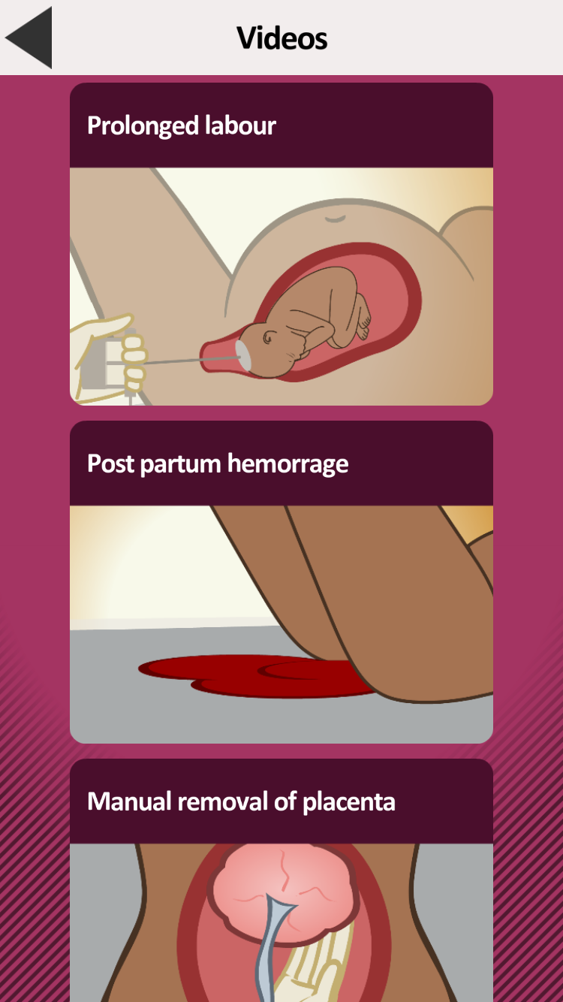
Notes:
Peggy- click to next after 1 second.

Slide 36
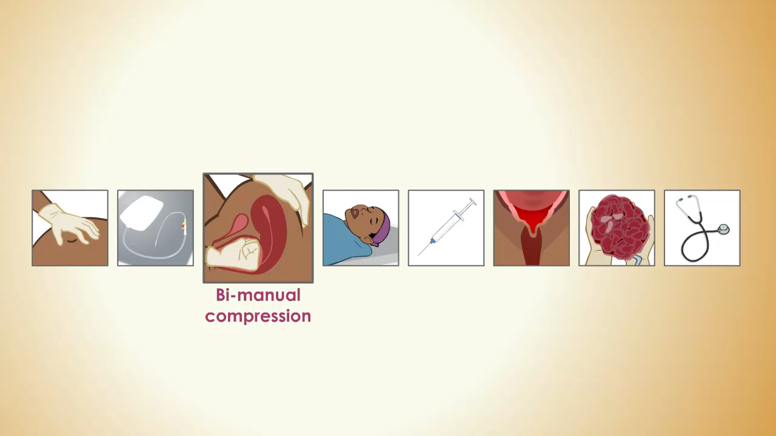
Bimanual compression video clip
Notes:
Peggy double clicks to play video clip. Stay on this slide until Carolyn the Assistant says ” Okay, let me click back and find it…” then click next.

Slide 37
Notes:
Peggy after 1 second click next.

Slide 38
Notes:
Peggy after 1 second click next.

Slide 39
Notes:
Peggy after 1 second click next.

Slide 40
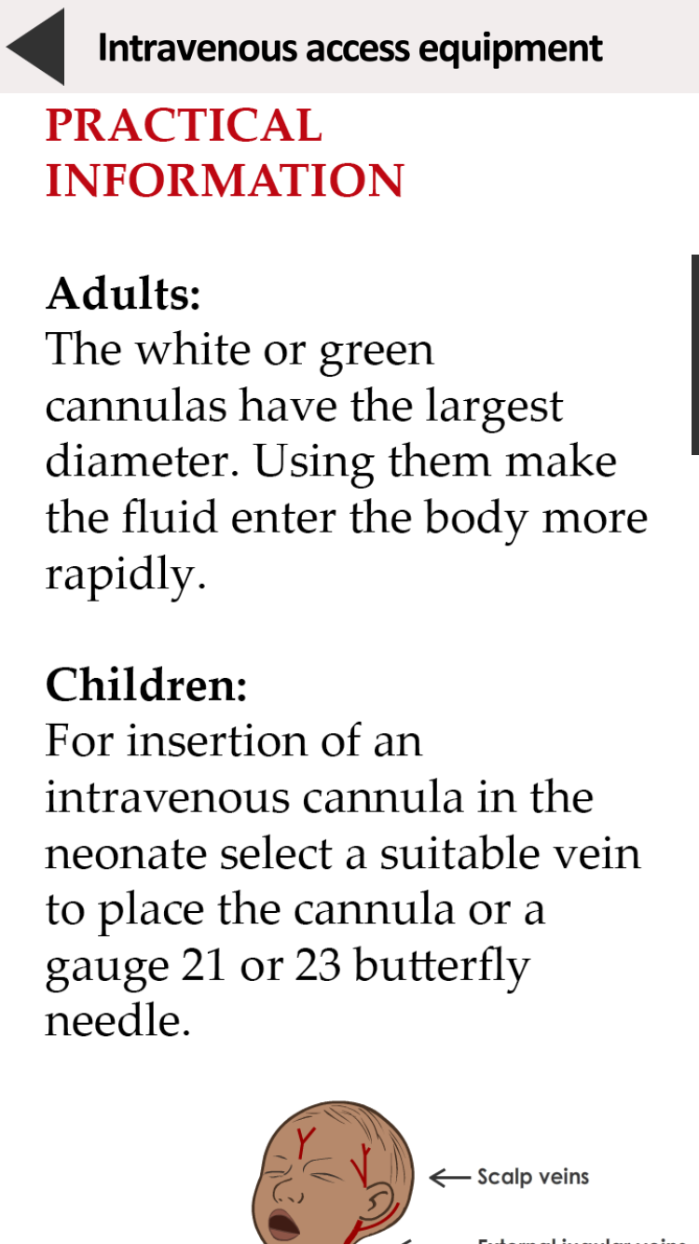
Notes:
Peggy to keep slide up until Carolyn the Assistant says: “Okay, let me just go back… let’s see... “ then clicks to next.

Slide 41
Notes:
Peggy to click next after 1 second.

Slide 42
Notes:
Peggy after 1 second click next.

Slide 43
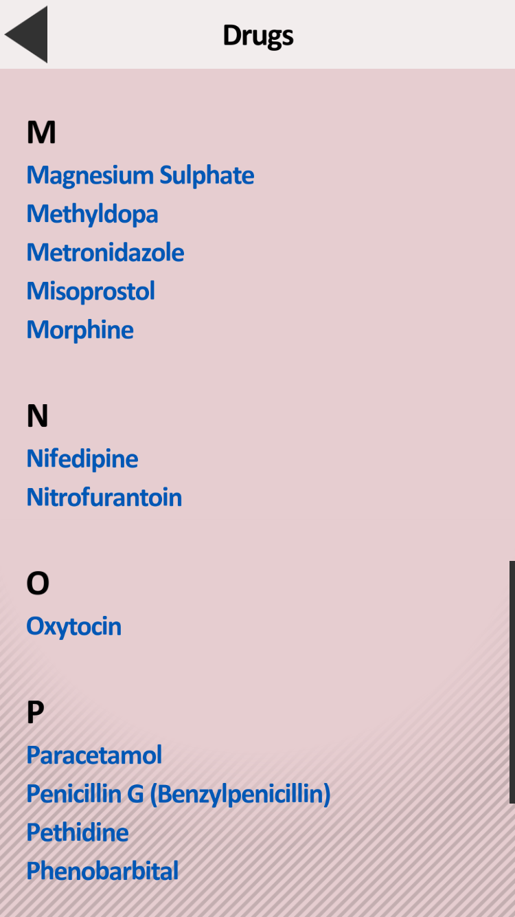
Notes:
Peggy after 1 second click next.

Slide 44

Notes:
Peggy- keep up slide until Anne Marie the Instructor says ”What did you learn?” then click next.

Slide 45
How well did you listen?
What are the four actions?
Notes:
Anne Marie to read and quiz audience.
[Answer: massage uterus, empty bladder, bimanual, repeat uterotonic]

Slide 46
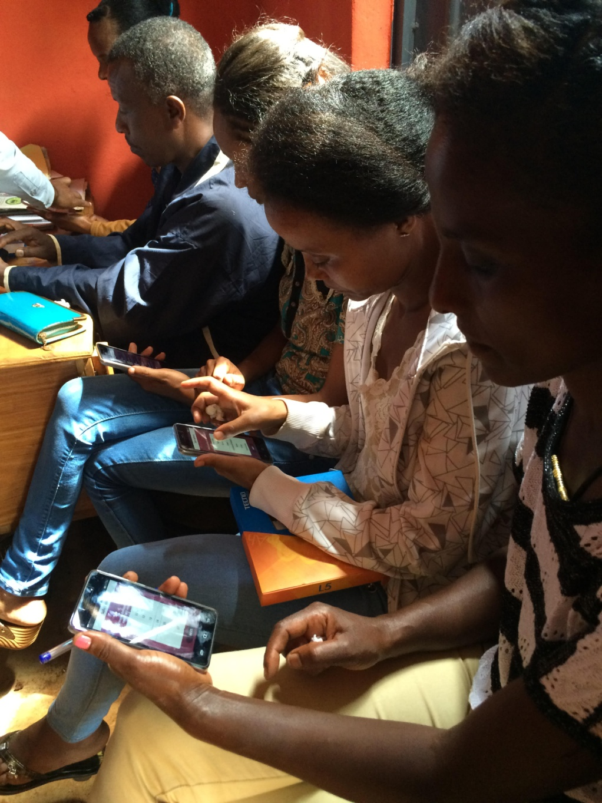
Discussion & Questions
Notes:
Peggy: We’ve seen the ways that digital tools can play a role in training alongside traditional tools. What are some of the ways that we can take advantage of these tools in a more comprehensive way, or how can audience members use this in their own work?
Jen, Tara, Anne Marie and Carolyn share examples.
Peggy: opens to the audience for questions and facilitates them.

Slide 47
Presentation Links
Jhpiego
Managing Postpartum hemorrhage e-learning module: http://reprolineplus.org/learning-opportunities/course/managing-postpartum-hemorrhage/take-the-course
Helping Mothers Survive
  HMS Secretariat website: www.helpingmotherssurvive.org
  Link to download materials: https://www.jhpiego.org/hms/training-materials/
Maternity Foundation
Safe Delivery App (iTunes): https://itunes.apple.com/dk/app/safe-delivery/id985603707?mt=8
Safe Delivery App (Google Play): https://play.google.com/store/apps/details?id=dk.maternity.safedelivery&hl=da
Safe Delivery App Video: https://youtu.be/0APRFjop8WI
mPowering Frontline Health Workers
ORB Mobile Training Content Platform: health-orb.org
Ideas for Using ORB Content: http://mpoweringhealth.org/wp-content/uploads/2016/10/Getting-started-with-ORB.pdf

Slide 48
Thank you!

