Slide 1
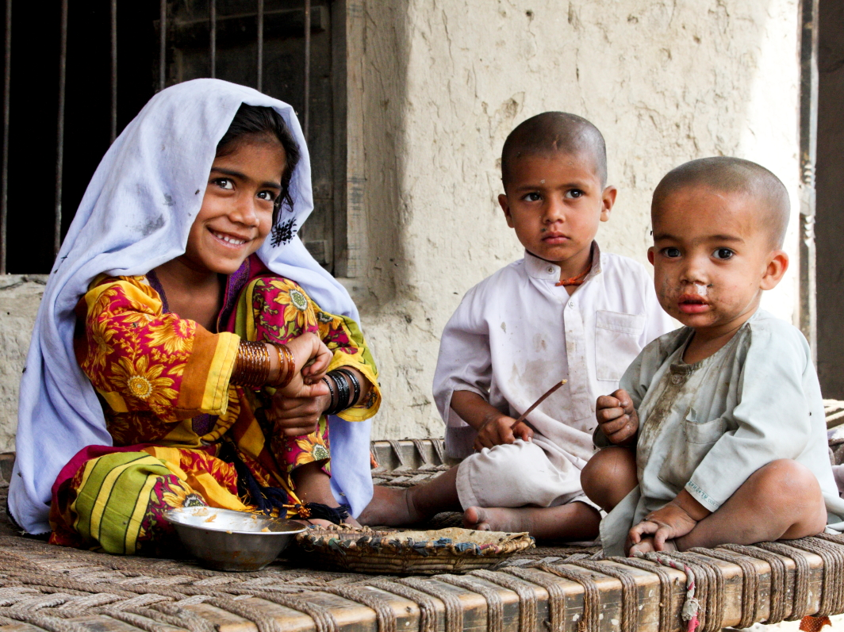

Zindagi Mehfooz (Safe Life) Immunization Program
Subhash Chandir, PhD
Maternal & Child Health Program
Dec 13, 2016 @ PHCA Conference

Slide 2
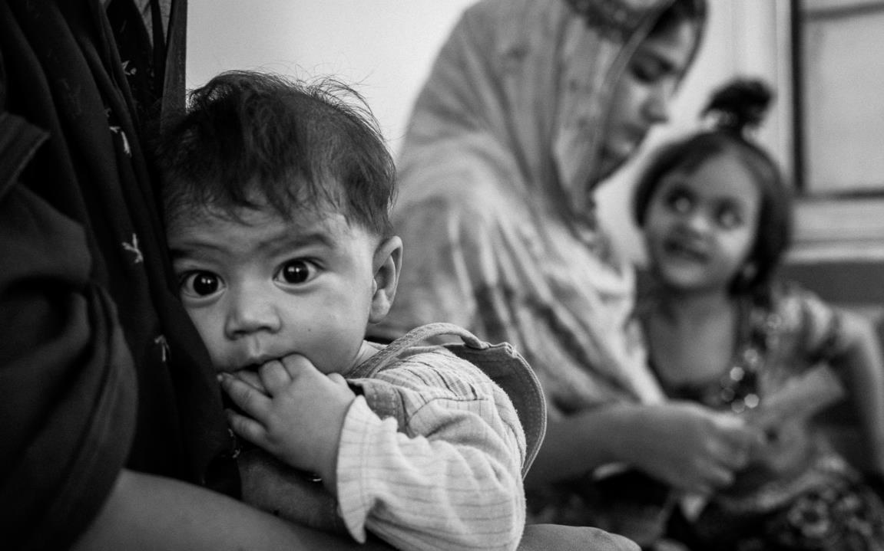

The Problem
Immunization coverage rates are low and delayed
20m children deprived of routine life saving immunizations

Slide 3
DTP3 Coverage and
# of Unvaccinated Children by Country
Source: WHO/UNICEF Estimates of National Immunization Coverage (July 2016)

Slide 4
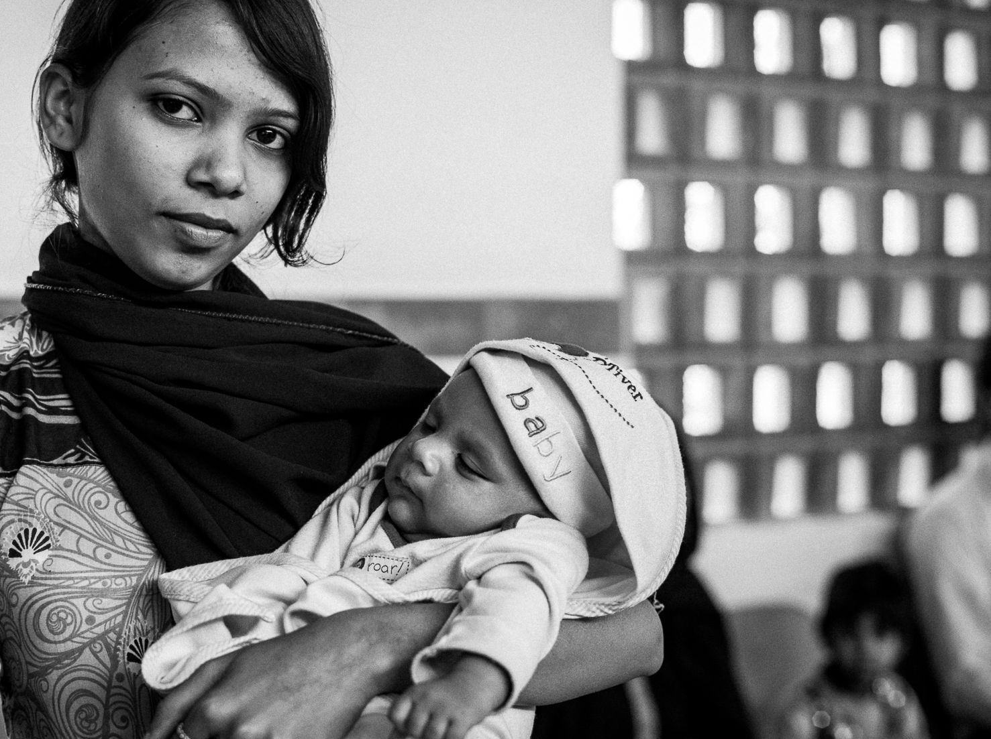

Zindagi Mehfooz
(Safe Life) Immunization Registry Program
Objective:
To increase routine immunization coverage and timeliness using
Low Cost Technology & Behavioral Economics and Generate real-time actionable data for M&E
Funded by The United Nations (UN) Foundation through the UN Secretary General's Innovation Working Group (IWG) Grant.
c

Slide 5
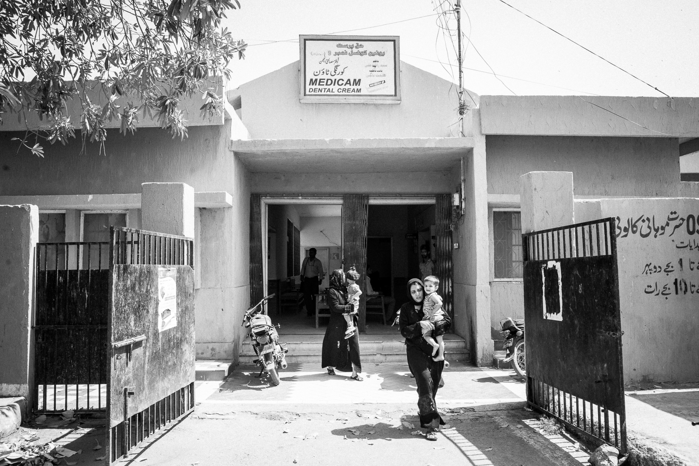



Pilot Program Overview (Jun 2012-Oct 2014)
  Fixed center cadre
  15 Vaccinators
June 2012
ZM Application launched
in 12 immunization centers in Korangi, Karachi
25,000+ children Enrolled in the Registry

Slide 6

Initial Features of the Immunization Registry
01
Electronic vaccine registry
Phone based data entry and access
Web interface for monitoring and reporting
02
Radio Frequency Identification (RFID) / Quick Response (QR) sticker on EPI immunization cards
03
Interactive Reminders (2-way SMS)
04
Lottery-based Conditional Cash Transfer (CCT)

Slide 7

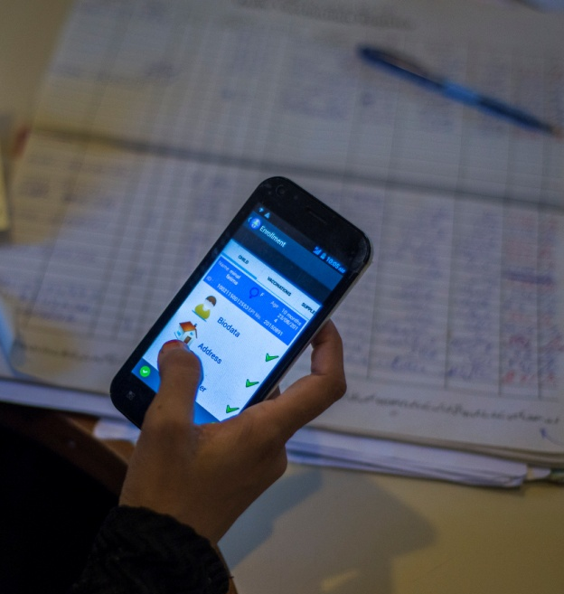
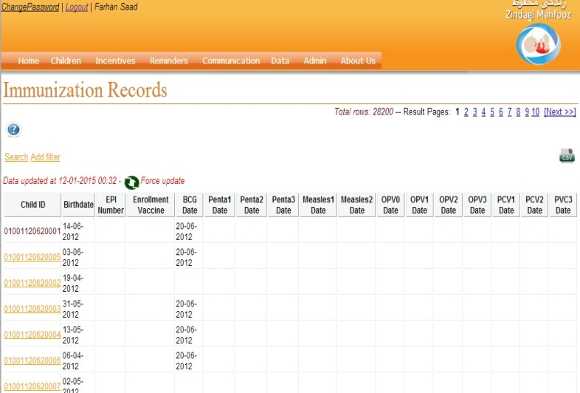
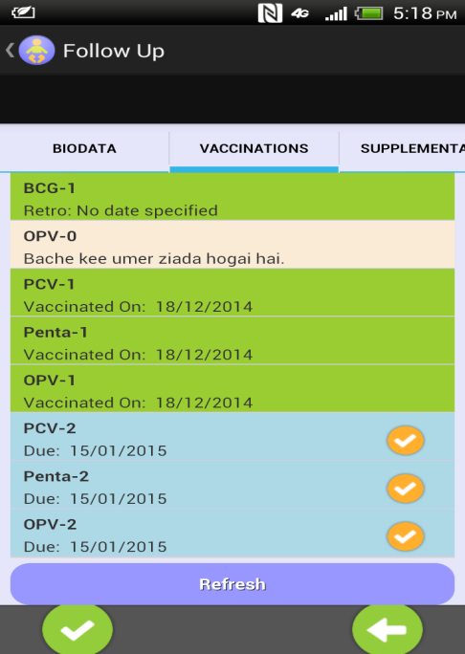
Intervention: Immunization Vaccine Registry with QR Code based identification
1
2
3
Child data recorded at enrollment
Data stored in database
Data retrieved at follow up events
Notes:
1. Whatever the data is collected through EPI registers we are recording that data through phones with EPI application.
2. Data is submitted to server and stored in a database and can be seen through website.
3. Child data can be retrieved at the time of follow-up or whenever required.

Slide 8



























mCCTs for Immunization
Participant Flowchart
Enrollment
Course Completion
No further vaccines after Measles 2
Bio-data filled on Zindagi Mehfooz (ZM) card with QR code. Data entered on phone
Child approached during outreach activities or arrives for enrollment or follow-up vaccine
SMS reminder
for next scheduled vaccination
ID retrieved
from QR code
Follow-up
Data retrieved
from server
Parents encash incentives through CNIC
P4P for vaccinator
Child is vaccinated
Parents and vaccinators enrolled in CCT/Incentive scheme
SMS alert for incentivization
Form submitted to server
Note: All icons are from the nounproject.com

Slide 9
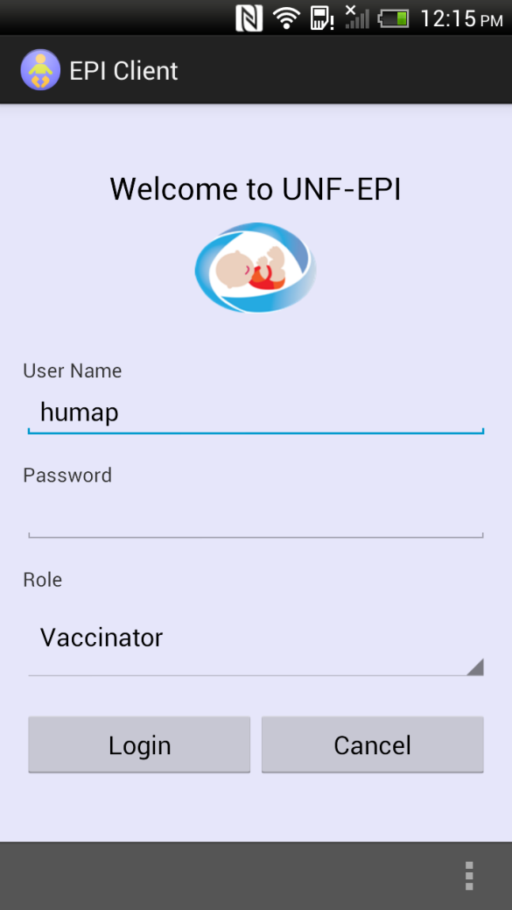
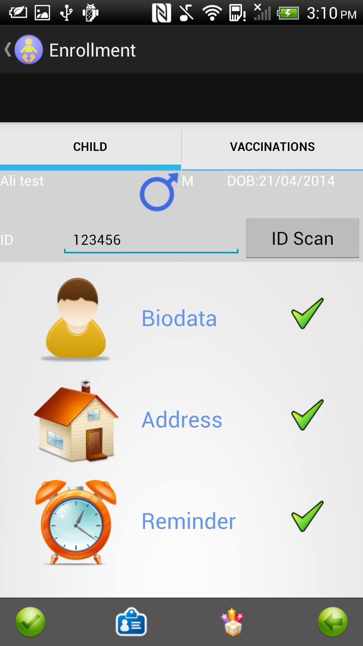
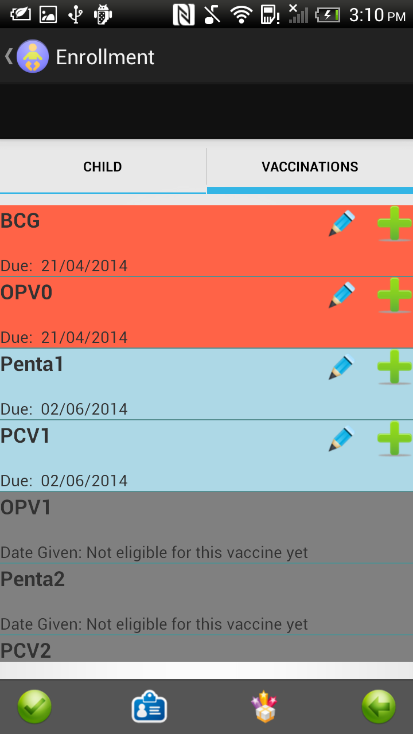
Screenshots of the application

Slide 10

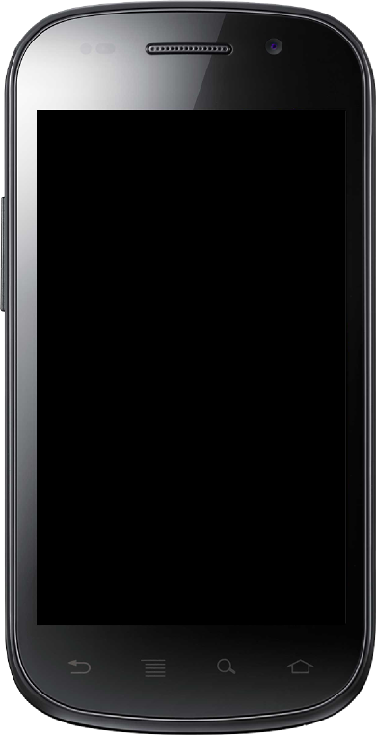
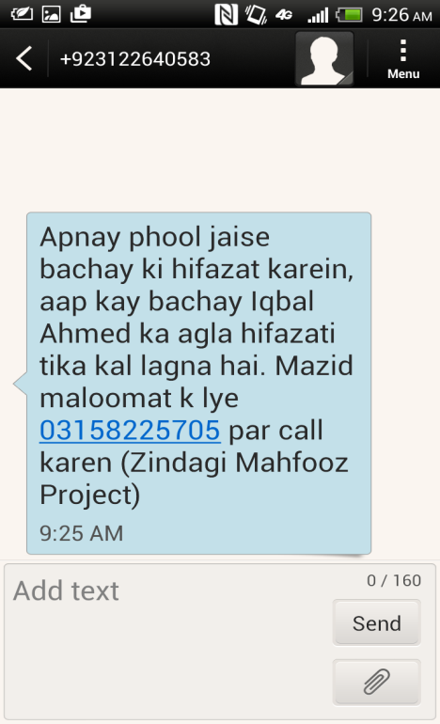
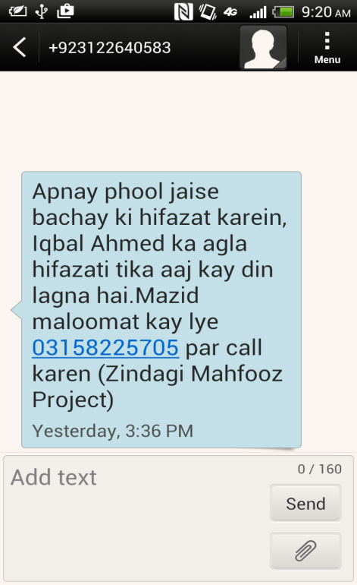
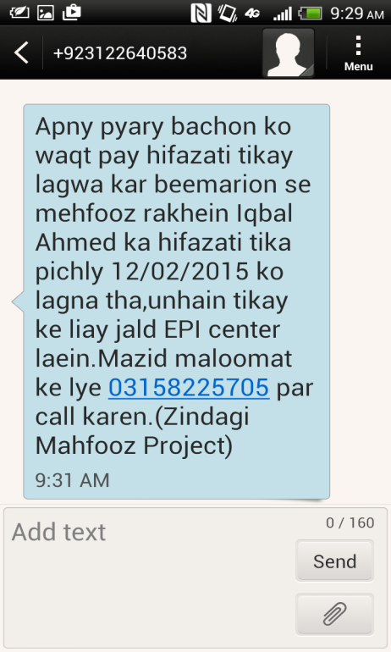
Intervention: Interactive SMS Reminders
Reminder 1 – One day before due date
Reminder 2 – On the due date
Reminder 3 – A week after the due date

Slide 11
Intervention: Interactive SMS Reminders
“Sadia is sick, how long is due date?”
“They are out of pentavalent vaccine”
Concern/Queries
Complaints
Information
Adverse Events
Vital Events
“We have lost the card. Can we get another?”
“Zain has developed rash. What should we do?”
“Sadia has died”

Slide 12
Lottery based CCT for Mothers and Vaccinators - I
Vaccine Name | Timely vaccination (USD) | Late vaccination (USD)
BCG | 2 | 2
Penta1 | 3 | 2.5
Penta2 | 5 | 3.5
Penta3 | 6 | 4
Measles1 | 7 | 4.5
Measles2 | 8 | 5

Slide 13
Lottery based CCT for
Mothers and Vaccinators – II
20%
chance to win at each vaccination
40%
chance to win at least once during six EPI visits per child
Additional 40%
of Mother’s incentives for vaccinator
Additional 5%
of Mother’s incentives for shopkeeper

Slide 14

Performance Based Incentives for Vaccinators
Vaccine Name | Timely vaccination (USD)
BCG | 0.8
Penta1 | 0.8
Penta2 | 0.8
Penta3 | 1
Measles1 | 1.2
Measles2 | 1.5
Structure of Incentives: Existing data indicate that the highest drop off in the immunization sequence occurs towards the end of the sequence. The advantage of back-loading the incentive to the end of the schedule is that this is where behavior change/improved performance is most needed. It may also improve cost-effectiveness.

Slide 15

Mode of Transfer
Performance Based Incentives for Vaccinators
Average monthly salary of Vaccinator: USD 160
Monthly Performance Based Incentive:
  Average: USD 65
  Range: USD 31 - 97
Vaccinators
  Mobile money transfer
  Can be en-cashed at widely located service outlets

Slide 16
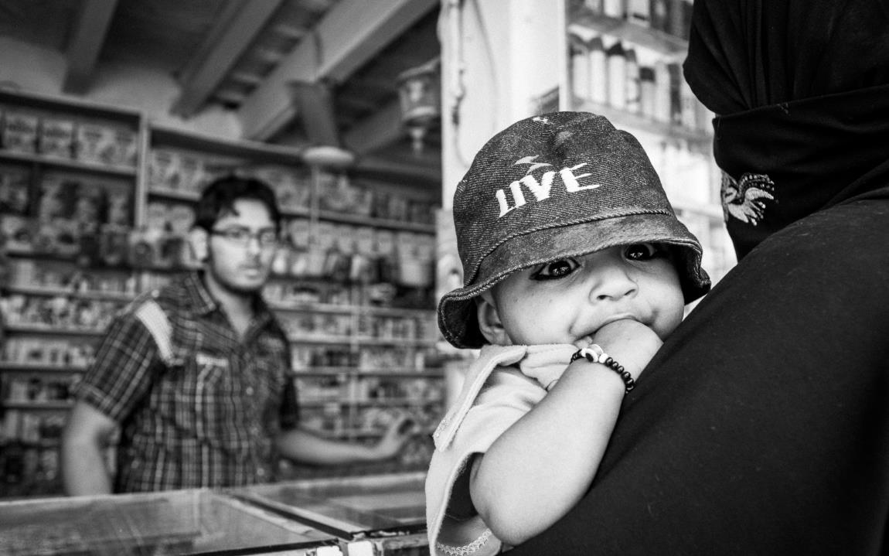






Output & Impact
25,000+ children enrolled during pilot
Vaccinator Performance
  Increased motivation and work hours
  Improved interaction with clients
  Stoppage of ‘unofficial fees’
  Improved visibility of routine EPI service
Improved Penta-3 and FIC coverage

Slide 17

Age-appropriate immunization coverage rates for children enrolled at BCG vs. estimates by PDHS 2012-13
Jun 20, 2012 – Oct 01, 2014
FIC: Fully Immunized Child indicates receipt of BCG, 3 doses of pentavalent and polio, and one dose of Measles vaccines.
25,474 children enrolled, BCG cohort is of 11,079 children.

Slide 18








ZM Immunization Registry Features
Version 2.3 of immunization registry (released Nov’14)
Web Interface
Mobile based (android) data entry & access
RFID/QR code-based identification
Interactive
SMS Reminders
Offline Mode
Lottery based conditional cash transfers for mothers and vaccinators
Built in DSS for routine & catch-up immunization
GIS tracking
of vaccinators
(to be released)
Virtual Immunization
Certificate
Defaulter list and addition of Reports on Vaccinators Mobile

Slide 19
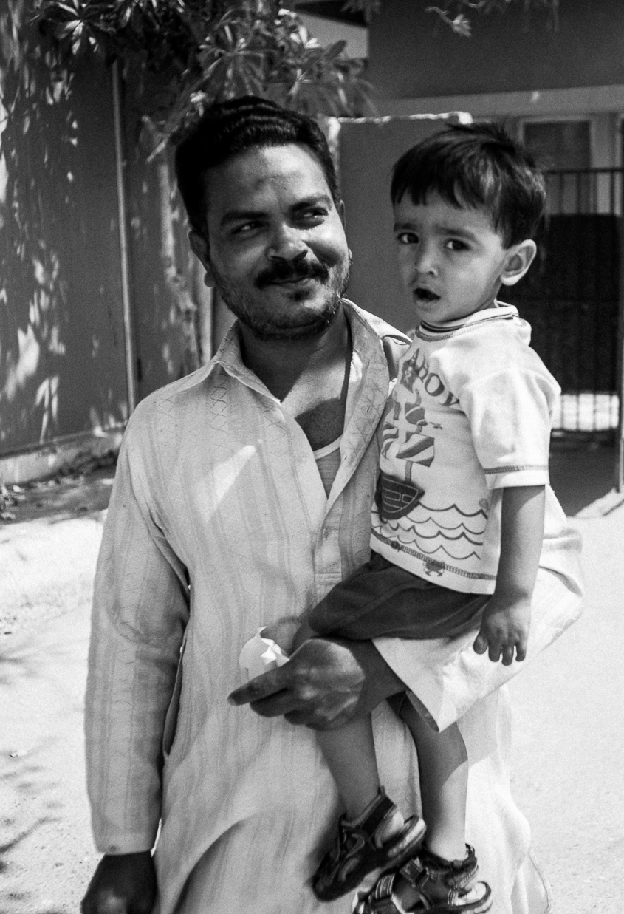



Features under R & D
Predictive analytics to identify children at high drop-out rate
Vaccine adverse events surveillance
Illness and treatment history

Slide 20
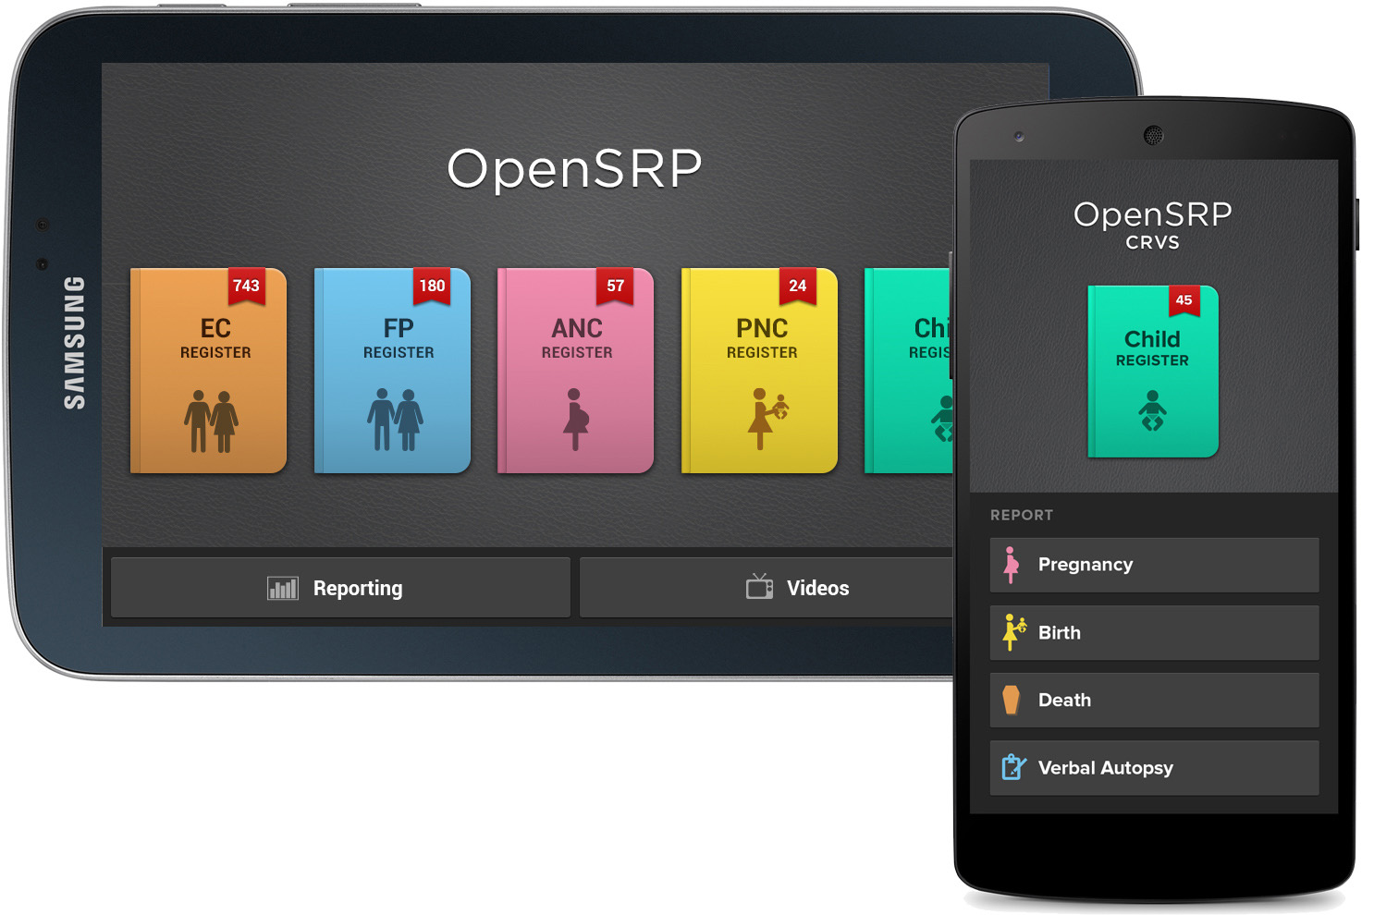
THRIVE Application Screenshot
Open Smart Register Platform (OpenSRP)
Further info: smartregister.org

Slide 21
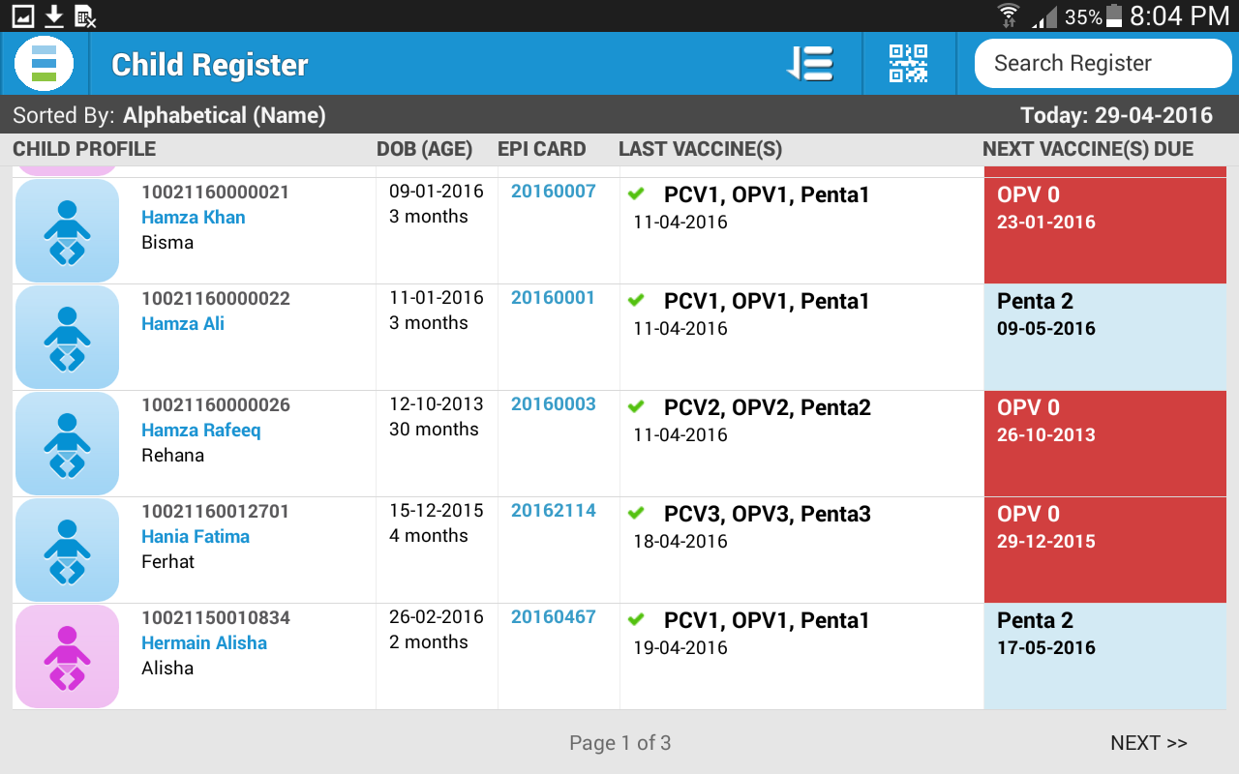
Child Register

Slide 22
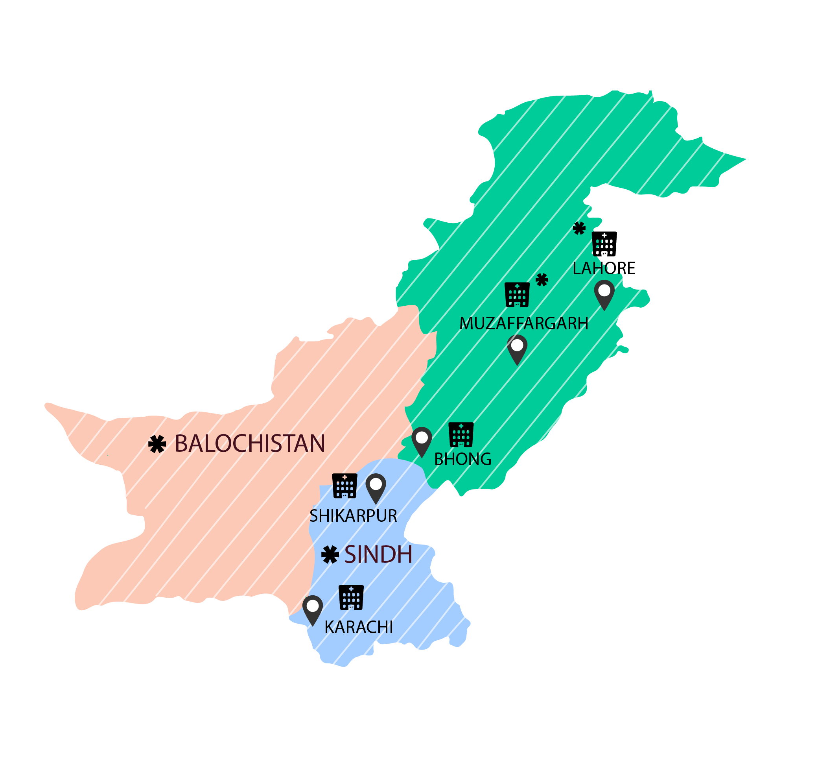

In-country
Program Expansion
On-going Projects
Expansion Sites
Notes:
*Indus hospital network

Slide 23

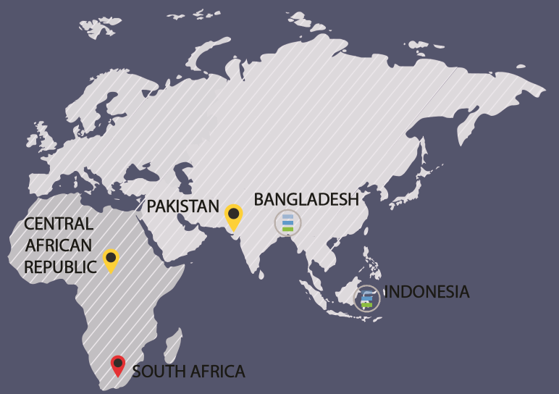
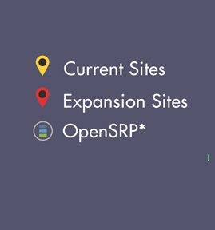
Initial Features of the Immunization Registry

Slide 24
RCT for Incentive Scheme & Reminders
Identify optimal incentive amount for achieving target immunization coverage
Low Incentive
High Incentive
SMS
Control
Flat Rate
Sharp Rate
Flat Rate
Sharp Rate
Vaccine Name
Without Lottery (1)
With Lottery (2)
Without Lottery (3)
With Lottery (4)
Without Lottery (5)
With Lottery (6)
Without Lottery (7)
With Lottery (8)
No incentive(9)
No SMS / incentive (10)
BCG
Penta-1
Penta-2
Penta-3
0.83
0.83 0.83 0.83
2.08 2.08 2.08 2.08
0.5
0.5
0.5
0.5
1.25
1.25
1.25
1.25
2.5
2.5
2.5
2.5
6.25
6.25
6.25
6.25
1.5
1.5
1.5
1.5
3.75
3.75
3.75
3.75
0
0
0
0
0
0
0
0
Measles-1
Measles-2
0.83
0.83
2.08
2.08
1
2
2.5
5
2.5
2.5
6.25
6.25
3
6
7.5
15
0
0
0
0
Cost/child
4.98
2.5
5
2.5
15
7.5
15
7.5
0
0
* All amounts are in USD; Probability of winning lottery set at 0.2 (1 out of 5).

Slide 25










Thank you
"Okay thanks"
"thnx u. Appriciate ur msg service"
"Thanks 4 reminder"
"Please call me back at +92314#######"
"We are travelling, will get the immunization from different center. Thanks for msg"

