Slide 1
How Wireless Reach Contributes to the Digital Health Evidence Base
Lauren Reed
@laurenhreed
@QCWirelessReach

Slide 2
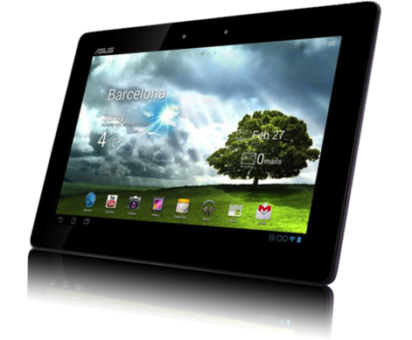
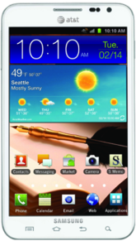
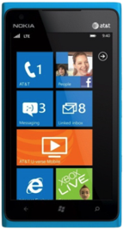
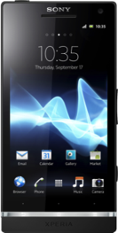
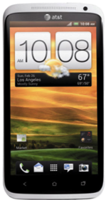
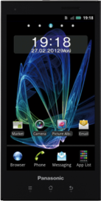
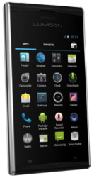
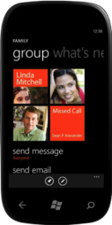







Notes:
At Qualcomm, we design the chips and the software inside your mobile devices, essentially the “Brains” of the device that enable you to make a phone call, navigate, search the web, run your apps, take pictures and movies, and more.

Slide 3
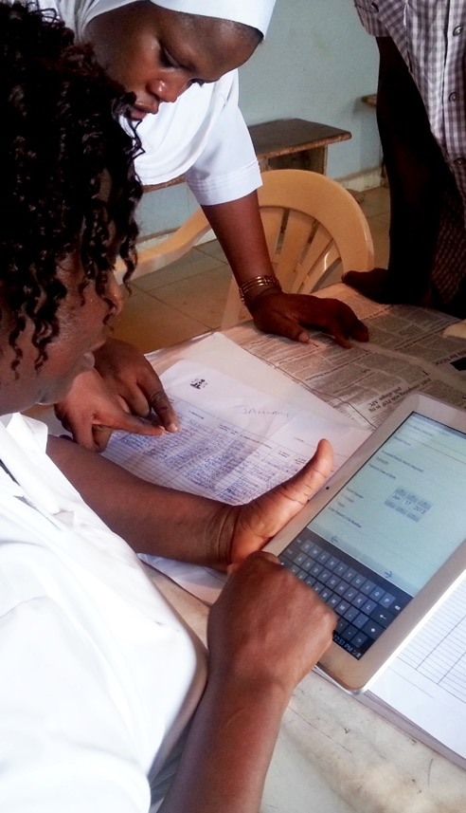
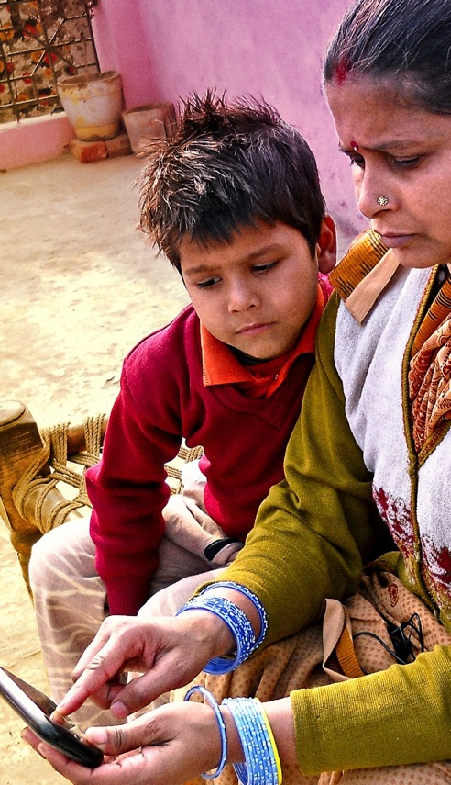
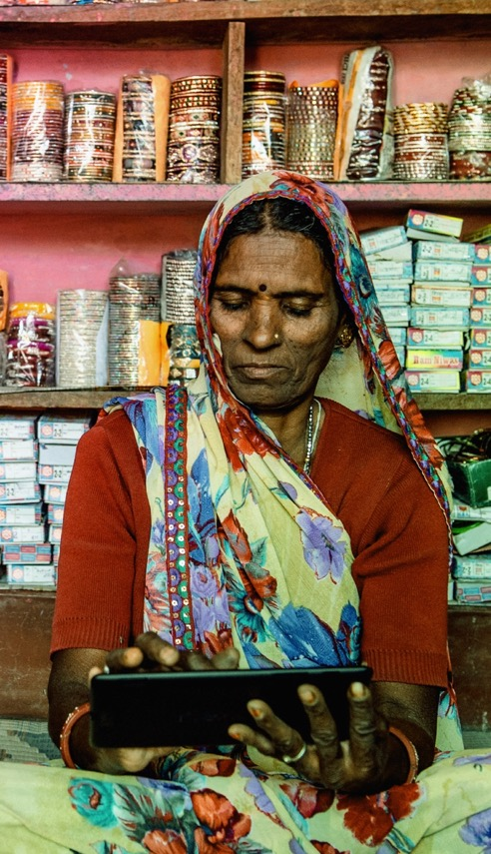

Mobile Technology
@QCWirelessReach
Notes:
Qualcomm’s passion for innovating wireless technologies and belief in its ability to be a force for social good is why we created Wireless Reach. Formalized in 2006, Wireless Reach invests in programs that leverage mobile broadband for social and economic development.

Slide 4

114
46
650
10M
PROGRAMS
COUNTRIES
STAKEHOLDERS
BENEFICIARIES
@QCWirelessReach

Slide 5





Monitoring and Evaluation Charter
To continually improve Wireless Reach by conducting strategic research and weaving data collection, analytics and visuals into all our work while also ensuring data security and ethical use
PORTFOLIO MANAGEMENT
PROGRAM MANAGEMENT
EXTERNAL COMMUNICATION
INTERNAL COMMUNICATION& DECISION MAKING
Notes:
But we’re here to talk about the digital and mobile health evidence base. We revamped our M&E program in 2013 to bring Wireless Reach to the next level.

Slide 6
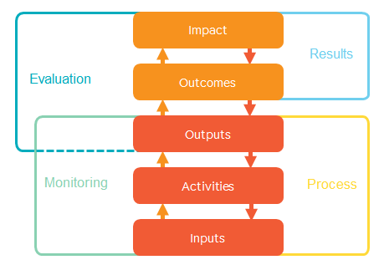
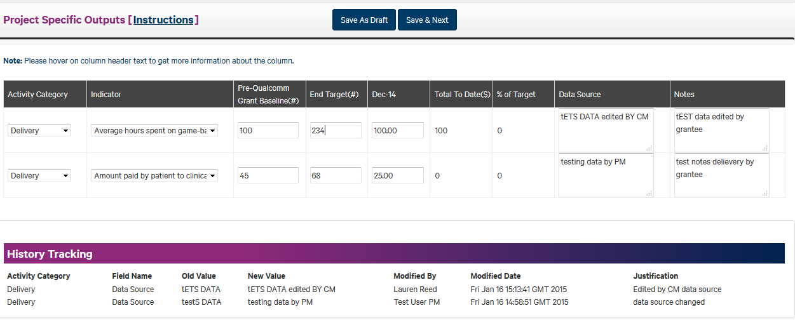
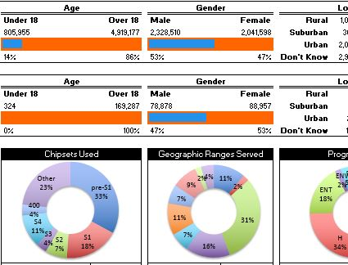
Monitoring and Evaluation Framework
Designing the roadmap to ensure program success
Partners enter over 100
data points per program on
a quarterly basis, which
we validate
Seamless data aggregation and analysis producing visuals across geographies. verticals and time
Logical Framework per Program
Quarterly Monitoring Report per Program
Dashboards for Programs and Entire Portfolio

Slide 7
Evaluation Approach
LEVEL 1: MONITORING & PROCESS EVALUATION | LEVEL 2: OUTCOME EVALUATION | LEVEL 3: IMPACT EVALUATION
story of accessibility through mobile | prove-out product benefits inferentially | prove-out causality of product benefits
Notes:
Level 1 - Social outcomes conveyed by anecdotal linkages to already proven-out concepts
Level 2 - Pre/post data is collected to show individual outcomes
Level 3 - Pre/post plus control data is collected to show population outcomes
Considerations: policy need for evidence, existing research, feasibility, risk, cost, timelines, power calculations and design – will it all be worth it?

Slide 8
>23 Million
#1 Killer
$863 Billion
Cardiovascular disease (CVD) is the world’s leading cause of death
Over 23 million deaths predicted annually from CVDs by 2030
Global cost of CVDs in USD
@QCWirelessReach
Notes:
You may not know that CVD is the world’s leading cause of death over cancer, respiratory diseases, and diabetes.
Currently, there are over 17 million deaths annually from CVD, with low and middle-income countries accounting for 80% of those deaths. This number will rise to over 23 million by 2030.
The global cost of CVDs is $863 billion dollars, which is predicted to increase in years to come.

Slide 9

Care Beyond Walls & Wires, United States
@QCWirelessReach
Notes:
US hospitals are penalized financially if patients are readmitted to the emergency room within 30, 60, and 90 days. Patients with congestive heart failure in remote areas of Northern Arizona, many of whom live on a reservation, don’t have the luxury of visiting their care providers regularly.
In partnership with Northern Arizona Health, the National Institutes of Health, and Verizon, we gave patients take-home kits with 3G-enabled smartphones, biometric sensors, and remote monitoring software for them to monitor their health and send their data to their care providers wirelessly over the network.

Slide 10
44%
64%
$92,000
Patients were hospitalized 44% less than before the trial
Patients experienced 64% fewer days hospitalized
Hospital charges per patient were on average $92,317 less
@QCWirelessReach
Notes:
The National Institutes of Health researchers found that, compared to the six months prior to enrollment, these patients had 44% fewer hospitalizations and 64% fewer days hospitalized in the six months following enrollment compared to before enrollment.
As a result, hospital charges per patient were a mean of $92,000 less in the six months following enrollment compared to before enrollment.
The remote monitoring program is now scaling across Northern Arizona as the standard of care, and will be used for all patients with congestive heart failure, respiratory disease, and sepsis.

Slide 11
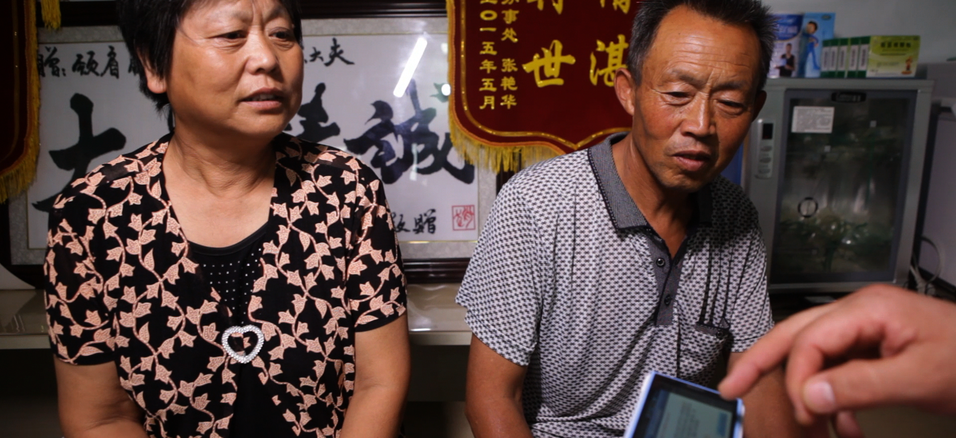
Wireless Heart Health, China
@QCWirelessReach
Notes:
Morbidity and mortality due to CVD is on the rise in China, especially in rural areas. Most people don’t have access to affordable screening, and don’t know if they are at-risk or have CVD.
To support the prevention and management of CVD in China’s rural communities, we launched Wireless Heart Health with Life Care Networks, a Chinese digital health company. They developed a purpose-built smartphone with three built-in electrocardiogram (ECG) sensors to enable the collection of heart data.
Health providers simply hold the device to a patient’s chest to take a reading lasting approximately 60 seconds. The data is immediately sent over the 3G or 4G LTE network to a 24/7 Call Center staffed by cardiac specialist who provides diagnosis and treatment feedback within minutes.

Slide 12
6x Less Expensive
Decrease in cost of ECG-sensing smartphone as compared to conventional ECG machine
  Increased Capacity
  2/3 of providers examined more patients & diagnosed more CVD cases
  >180,000 Screenings
  Over 180,000 rural patients have been screened in the past 2 years
  Call Center Benefits
  3/5 of providers said call center increased the accuracy of diagnoses
@QCWirelessReach
Notes:
We found that the ECG-sensing smartphone is 6 times less expensive for patients than the conventional ECG machine, thanks to government support of the program.
2/3 of rural providers surveyed cited that the convenience of the smartphone allowed for them to screen more patients and moreover, diagnose more CVD cases, which is really getting to the heart of the program (no pun intended).
Also, over the past two years the program has benefitted over 180,000 people in 21 provinces, and many of those screenings were done in the home.
Last, 3/5 of providers cite that the call center has increased the accuracy of their diagnoses, and also help improve their understanding of the ECG readings.

Slide 13
Thank you!
@QCWirelessReach
@laurenhreed

