Slide 1
Are messaging programs good value for money?
Methodological musings and early findings from MAMA South Africa
Amnesty LeFevre PhD MHS

Slide 2
Presentation overview
What is value for money?
Conceptualizing economic and financial evaluations for digital health
What do we know about the value for money of messaging programs?
MAMA South Africa
Next steps

Slide 3




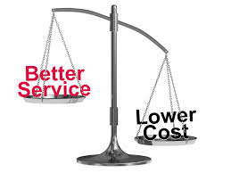
What is “value for money”?

Slide 4
Value for Money
DfID UK: “the optimal use of resources to achieve intended outcomes”
  About maximizing the impact of each pound spent to improve poor people’s lives.
  Purpose: To develop a better understanding (and better articulation) of costs and results so that we can make more informed, evidence-based choices. This is a process of continuous improvement.
  Driven by increased transparency and accountability in our operations
  Source: https://www.gov.uk/government/uploads/system/uploads/attachment_data/file/67479/DFID-approach-value-money.pdf
Notes:
3E’s Framework
Economy Are we or our agents buying inputs of the appropriate quality at the right price? (Inputs are things such as staff, consultants, raw materials and capital that are used to produce outputs)
Efficiency: How well do we or our agents convert inputs into outputs? (outputs are results delivered by us or our agents to an external party. We or our agents exercise strong control over the quality and quantity of outputs)
Effectiveness: How well are the outputs from an intervention achieving the desired outcome on poverty reduction? (Note that in contrast to outputs, we or our agents do not exercise direct control over outcomes)

Slide 5
What is economic evaluation?
Economic evaluation-- Evaluates two or more interventions simultaneously
  Cost minimization
  Cost effectiveness
  Cost utility
  Cost benefit analysis
Economic evaluations aim to place a value on things – in this context the training programs.
Underpinning motivation behind an economic evaluation is to foster dialogue on optimal resource allocations
  Source: https://www.gov.uk/government/uploads/system/uploads/attachment_data/file/67479/DFID-approach-value-money.pdf
Notes:
3E’s Framework
Economy Are we or our agents buying inputs of the appropriate quality at the right price? (Inputs are things such as staff, consultants, raw materials and capital that are used to produce outputs)
Efficiency: How well do we or our agents convert inputs into outputs? (outputs are results delivered by us or our agents to an external party. We or our agents exercise strong control over the quality and quantity of outputs)
Effectiveness: How well are the outputs from an intervention achieving the desired outcome on poverty reduction? (Note that in contrast to outputs, we or our agents do not exercise direct control over outcomes)

Slide 6
Full economic evaluation vs. partial evaluations
 | Measures only effects or consequences | Measures only costs | Costs and consequences are both measured
Single program | Output/ Outcome/ Impact description | Cost description | Partial economic evaluation Cost-outcome description analyses
Comparison of two or more alternatives | Efficacy or effectiveness evaluation | Cost analysis | Full economic evaluation Cost effectiveness analysis Cost utility analysis Cost benefit analysis
Notes:
Can be distinguished from economic analysis in which “economic theories are tested and predictions of change are made in response to resource re-allocation” (Frick, Walker 2010)
measures consequences in natural units, such as life years gained, disability days avoided, or cases detected. In a variant of CEA, often called cost utility analysis, consequences are measured in terms of preference-based measures of health, such as quality adjusted life years or disability adjusted life years.

Slide 7
Stage-based process for economic and financial evaluations of digital health
Notes:
SM₁₋₅ corresponds to Stages of Maturity 1-5 denoting the need to repeat the stages to catalyze advancement to the next stage of maturity

Slide 8
Linking stages of maturity and evaluation with economic and financial evals
Add questions to promote audience discussion

Slide 9
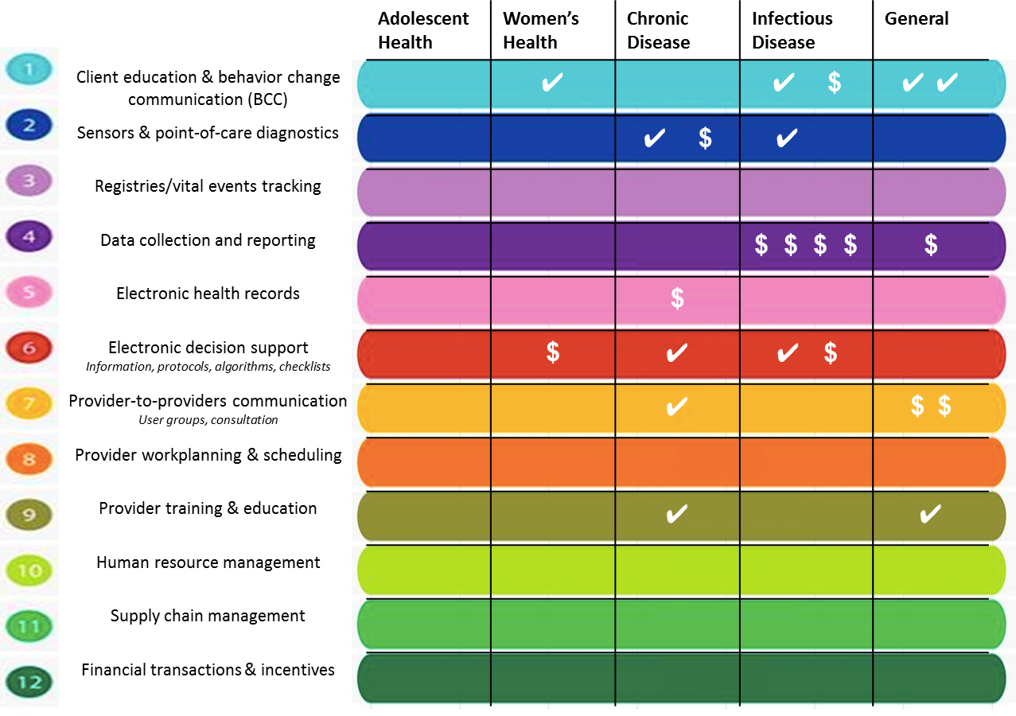
What do we know about economic and financial evaluations digital health programs?

Slide 10
Limited evidence and poor quality evidence reporting
Paper Title | Total n=24 | Introduction | Methods | Results | Discussion | Other
CEA Mobile Phone Text-Message Reminder Programs to Improve Health Workers' Adherence to Malaria Guidelines in Kenya | 90% | 100% | 86% | 88% | 100% | 100%
CEA recall methods for cervical cancer screening in Selangor | 65% | 100% | 64% | 38% | 100% | 0%
CEA smoking cessation in Thailand | 54% | 100% | 64% | 13% | 100% | 100%
CEA of SMS vs. phone reminder to improve attendance at a health promotion center | 38% | 100% | 46% | 0% | 100% | 0%

Slide 11
MAMA South Africa
      Program: Small scale deployment of health information messaging program which sent up to 172 SMS messages to women enrolled during pregnancy in Johannesburg South Africa
Objective: Determine the incremental cost effectiveness of exposure to SMS messages vs. no exposure on increasing utilization of MNCH services in Gauteng, South Africa from Retrospective CEA of women exposed vs. not exposed
      Analytic time horizon: 2012-2017
Perspective: societal (program + users + health systems)
Health effects: measure of comprehensive care
  ANC 1-4
  PNC 1-5 (fully immunized)
Methods:
  Patient interviews
  Review of ANC and child health cards

Slide 12
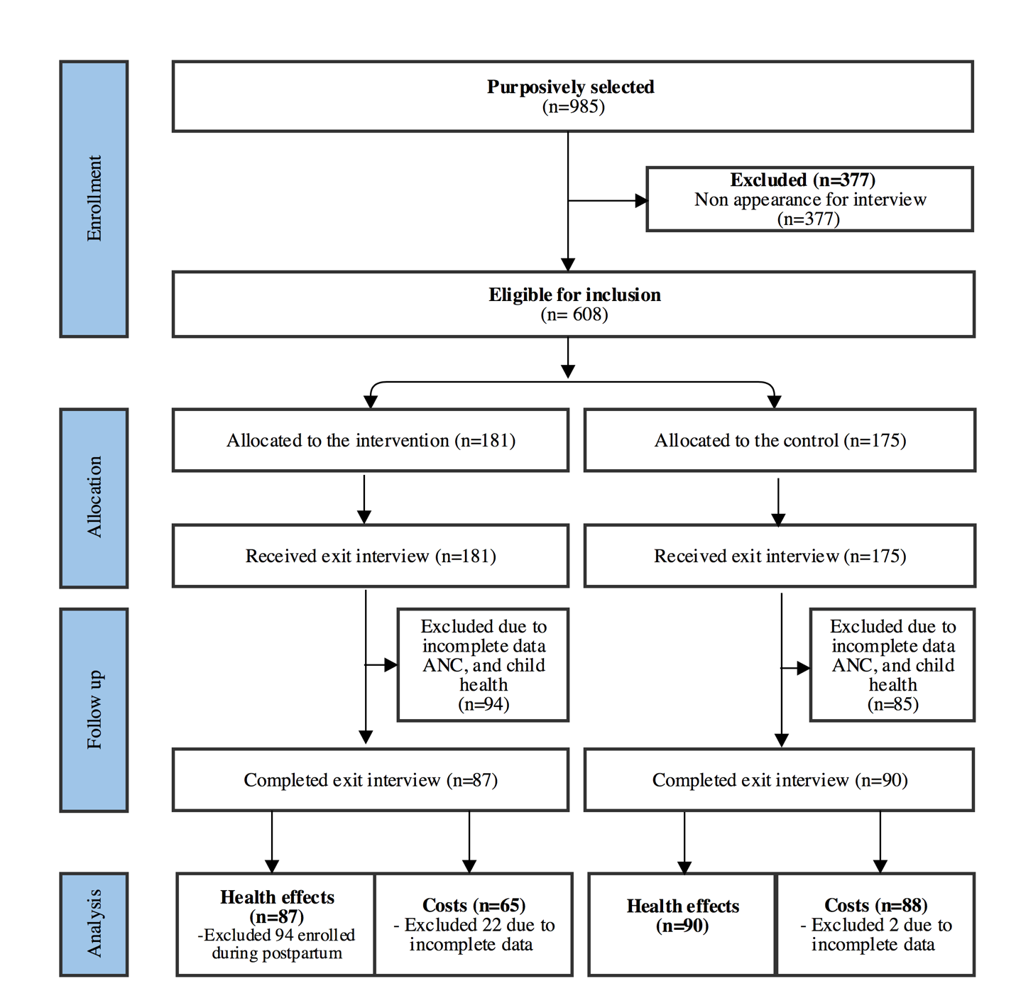
Key finding 1: Data gaps limit final sample included in the analysis

Slide 13
Key finding 2: Significant increase in ANC4+ and Comprehensive care
 | Unadjusted |  |  | Adjusted*
 | MAMA n=87 | Non-MAMA Users n=90 | p-value | MAMA vs. Non-MAMA
 |  |  |  | Odds Ratio (CI) | p-value
ANC 4+ | 0.72 (0.55-0.85) | 0.46 (0.38-0.53) | 0.01 | 3.21 (1.73-5.98) | 0.01
Children fully immunized | 0.90 (0.77-0.96) | 0.84 (0.75-0.91) | 0.32 | 1.73 (0.54-5.52) | 0.282
Comprehensive care: ANC 4+ and fully immunized up to 1 year | 0.67 (0.57-0.75) | 0.39 (0.26-0.53) | 0.01 | 3.20 (1.63-6.31) | 0.007
When delivered to a total population of ~ 13 million or 300,000 pregnant/ postpartum women, this translates to 190 lives saved or 5,130 DALYs averted

Slide 14
Key finding 3: Costs to users constitute a large proportion of total costs
Year 5 total program cost is $3.8 million USD: 55% borne by users, 16% program, 28% health system
>80% costs to users are attributed to lost wages
Nearly 50% of program costs are on SMS

Slide 15
5-year trends in the unit program cost per registered user and per case of comprehensive care (CC) received among MAMA users over 60 months
Key finding 4: $3.57 cost per registered user by year 5

Slide 16
Key finding 6: Cost per live saved is $25 from a societal perspective

Slide 17
Summary findings and considerations
Findings suggest that with time, model based analyses demonstrate that MAMA is cost effective in this context → but is it affordable?
Analyses are only as strong as the underlying data → as a field we need to be advocating for stronger study designs
Societal perspective costs are important → be leery of programs that selectively present data
Significant increase in comprehensive care were observed despite high baseline utilization of services→ translating this to health outcomes was challenging.
  Data on co-coverage of ANC interventions limited
  Not powered to detect such small increases in immunizations
Assumed a forecasted analytic time horizon as scenarios which assumed program time horizon were not CE → higher thresholds of registered users were needed to demonstrate VFM
SMS costs are the primary cost driver → future programs need to consider alternative, lower cost delivery strategies (USSD), pairing down the number of messages, and/or focusing on populations most in need

Slide 18
Supplementary slides

Slide 19
Key finding : Childhood immunizations improve but the margins too small to detect a difference
 | Unadjusted |  |  | Adjusted*
 | MAMA n=87 | Non-MAMA Users n=90 | p-value | MAMA vs. Non-MAMA
 |  |  |  | Odds Ratio (CI) | p-value
Birth: Bcg | 0.99 (0.86-1.00) | 0.97 (0.83-0.99) | 0.40 | 3.45 (0.10-122) | 0.41
Birth: OPVD | 0.97 (0.65-0.99) | 0.97 (0.83-0.99) | 0.98 | 1.06 (0.03-35.18) | 0.97
6 week: OPV1 | 0.99 (0.86-0.99) | 0.98 (0.85-0.99) | 0.62 | 1.05 (0.01-179.47) | 0.98
6 week: RV1 | 0.99 (0.86-0.99) | 0.98 (0.85-0.99) | 0.62 | 1.05 (0.01-179.47) | 0.98
6 week: Dtap-IPV-Hib1 | 0.99 (0.96-0.99) | 0.97 (0.93-0.98) | 0.12 | 2.83 (0.69-11.64) | 0.12
6 week: PCV1 | 0.99 (0.86-0.99) | 0.98 (0.85-0.99) | 0.62 | 1.05 (0.01-179.47) | 0.98
6 week: Hep B1 | 0.99 (0.86-0.99) | 0.98 (0.85-0.99) | 0.62 | 1.41 (0.06-35.67) | 0.80
10 week: Dtap-IPV-Hib2 | 0.98 (0.96-0.99) | 0.97 (0.94-0.98) | 0.33 | 1.31 (0.71-2.42) | 0.32
10 week: Hep B2 | 1 | 0.98 (0.97-0.98) | 0.12 | 1 | -
14 week: Dtap-IPV-Hib3 | 1 | 0.94 (0.91-0.97) | 0.12 | 1 | -
14 week: Hep B3 | 0.99 (0.86-0.99) | 0.97 (0.78-0.99) | 0.43 | 2.83 (0.08-96.75) | 0.48
14 week: PCV2 | 0.98 (0.75-0.99) | 0.97 (0.78-0.99) | 0.78 | 1.50 (0.05-45.45) | 0.77
14 week: RV2 | 0.97 (0.88-0.99) | 0.96 (0.88-0.98) | 0.71 | 1.53 (0.25-9.48) | 0.58
9 month: Measles1 | 1 | 0.94 (0.82-0.98) | 0.22 | 1
9 month: PCV3 | 0.98 (0.96-0.99) | 0.94 (0.82-0.98) | 0.16 | 2.38 (0.60-9.42) | 0.17

Slide 20
Study population characteristics for MAMA and Non-MAMA users
 | Mama n=87 | Non-Mama n=90 | p value
Nationality |  |  | 0.04
South African | 0.45 (0.26-0.65) | 0.29 (0.23-0.36)
Zimbabwe | 0.54 (0.37-0.70) | 0.57 (0.50-0.63)
Other nationality | 0.01 (0.00-0.14) | 0.14 (0.12-0.17)
Completed secondary school or higher | 0.55 (0.48-0.62) | 0.52 (0.47-0.57) | 0.40
Employment Status
Employed full-time | 0.24 (0.21-0.28) | 0.33 (0.25-0.42) | 0.32
Employed part-time | 0.25 (0.23-0.27) | 0.16 (0.04-0.44)
Unemployed | 0.46 (0.45-0.47) | 0.49 (0.42-0.56)
Other | 0.05 (0.01-0.17) | 0.02 (0.00-0.14)
Parity: 1 or more prior children | 0.58 (0.52-0.63) | 0.67 (0.46-0.83) | 0.31
Average Monthly Household Income
Under R1,300 (<$95 USD) | 0.13 (0.09-0.17) | 0.14 (0.08-0.24) | 0.33
R1,300 - R2,000 ($95-$150 USD) | 0.10 (0.07-0.15) | 0.08 (0.05-0.11)
R2,001 - R3,000 ($150-220 USD) | 0.10 (0.04-0.23) | 0.18 (0.11-0.28)
R3,001 - R4,000 ($220-300USD) | 0.22 (0.16-0.29) | 0.16 (0.07-0.31)
Over R4,001 (>$300 USD) | 0.45 (0.30-0.61) | 0.44 (0.42-0.47)

Slide 21
Key finding 3: Costs to users constitute a large proportion of total costs
Year 5 total program cost is $3.8 million USD: 55% borne by users, 16% program, 28% health system

Slide 22
Key finding 3: Costs to users constitute a large proportion of total costs
Year 5 total program cost is $3.8 million USD: 55% borne by users, 16% program, 28% health system

