Slide 1
December
2016
DIGITAL HEALTH FOR FAMILY PLANNING SYSTEM STRENGTHENING
NICOLE IPPOLITI, TECHNICAL OFFICER, FHI 360
Notes:
Thank you for inviting me today to speak on our work in reviewing current approaches which leverage DH tools for FP SSS.

Slide 2
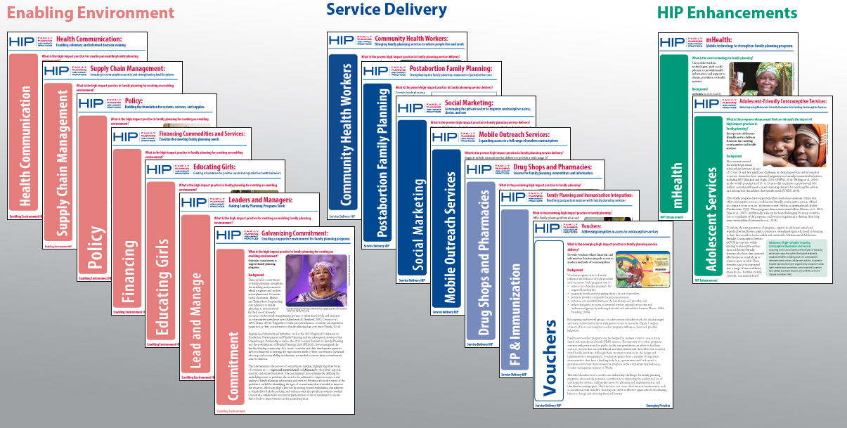
HIGH IMPACT PRACTICE BRIEFS
Notes:
Today, I’ll be presenting on findings from a brief that FHI 360 is currently developing (still in progress) that will be a part of USAID’s Family Planning High Impact Practice compendium. These briefs offer concise summaries of effective service delivery or systems interventions that advance family planning outcomes. These briefs are categorized by whether they are proven, promising, or emerging practices. And in the case of mhealth, which is what I’ll be presenting on today, this brief will be categorized as an “enhancement” which refers to a technology that could be added to a practice for additional impact or cost-effectiveness.
In early 2013, my colleagues published a HIP brief on mhealth, and this year we’ll be updating it to reflect relevant interventions that have popped up in the last three years. Initially we presented a concept which included examples of both client and systems level approaches that integrate digital health solutions for family planning. The recommendation for the HIP technical advisory group was to choose either client-facing or health systems strengthening approaches in order to allow for greater depth on both the evidence base and lessons learned. They also recommended that we move beyond mhealth to allow for a broader definition of digital health, which also includes e-health, ICT. So today, I’ll be presenting our review of digital health approaches focused on systems strengthening, though next year we’ll develop a brief that focuses on the client/demand side.

Slide 3
HIGH IMPACT PRACTICE DEFINITION
Digital Health for Family Planning: Health Systems Strengthening
Digital applications (including mHealth, eHealth, and Information Communication Technology) which support the delivery of family planning commodities, services, systems-level information, and counselling.ⁱ
ⁱAdapted from: Labrique AB, et al.. mHealth innovations as health system strengthening tools: 12 common applications and a visual framework. Global Health: Science and Practice. 2013
Notes:
Currently, there is no standardized definition for digital health for family planning systems strengthening. The definition we present here is adapted from both the Labrique article which provides a framework of common mHealth applications used as health systems strengthening innovations (within RH), as well as from information included in the mhealth evidence taxonomy.
You’ll note that in both this definition and the theory of change presented on the next slide, we focus on system-level processes and outcomes.

Slide 4
THEORY OF CHANGE
Supply Management
Reduced stock outs of FP commodities
Workforce Development & Performance Support
Time and resource efficiencies when training service providers
Family Planning Health System
Service Delivery
Point-of-care decision support tools to ensure quality of care
Information Systems
Improved monitoring and data collection on FP indicators
Financial Transactions & Incentives
Improved economic efficiency, accountability, and transparency
Notes:
TOC is adapted from the WHO Health Systems Building Blocks. Here we dissect the overall health system into five primary domains where digital health innovations have had emerging practice in supporting family planning system strengthening. We did receive feedback from the TAG to include leadership and governance as an additional domain within the framework, so the final version of the brief will include results for that as well.
Supply management
Allows for tracking, reporting, and managing supplies to reduce stock outs of essential FP commodities
Workforce development and performance support
Looking at the resource and time efficiencies of offering virtual training support and skills monitoring to frontline or remote providers, which would otherwise would have to be done in person
Service delivery and support
Readily accessible point-of-care decision support tools to help ensure quality of care in task-shifting scenarios and guide frontline health workers through service delivery.
Information systems
Departure from paper-based systems of data collection/reporting to real-time data aggregation, visualization, and sharing.
Financial transactions and incentives
Mobile financial transactions to pay for healthcare, supplies, or drugs, OR for facilitating performance-based financial incentives for healthcare workers
Use this framework to evaluate how projects which are implementing digital health tools for FP system strengthening measure against the following criteria:
Time and Resource efficiencies
Improved quality of care
Better trained providers
More widely available FP commodities
Better data for decision-making
Ultimately, what we want to see in interventions applying digital health tools for these FP system strengthening is impact at the client level. We want to see increase in contraceptive prevalence, wide-range of contraceptive options, and reductions in unplanned pregnancies.
So let’s see how we’re doing to date.

Slide 5
RESULTS: SUPPLY MANAGEMENT
Project | Country | Program Description | Results
CSTOCK, JSI | Malawi | Allows health surveillance assistants (HSA) to use their personal phones to submit SMS with stock information. | Reporting rates average above 80% in all districts, compared to 43% at baseline, with some districts reaching 100%.
eLMIS | Bangladesh | SMS alerts to push real time data to users, producers, and their supervisors on family planning commodities and supply chain performance from all districts and sub-districts. | At the facility level, stock-out rates for implanon went from 69% in 2009 to 1.0% in 2014.
Notes:
A bit about our process: reviewed peer-reviewed articles and grey literature studies published from 2013-2016 that highlight the use of digital health technology to strengthen FP systems in LMICs
A total of 9 studies met our inclusion criteria, the majority of which report on approaches implemented in Sub-Saharan Africa
And focus on digital health approaches for supply management, workforce development, and service delivery. The strongest quality of data being in supply management, in both these examples of interventions that uses SMS to report on stock flows, and as a result we see very clear reductions in stock outs and increases in reporting rates at both district and national levels.

Slide 6
RESULTS: WORKFORCE DEVELOPMENT & PERFORMANCE SUPPORT
Project | Country | Program Description | Results
iDEA, The Nigerian Urban Reproductive Health Initiative | Nigeria | Entertaining videos and instructional exercises to help midwives counsel clients without bias. | Video role play emphasized to midwives their tendency to exhibit negative bias towards clients.
ICT Continuum of Care Services (CCS), CARE | India | Mobile tools for FLWs to increase the coverage and quality of services provided, enhance communication with beneficiaries, and facilitate supervision. | ICT features of the mobile tool helped promote permanent methods of contraception: 24% in the intervention relative to 18% in the control.
mLEARNING, CapacityPlus | Senegal | IVR and SMS refresher training on management of contraceptive side effects and misconceptions to 20 nurses and midwives | Increase in knowledge of contraceptive side effects; remained high 10 months after intervention without any further reinforcement.
Notes:
A variety of approaches to training and supporting health workers in their daily workforce tasks. Variety of types of measures and results, which will continue to see elsewhere, which is reflective of this nascent field with regards to research.

Slide 7
RESULTS: SERVICE DELIVERY AND SUPPORT
Project | Country | Program Description | Results
Marietxt, MSI | Uganda | Voucher service; text based FP/HIV/SRH hotline + referrals with opt in feature; records stock disbursement to providers; | In year one, the system received 29,984 messages; 17,765 messages reported voucher sales.
mHEALTH for Community-Based Family Planning Services, Pathfinder | Tanzania | App for CHWs to provide FP counseling using the Balanced Counseling Strategy, sends follow-up reminders and referral confirmations for LARCs. | A 522% increase in # of monthly registrations via mobile vs. paper. A 15X increase in the # of follow-up visits.
Notes:
Some interventions are reporting from a monitoring standpoint while others are attempting research and evaluation methodologies.

Slide 8
RESULTS: SERVICE DELIVERY AND SUPPORT cont.
Project | Country | Program Description | Results
Mobile Job Aid, FHI 360 | Tanzania | A text-only mobile job aid to support CHW counseling, screening, service provision and referrals w/ PFP schemes and electronic Citizen Card to report on quality of care. | CHWs reported timelier care; better quality of information; increased method choice; and improved confidentiality and trust with clients.
Texting for Maternal Wellbeing, Center for Human Services | Benin | App for CHWS to register FP clients and impart FP counseling using images and audio messages in the local language; registers FP option chosen, sends information on possible side effects by clients after the adoption of a method; records any FP products CHWs sell. | 264 clients received FP counseling via mobile app; 225 had an FP session; 68 adopted an FP method.
Notes:
We are seeing a trend of digital health tools with multiple functionalities. Tools that allow for both reporting by service providers and community based distributors and function as job aides (Marie txt), tools that allow for performance-based incentive schemes and on-demand decision-support tools for FP counselling
Don’t have for information systems (FP embedded in large health information systems like DHIS2 or iHRIS) or financial transactions (no articles about provider payments or reimbursements, except D-Tree which is a mobile job aide, and whose primary function falls under service delivery and support, but also secondarily, has a component for performance-based payments

Slide 9
LIMITATIONS AND FUTURE DIRECTIONS
Comparison of digital health innovations to non-digital
  Cost savings
  Resource and time efficiencies
Cost of digital health applications
Operations research and impact evaluations of digital health interventions which support family planning service delivery
Notes:
What are we not seeing?
-lack of rigorous evaluations which assess the impact of digital health innovations to strengthen the family planning health system
-as a result, we see no uniformity or standardized approaches in data reporting (self-report of improved quality of care from CHWs and clients, voucher sales, feasibility/acceptability amongst users
-and despite the fact studies that try to speak to the utility of digital health for system strengthening, we are still seeing data reporting at the client level with regards to FP uptake

Slide 10
SEARCH TERMS
In January 2016, we ran mHealth AND ("family planning" OR contraception), restricted to 2013-2016 in Pubmed and mHealth Evidence.
In April 2016, we reran the search in Pubmed and mHealth Evidence using the following key terms: “digital health” AND (“family planning” OR contraception) from 2013-2016.
We also reviewed other grey literature sources that we know of, including the mHealth compendium.
Our inclusion criteria is “peer-reviewed articles and grey literature that highlight the use of digital health technology to advance family planning in LMICs from 2013-2016.”
In September, we ran an additional search using each health system domain and “digital health” AND (“family planning” OR contraception) AND “cost” AND “scale” OR “efficiency.”

