Slide 1
A Journey into eLearning in
Ethiopia, Ghana & Zambia
Meaza Raya
Leonard Mensah
George Muyunda
Jodi Lis
December 14, 2016

Slide 2
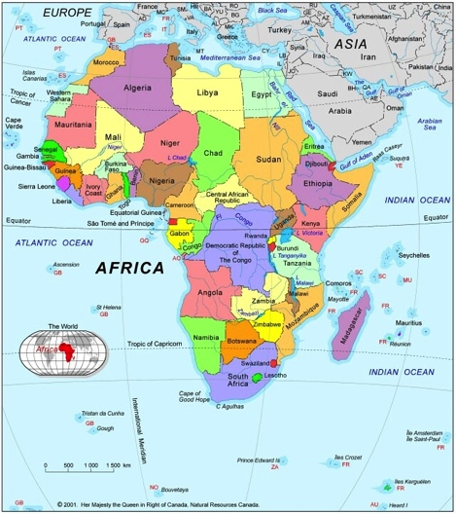
Where are we going?
Ethiopia
mLearning course for Health Extension Workers
Ghana
eLearning in midwifery & community nursing schools
Zambia
eLearning & onsite mentoring for health providers

Slide 3
What are we doing?
Degree
Simulation
Learning and Technology
Reference
Flipped Classroom
Lesson
Course
Review/Study Aid

Slide 4
How are we going to get there?
ASSESSMENT
Culture of Technology
Technology & Access
COMPETENCIES
Digital Literacy
Clinical Competencies
TECHNOLOGY
Identify, deploy & maintain
CONTENT
Develop
Identify Resources
TRACK LEARNING
What are learners’ experiences?
How are they doing?
LEARNING
Gain knowledge, practice & apply learning with tech
CAPACITY BUILDING
(for faculty & trainers)
Digital Literacy
ICT competencies
Coach & mentor
ACCREDITATION
NATIONAL SYSTEMS
Link learners’ achievements to national registries
M&E
Which indicators? What data?
How to use data?

Slide 5
Who is coming with us?
Learner
Tech team
Tutor/Trainer/Teacher/Faculty
ICT Trainer/Coach/Mentor
Instructional Designer
Multimedia eLearning Developer
Subject Matter Experts
National Gov’t & Organizations
Data Analyst/M&E
Project Manager

Slide 6
Five Stops
What will we see?
What will we do?
What will we hear?
What was good & what do different?
How will make our connection?

Slide 7
First Stop
What will you see?
Content Development

Slide 8
Content Development
Subject Matter Experts – Content experts
eLearning Expert
“creative and interactive learning experiences”
Instructional Design – Trim to “Need to know”
Quality eLearning Course

Slide 9
Adapting print material
Many patients seek traditional remedies and healing (e.g., herbal treatments, immunity boosters) before seeking care at health institutions.
Some of these remedies may have interactions w/ ARV agents.
Such interactions could potentially decrease the effectiveness or increase the risk of adverse effects.
Rise in anti-social behaviors such as child defilement and incest are increasing HIV transmission to children
Certain traditional practices, such as polygamy and sexual cleansing, may increase the risk of transmission.
Misinformation from spiritual healers and beliefs in miracle cures resulting in some patients discontinuing cART.

Slide 10
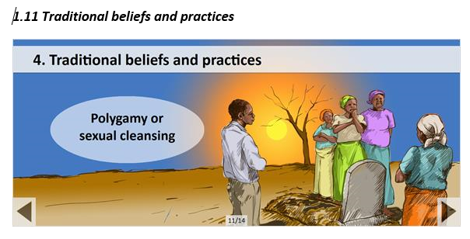
…converted to eLearning content

Slide 11
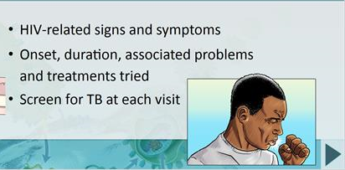
Considerations when taking a patient’s history
  Visual for eLearning
  Is the image suitable or not for the given context?

Slide 12
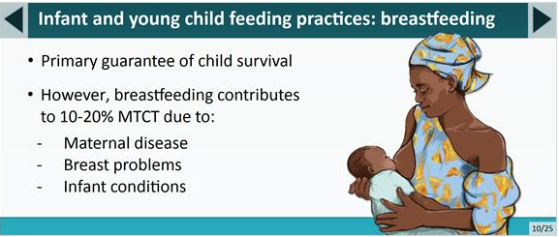
  Visual for eLearning
  Is the image suitable or not for the given context?
Breastfeeding

Slide 13
Characteristics of a good visual
Relevant and on-topic
Quality and not quantity
Engaging vs distractive
Navigation & graphics user-friendly
Reflect your message you want to deliver
Cohesive & consistent to overall design
https://elearningindustry.com/7-tips-to-choose-images-and-graphics-for-elearning-course

Slide 14
Second Stop
What will we hear?
Content Development

Slide 15
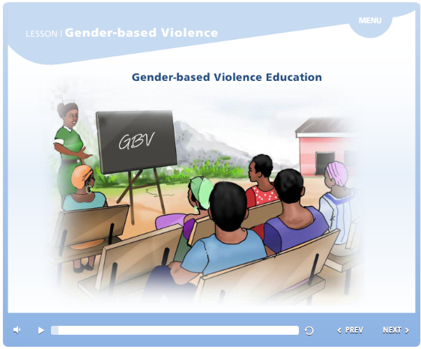
Audio Part I

Slide 16



Audio Clarity
AUDIO ONE
AUDIO TWO

Slide 17

Audio Part II

Slide 18
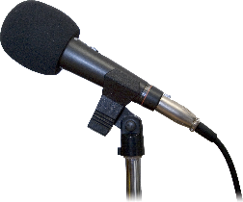


Tips for Recording Audio
  Test the recording quality
  Adjust your microphone: not too close, not too far away
  Edit your outtakes. If make a mistake, clap as a reminder.
  Save it in a high quality format. Don’t let file type ruin a good recording.

Slide 19

Third Stop
What will we do?
Mobile Learning
Health Extension Workers
Tigray, Ethiopia

Slide 20
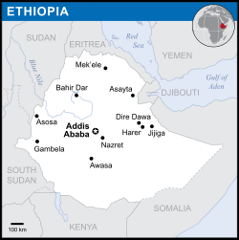
Health Extension Program
Over 38,000 Health Extension Workers (HEWs) deployed to over 15,000 health posts since 2003
Bringing basic health services to rural population: closer contact between health workers and communities

Slide 21
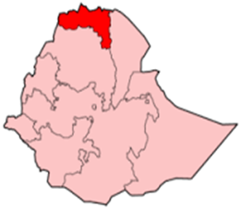


Project description
Objective: To improve health extension training & effectiveness through continuous skill improvement, knowledge assessment and patient management process using mobile learning
Target population: 157 Level Four Health Extension Workers, Dr. Tewelde Legesse Health Sciences College
Project implementation time:
  April - Oct. 2015: Upgrade training at college
  Oct. 2015 - Oct. 2016: Follow-up at posts
  Project area: Health posts located on East, South east and southern zones (sixteen woredas) of Tigray region

Slide 22
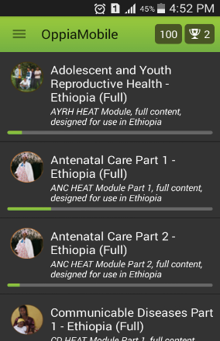
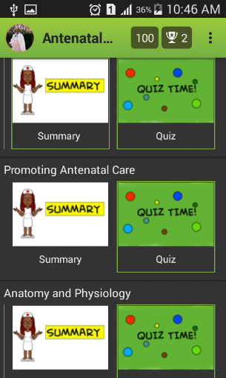
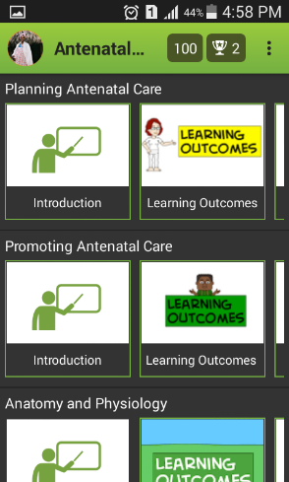
Platform & Content

Slide 23
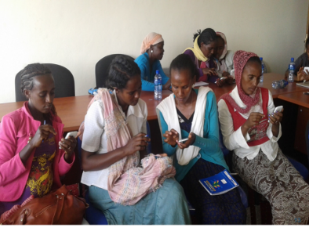
Implementation: Mobile Phones
Each of 157 HEWs received own mobile
93.6% of HEWs no exposure to smart phone or computers before the training
Training on basic Android functions such as:
    Reinstall applications
    Restore settings
    Refresh storages
100% of health extension workers fully competent within one month of training and follow up support

Slide 24
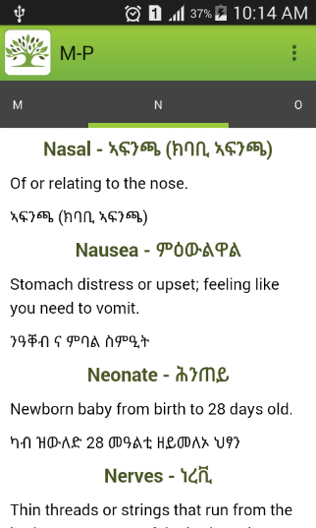
Mobile Resources
Glossary: More than 600 medical words and definitions prepared & installed on mobile.
Resources: Additional training reference content and apps such as Pregnancy Calculator were installed on mobile
Tutors: Additional tools for monitoring and assessing skills and knowledge of HEWs.

Slide 25
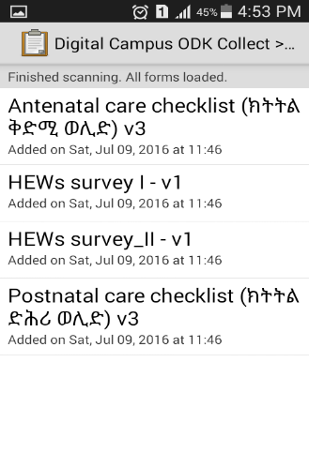
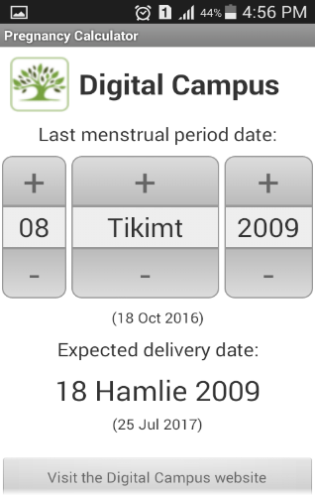
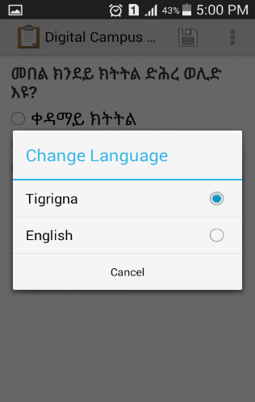
Checklist for ANC and PNC services

Slide 26
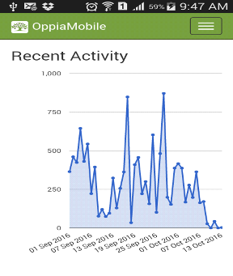
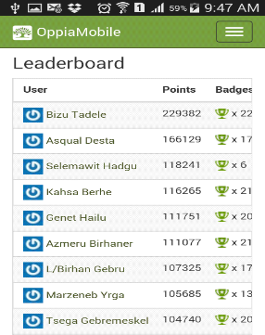
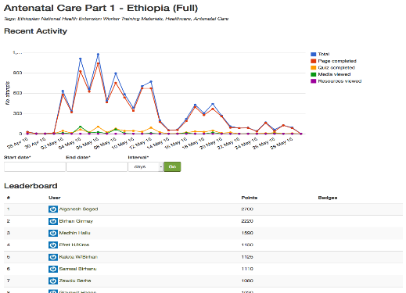
Back at their posts:
Monitoring & Follow-up

Slide 27
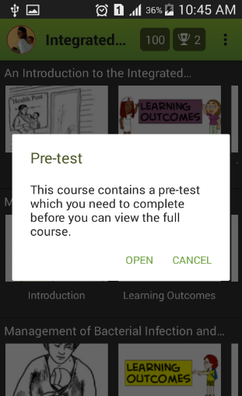
Pre & Post Competency
Pre implementation basic competency
  41% of HEWs answered less than 60% of questions.
Post implementation knowledge retention assessment: 10 months after deployment health posts
  70% answered more than 75% of quizzes provided
  93% HEWs Passed

Slide 28
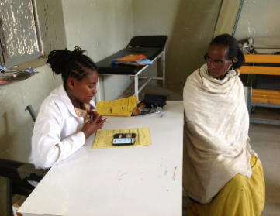
Some of HEW’s feedback on mobile learning
  HEW1: This phone is always with us, and it is hard not to look at it.
  In our college there was shortage of text books. We shared most of the books in to five some of them to more.
  Videos are very helpful to understand more what is written and improve our skills.
  HEW 2: “In our work place we do not have much reference materials or job aids.
  We also do not have health professionals to consult to.
  But this phone, said in Tigrigna, “እዛ ስልኪስ ካለአይተይ እያ’’ means “this phone is my partner.” “

Slide 29
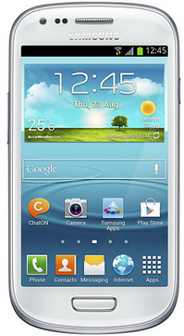
Other Findings
Woreda (District) Heads conducted competency assessment between HEWs and their supervisors. Findings:
  HEWs more competent than their supervisors
  One of major reasons was mobile learning tools.
  HEWs: They don’t want to remember their life before their mobile phones.

Slide 30
Fourth Stop
What was really good & what would we want to do differently?
Assessment

Slide 31


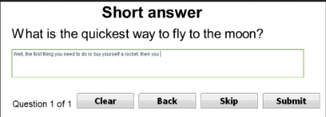
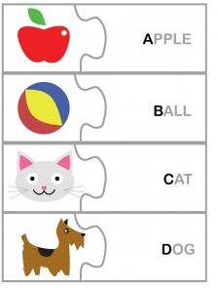
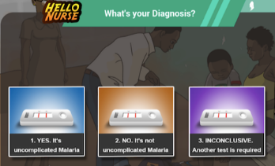
Fourth Stop: Assessment
What was really good & what would want to do different?

Slide 32
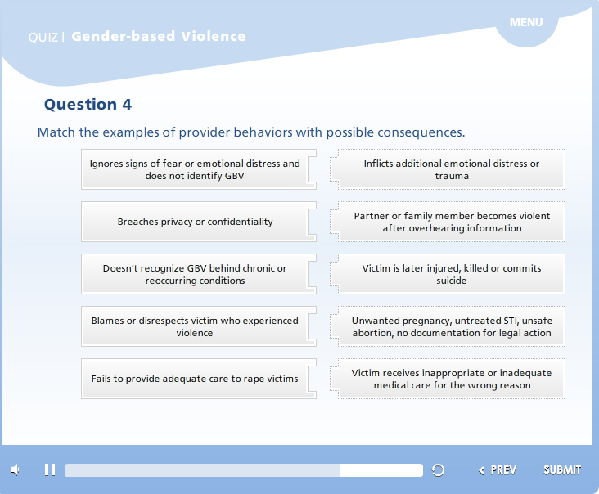
Fourth Stop: Assessment

Slide 33
Fifth Stop
Where we will make our connection?
Tracking Learning

Slide 34
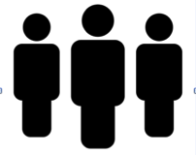


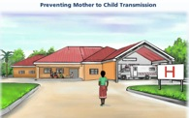


Integrated Use of Data for Learning
Fifth Stop: Making the Connection
Correlation and analysis of diverse data sources to provide a fuller picture of learning & performance

Slide 35
How are we going to get there?
ASSESSMENT
Culture of Technology
Technology & Access
COMPETENCIES
Digital Literacy
Clinical Competencies
TECHNOLOGY
Identify, deploy & maintain
CONTENT
Develop
Identify Resources
TRACK LEARNING
What are learners’ experiences?
How are they doing?
LEARNING
Gain knowledge, practice & apply learning with tech
CAPACITY BUILDING
(for faculty & trainers)
Digital Literacy
ICT competencies
Coach & mentor
ACCREDITATION
NATIONAL SYSTEMS
Link learners’ achievements to national registries
M&E
Which indicators? What data?
How to use data?

Slide 36

Discussion / Questions

Slide 37

Thank you
Meaza Raya, Education and Training Officer, Ethiopia
meaza.raya@jhpiego.org
George Muyunda, Strategic Information Technical Advisor, Zambia
george.muyanda@jhpiego.org
Leonard Mensah, ICT4D Officer, Ghana
leonard.mensah@jhpiego.org
Jodi Lis, Technical Advisor
jodi.lis@jhpiego.org

