Slide 1



Global Digital Health Forum
Open Source Data Analysis
Jillian Berkowitz
Nancy Brown
Robert Mangel
Alison Thaung
12/14/2016

Slide 2
Overview of session
Objectives:
  Introduce you to open-source tools; text analytics
  Understand types of problems/opportunities addressed
  First hand look and experience with example tools
  All share stories of current and emerging uses
Session approach
  Quick overview, intro 2 tools, hands on experience
  ‘101’ approach: covering basics, illustrating, and opportunities to go a little deeper, 2 groups
Quick poll of audience experience

Slide 3
Getting started
Why consider these options?
  New digital tools open up more possibilities to monitor, track, evaluate the impact of health intervention programs
  Amount of data up; tool power and efficiency up
Definitions:
  Open Source: ‘open’ access to code; most ‘free,’ with some license constraints
  Text Analytics: gleaning understanding from unstructured text, e.g. patterns, trends

Slide 4
Communication cycle
Talking: TV, Print, Blogs, Social Media, SMS, Direct Conversation
Listening: Direct Conversation, Surveys, Social Media Analytics

Slide 5
Data sources and analyses
Text Messages
Social Media
Medical Record Notes
Open
Ended
Surveys
Topics Trending
Sentiment, Understanding
Tests of Efficacy
Gender
Location
Time

Slide 6
Issues tracked and analyzed

Slide 7
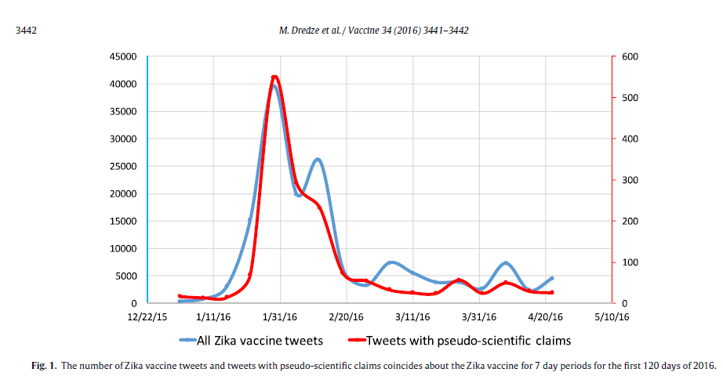
Zika vaccine research example
Notes:
--monitoring psuedo scientific claims, rumors, misunderstanding importtant to do especially when it is counter to prevention efforts
--

Slide 8
Building blocks of modern tools
Packaged solutions
(e.g. Voyant)
Custom solutions (e.g. built in Python NLTK)
Open source libraries
Free sample programs
Public
use
cases
Open Languages (Python/R)
Cloud and inexpensive platforms

Slide 9

Open methods
Open and transparent methods
Understand how and why processes work, even if not every calculation
Open source facilitates open methods, but there’s more
Understanding builds trust, and trust enables change and improvement
Researchers & Subject experts in the loop-- leverage expertise, rather than replace
Understanding enables adjustments to changing conditions and underlying assumptions

Slide 10
Power of modern day tools
Improved computing power and software do a better job at understanding language, images, and other data to help fight infectious and chronic diseases
  Detecting diabetic eye disease through deep learning
    Fastest growing cause of blindness 415 million world wide

Slide 11
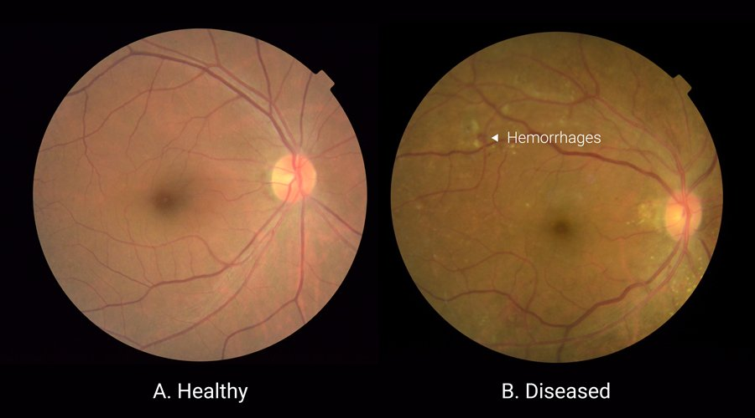
Neural networks analyzing images
* Google deep learning: https://blog.google/topics/machine-learning/detecting-diabetic-eye-disease-machine-learning/

Slide 12
Next…
We’ll talk more about images in a minute, but first lets start with one of the demos..

