Slide 1
JEMBI HEALTH SYSTEMS
“A World in which health systems and information advance global health”
Carl Fourie,
Senior Programme Manager
Pierre Dane,
Director of Technology

Slide 2
Who we are
African-based non-profit organization based in South Africa
Donor-funded programs and solid partnerships with African institutions aimed strengthening health systems to improve the quality of health care
Three Country offices: South Africa, Mozambique, Rwanda
Projects: In-country offices + Kenya, Zambia, Zimbabwe, Botswana, Lesotho
80+ staff: Health information system specialists, epidemiologists, developers, business analysts, statisticians, quality assurance specialists, Program managers and administrators, implementers, IT technicians
Notes:
A little about us and why we are here today

Slide 3
What we do
Health information systems design, development and implementation
Provide technical skills and implementation expertise institutions and nonprofit organizations
Country-level enterprise architecture for public and private health information systems
Management and coordination of a collaborative network of partner organizations and specialists, and the provision of specialist technical and project support
Research into the application of health information systems in developing countries
Share experience and knowledge (academic publications & conferences)
Notes:
Jembi offers a range of services and has seen these put to use in an ever expanding set of programmes and projects

Slide 4

Funders and Partners
Notes:
Some of our funders and partners that we have worked with.

Slide 5
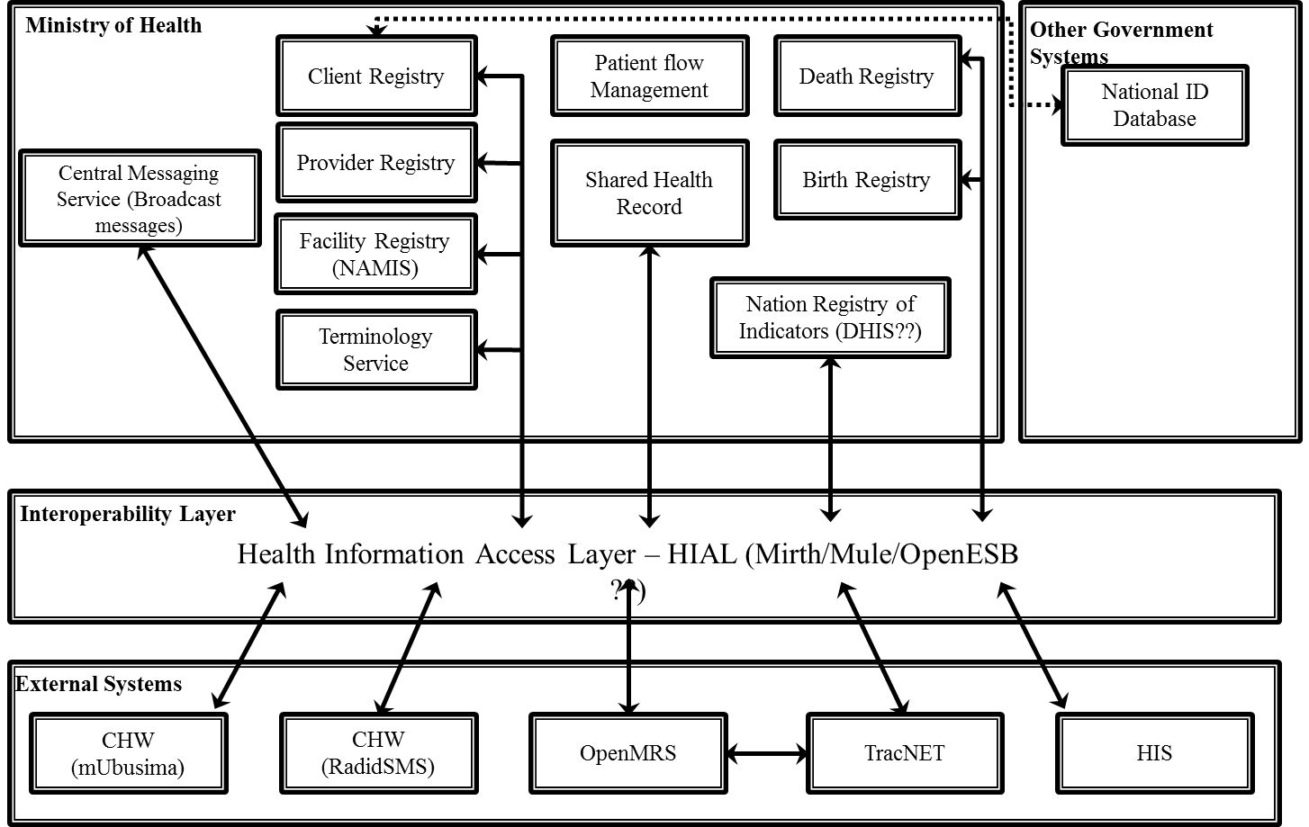
Rwanda Health Enterprise Architecture (RHEA)
Notes:
More to the point, Jembi was involved in the Rockefella lead project in the design and documentation of the Rwanda Health Information Exchange (Karl B – can expand more). Here we saw a team expand on understanding how to go about documenting the key areas of the health architecture in Rwanda. This formed the basis for the implementation of the technical design (next slide).

Slide 6
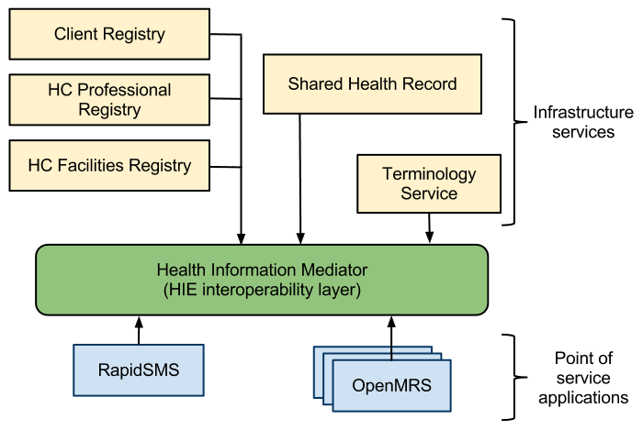
Rwanda Health Information Exchange (RHIE)
Notes:
The RHEA was used to elaborate an information system architecture that supported the Maternal Care use case but would be expandable to other areas of care as the need and desire grew.

Slide 7
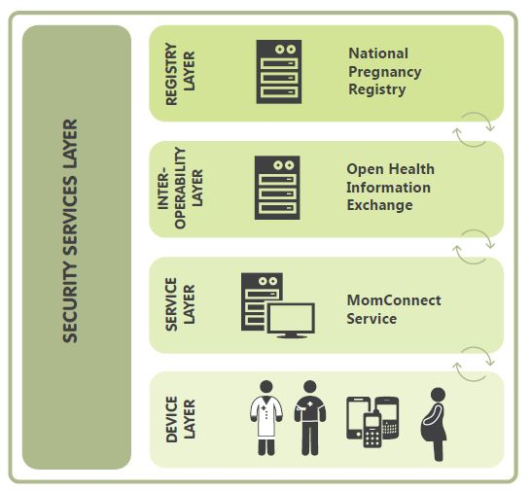
Where to from here?
Design and experience translated into OpenHIE Communities.
Patterns have formed basis of multiple other projects that the Jembi team is involved in:
  Pregnancy Registration (MomConnect)
  CRVS (Mozambique)
  Aggregate data exchange
Notes:
Our work in Rwanda has paved the way for some exiting opportunities for Jembi to form projects and build into open source communities.

Slide 8
Thoughts / Lessons
Political buy-in and leadership is key to success and handover
Managing topic of data ownership, use and curatorship is key
Consider data provenance(i.e. where it comes from and from who’s authority)
Map solutions to available skills
Plan for maintainability and understand what ownership of a system / solution looks like early (i.e. updates, responsibilities etc)
Be aware of Low Resource Settings and design accordingly

Slide 9
Thank You www.Jembi.org

