Slide 1



A Navigator for Digital Health Capability Models

Slide 2
Overview of the Navigator content
Why is the Navigator needed and what is it?
The Navigator provides guidance to users in navigating publicly available maturity model-based tools designed to assess digital health systems.
Why use a maturity model-based assessment?
These tools use a systematic basis of measurement to describe the current level of capability and to inform progress. Assessments are conducted using a measurement scale.
What tool(s) best fits
my goal(s)?
How can the tools be used together?
Depending on the context-specific goal(s), one tool may yield more valuable results than another for a given setting.
Depending on the context and available resources, one tool may be sufficient, or a combination of tools may best inform a path forward. Past assessment results can be used to inform new assessments.
What about system-specific maturity models?
Tools designed for a specific digital health system may better suit specific assessment needs and complement holistic digital health assessment tools.
Notes:
This slide provides a high-level overview of the content in Navigator slide deck. You can click on each of the modules to go to the section of the PPT. The content in this slide deck has been adapted from a collaboratively created User’s Guide, which provides additional tool details, definitions, and appendices.
The User’s Guide is available at https://wiki.digitalsquare.io/index.php/Navigator_for_Digital_Health_Capability_Models

Slide 3
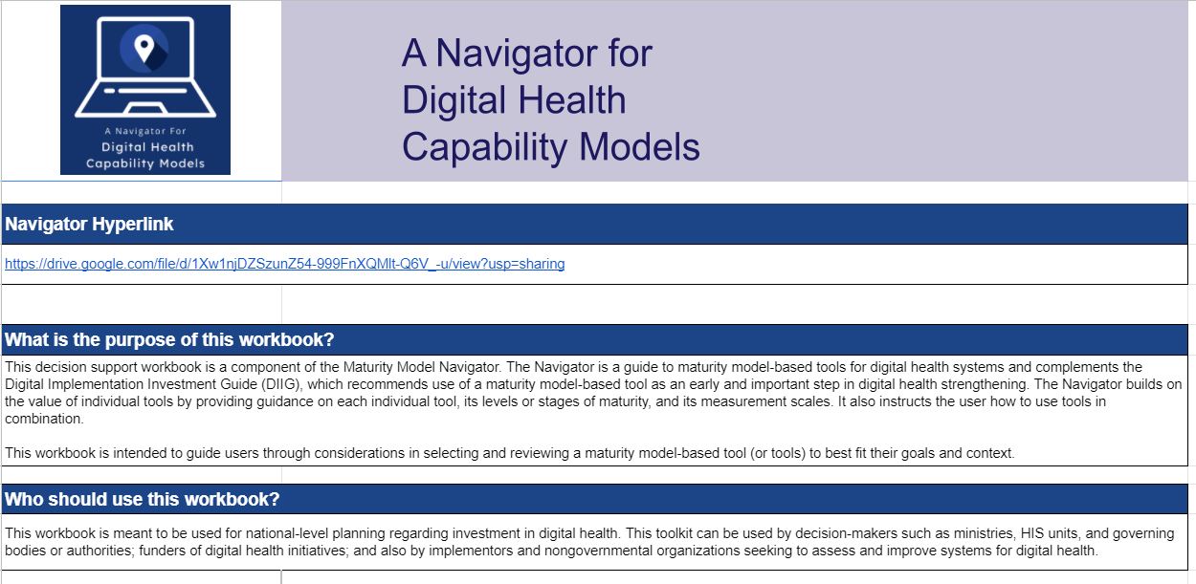
Why is the Navigator needed?
Maturity models have served a useful purpose in
determining the “as is” status of a country or
organization’s system for health data.
The number of publicly available maturity model-
based tools may leave potential users unsure of
where to start.
Maturity model-based tools stand to add the most value to a health system when aligned with the specific digital health goals of a country or organization.
The Navigator builds on the value of independent maturity model-based tools by providing guidance to navigate their effective use.
Digital Square | connecting the world for better health
Notes:
The Navigator builds on the value of independent maturity model tools by providing guidance to navigate their effective use. The Navigator adds value to the WHO Digital Implementation Investment Guide, which recommends the use of maturity model-based tools in phase 1 (i.e., assessing the current state and enabling environment). The Navigator will help stakeholders choose and use a maturity model-based tool(s) that is most appropriate to their context and purpose as well as to consider the results from past maturity model-based assessments.
The Navigator provides an overview of maturity model-based tools, including details about each tool’s:
Focus and purpose
Level of focus in the healthcare system (e.g., national, subnational)
Levels or stages of maturity (number of stages/levels, how each level is defined)
Attributes or components of the tool (domains/components/subcomponents)
Assessment approach and method of data collection
Estimated level of effort needed, duration, and technical know-how required for implementation.
Version 1.0 of the Navigator provides in-depth guidance on publicly available maturity model toolkits (users’ guides, assessment worksheets, etc.) that are designed to holistically assess national-level digital health systems that are agnostic to any one platform or subsystem of the HIS. The Navigator also provides linkages to maturity models that are designed for a specific subsystem, such as immunization or supply chain information systems.

Slide 4
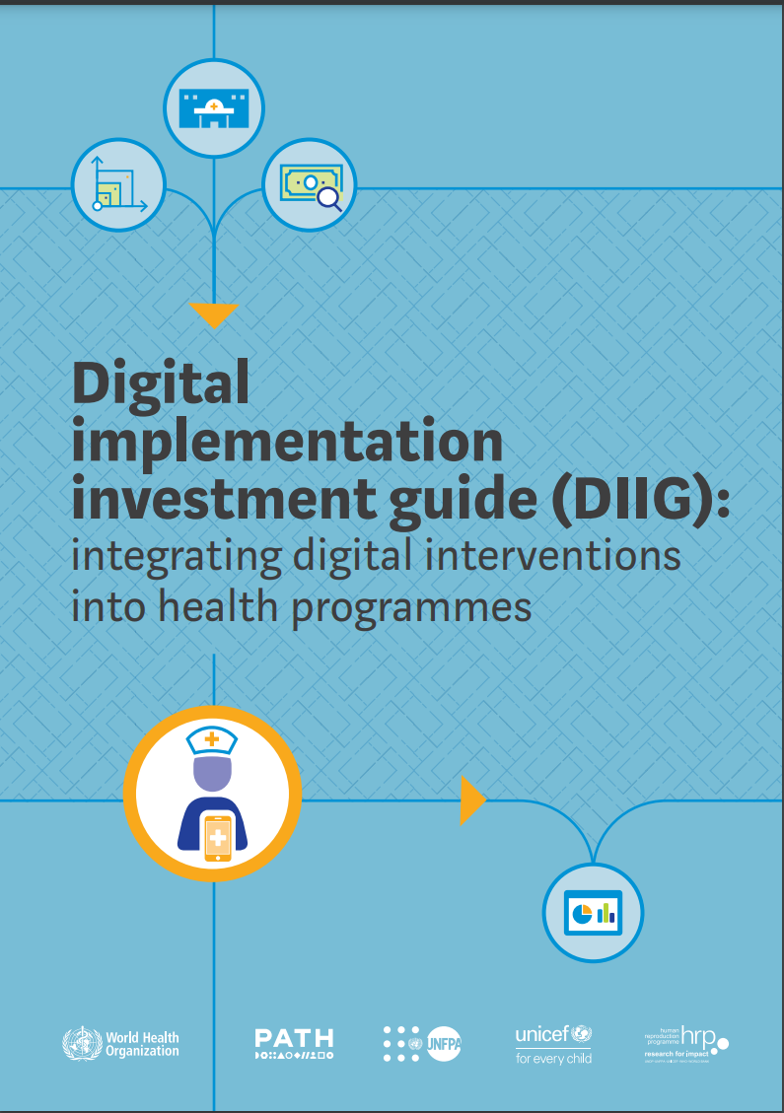
What is the Navigator?
The Navigator is a guide to maturity model-based tools for
digital health systems. The Navigator includes:
  A User’s Guide that expands on this slide deck.
  An accompanying Decision Support Workbook in Excel.
  This slide deck (an abridged version of the User’s Guide).
The Navigator complements WHO’s Digital Implementation Investment Guide, which recommends the use of a maturity model-based tool as an early step in digital health strengthening.
The Navigator builds on the value of individual tools by providing guidance on each tool and on how to use the tools in combination.
Digital Square | connecting the world for better health
Notes:
The Navigator also includes an Excel-based appendix with one-to-one mapping of tool indicators.

Slide 5

Capability and maturity
Capability is used in relation to process, system, people, and organization.
Many of the tools included in the Navigator use the term maturity model to describe tool structures.
The tools in the Navigator are multidimensional models that measure the capability and maturity
of various attributes of digital health.
In describing specific tools, we will mirror the language of the tools in using maturity models to describe the tools.
Note: The terms digital health, eHealth, and health information systems are often used interchangeably and their definitions may overlap. For the purposes of the Navigator, digital health will be used as an umbrella term. See slides 34-35 for more information.
Notes:
Notes on the terms used in the Navigator. See the User guide for more details on language as well as a glossary.

Slide 6

Why use a maturity model-based assessment tool? (1 of 2)
Maturity model-based assessment tools for digital health establish a systematic basis of measurement to:
  Describe the current maturity level of digital health systems in terms of human resources, business processes, technology, and organizational capabilities.
  Facilitate users’ ability to set goals for future levels of maturity.
  Inform the development of improvement plans to realize the next maturity level toward a stronger digital health system for a country to meet its public health targets.
Digital Square | connecting the world for better health
Notes:
Identifying strengths and weaknesses is critical to inform strategic planning for donors to understand, at technical and granular levels, where countries are in their digital transformation journeys. We hope that this will be a tool that people will want to rely on, also to monitor progress of investment over time, using a rapid and low-resource effort.

Slide 7
Why use a maturity model-based assessment tool? (2 of 2)
The elements defined in a model can be used to assess digital health capabilities. Assessment results help an organization or country understand where it is on the path to maturity, and to visualize the future workforce, business processes, and technology capability required to achieve optimal function for purpose.
Results from maturity model assessments identify both strengths and shortfalls in achieving the goals of a given health system.
Digital Square | connecting the world for better health

Slide 8
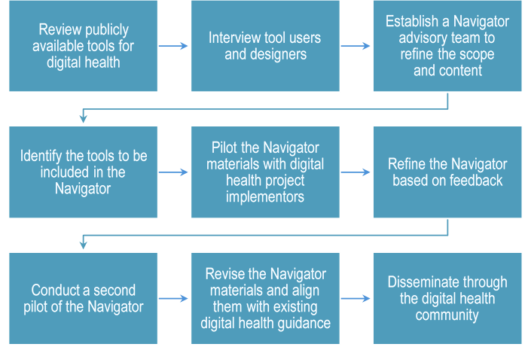
How was the Navigator developed?
Notes:
This Navigator was developed through an iterative and multi-step process, the first of which was to review publicly available maturity model-based tools for digital health, their accompanying guidance, and available reports of where assessments have been done and used.
The next step was to interview users and developers of the tools, to better understand each tool’s unique purpose and design, and to understand how the tools have been practically applied in the field. (A PDF document summarizing these interviews is available in the Digital Square Resource Library at https://lib.digitalsquare.io/.)
In developing the Navigator content, we outlined the scope of the Navigator to determine which tools should be included and what parameters would define the tools that were included. See slide 13 for more information.
To review drafts, content, and tools to include, we established a multi-stakeholder advisory group with members from USAID, Kati Collective, WHO, UNICEF, and JSI.

Slide 9
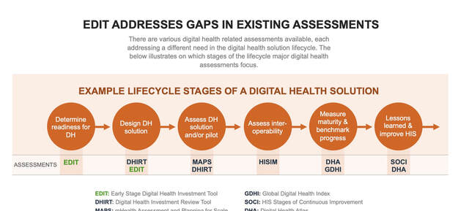
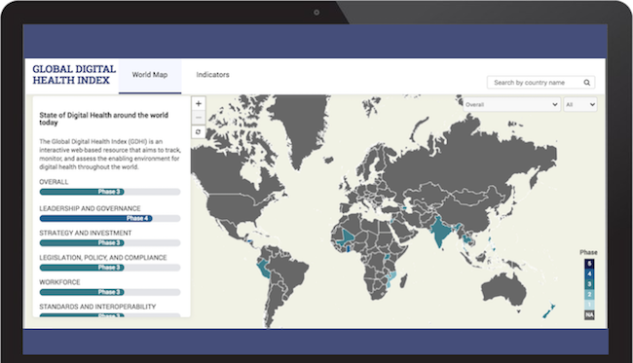




What tools are included in the Navigator?
 | The Early Stage Digital Health Investment Tool (EDIT) is a global good designed to assess a country’s readiness to implement a digital solution(s).
 | The Global Digital Health Index (GDHI) is an interactive digital resource that tracks, monitors, and evaluates the use of digital technology for health across countries.
 | The HIS Interoperability Maturity Model (IMM) identifies the major components of HIS interoperability and lays out an organization’s growth pathway through these components.
 | The HIS Stages of Continuous Improvement (SOCI) Toolkit was collaboratively designed to help countries or organizations holistically assess, plan, and prioritize interventions and investments to strengthen an HIS.
 | The Information Systems for Health (IS4H) Toolkit describes the method, tool, and questions for assessing organizational capacity.
 | WHO’s Survey, Count, Optimize, Review, Enable (SCORE) Essential Interventions is part of the SCORE for Health Data Technical Package of five essential interventions with key elements to strengthen country health data and information systems, and enable governments to track progress toward the health-related SDGs and national and subnational priorities.
Notes:
Individual tool fact sheets can be found in the Excel Decision Support Workbook.

Slide 10
Tool selection parameters
The following criteria were used to include maturity models for alignment and developing a maturity model navigator.
  Focused on advancing the maturity of national capabilities and not specific system categories.
  Agnostic to disease (HIV, TB, malaria, etc.) domains.
  Implemented by MOHs in low- and middle-income countries.
  Available and accessible for the purpose of alignment (tool, user’s guide, and accompanying documents available).

Slide 11
What tool best fits my goal?
Each tool is designed to serve specific purposes and functions related to assessing and advancing digital health.
The Excel-based Decision Support Workbook provides guidance on selecting a tool based on the goal(s) of the assessments, along with the intended audience, available resources, and priority areas of digital health to assess.
The Navigator will also include guidance on how to use tools and their results in combination, including a detailed mapping of indicators.
Digital Square | connecting the world for better health

Slide 12
Main criteria for selecting a tool
A key first step in determining the best tool for a given context is to determine the goal(s) of conducting the assessment. The goal(s) should align with the purpose of the selected tool.
Possible goals for assessments:
    Assess and monitor digital health readiness to prioritize digital health investments.
    Track, monitor, assess, and benchmark the effective use of digital health.
    Develop a digital health (or eHealth) strategy.
    Develop an HIS interoperability strategy.
    Assess and improve HIS interoperability maturity.
    Develop an HIS strategy.
    Monitor and evaluate HIS process improvements.
    Determine current and desired maturity levels to develop
    a roadmap for continuous HIS improvement.
    Assess and strengthen country HIS and data to track progress toward the health-related SDGs.
Notes:
The goals outlined here were taken from each tools’ intended purposes. More details on tool purpose can be found in the Navigator User’s Guide.

Slide 13
Previous assessments
Assessment tools used in the past
two years
Considering what, if any, maturity model-based tools have been used in the previous two years will be important for assessment planning purposes. Future assessments may be able to draw from past results.
The Navigator provides guidance on how to use tools in combination, including a detailed mapping of individual tool indicators.
Notes:
The goals outlined here were taken from the included tools’ intended purposes. More details on tool purpose can be found in the Navigator User’s Guide.

Slide 14
Additional criteria for selecting a tool
Additional criteria: Audience and methods
If multiple tools align with a given goal or goals, additional criteria can help determine a best-for-fit option.
Additional criteria include:
Assessment language lists in what languages assessment materials are available. All assessments included in the Navigator are available in English; some assessment toolkits are also available in French, Spanish, Portuguese, or Arabic.
Methods cover the prescribed process for conducting the assessment. This varies by tool from a half-day workshop with several key stakeholders, to multi-day workshops, to site visits and observations. The selection of methods should consider what resources are available to support the assessment methods.
Areas assessed are the specific elements or components of digital health measured by a given assessment. (See the next slide.)
Notes:
Note: Additional considerations for selecting and using a tool include maturity model-based tools that have previously been used in the given context, for example if the HIS Interoperability Maturity Model was already implemented in a country, and that country would like to conduct another assessment that aligns with a different goal, such as HIS strategic planning. Guidance on how to use tools in combination, including how to consider previous tool assessment results, is forthcoming.

Slide 15
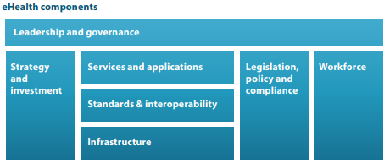
Areas assessed
The tools included in the Navigator assess the maturity of various attributes of digital health as outlined in the WHO-ITU framework.
Digital health components (adapted from WHO-ITU framework eHealth components)
Digital Square | connecting the world for better health
Notes:
Each tool organizes these areas a bit differently; the WHO-ITU eHealth strategy provides a useful framework for grouping elements. A more detailed mapping of indicators is forthcoming and will provide guidance at the most granular level.

Slide 16

Decision Support Workbook
The Excel-based Decision Support Workbook asks users to input their main goal or goals (up to two) in conducting an assessment and makes a recommendation.
Users are also asked to indicate whether any of the tools have been used in the previous two years
in their specific context, country, or organization.
Users may be prompted to select additional criteria
if more than one tool aligns with the selected goal(s).
Recommendations are meant to indicate which tools users should review more closely to determine the best fit for purpose.
Digital Square | connecting the world for better health
Notes:
The decision support workbook is Excel-based.

Slide 17
Using the Decision Support Workbook
Review the Overview and Instructions tabs.
Select the Tool Selection tab. Select up to two goals for implementing an assessment and any previous tools used.
  If multiple goals are selected and no one tool fits those goals, you will be prompted to select fewer goals.
  If multiple tools align with the selected goal statement, you will be prompted to select additional criteria.
Digital Square | connecting the world for better health

Slide 18
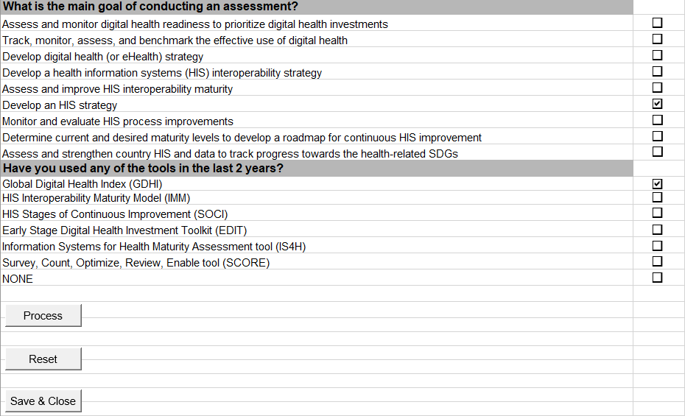
Decision Support Workbook
Select up to two goals as a primary means of selecting a tool (up to two).

Slide 19
Decision Support Workbook
Select any/all tools that have been used in the context in the previous two years.

Slide 20
Using the Decision Support Workbook
If prompted to select additional criteria, you must make at least one additional selection. Additional selection options include:
  Languages in which toolkits are available.
  Methods prescribed for each tool.
  Key areas each assessment covers.
Digital Square | connecting the world for better health

Slide 21
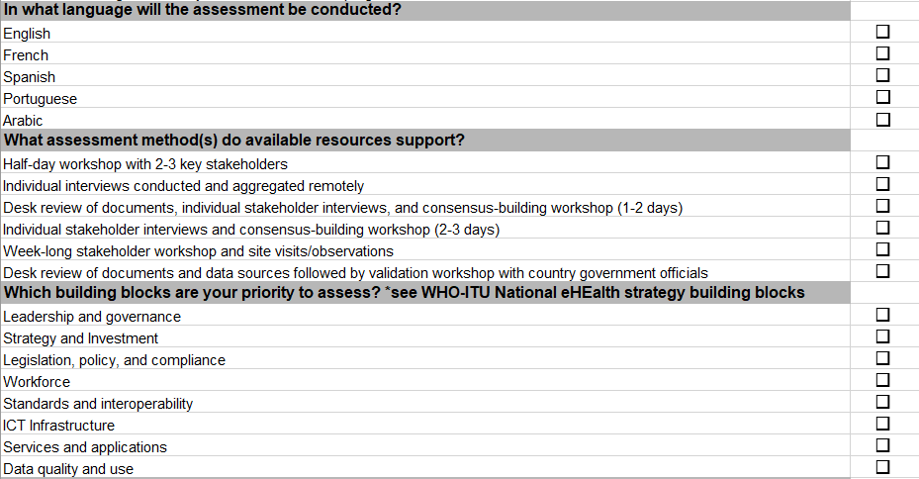
Decision
Support Workbook
When more than one tool aligns with the goal, additional criteria can be selected.
Make additional selections to further filter the tool recommendations.

Slide 22
Output of the Decision Support Workbook
The workbook makes a recommendation based on your responses.
If additional criteria selected do not align with a tool option, two tool options will be recommended for further review.
If you have used a different tool(s) in the previous two years, new tabs will populate, which compare indicators across the recommended and previous tools.
Digital Square | connecting the world for better health

Slide 23
Decision Support Workbook output
Tools that align most closely with the assessment goal(s) are recommended.
Based on the goal(s) you have selected:
The tools that best fits your selected goal(s) | Based on main selection criteria:
Tool Name: GDHI | Selected Goal: Develop digital health (or eHealth) strategy
Tool Name: EDIT | Selected Goal: Develop digital health (or eHealth) strategy
Based on your additional selected criteria, the most appropriate tool in the Navigator is:
Most appropriate tool: | Based on additional selection criteria:
Tool Name: GDHI | Portuguese
Please select the GDHI tab for more information on this tool
Please review the findings from past assessment using GDHI before deciding to conduct another assessment using GDHI.
If additional criteria are selected, this may narrow the tool selection. In this example, Portuguese was selected as the preferred tool language.

Slide 24
How can tools be used together?
What is the goal of conducting an assessment?
What assessments have been conducted previously?
Guidance on using results from the previous assessment
Digital Square | connecting the world for better health

Slide 25
Using tools in combination
Based on your main assessment goal [and additional criteria], the HIS Interoperability Maturity Model (IMM) is the recommended tool.
Given that you have used IMM in the past, the Navigator recommends reviewing the data for the following indicators from the GDHI assessment to (1)determine its relevance and applicability to your main assessment goal, and (2) decide whether you need to conduct comprehensive GDHI assessment or apply part of the IMM tool. Please see the Overview tab for more on the coding system used here.
IMM Code | IMM Subdomain | IMM Subdomain Definition | GDHI Code | GDHI Indicator | GDHI Indicator Description
M.A.1 | Governance Structure for HIS | The exercise of technical, political, and administrative authority to manage national HIS affairs at all levels of a country’s health system. The governance structure consists of the mechanisms, processes, and institutions through which actors and stakeholders articulate their interests, exercise their rights, meet their obligations, mediate their differences, and oversee the functioning of the HIS. | G.A.1 | Indicator 1 - Digital health prioritized at the national level through dedicated bodies / mechanisms for governance | Does the country have a separate department / agency / national working group for digital health?
M.A.2 | Interoperability Guidance Documents | The documents (policies, strategies, and frameworks) that guide decisions, implementation, and the course of action for HIS interoperability. They are important reference materials for stakeholders who are developing the HIS from its current status to a mature status. | G.E.2 | Indicator 14 - Health information standards | Are there digital health / health information standards for data exchange, transmission, messaging, security, privacy, and hardware?
M.B.1 | Human Resources Policy | A set of principles, guidelines, and norms that an organization adopts to help manage its employees. | G.G.3 | Indicator 19 - Maturity of public sector digital health professional careers | Are there public sector professional titles and career paths in digital health?
When a tool has been used previously, the workbook will provide a mapping of indicators from the recommended tool to the previous tool.

Slide 26
Decision Support Workbook buttons
Select Process to return an output.
Select the Reset button to start over. (Note: you will lose any output if you select this.)
Use the Save and Close button to save a version of the workbook with the tool recommendations. Use a unique file name when saving.
Digital Square | connecting the world for better health

Slide 27
What about system-specific maturity models?
In addition to the tools listed in Slide 9, there are maturity model-based tools designed to assess specific information subsystems that can provide detailed and specific assessment criteria, indicators, and steps for improvement to support specific subsystems.
Such tools can be used in combination with the tools in the Navigator that take a broader lens to assessing systems for digital health.
Determination of when to use such tools will depend on the specific goals of a country or the organizational context.
Digital Square | connecting the world for better health

Slide 28
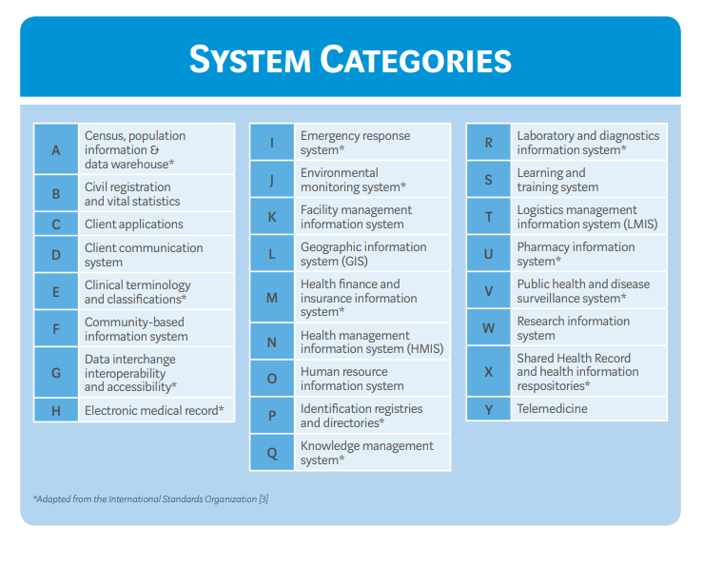
System-specific maturity models can be used for the following system categories, as organized by the WHO Digital Implementation Investment Guide (DIIG) framework.
WHO System Categories, DIIG

Slide 29
How can tools be used in combination?
Countries and organizations focusing on overall digital health transformations may benefit from first using a maturity model-based tool that is not specific to any particular subsystem to assess the “as is” status of systems for digital health.
For countries that have identified priority areas for strengthening specific systems, a tool designed specifically to assess that system may be a good choice to use independently or following an overall digital health assessment. (For example, the Supply Chain Information System Maturity Model shown on the next slide.)
The determination of when to use such tools will depend on the specific goals of a country or the organizational context.
Digital Square | connecting the world for better health

Slide 30
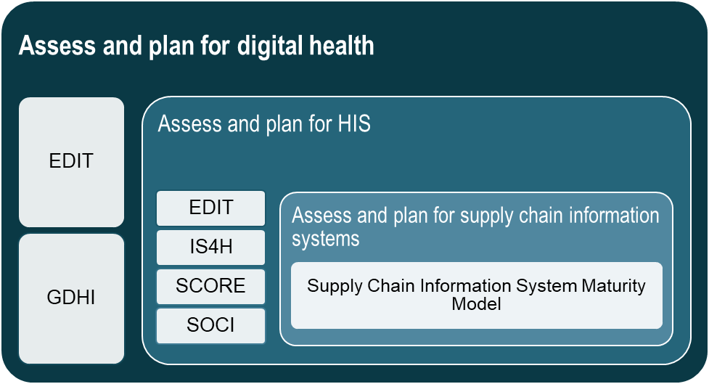
Choosing an assessment based on organizational priorities
Countries and organizations should consider assessment tools that align with their priorities, which may be in digital health, HIS, or for a specific information system, such as the supply chain information system.
This graphic shows how specific tools align with priorities.
Digital Square | connecting the world for better health
Notes:
SCISMM is one example of a system specific maturity model that can be used in combinations with other maturity model-based tools included in the Navigator.

Slide 31
Summary
The Navigator is intended to provide guidance for selecting and using one
or more maturity model-based tools.
The accompanying Decision Support Workbook (in Excel) is intended to guide users in determining which tool or tools
to review more closely.
Assessment planners should consider
what tools have been used previously
and whether the assessment results can
be reviewed to inform a new assessment.

Slide 32
Digital Square is supported by:
Digital Square is a PATH-led initiative funded and designed by the United States Agency for International Development, the Bill & Melinda Gates Foundation, and a consortium of other donors.
This presentation was made possible by the generous support of the American people through the United States Agency for International Development. The contents are the responsibility of PATH and do not necessarily reflect the views of USAID or the United States Government.

Slide 33
Appendix slides

Slide 34

Digital health
The terms digital health, eHealth, mHealth, and health information systems are often used interchangeably, and their definitions may overlap. For the purposes of the Navigator, digital health
is used as an umbrella term that encompasses
all applications of ICT, such as electronic health records, mobile health technologies, and interoperable platforms to support the collection
and use of health information.
When describing specific tools and their intended goal(s), the Navigator uses the language of the tool, including HIS, digital health, and/or eHealth.
Notes:
We use digital health as an umbrella term to encompass applications of ICT to support the use of health information. In some cases, more specific terms—such as health information systems or eHealth—are used to describe specific tools and their intended goals.

Slide 35
What do we mean by digital health?
Digital health is the systematic application of ICT, computer science, and data to support informed decision making by individuals, the health workforce, and health systems to strengthen resilience to disease and improve health and wellness.
  (WHO, 2020)
Notes:
This slide is to elaborate on what we mean by the term “digital health” in the Navigator. More guidance on terms can be found in the Navigator User’s Guide and in the Digital Implementation Investment Guide, linked in the slide.

Slide 36
Tool attributes explored
The tools in the Navigator vary in the
following ways:
  Specific purpose or goal in conducting
  the assessment
  Languages in which the tools are available
  Methodology and resources needed to conduct an assessment, including subject matter expertise of participants
  How attributes of digital health are organized (domains, components, subcomponents, etc.)
  The number of levels/stages and how each level of maturity is defined
  Results output

Slide 37
What does each maturity model comprise? (1 of 2)
 | EDIT | GDHI | IMM | IS4H | SCORE | SOCI
Number of levels/ stages | Scale of 1-5 | Five maturity phases | Five maturity levels | Five maturity levels | Five levels | Five stages for improvement
Notes on scoring | Average scores from multiple stakeholders; tool allows for weighting of certain stakeholder responses | In average phase calculations, the platform rounds up and is meant to celebrate achievements | Scoring allows for full completion of levels and partial completion (if only two of three attributes have been met for a given level) | Average of ranking scores for each goal | Scores given for each of the five intervention categories in the SCORE package; indicators are scored based on a country’s current capacity | Initial scoring done by averaging scores from stakeholders; final assessment scores determined in consensus building workshop
Digital Square | connecting the world for better health

Slide 38
What does each maturity model comprise? (2 of 2)
 | EDIT | GDHI | IMM | SOCI | IS4H | SCORE
Attributes | Six essential building blocks with 19 respective subcategories and 71 total indicators; indicators are categorized as information, enabling, or critical | 19 core indicators aligned with the seven components of the WHO-ITU Strategy Framework | Three domains and 18 respective subdomains | Five HIS core domains, 13 corresponding components, and 39 subcomponents | Four strategic goals, 26 components | Five technical areas
Main areas of assessment, as described by the tool | Human capacity Standards and interoperability Governance and policy Data capture and use Investments and funding Infrastructure | Leadership and governance Strategy and investment Legislation, policy, and compliance Workforce Standards and interoperability Infrastructure Services and applications | Leadership and governance Human resources Technology | Leadership and governance Management and workforce ICT infrastructure Standards and interoperability Data quality and use | Data management and information technologies Management and governance Knowledge management and sharing Innovation | Survey populations and health risks Count births, deaths, and causes of deaths Optimize health service data Review progress and performance Enable data use for policy and action
Notes:
It is important to note that the last row here, the main areas of assessment, are very general. Each tool defines each of the main areas for assessment differently. For example, leadership and governance are assessed in all six tools, but the tool varies in what falls under leadership and governance. Some tools include strategic planning and financing here, whereas others assess those attributes under other areas. The detailed tool mapping is forthcoming and will provide more insight on this.

