Slide 1
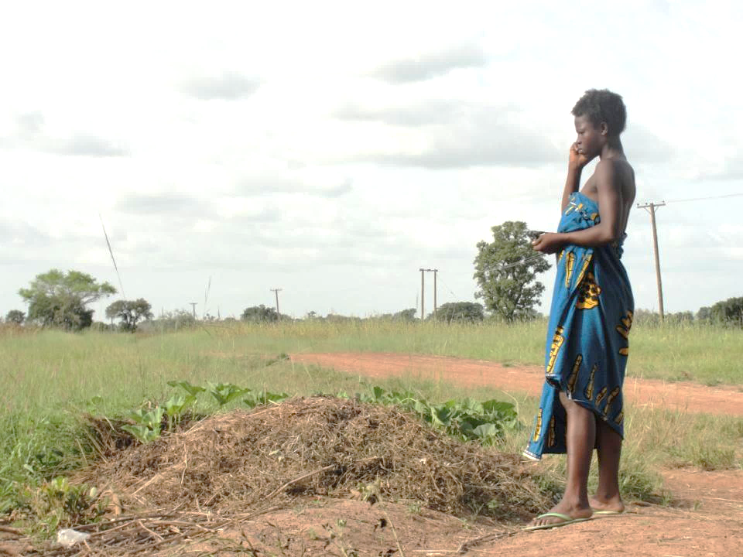





Hindsight is 20/20:
What we can learn from the
Mobile Technology for Health (MOTECH) program in Ghana?
David Hutchful, Larissa Jennings, Amnesty LeFevre, Garrett Mehl, Diwakar Mohan, Anitha Moorthy, Tim Wood

Slide 2
Session Overview
Introductions (Garret Mehl, 5 minutes)
  Moderator and speakers
  Audience introduction
Part 1. Introduction to MOTECH (Anitha Moorthy & David Hutchful, 15 minutes)
  Background and rationale
  What is it? How does it work?
  Deep dive into technology development
Part 2. Reflections on program evaluation-- Summary findings from MOTECH M&E activities (Amnesty LeFevre & Larissa Jennings, 15 minutes)
Part 3. Group reflections on future strategies for improving program implementation, data collection and use (Tim Wood, 25 minutes)

Slide 3
Part 1. Introduction to MOTECH

Slide 4
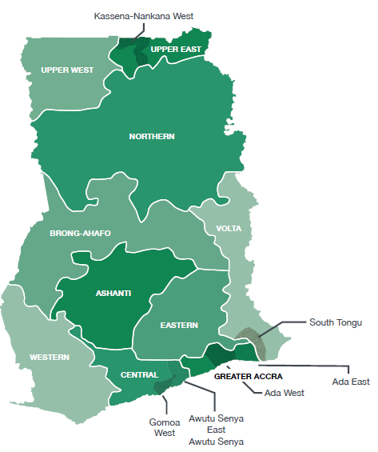
MOTECH
Partnership between Ghana Health Service and Grameen Foundation
Piloted in Upper East Region and in Awutu Senya districts in Central Region in 2010-2011
Replicated in 4 districts in 3 regions in 2013
Program goal: improve maternal, newborn & child health (MNCH) through two inter-related programs
Mobile Midwife: free messaging service that delivered educational and actionable information for rural women
Client Data Application: mobile-phone based clinical data collection, tracking and reporting tool for frontline health workers

Slide 5
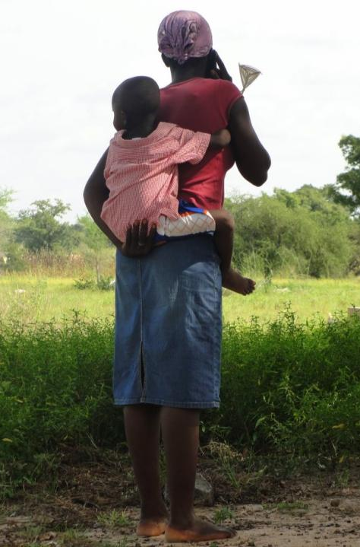
How Mobile Midwife Worked
  Target pregnant women, mothers of infants, other household members
  Culturally adapted stage-based MNCH educational information timed to women’s gestational age or age of their infant
  Alerts on when to seek routine antenatal, delivery, postnatal and infant care (<12 mo)
  Reminders on missed clinic visits
  Weekly voice (in local language) or SMS messages at a day and time of their choosing
  Retrievable messages
Why do I need injections for me & my baby?
Why do I need to take malaria drugs?
What do I do about body swelling during pregnancy?
Why should I practice exclusive breastfeeding?
Why should
I attend clinic at first
signs of pregnancy?

Slide 6


What Health Facilities were Engaged?
Client Data Application:
MNCH SERVICES AT PUBLIC HEALTH FACILITIES
HOSPITALS
Comprehensive MNCH, c-section, and severe disease management
Women and children move between public and private health facilities for MNCH care
Client data application (CDA) initially engaged community health nurses at CHPS facilities, but evolved over time to engage all public health facilities, and later private health facilities in the districts
HEALTH CENTERS
Comprehensive ANC, uncomplicated delivery, PNC, immunizations, disease management, family planning
COMMUNITY CLINICS (CHPS)
ANC, PNC, family planning counseling & basic services, immunizations, uncomplicated malaria, nutrition counseling & supplements, basic curative & first-aid

Slide 7
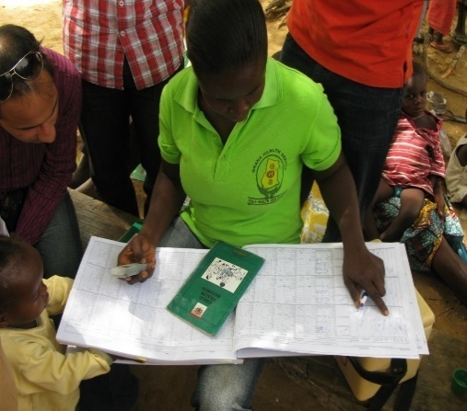
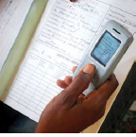
How Client Data Application Worked
Registering Clients
Clients registered into Mobile Midwife during home visits, outreach activities or clinic visits
Assign MOTECH IDs
Recording Clinical Data
Health workers provide care in the community or at clinics
Record care in simplified paper registers
Transfer patient data using mobile phones
Upload data to central database
Tracking Clients
Weekly SMS lists sent to nurses on pregnant women and mothers/infants who are due for routine care or missed visits
Ability to query system to retrieve lists
Data Collection & Reporting
Routine data quality checks to ensure data accuracy & completeness
Automated generation of monthly reports for facilities with high degree of data quality uploads

Slide 8
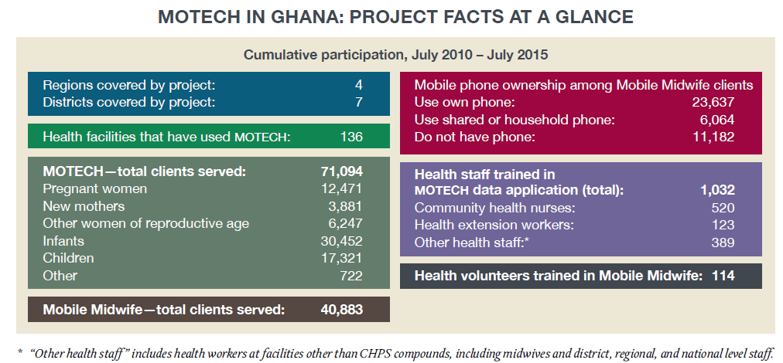
MOTECH Coverage: 2010 to 2015

Slide 9






MOTECH: Mobile Midwife Service
CLIENT
DHMT
NURSE
CDA
- Health messages
- Alerts & Reminders
Follow up list of upcoming
and missed care
Pregnancy Messaging Campaign
First Year of life Messaging Campaign
Monthly Reports
Patient Health Records

Slide 10
MOTECH: Mobile Midwife Service
CLIENT
DHMT
NURSE
CDA
- Health messages
- Alerts & Reminders
Follow up list of upcoming
and missed care
CDA form submissions
Client registration
Call Requests
IVR Call Logs
Pregnancy Messaging Campaign
First Year of life Messaging Campaign
Patient data
Monthly Reports
Patient Health Records

Slide 11
Part 2. Reflections on program evaluation

Slide 12
Study Overview
Collaboration between GF and JHSPH/ JHU-GmI with support from WHO
Aims to present data on the MOTECH platform’s effectiveness in message delivery and user response (providers and clients) across study sites in five districts from 2011-2014.
Capture trends in provider engagement: assess the frequency and volume of data uploads over time and by level of facility
Message delivery platform: effectiveness in ‘pushing’ out messages across the continuum of care and by content area to registered women
Explore client engagement: identify proportion of and characteristics of message recipients who listened to at least 50% the length of each message received (defined as ‘active listeners’)
Assess the feasibility, usability, and acceptability of Client Data App
Notes:
Excluded following registered clients from analysis:
Who did not have access to a phone, and instead had to rely on a community phone to retrieve their weekly messages
Who shared the same mobile phone to access messages

Slide 13
Linking MOTECH activities with careseeking
MNCH messages sent to clients
Clients receive messages
Clients listened to messages
Knowledge, careseeking improved
Health worker registers clients
Health worker uploads client data
Client data received
Care reminders sent to clients
High quality MNCH care provided
Client adheres to care, health improved
Upcoming & missed care alerts sent to health workers
Health workers received SMS lists of clients
Health workers reads list of clients due for or missed care
Health workers follow-up with clients
MOTECH server aggregates client data per health facility
Program team verifies data and provides data support
Data quality checks at each facility
Automated facilities receive select auto-generated monthly reports
Provider or health system factors
Technological factors
Generating Demand and Client Care
Client or community level factors
Technological & programmatic factors
Data Reporting

Slide 14
Key finding 1: Who are registered users?
 | Total
Pregnant women | N= 4,635
Gestational age at enrolment – 2nd Trimester | 53%
Phone Ownership – Private | 86%
1 or more previous children | 69%
Postpartum | N=7,933
Age at enrollment: 7 weeks-6 months postpartum | 50%
Phone Ownership - Private | 78%

Slide 15
Overall Less than 2/3rd of expected MM messages were received by intended recipients
Key Findings 2 & 3
42-61% of registered received at least 1 message due to network issues, call congestion, and/or insufficient electricity
Notes:
Study findings suggest that between 42% and 61% of women received at least 1 message at each of the six timepoints assessed across the continuum of care.

Slide 16
Key finding 4: Among pregnant women, almost 90% chose to listen to messages received; however, postpartum rates of active listening declined significantly over time
Notes:
Light grey: The denominator is the total number of women who received at least one message. The numerator is the number of women that listened to 50% of number of messages that they received for at least 50% of the length of each message. Said another way: active listening defined as the number of women that listened to 50% of number of messages for at least 50% of the length of each message.
Amongst message recipients, 48% to 91% of women who received messages during pregnancy and/or postpartum listened to at least 50% the length of each message
Among pregnant women, almost 90% chose to listen to messages received; however, postpartum rates of active listening declined significantly over time.
By thematic area, the highest rates of active listening occurred for messages on malaria (87%), followed by pregnancy care/ danger signs (77%), infant care (76%), postpartum care/ danger signs (76%), infant feeding (75%), and immunizations (73%).

Slide 17
Key finding 5: rates of active listening were similar by thematic area
Messages by thematic areas | n | %
Postpartum family planning | 5429 | 69.3%
Infant care and developmental milestones | 4905 | 75.9%
Malaria | 1458 | 86.7%
Pregnancy care, danger signs | 5374 | 77.2%
Postpartum care, danger signs | 6286 | 75.5%
Infant feeding/Nutrition, anemia | 6128 | 75.4%
Immunizations, hygiene and infection control | 5027 | 72.5%
Notes:
**The denominator is the total number of women who received at least one message. The numerator is the number of women that listened to 50% of number of messages that they received for at least 50% of the length of each message

Slide 18

Measuring Program Effectiveness:
Health worker perceptions of CDA
Qualitative assessment in 3 MOTECH districts
  In-depth interviews and focus groups with community health nurses at CHPS facilities and health centers, one midwife, and district health directorate staff in each district
  Assess health worker perception of CDA:
    Feasibility, Usability, and Acceptability

Slide 19
Measuring Program Effectiveness:
Health worker perceptions of CDA
FEASIBILITY
Easily integrated into work and data capture
“…Every Monday morning, …the MOTECH system sends us alert messages to remind us on those who are due for care. And those who are defaulters too... So, every Monday morning I checked the phone and gets tracked on the data, and the details on those who are due for care and those who are defaulters and follow them and give the care to them”. -- (CHN, community health post)
Whether implementation of CDA was easily achieved, and integrated into routine care
Manageable client load needed for feasible implementation
“…By the end of the day, maybe you have a lady who haven't deliver[ed] yet, so after you close the antenatal phase, you have to go to the labor ward and be monitoring this labor case. Then by the end of the day,…you are coming back to load the MOTECH…In fact it’s a headache.” -- (Midwife, health center)
Hardware and uploading requirements posed some inconveniences
“…We also have problems with network connectivity. For example, so the uploading may be a challenge. And sometimes they're typed, but it doesn't go through. Sometimes it doesn't go through at all. You have to go and climb a tree.” -- (District health information officer)

Slide 20
Measuring Program Effectiveness:
Health worker perceptions of CDA
Technical errors led to incomplete data tasks
“They will say “the MOTECH ID is already in use.” The MOTECH ID says it’s new. So I stopped registering them. I have five clients who are not registered now. If I use those MOTECH ID numbers, they will just send me errors.” -- (CHN, community health post)
USABILITY
Whether CDA can be used to record, track, and sum data; and improve health worker productivity
Improved productivity through essential inputs versus paper register
“I think MOTECH has made our work much easier. Before there is a lot of writing, then after MOTECH, maybe the important information will be portioned, so maybe when you write, it’s easier.” -- (CHN, health center)
Unable to remedy all of the information system redundancies and interoperability
“Mind you, we have been advocating that if the MOTECH system and the DHIMS-2 would be on the same platform - so that this one will fit into this. So you don't have to print out, before you re-enter. That will save a lot of time.” (District health information officer)
“The reminder is good, but the difficulty in tracing the defaulters is the address. To get the address, we still have to go back to the simplified registers to locate the defaulters. When the phone is in your pocket and you look at it, you see the person…[but] it only comes with the name and the care. The addresses are not there.” (CHN, health center)

Slide 21
Measuring Program Effectiveness:
Health worker perceptions of CDA
Praised for providing novel job aids
“Sometimes, when you go to the outreach…it’s difficult for you to go to the register and find out which community you went to and which not. When you go to the reminders on MOTECH, it will just tell you because you uploaded the information after the outreach. So MOTECH has been really helpful to us, especially in the remote areas.” -- (CHN, community health post)
ACCEPTABILITY
Whether CDA was likeable, including its interface and features, by nurses & other stakeholders
Broader appeal of aiding policy and managerial decisions
“As you know, these things are needed to help with decision-making… at that level. You can clearly see the trends. You can clearly see where you are doing well [and] where you are not doing well. It is so good. So when it is ready-cooked like this, of course it's easy for them to—if it's [a] graphical presentation… you can visualize everything that you want. And that is very handy.” (District health director)
Valued for critical support to client follow-up
“Before MOTECH, sometimes we don’t trace defaulters. It’s better to trace. It’s very helpful. Because if you don’t trace, you don’t know what’s happening to your clients. Everything about the clients is on the phone. The vaccine [and] the routine.” -- (CHN, community health post)

Slide 22
Summary:
Mobile Midwife message delivery and client engagement
Poor rural women were willing to trust and listen to mobile voice messages on MNCH topics
  Enhanced by localization of health messages
  Even women with some literacy preferred voice over SMS
Willingness to listen to messages when received was high among pregnant women and during early postpartum period, but rates of active listening declined over time
  Unclear if this is due to waning interest in the late postpartum period or mainly due to inconsistent receipt of messages
Pushing out voice messages was challenging
  Less than 2/3rd of overall expected messages were received by registered clients
  Primarily caused by :
    Call congestion issues
    Network connectivity issues
    Inconsistent access to electricity to charge phones
  Customer Support Center, towards the second half of program period, focused more on CDA support, and shifted responsibility for client feedback and monitoring to districts. Likely led to delays in detecting technical problems

Slide 23
Summary:
CDA and health worker perception of MOTECH
Health workers able to register and upload patient-level data on MNCH care
  Majority of uploads occurred in frontline community clinics (CHPS facilities)
  Maintaining data uploads difficult in high patient-volume facilities providing bulk of clinical MNCH services, and may require dedicated data management staff
Health workers liked several features of MOTECH
  Alerts and reminders to track clients who are due for or missed routine care
  Able to listen to Mobile Midwife messages themselves
  Receive auto-generated aggregate monthly reports
Inconsistent mobile network connectivity, software glitches continued to be a problem for health workers working in remote areas
  Led to errors or missing data, despite consistently uploading data
  In some cases, extended work hours when having to re-enter data
Health workers and district health staff wanted additional features
  Better access to patient records
  Integration of uploaded client data into national health information system
  Larger mobile devices, such as smart phones or laptops, especially at higher patient volume facilities

Slide 24
Lessons from Monitoring & Evaluation
Implications for the future:
With mobile messaging programs, important to define and quantify “exposure”
  IVR-system call logs can capture which messages were opened/listened to and for how long
  Simple dashboards to track message delivery
  Using other delivery channels, such as SMS, will require their own monitoring systems
Linking exposure to messaging with care seeking
  Sought initially to do this, but were inhibited with missing data
Follow the client to detect changes in care seeking behavior
  Unless all health facilities participate in the program, capturing care seeking will be difficult given clients move between various public and private health facilities
  Surveys to capture self-reported care, or recording clinical data from client’s personal health records maybe key
Systems to check data quality are needed to ensure accuracy and completeness of clinical information
  Building district-level capacity for routine monitoring of data uploads, and periodic verification within paper records will be key to avoid “garbage in-garbage out” problem

Slide 25
Supplementary slides

Slide 26
Key finding 7: Among pregnant women, personal phone owners had slightly higher rates of “active listening”
 |  | Pregnant women |  |  |  | Postpartum women
 |  | % women choosing to listen to messages* |  |  |  | % women choosing to listen to messages*
 |  | N | Mean | 95% CI |  | N | Mean | 95% CI
Total by client type |  | 2551 | 88% | 86% | 89% | 6365 | 75% | 74% | 76%
Phone ownership | Shared phone | 355 | 82% | 78% | 86% | 1463 | 76% | 74% | 79%
 | Personal phone | 2196 | 89% | 87% | 90% | 4902 | 75% | 73% | 76%
*“Active listening” is defined as the number of women that listened to 50% of number of messages for at least 50% of the length of each message

Slide 27
Key finding 2: Wide variability in the % of messages successfully pushed out over time and across geographic areas
The percentage of messages successfully pushed out to pregnant women from October 2011 to September 2014

Slide 28
Key finding 5: Wide variability in the % of messages successfully pushed out over time and across geographic areas
The percentage of messages successfully pushed out to postpartum women from October 2011 to September 2014
Notes:
The grey area denotes the percentage of messages sent by geographic area over the period of implementation in each site. Message delivery varied across sties and over time, falling under a threshold of 30%.

Slide 29
Key finding 6: Patient level data is feasible to upload; variations in uploads were observed across geographic areas over time
Total data uploads on service utilization by district for 69 Community-based Health Planning and Services (CHPS) facilities and 23 Health Centers/ Hospitals

Slide 30
Key finding 7: The majority of uploads occur in Community-based Health Planning and Services (CHPS) facilities where patient volume is less
Proportion of data uploads by facility type and district

Slide 31
Key finding 8: Provider responsiveness increases in facilities which receive summary reports aggregating data
Average data uploads for automated (n=16) vs. non-automated facilities (n=17) from July/Sept 2011-2014 in Awutu Senya East & West
Notes:
Facilities in Awutu Senya East and West that attained 85% completion and accuracy ratings for reporting for 3 consecutive months based on comparison with paper-based simplified paper registers were eligible to be ‘automated’. Automated facilities received auto-generated monthly reports containing aggregate care for CHPS facilities.

Slide 32
Key finding 5: by 6 to 12 months postpartum only 5% of users received and ‘actively’ listened to messages
Notes:
Light blue: The denominator is the total number of women eligible to receive a message. The numerator is the number of women that listened to 50% of number of messages for at least 50% of the length of each message

