Slide 1
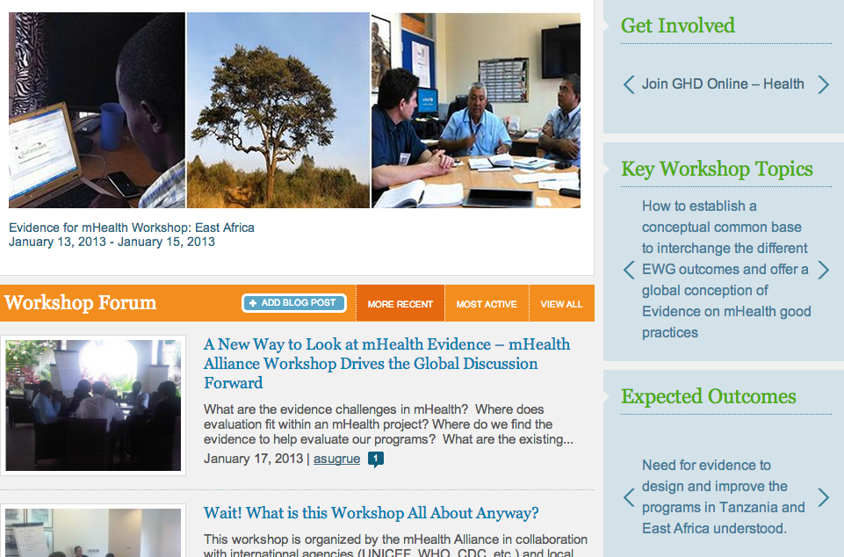
mHealth Evidence Workshop
East Africa

Slide 2
Summary
39 representative from Tanzania (both mainland and Zanzibar), Kenya, Rwanda, Uganda, South Africa, United Arab Emirates, United Kingdom, Canada, United States of America and Mexico.
Organizations included UNICEF, WHO, NORAD, Ministries of Health, Etisalat, Vodafone, D-Tree, and MAMA

Slide 3
Workshop Objectives
Sharing of experiences around various aspects of mHealth evidence from regional partners based on ongoing projects.
Understanding gaps in mHealth evidence, its generation, dissemination and use by multiple stakeholders.
Understanding needs for evidence to demonstrate impact of mHealth on health systems
Collaboratively formulating actionable steps around evidence discovery, use and dissemination.
Formulating tangible next steps around how to move mHealth evidence agenda at project, country and regional levels.

Slide 4
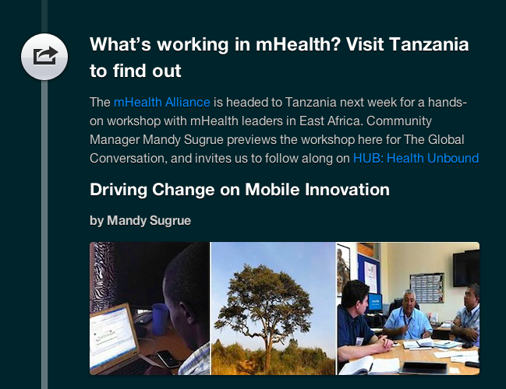
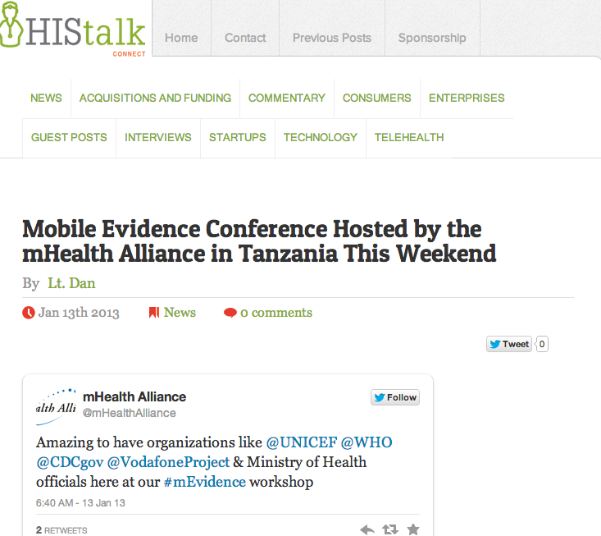
Promotion Summary
Live tweeting
Live blogging
Real time video interviews
Coverage on UNF, Global Conversation, and HIStalk

Slide 5
Identified Priority Evidence Gaps
Difficulty deciding on appropriate evaluation approaches.
Bias in reporting, especially not reporting failures.
Lack of an integrated mHealth evidence strategy by countries and programs.
Lack of or unawareness of mHealth evaluation frameworks, protocols and indicators.
Difficulty accessing appropriate knowledge-bases curated for target audiences.

Slide 6
Suggested Solutions
Develop well-defined mHealth evaluation strategies within ministries and large implementing programs.
Create mHealth evidence communities of practice.
Access to technical assistance on evaluations, and appropriate evaluation framework containing relevant key indicators for evaluation process.
Encourage reporting of failures without fear of adverse consequences. Fail-fares were suggested as one approach.
Curation and Access to Knowledge

Slide 7
Suggested Action Items
Action Item | Partners | Suggested lead(s)
Develop mHealth Evidence strategy | Key regional stakeholders including Govt, International and local partners, donors, Telcoms, and mHealth Alliance | Ministry of Health and Social Welfare
Develop and provide access to frameworks, models and tools to help with evaluations | mHealth Alliance, Evidence working group, other local partners with specific skills | mHealth Alliance
Establish Community of Practice for building capacity among the users of Evaluation | Regional partners, donors and mHealth Alliance | Local partners, mHealth Alliance
Provide access to databases and knowledge bases. | Higher learning institutions, mHealth Alliance, Evidence Working group | mHealth Alliance

Slide 8
Participant Feedback
High Satisfaction
Enjoyed group activities and priorities
Use of more practical examples
Access to resources
Clear Action items and Next steps
Average of 4 out of 5 of participant satisfaction

