Slide 1
CommCare 101:
The PMI AIRS Project Supervisory Tool
Ashley Thomas, AIRS

Slide 2
Agenda
Introduction to the PMI AIRS Project
Dimagi systems on the PMI AIRS Project
CommCare Supervisory Application
Supervision Data
Successes & Challenges
Q&A

Slide 3
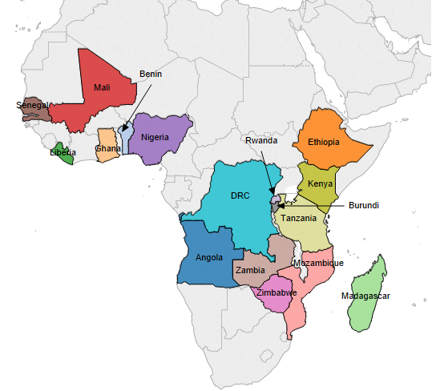
The PMI Africa Indoor Residual Spraying (AIRS) Project
1. Objective – to reduce the burden of malaria in Sub-Saharan Africa by implementing high-quality, timely, cost-efficient, and effective indoor residual spraying (IRS) programs.
2. Average annual project outcomes*:
- 11,790,445 people protected
3,234,827 structures sprayed
390,768 pregnant women protected
1,919,765 children under 5 protected
*based on annual outcomes between 2012 and 2015
Notes:
Geography – IRS and entomological monitoring implemented in 12 countries, six countries focusing only entomological monitoring
IRS:
Tanzania
Kenya
Benin
Ghana
Mali
Senegal
Ethiopia
Madagascar
Zambia
Rwanda
Mozambique
Zimbabwe
Ento:
Burkina Faso
Liberia
Nigeria
Burundi
DRC
Malawi

Slide 4
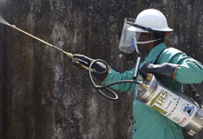
What is Indoor Residual Spraying?
Cornerstone of WHO / US Government’s malaria prevention approach:
  IRS
  Long-Lasting Insecticide-treated Bed Nets (LLINs)
  Intermittent Preventive Treatment in Pregnancy
  SMC (where applicable)
Effects of IRS:
  Reduces the density of vector mosquitoes
  Reduces the life span of vector mosquitoes so they can no longer transmit the malaria parasite from one person to another
  Repels mosquitoes entering
  homes, thus reducing
  human-vector contact
Notes:
IRS is the application of long lasting insecticides on the inside walls, ceilings and surfaces of all houses and resident structures in a given area, in order to kill the malaria transmitting mosquitoes that land or rest on these surfaces.

Slide 5
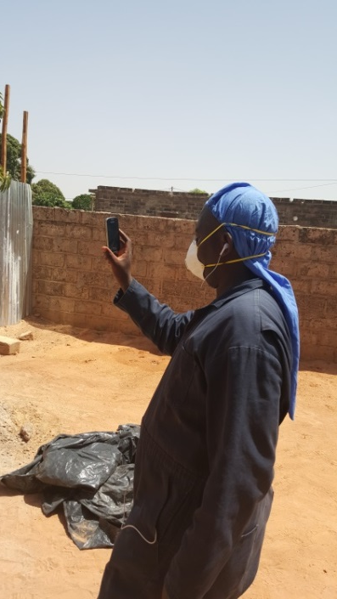

Mobile Technology for PMI AIRS
2014
2015
2016
2017
Madagascar
Senegal
Ethiopia Senegal
Madagascar Zambia
Mali Zimbabwe
Rwanda
Benin Rwanda
Ethiopia Senegal
Ghana Tanzania
Madagascar Zambia
Mali Zimbabwe
Mozambique
Benin Mozambique
Ethiopia Rwanda
Ghana Senegal
Kenya* Tanzania
Madagascar Zambia
Mali Zimbabwe
Dimagi has built mobile systems to support AIRS programs in ten countries:
  Malaria spray teams submit daily data re: spray coverage via SMS
  Supervisors use CommCare to record field activities
  All sprayers receive daily SMS reminders
  All projects will use the mobile system, same reports, and same training materials.
*this is a new country planned for implementation in the upcoming IRS campaigns
Notes:
Made some changes to the way this slide looked. We can chat about if you want to continue finessing it

Slide 6
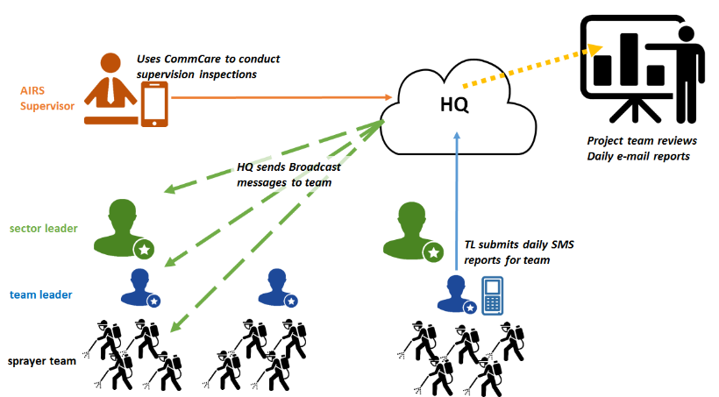
Day in the Life of an IRS Campaign
Notes:
Is this country office? Can we update this graphic to show Country office HQ. Thanks!

Slide 7
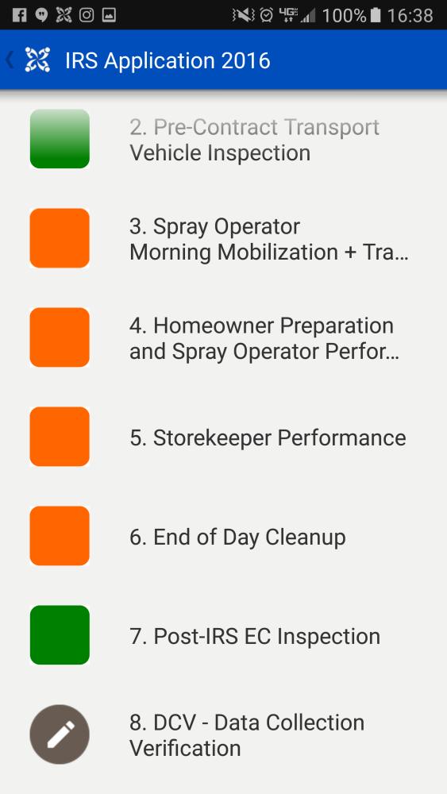
CommCare Supervisory Application
Includes 5 unique forms that are to be used at specific times by different actors
  Morning Mobilization & Vehicle Inspection
  Homeowner Preparation & Spray Operator Performance
  Storekeeper Performance
  End-of-day Cleanup
  Data Collection Verification Forms
Objective: improve overally quality of spray campaigns via increased use of supervision tools and improved accountability of supervisors
Fun fact: the app has been translated into four languages!
Notes:
Is this country office? Can we update this graphic to show Country office HQ. Thanks!

Slide 8
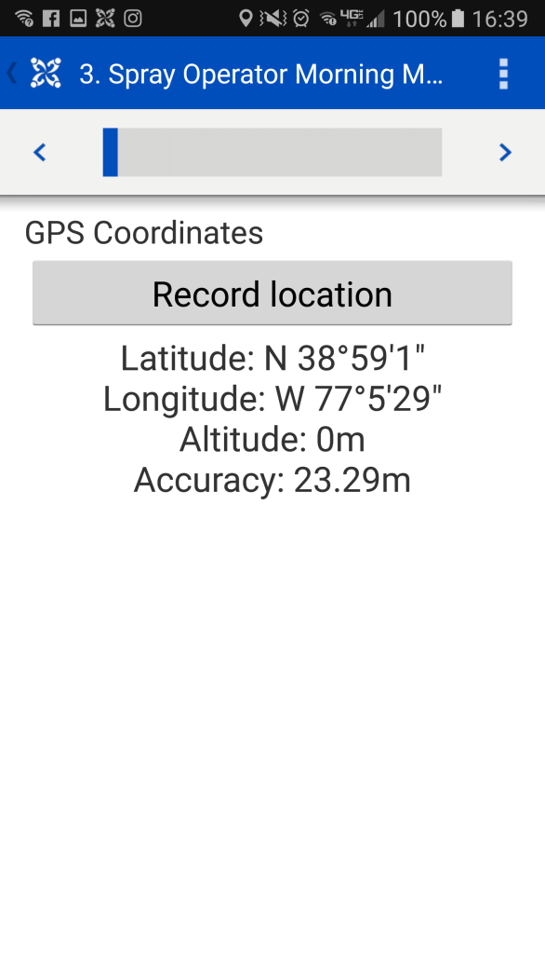
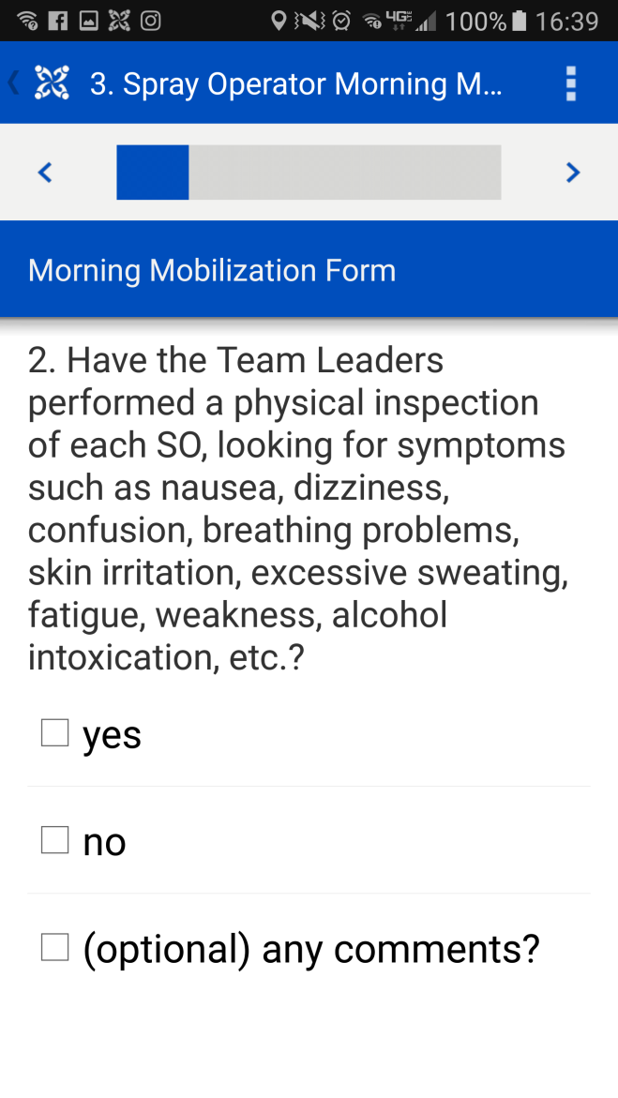
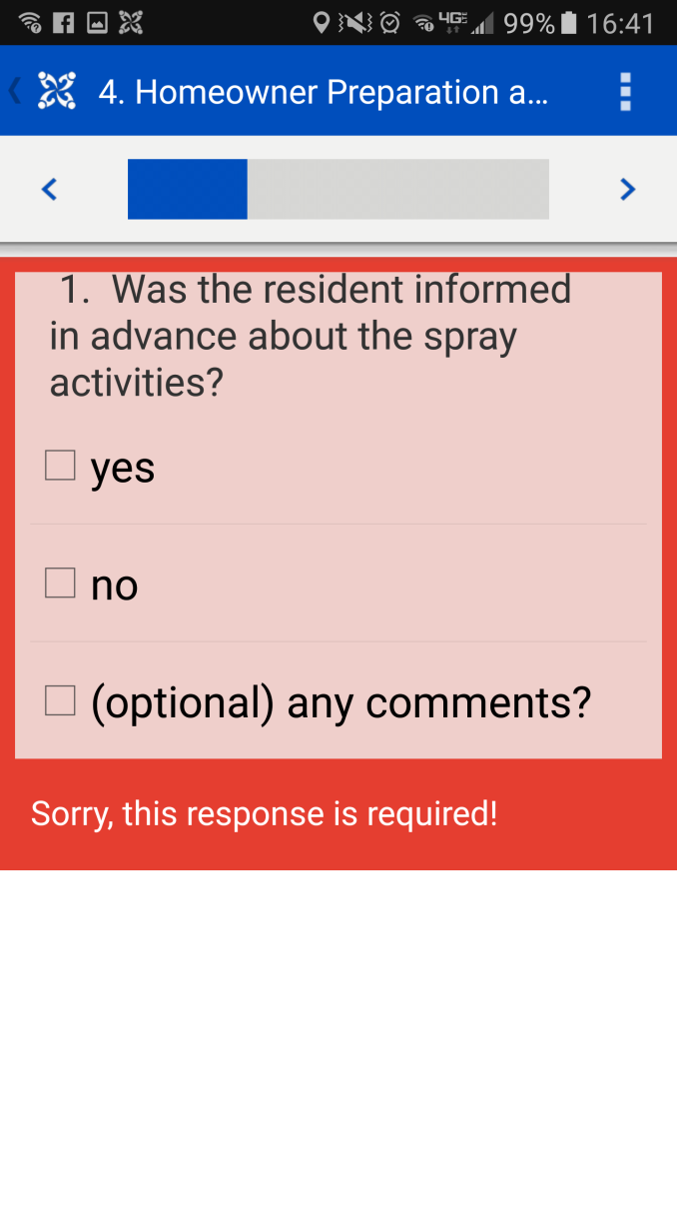
CommCare Supervisory Application

Slide 9
Supervisory Application Use in 2015 Campaigns
Country | Number of Reports Submitted | Number of Red Flags Reported | Number of People Trained
Ethiopia | 844 | 845 | 51
Madagascar | 315 | 491 | 78
Mali | 166 | 125 | 150
Rwanda | 3,754 | 1,563 | 88
Senegal | 2,709 | 3,406 | 200
Zimbabwe | 15,128 | 15,998 | 80
Total | 22,916 | 22,428 | 647

Slide 10
AIRS Zimbabwe 2015 Campaign Supervision Data

Slide 11
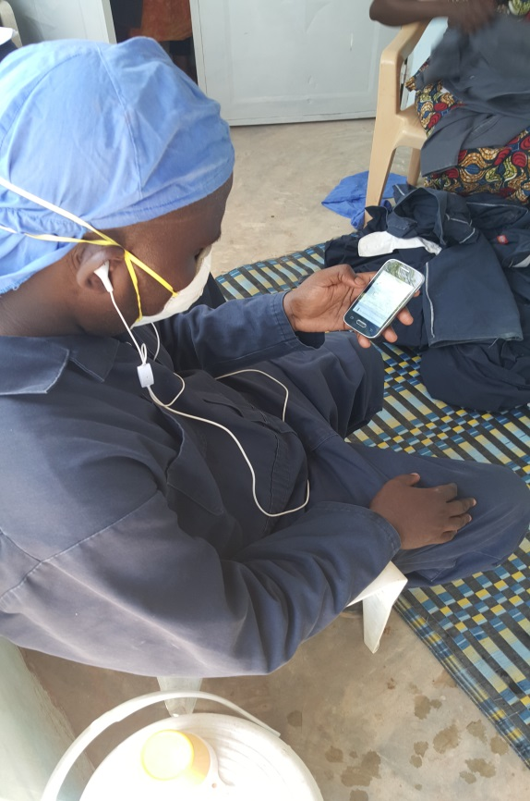
Successes
Immediate data availability (for corrective action)
Benefited from economies of scale with tool development
Built capacity of local users
Increased operational feedback across all countries
Comprehensive feedback provided to IRS actors

Slide 12
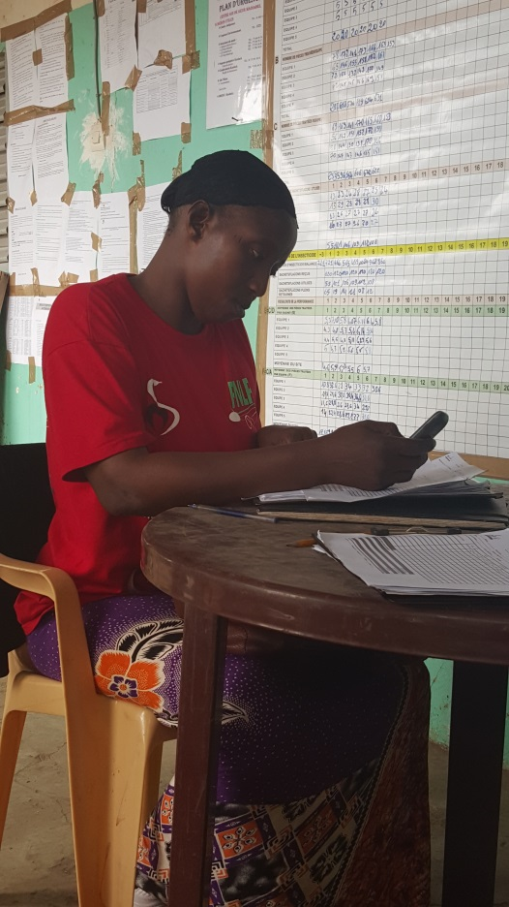
Challenges
Mobile literacy and penetration varied within and across countries
Negotiations with telecom providers
Availability of quality equipment on local markets
Unanticipated costs for technology
Customized reporting needs
Lack of comprehensive network coverage

Slide 13
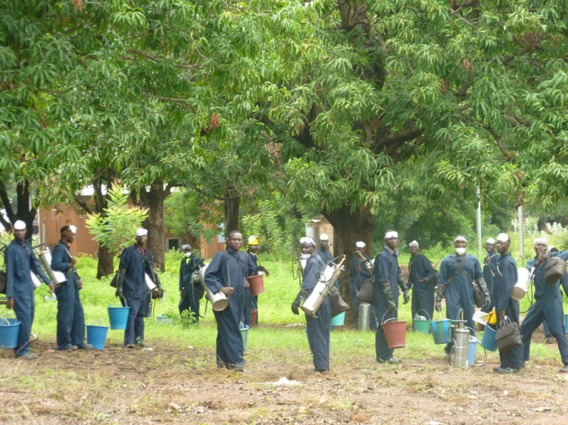
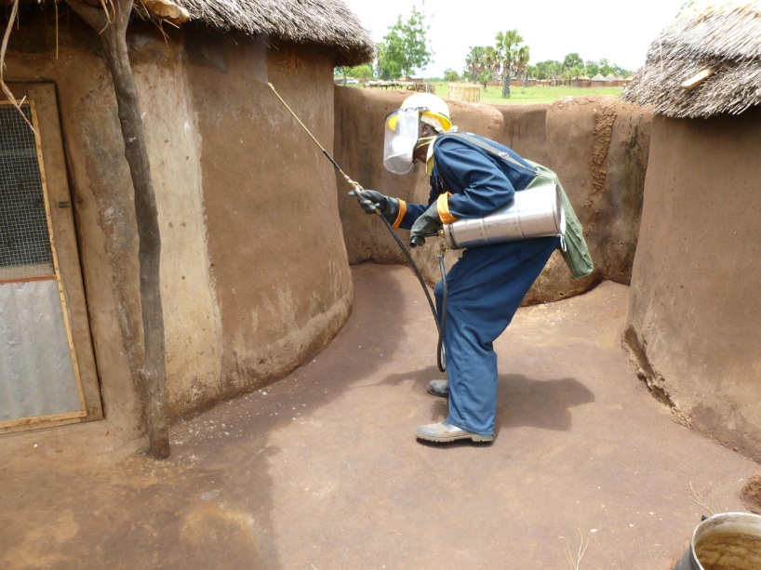
Thank you for Listening!
Questions?
http://www.africairs.net/

